Slide 1
Sparak
Industries are using Hadoop extensively to analyze their data sets. The reason is that Hadoop framework is based on a simple programming model (MapReduce) and it enables a computing solution that is scalable, flexible, fault-tolerant and cost effective. Here, the main concern is to maintain speed in processing large datasets in terms of waiting time between queries and waiting time to run the program.

Slide 2
Spark was introduced by Apache Software Foundation for speeding up the Hadoop computational computing software process. As against a common belief, Spark is not a modified version of Hadoop and is not, really, dependent on Hadoop because it has its own cluster management. Hadoop is just one of the ways to implement Spark. Spark uses Hadoop in two ways – one is storage and second is processing. Since Spark has its own cluster management computation, it uses Hadoop for storage purpose only.

Slide 3
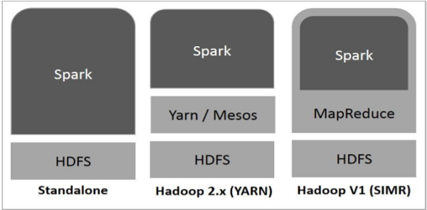
Spark Built on Hadoop

Slide 4
There are three ways of Spark deployment as explained below.
Standalone − Spark Standalone deployment means Spark occupies the place on top of HDFS(Hadoop Distributed File System) and space is allocated for HDFS, explicitly. Here, Spark and MapReduce will run side by side to cover all spark jobs on cluster.
Hadoop Yarn − Hadoop Yarn deployment means, simply, spark runs on Yarn without any pre-installation or root access required. It helps to integrate Spark into Hadoop ecosystem or Hadoop stack. It allows other components to run on top of stack.
Spark in MapReduce (SIMR) − Spark in MapReduce is used to launch spark job in addition to standalone deployment. With SIMR, user can start Spark and uses its shell without any administrative access.

Slide 5
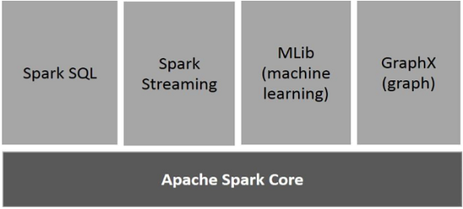
Components of Spark

Slide 6
Resilient Distributed Datasets
There are two ways to create RDDs
parallelizing an existing collection in your driver program, or referencing a dataset in an external storage system, such as a shared file system, HDFS, HBase, or any data source offering a Hadoop Input Format.

Slide 7
Problem Statement: You have to create data or files from the given dataset (Check Data Tab to access and download the data).
• hecourses.json
• students.csv
so, You have to create this file locally as well as In Hadoop file structure. Using Hadoop terminal commands

Slide 8
1. Create this two files in local directory and then upload the hdfs under the spark4 directory.
$> cd/Hadoop/sbin
Sbin> start-all.cmd
Sbin>jps
Bin>hdfs dfs -mkdir /spark4
Local folder c:/spark4->hecourses.json , students.csv
Move to this file in to Hadoop
hdfs dfs -put –f C:/sprak4 /spark4
hdfs dfs -ls /spark4

Slide 9
2.Use the inbuild schema for the hecourses.json file and create a new Dataframe from this.
// load json file in to spark from Hadoop path
Scala> val heCourseDF = spark.read.option("multiline","true").json("hdfs://localhost:9820/spark4/sprak4/hecourses.json")
//print schema
Scala> heCourseDF.show(false)

Slide 10
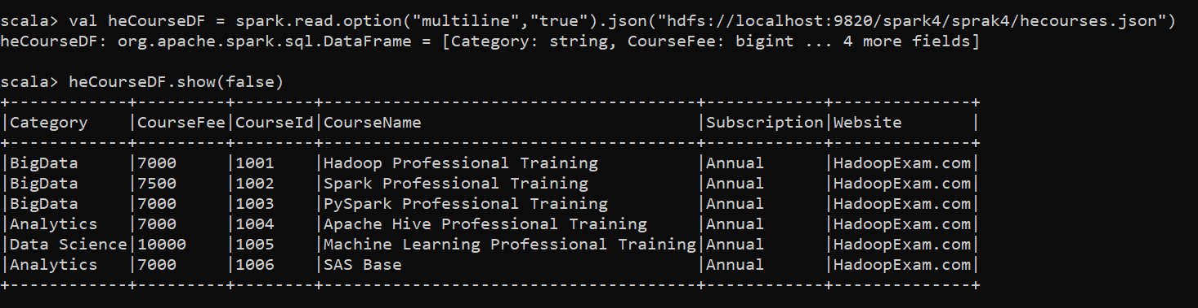

Slide 11
3.Define a new schema for the students.csv as given below column name. a. StdID b. CourseId c. RegistrationDate
Scala> import org.apache.spark.sql.types.{IntegerType, StringType, StructType, StructField}
Scala>val simpleSchema = StructType(Array(
StructField("StdID",StringType,true),
StructField("CourseId",IntegerType,true),
StructField("RegistrationDate",StringType,true)
))

Slide 12
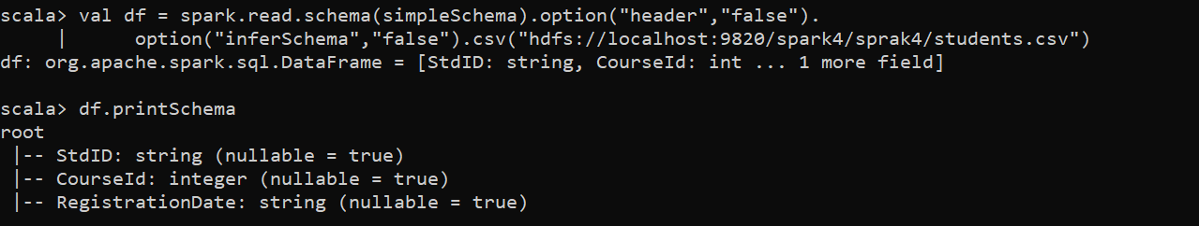

Slide 13
4. Using the above schema create a DataFrame for the "students.csv" data.
//load csv file with schema
Scala> val df = spark.read.schema(simpleSchema).option("header","false"). | option("inferSchema","false").csv("hdfs://localhost:9820/spark4/sprak4/students.csv")
Scala> df.printSchema

Slide 14
Find the list of the courses using both the dataframe which is/are not yet subscribed and then save the result in the "spark4/notsubscribed.json" directory.
//We can use the join operation to find all the courses which is not yet subscribed.
scala> heCourseDF.join(df,heCourseDF("CourseId") === df("CourseId"),"left").show(false)
//Now filter all the records where StdID is null.
scala> heCourseDF.join(df,heCourseDF("CourseId") === df("CourseId"),"left").filter("StdID is null").show(false)

Slide 15
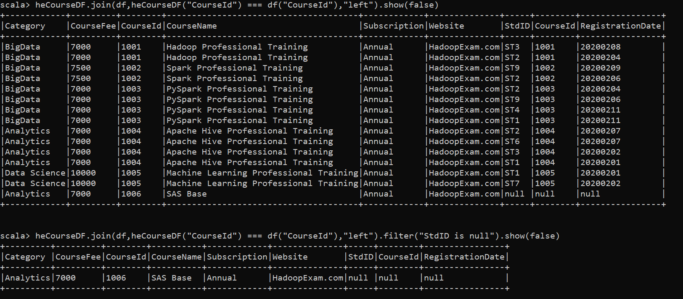

Slide 16
//We can save this dataframe as json data. Before saving we need to remove duplicate column as well.
Scala> heCourseDF.join(df,heCourseDF("CourseId") === df("CourseId"),"left")
.filter("StdID is null")
.drop(df("CourseId"))
.write
.json("hdfs://localhost:9820/spark4/sprak4/notsubscribed.json")
//show content in HDFS notsubscribed.json
Bin> hdfs dfs -cat /spark4/sprak4/notsubscribed.json/*

Slide 18
6.Find the total fee collected by each course category. The column name of the total fee collected field should be "TotalFeeCollected"
Scala> heCourseDF.join(df,heCourseDF("CourseId") === df("CourseId"),"left")
.groupBy("Category")
.agg($"Category", sum("CourseFee"))
.withColumnRenamed("sum(CourseFee)", "TotalFeeCollected")
.show(false)

Slide 19
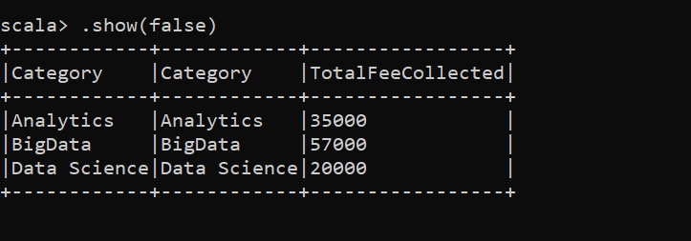

Slide 20
7. Save the result in the "spark4/TotalFee.json"
Scala> heCourseDF.join(df,heCourseDF("CourseId") === df("CourseId"),"left")
.groupBy("Category")
.agg($"Category", sum("CourseFee"))
.withColumnRenamed("sum(CourseFee)", "TotalFeeCollected")
.select($"Category" , $"TotalFeeCollected")
.write
.json("hdfs://localhost:9820/spark4/sprak4/TotalFee.json")

Slide 21
//show content of TotalFee.json in hadoop
bin>hdfs dfs -cat /spark4/sprak4/TotalFee.json/*

Slide 22
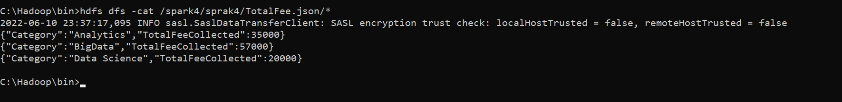

Slide 23
Exercise-2
Create a DataFrame from the "Courses" datasets. And given three fields as column name below. a. course_id b. course_name c. course_fee
Spark> val heUserDF = Seq( (1001, "Hadoop" , 7000) ,(1002, "Spark" , 7000) ,(1003, "Cassandra" , 7000) ,(1004, "Python" , 7000) ).toDF("course_id", "course_name", "course_fee")
2. Using the Case Class named Learner and create an RDD for second dataset. a. name b. email c. city
spark> case class Learner(name : String , email : String , city :String)

Slide 24
3. Create the instances of the Learners and save them in an Array object spark>val heData = Array( Learner("Amit" , "amit@hadoopexam.com", "Mumbai"), Learner("Rakesh" , "rakesh@hadoopexam.com", "Pune"), Learner("Jonathan" , "jonathan@hadoopexam.com", "NewYork"), Learner("Michael" , "michael@hadoopexam.com", "Washington"), Learner("Simon" , "simon@hadoopexam.com", "HongKong"), Learner("Venkat" , "venkat@hadoopexam.com", "Chennai"), Learner("Roshni" , "roshni@hadoopexam.com", "Banglore") ) 4. Create an RDD from the raw data spark>val heRDD = sc.parallelize(heData)

Slide 25
5. Create DataFrame from RDD spark> val heDF = spark.createDataFrame(heRDD) saprk> heDF.show() 6. convert Dataframe to Dataset spark> val heDS = spark.createDataFrame(heRDD).as[Learner] spark> heDS.show(false)

