Slide 1
Customer Churn Analysis for Telecom Industry
Predicting customer churn using data analytics
Notes:
S.Chaitanya | Telecom Customer Churn Analysis

Slide 2
OBJECTIVE
Objective :
Analyze customer behavior in a telecom company
Predict customer churn using machine learning
Identify actionable strategies to reduce churn

Slide 3
DATASET & TOOLS
Dataset:
Telecom Customer Churn dataset
Contains customer demographics, services, and billing details
Tools Used:
SQL (data cleaning & aggregation)
Python (Pandas, Seaborn, Scikit-learn)

Slide 4
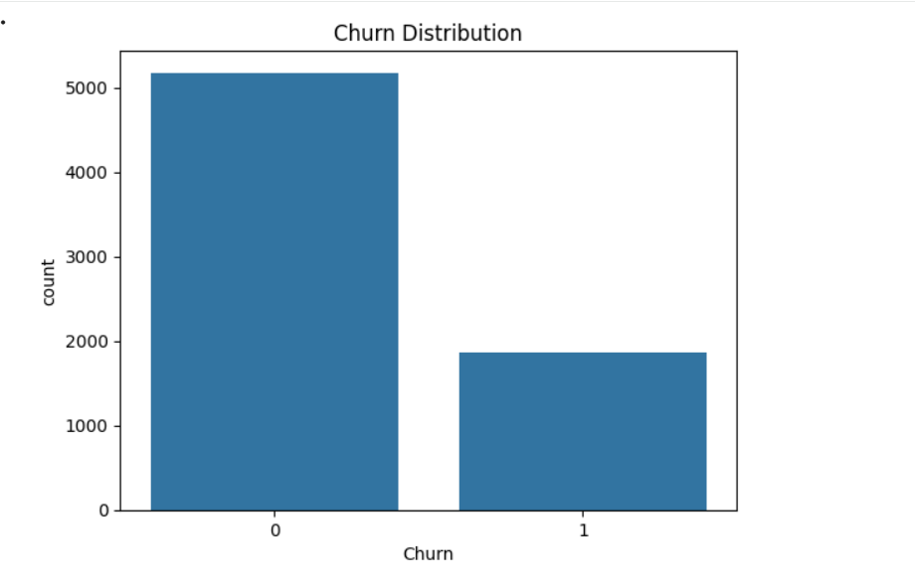
KEY BUSINESS INSIGHTS
Overall churn rate: 26.5%
Month-to-month contract customers have the highest churn (42.7%)
Two-year contract customers show the lowest churn (2.8%)
Contract type and tenure strongly influence churn

Slide 5
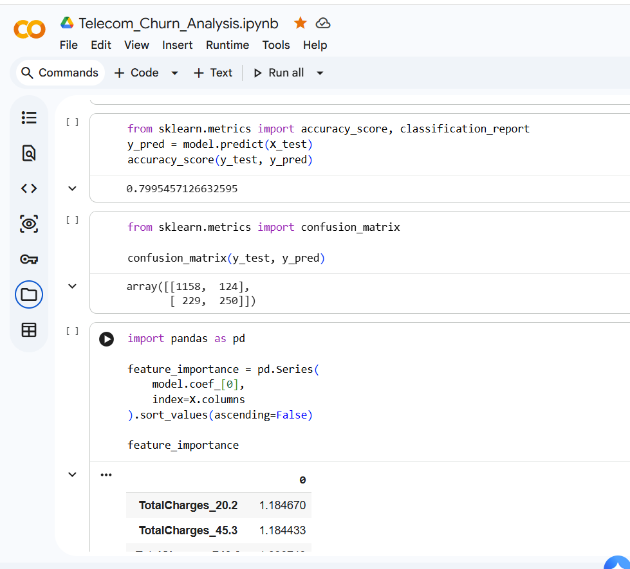
MODEL & RESULTS
Model Used:
Logistic Regression (Binary Classification)
Results:
Model accuracy: ~80%
Key predictors: tenure, contract type, monthly charges

Slide 6
CUSTOMER SEGMENTATION
Customer Segments :
At Risk: High probability of churn
Dormant : Low tenure and low engagement
Loyal : Long-term retained customers
Purpose of Segmentation :
To prioritize retention efforts instead of treating all customers the same
To reduce churn by focusing on high-risk customers first
To help the business design targeted offers, discounts, and engagement plans
To optimize marketing and retention costs

Slide 7
RECOMMENDATIONS & CONCLUSION
Recommendations:
Encourage long-term contracts
Offer retention plans for month-to-month users
Re-engage dormant customers with offers
Conclusion:
Data-driven insights can significantly reduce customer churn
Predictive models help identify high-risk customers early

