Slide 1

Customer Shopping Behavior Analysis
Uncovering strategic insights from transactional data to guide business decisions and optimize performance.

Slide 2
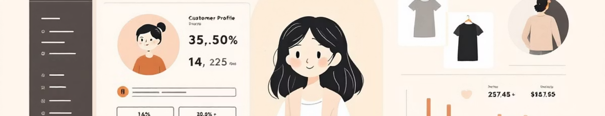



Project Overview & Goals
Data Scope
Core Objective
Strategic Guide
Analyzed 3,900 purchases across various product categories.
Uncover insights into spending patterns, customer segments, and product preferences.
Inform key business decisions, including marketing and loyalty programs.

Slide 3

Dataset Summary: Key Features
Customer Demographics
Purchase Details
Shopping Behavior
Age, Gender, Location, and Subscription Status.
Item, Category, Amount, Season, Size, and Color.
Discount/Promo Use, Previous Purchases, Frequency, Review Rating, and Shipping Type.
The dataset contains 3,900 rows and 18 columns. 37 values were missing in the Review Rating column.

Slide 4




Exploratory Data Analysis (Python)
Initial data preparation and cleaning were crucial for accurate analysis.
Missing Data Handling
Data Loading & Exploration
Imputed 37 missing Review Rating values using the median rating per product category.
Imported dataset and checked structure/summary statistics.
Database Integration
Feature Engineering
Loaded the cleaned DataFrame into PostgreSQL for structured SQL analysis.
Created age_group and purchase_frequency_days columns.

Slide 5
Key Financial Insights (SQL)
Revenue by Gender
Subscribers vs. Non-Subscribers
Male customers generated significantly higher total revenue.
Non-subscribers account for the majority of total revenue, though average spend is similar.
Gender
Revenue
Status
Customers
Avg. Spend
Total Revenue
Male
$157,890
No
2,847
$59.87
$170,436
Female
$75,191
Yes
1,053
$59.49
$62,645

Slide 6

Product Performance and Preferences
Top 5 Products by Rating
Top 3 Products per Category
1
Gloves
The most purchased items within each major category:
3.86 Average Rating
Accessories: Jewelry, Sunglasses, Belt
Clothing: Blouse, Pants, Shirt
2
Sandals
Footwear: Sandals, Shoes, Sneakers
3.84 Average Rating
Outerwear: Jacket, Coat
3
Boots
3.82 Average Rating
4
Hat
3.80 Average Rating
5
Skirt
3.78 Average Rating

Slide 7
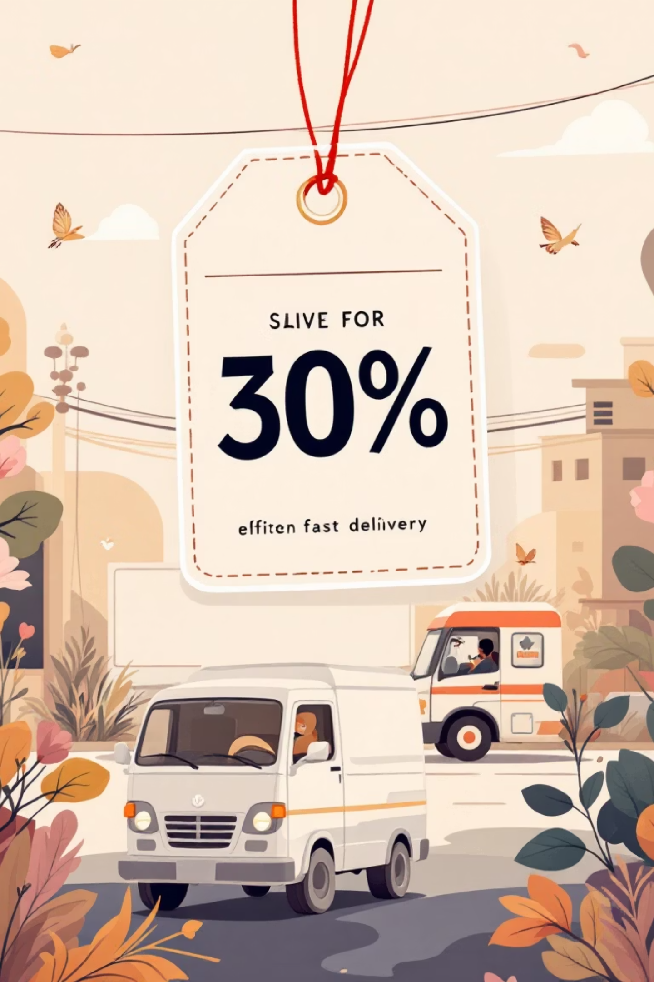



Discount and Shipping Dynamics
Discount-Dependent Products
Shipping Type Spend
Express shipping users had a slightly higher average purchase amount ($60.48) than Standard ($58.46).
Hat (50.00%) and Sneakers (49.66%) had the highest percentage of discounted purchases.
High-Spending Discount Users
839 customers used a discount but still spent above the average purchase amount.

Slide 8

Customer Segmentation & Loyalty
Loyalty Segments
Customers were classified based on purchase history:
Loyal: 3,116 Customers
Returning (701)
Loyal (3,116)
Returning: 701 Customers
New: 83 Customers
Repeat Buyers & Subscriptions
New (83)
Customers with >5 purchases are more likely to subscribe (958 subscribers vs. 2,518 non-subscribers).

Slide 9

Revenue Contribution by Age Group
Revenue is relatively balanced across age groups, with Young Adults leading slightly.
Young Adult
$62,143 Total Revenue
Middle-aged
$59,197 Total Revenue
Adult
$55,978 Total Revenue
Senior
$55,763 Total Revenue

Slide 10
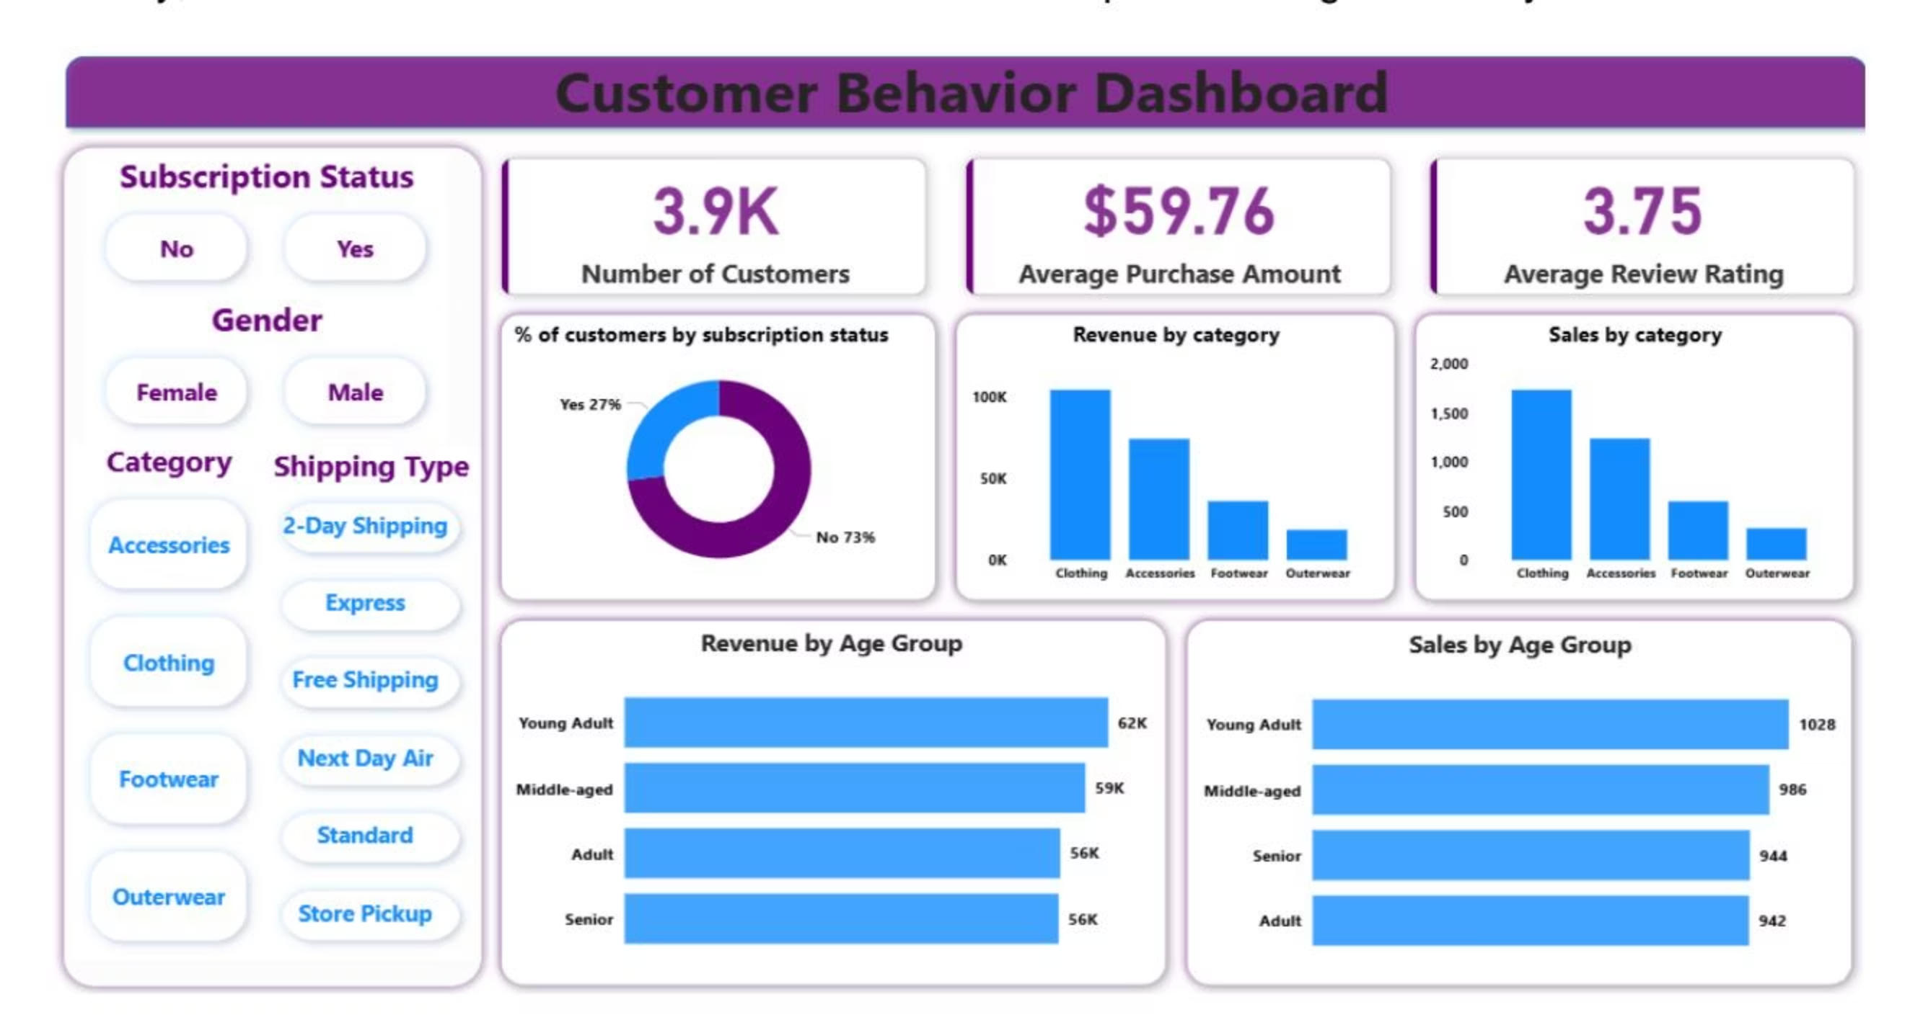





Strategic Business Recommendations
Boost Subscriptions
Promote exclusive benefits to increase subscriber base.
Customer Loyalty
Reward repeat buyers to drive them into the "Loyal" segment.
Targeted Marketing
Focus efforts on high-revenue age groups and Express shipping users.
Product Positioning
Highlight top-rated and best-selling products in marketing campaigns.
Review Discount Policy
Balance sales boosts from discounts with margin control.

