Slide 1

AWS Services for building SaaS Webapp

Slide 2
AWS Amplify
AWS Amplify helps in deploying the code (from any source github, zip file).
IT provides two option:-
1. To build an application
2. Host the webapp

Slide 3
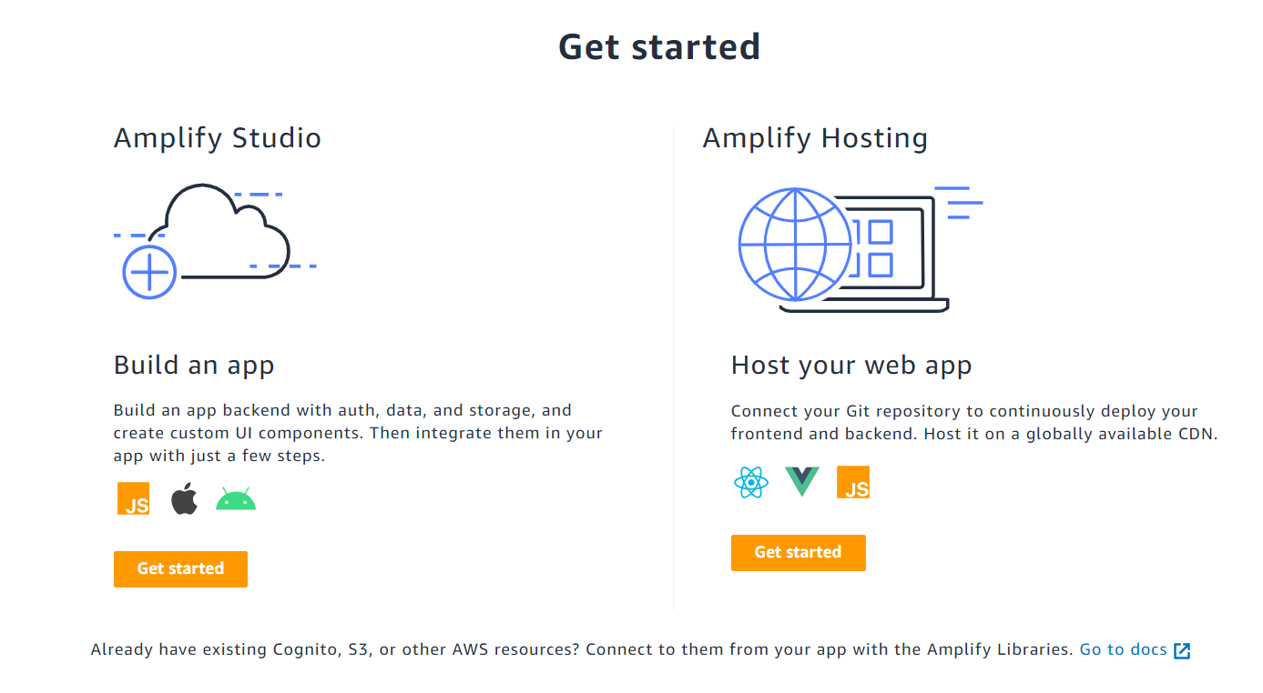
AWS Amplify
AWS Amplify helps in deploying the code (from any source github, zip file).
IT provides two option:-
1. To build a
2.

Slide 4
AWS API Gateway
We can build REST API using API Gateway
Create Method POST
Enable CHORS
Deploy

Slide 5
AWS Lambda
It is a serverless compute
We only pay for the time the code is running and number of the invocations of the AWS Lambda function
It gets timeout in 15 minutes
We can trigger the AWS Lambda in multiple ways, AWS CLI, Lambda API, etc.

Slide 6
AWS Dynamo DB
NoSQL database
It is a object oriented storage
We can easily scale it up.

