Slide 1

ERUVAKA NATURALS

Slide 2
CONTENT
Business problem
Purpose and Objectives
Entity-Relationship Diagram
Relational Schema
SQL Queries
Recommendations
Conclusion

Slide 3

Business Problem
Historically, Eruvaka's data management approach has leaned heavily on multiple spreadsheets.
Is this the optimal way of managing the Eruvaka Natural's data?

Slide 4
Purpose and Objectives
The primary objective of this project is to bolster Eruvaka Naturals' operational efficiency and profit margin. This can be achieved by:
Transitioning from the existing spreadsheet-based data management to a centralized database system
Derive data-driven insights to refine decision-making processes and optimize resource utilization
The purpose of these enhancements is to address the challenges in data management, improve supply chain dynamics, and thus, provide Eruvaka Naturals with a streamlined and sustainable business model.

Slide 5
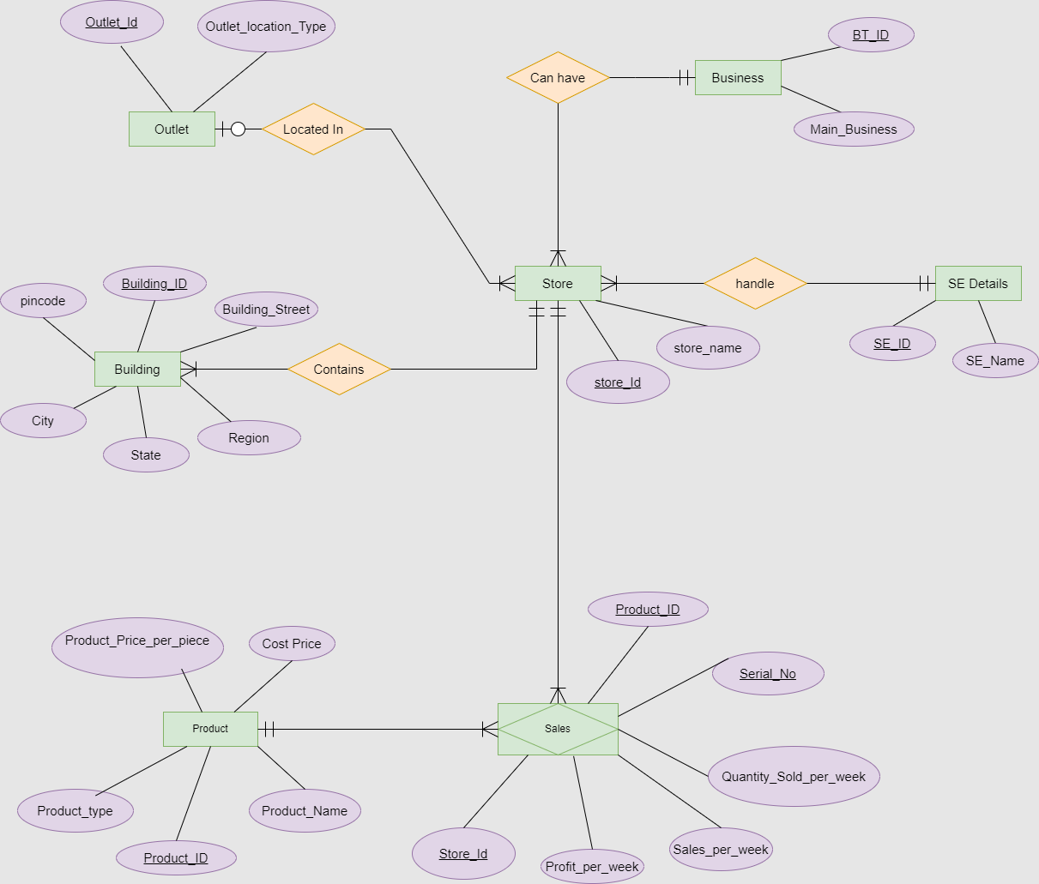
Entity-Relationship Diagram

Slide 6
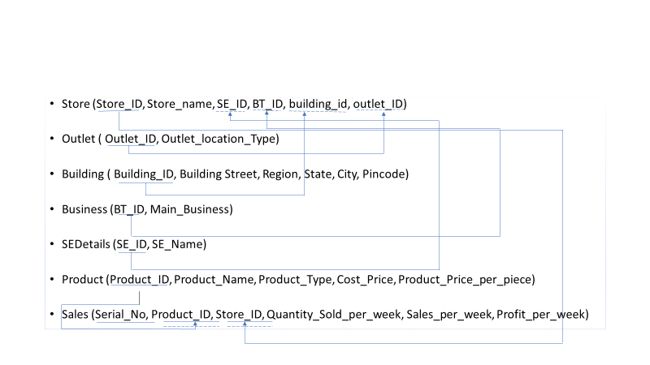
Relational Schema

Slide 7
SQL Queries
Query 1: Find the Main_Business with highest total profit
Query 2: Top 3 sales executives with highest sales.
Query 3: Which product has the highest margin?
Query 4: Which store has the least sales?
Query 5: List the top 10 bestselling products
Query 6: Which is the Most profitable PinCode
Query 7: Determine top 3 selling Product Types
Query 8: Which Product has the Lowest Margin
Query 9: In how many stores are the top 10 products being sold
Query 10:Which product has maximum number of sales

Slide 8
Recommendations
With a clear picture of the most profitable businesses, it's advisable to prioritize stores catering to these segments.
Recognize the efforts of high-achieving sales personnel and strategize training or store reallocation for those underperforming.
Consider discontinuing products with minimal margins and ensure a consistent supply of high-margin products.
Reframe strategies for low-performing stores, possibly by relocating sales executives to more lucrative areas.
Advise against maintaining inventory for products with sluggish sales.
Allocate more sales representatives to regions demonstrating high profitability.
Streamline logistics based on the distribution of products across stores and outlets.

Slide 9
Conclusion
In essence, this project has equipped the management with data-driven insights and actionable recommendations. If acted upon, these can lead to enhanced profitability, improved operational efficiency, and optimal resource allocation. Moving forward, the company is well-poised to capitalize on its strengths, address its challenges, and steer itself towards sustained growth and success.
The following primary insights have been gathered to enrich the business of Eruvaka Naturals:
Eruvaka Naturals' prime revenue-generating regions were identified as Mamidipalli, Amberpet, and MuradNagar.
Identified the top 10 best-sellers, facilitating targeted marketing strategies.

Slide 10


