Slide 1
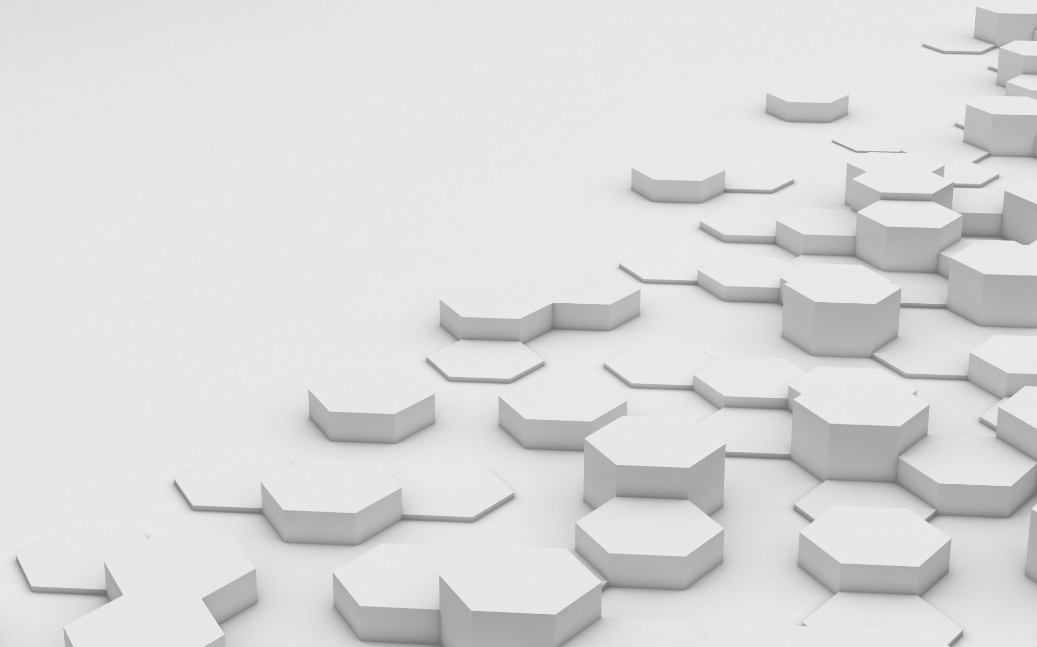
Customer Segmentation Using K Means
Group 04:
Neil Coleman
Aravinda Reddy Dandu
Chaitanya Sharma Domudala
Andrey Efremchev
Instructor : Prof. Antonio Miranda

Slide 2
Customer segmentation
The practice of dividing a customer base into groups of individuals that have similar characteristics. A business can use this strategy to target these specific groups of customers in order to effectively allocate marketing resources.

Slide 3
Clustering
The task of grouping together a set of objects such that objects in the same cluster are more similar to one another than objects in different clusters

Slide 4
K-Means
A type of centroid-based clustering
Centroid-based clustering is an iterative algorithm in which the notion of similarity is derived by how close a data point is to the centroid of the cluster.

Slide 5
Phases of Project
The project has four phases:
Information Gathering, Analytic Approach and Data Understanding Stage
Design Stage
Infrastructure Implementation Stage
User Interface Stage.

Slide 6
STAGE – 1 Introduction To Problem
Understanding the business/data to divide the customers into 3 groups
Analyzing different clustering algorithms and using k-means clustering in order to analyze them
Gathering the required data to make sure it includes all types of customers

Slide 7
STAGE – 2 Description of k-Means Clustering
K-means clustering- An iterative algorithm to partition the data into distinct subgroups
Unsupervised clustering algorithm- Does not use a response variable. Instead, it only uses predictor variables.
Involves use of centroids, or mean of all data points in cluster
Defines distance metric and is set up so that the sum of all the data points in each centroid is minimized.

Slide 8
Preparing Data for k-means Analysis
Removed address variable because addresses are just arbitrary codes and calculating the distance between them does not make sense.
Ran k-means clustering algorithm on the transformed dataset.

Slide 9
STAGE – 3 Implementation Stage
The implementation phase is the process of converting a system specification into an executable system. If an incremental approach is used, it may also involve refinement of the software specification.

Slide 10
Stage-4 User interface
Web App is designed and hosted in the flask server.
It takes two input items a) Number of clusters(select option ranging from 1-10) b) CSV file in prescribed format
To know valid headers, a sample CSV file can be downloaded using the 'Download sample' link in the right corner.
On click of submit, data will be sent to server, processed, clustered and plots will be sent back
The output is shown as two scatter plots a) 2-D plot with Age, income on X and Y axes b) 3-D plot with Education, Age and Income on X, Y and Z
To handle errors, file is parsed in front end for header matching, extension and validity.
Sample screenshots for the page are shown below

Slide 11
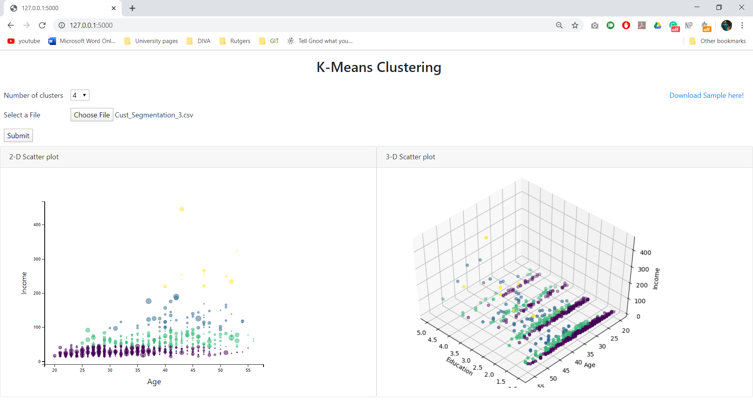
Notes:
Here is a 2-dimensional plot of age and income and a 3-dimensional plot of age, income, and education

Slide 12
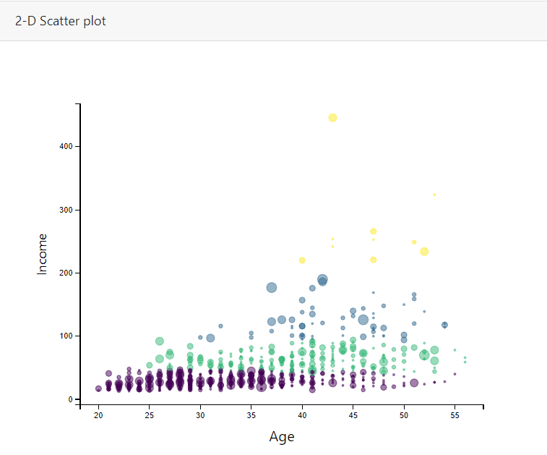

Slide 13
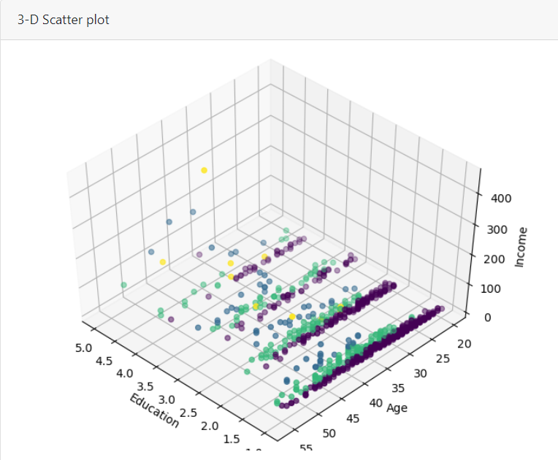

Slide 14
references
https://scikit-learn.org/
https://www.papaparse.com/
https://flask.palletsprojects.com/
https://getbootstrap.com/
https://matplotlib.org/
https://www.learndatasci.com/tutorials/k-means-clustering-algorithms-python-intro/
https://medium.com/ml-research-lab/part-1-data-science-methodology-from-problem-to-approach-e2d05e7afc6b

Slide 15
Thank you

