Slide 1




Music Recommendation System
By: Aravind Reddy Dandu(ad1452)
Sai Mounica Pothuru(sp1912)
Chaitanya Sharma Domudala(cd817)
SriKaavya Toodi(st938)

Slide 2
Contents
Objectives
Dataset Description
Data Exploration
System flowchart
Recommendation Algorithms
Results and Analysis
Conclusion and Future Work
References
Data Preparation

Slide 3



Objectives
Experimenting various recommendation models.
Extrapolating the data to find meaningful insights from it.
Evaluating the performance of the models .
Conclude the findings.

Slide 4
Dataset description
Data source : Million Song Dataset
Size: 3 GB( A subset of Million Song Dataset named triplets was used by us)
Files: 3 files (”train_triplets.txt”, “song_to_tracks.txt”, “track_metadata.csv”)
Important features: (UserID, SongID, TrackID, Plays, Artist, Title)

Slide 5
Data Preparation
As part of data preparation, we have done the following steps:
Loaded the data into spark data frames.
Cleaned the data remove outliers.
Transformed the data by combining it other tables to form a unified data frame
Created sub data frames needed for different purposes.

Slide 6
Data Exploration
When we were manually scrutinizing the metadata of all the files, we have produced few interesting questions which were the basis of the data exploration.
What is the percentage distribution of the no. of times a song played?
Does no. of times a song played have a connection with artist hotness?
Does no. of times a song played have a connection with artist familiarity?
Is there a co-relation between artist hotness and familiarity?
What is the trend of no. of songs and no. of plays over the years?

Slide 7
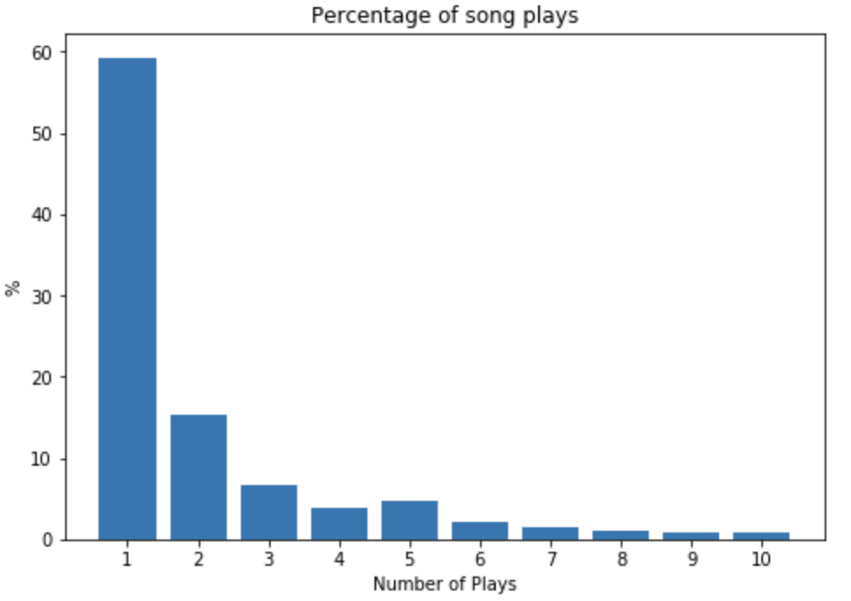
What is the percentage distribution of the no. of times a song played?
As you can see in the graph most of the songs played only once.
Also, there is a decrement in the percentage as the no. of plays increase.

Slide 8
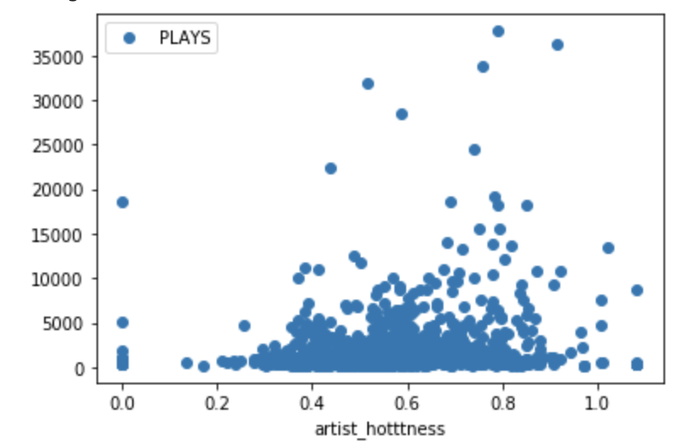
Does no. of times a song played have a connection with artist hotness?
Although there is an increase in no. of plays as the artist hotness increase, we can’t say that they are directly proportional.

Slide 9
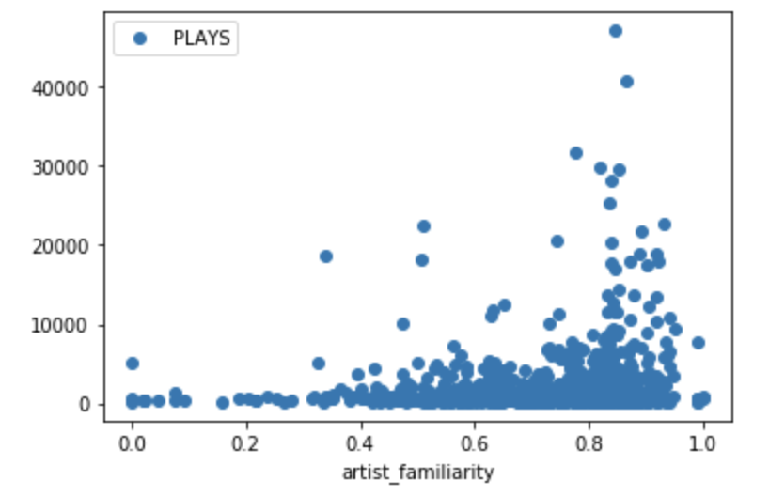
Does no. of times a song played have a connection with artist familiarity?
As you can see in the graph as the artist familiarity increases there is an increment in no. of plays.
Although this isn’t a strict increment, we can say that artist familiarity does have a positive impact on no. of plays of a song.

Slide 10
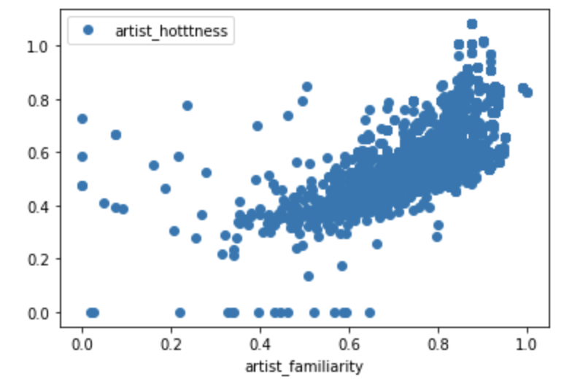
Is there a co-relation between artist hotness and familiarity?
There is a positive co-relation between artist hotness and artist familiarity.

Slide 11

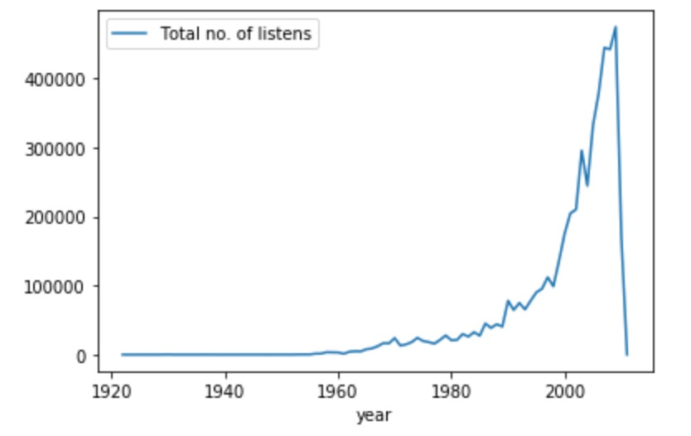
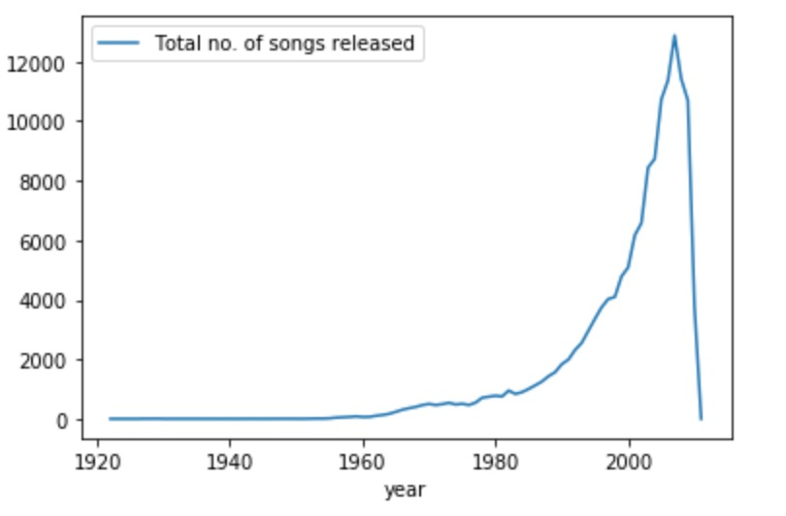
Trend of no. of songs and no. of plays over the years

Slide 12

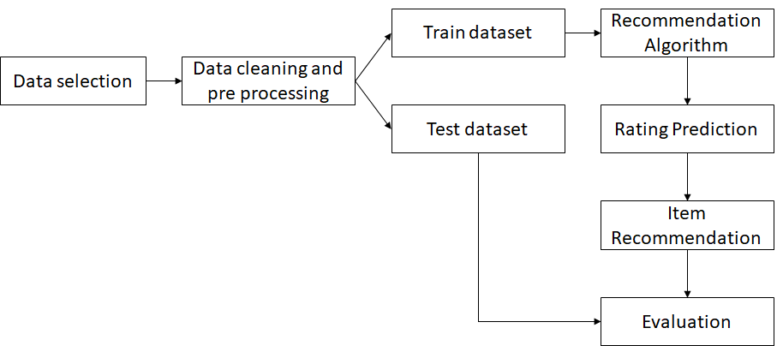
System flow chart

Slide 13
Recommendation Algorithms
Basic Recommendations
Memory based Collaborative Filtering
Collaborative Filtering -ALS (Alternating Least Squares)

Slide 14
Basic Recommendations
Memory based Collaborative Filtering
Collaborative Filtering -ALS (Alternating Least Squares)
As a basic recommendation system, we will have recommended the songs that are played the most no. of times.
For a better recommendations, we are using the distinct number of users and filter it by a count of 200.

Slide 15

Collaborative Filtering is a traditional and powerful tool for recommender systems that produces automatic predictions by collecting multiple user preferences or taste information.
The first method that we implemented in Collaborative Filtering is memory based.
The main idea behind this method is to compare one half of a user’s preference with others and predict the other half of the songs with precision.
Formulae for similarity score generation.
Basic Recommendations
Memory based Collaborative Filtering
Collaborative Filtering -ALS (Alternating Least Squares)

Slide 16
With collaborative filtering, the idea behind is to approximate the matrix by factorizing it as the product of two matrices: one that describes the properties of each user and one that represents the properties of each song.
We want to choose these two matrices such that the error for the users/song pairs where we know the correct number of plays is limited.
The Alternating Least Squares algorithm does this by first arbitrarily filling the user’s matrix with values and then optimizing the value of the songs such that more accurate results are produced.
Then, it holds the songs matrix constant and optimizes the value of the user’s matrix.
This alternation between which matrix to optimize is the reason for the “alternating” in the name.
Basic Recommendations
Memory based Collaborative Filtering
Collaborative Filtering -ALS (Alternating Least Squares)

Slide 17
Results & analysis
Basic recommendations gives the top songs according to the number of times the songs has been played
Memory based Collaborative filtering has a score of 10-12 out of 100 which means that 10-12 plays are accurate out of 100 which is almost 5 times better than the random generation
ALS generated a RMSE of 7.51 with average of 3 songs against all songs considered. But with the filtered dataset of at least 2 songs repeated, we had a better RMSE of 8.64 with an average of 6 songs. Even though the RMSE looks higher, the average is also higher assuring that it is a better model.

Slide 18
Conclusion & future work
We experimented with Million Song Dataset 3 GB data to generate music recommendations for users.
Models: Basic Recommendations, Memory based Collaborative Filtering, Collaborative Filtering -ALS (Alternating Least Squares)
Evaluation Metrics: RMSE
ALS model generates the best recommendations among the implemented ones
As further work we would like experiment on Content based including memory based on the complete dataset and use various Collaborative Filtering methods that include Deep learning to get the better models and hence better accurate recommendation system.

Slide 19
References
[1] Thierry Bertin-Mahieux, Daniel P.W. Ellis, Brian Whitman, and Paul Lamere. The Million Song Dataset.In Proceedings of the 12th International Society for Music Information Retrieval Conference (ISMIR 2011),2011.
[2] Fabio Aiolli.: Preliminary Study on a recommender system for the Million Songs Dataset challenge. (2011)
[3] Bertin-Mahieux, T ., Eck, D., Mandel, M.: Automatic tagging of audio: The state-of-the-art. In Wang,W., ed.: Machine Audition: Principles, Algorithms and Systems. IGI Publishing (2010) In press.

Slide 20
References
[4] https://www.ee.columbia.edu/ dpwe/pubs/BertEWL11-msd.pdf
[5] Musicbrainz: a community music metadatabase, Feb. 2011. MusicBrainz is a project of The MetaBrainzFoundation, http://metabrainz.org/.

Slide 21

Thank you

