Slide 1

LinkData2
Group Members:
Asif Ahmmed Joy, Chaitanya Prabhakar Ghadling, Garvit Jain, Niraliben Patel, Kaustubh Vijaykumar Pethkar.

Slide 2
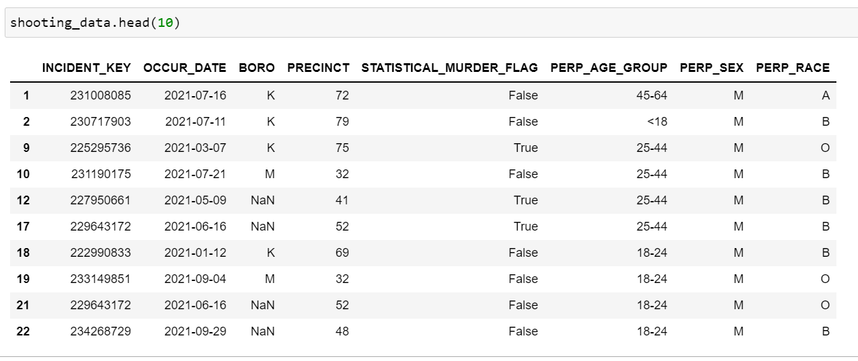
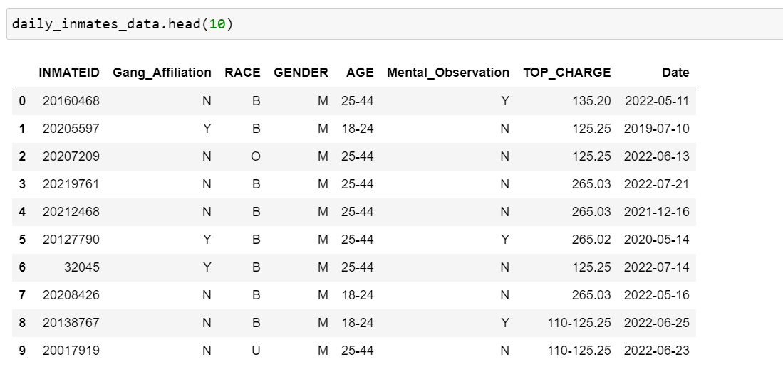
Understanding individual datasets.
Dataset Length : 16,249
Dataset Length : 5,928

Slide 3
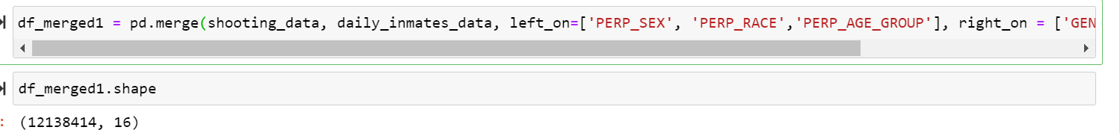
Need for linking
Put a face to crime.
Shooting Data gives information on suspects general discription.
Inmates data has perperstors confirmed discription with additional information
like gang affiliation and mental state but does not mention what crime they commited.
Linking the data will allow us to identify individual to a crime incident.
Directly linking the two datasets with common attributes: Race, Age and Gender?

Slide 4
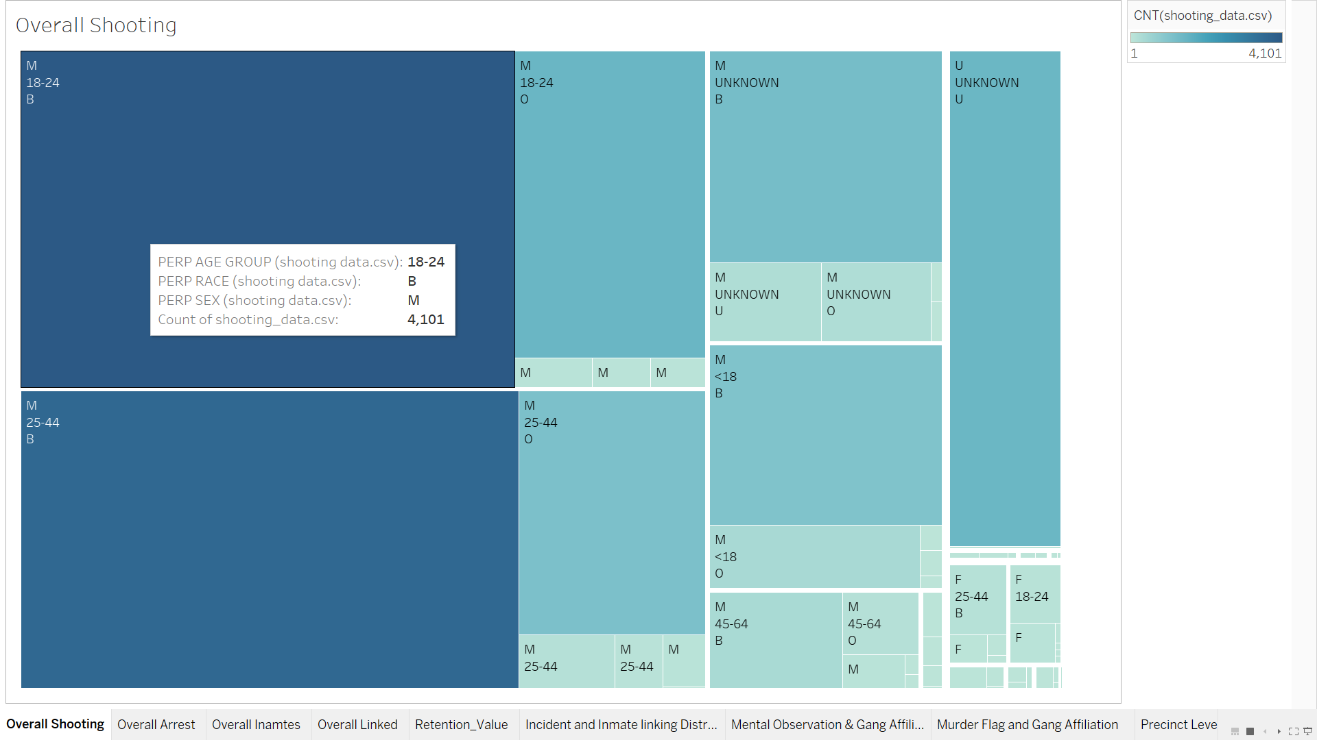
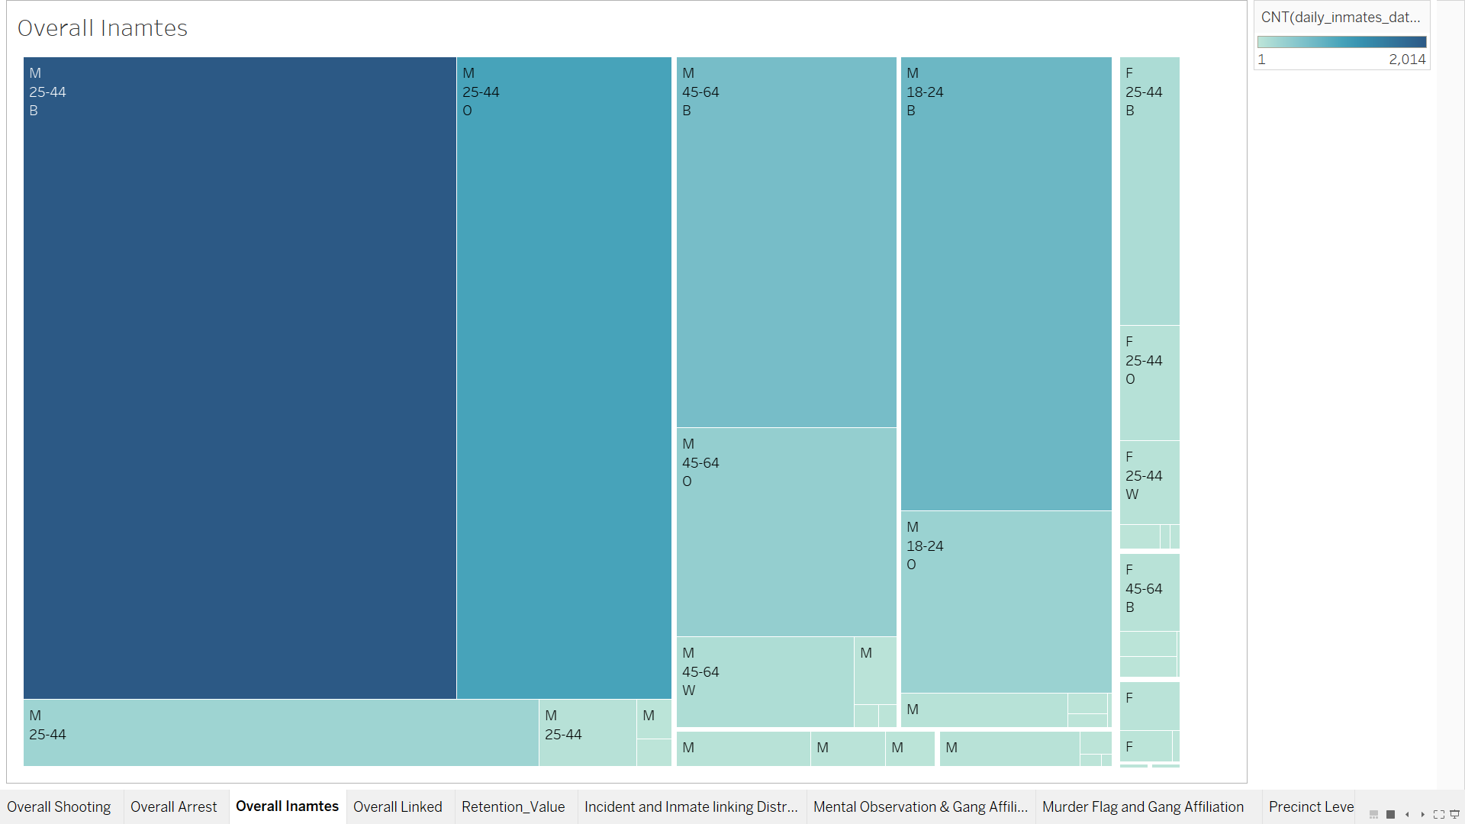
Distribution based on Race, Gender and Age Group

Slide 5
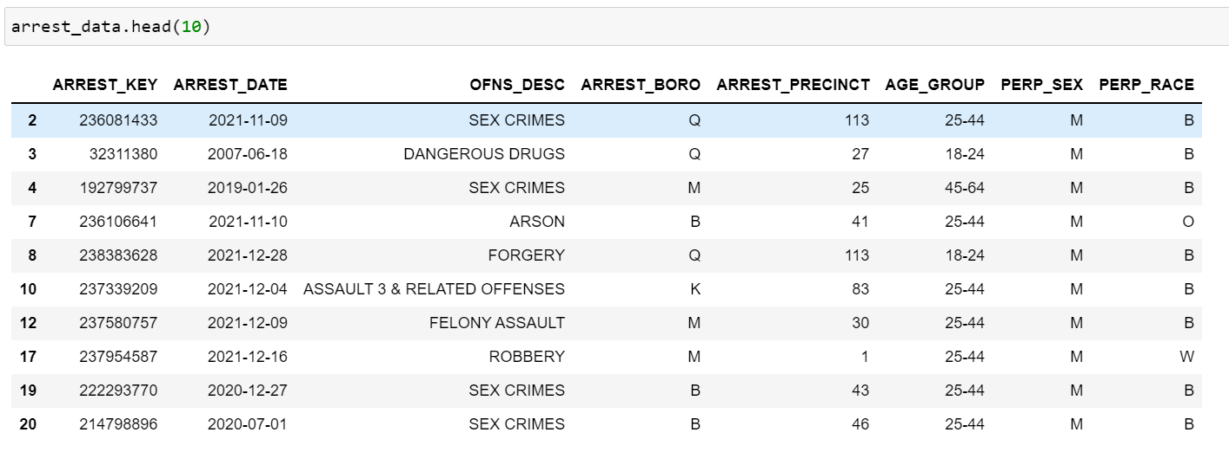
Adding Another dataset
Dataset Length : 3,441,036
More linking attributes like Borough, Precinct and Date.
We get additional information of the crime commited through offense description.

Slide 6
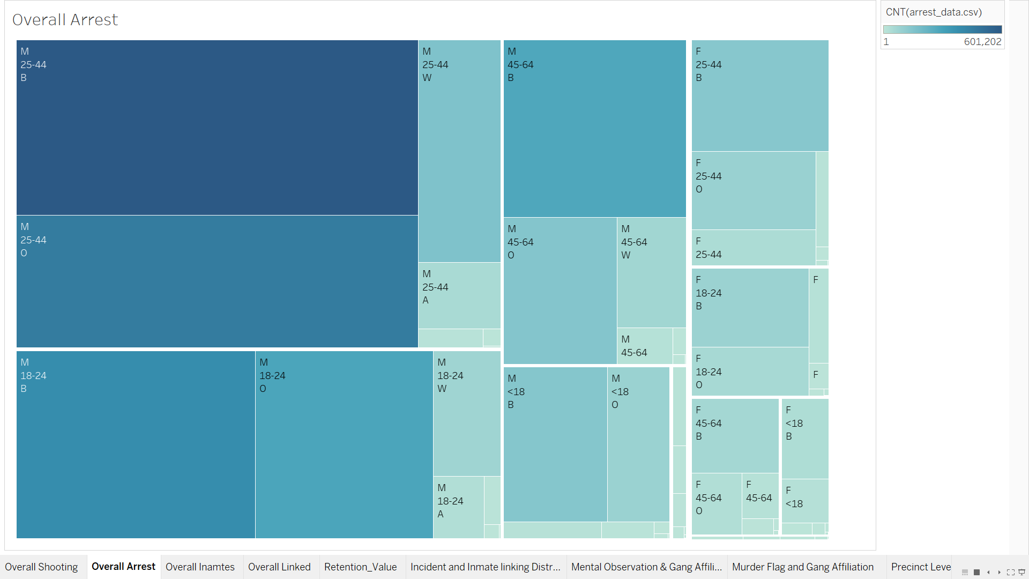
Arrest Data Distribution based on Race, Gender and Age Group

Slide 7
Linking the datasets.
Linking shooting and arrest data.
Filtered data by keeping perperators that have been caught within 3 days.
Again linking with daily_inmates.
Final Linked Dataset Length: 1,902

Slide 8
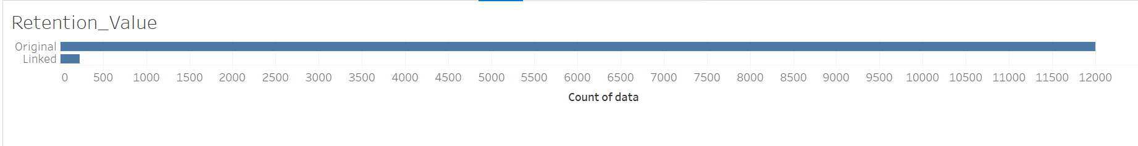
Understanding the Linked Data
Of 12,004 unique shooting incidents we were able to match 232 unique incident to its perperator.
That’s around 2% of matches in the linked data.

Slide 9
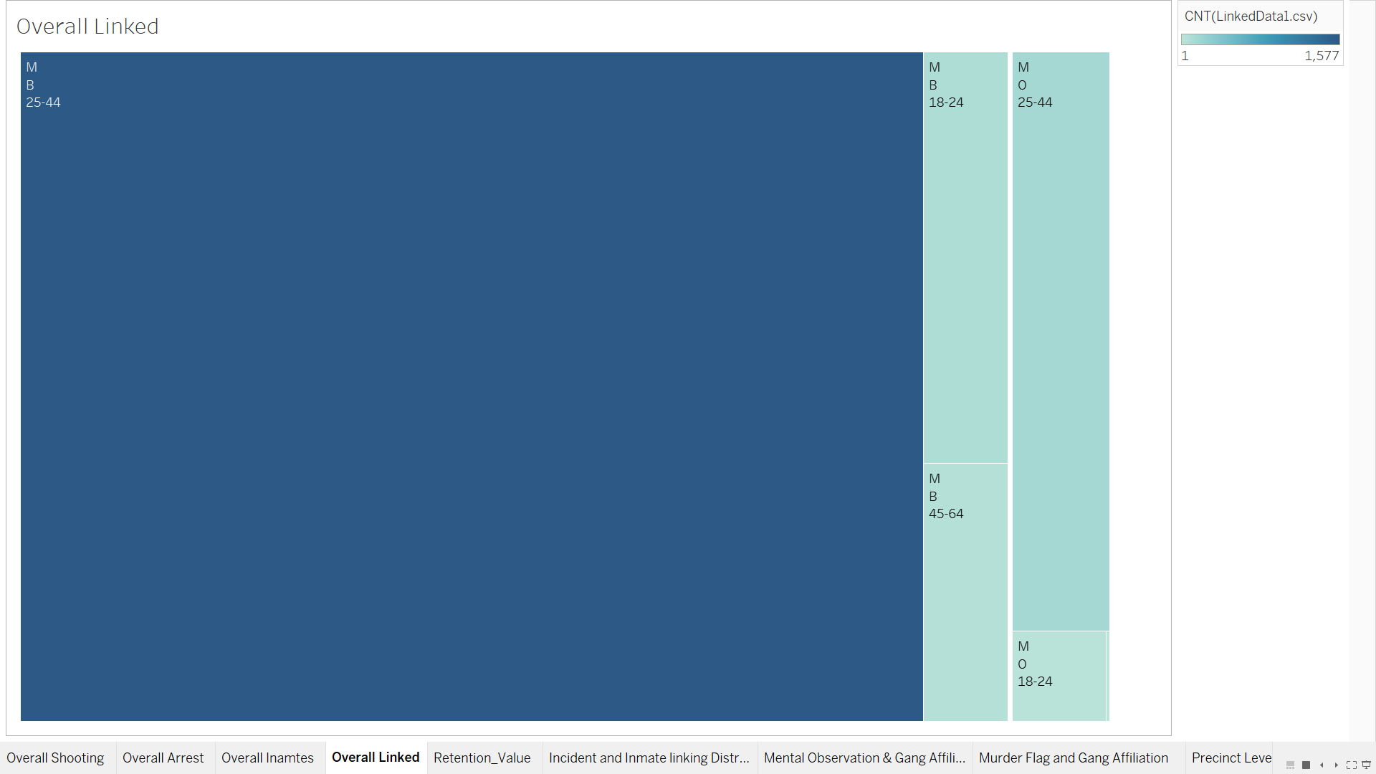
Linked Data Distribution based on Race, Gender and Age Group

Slide 10
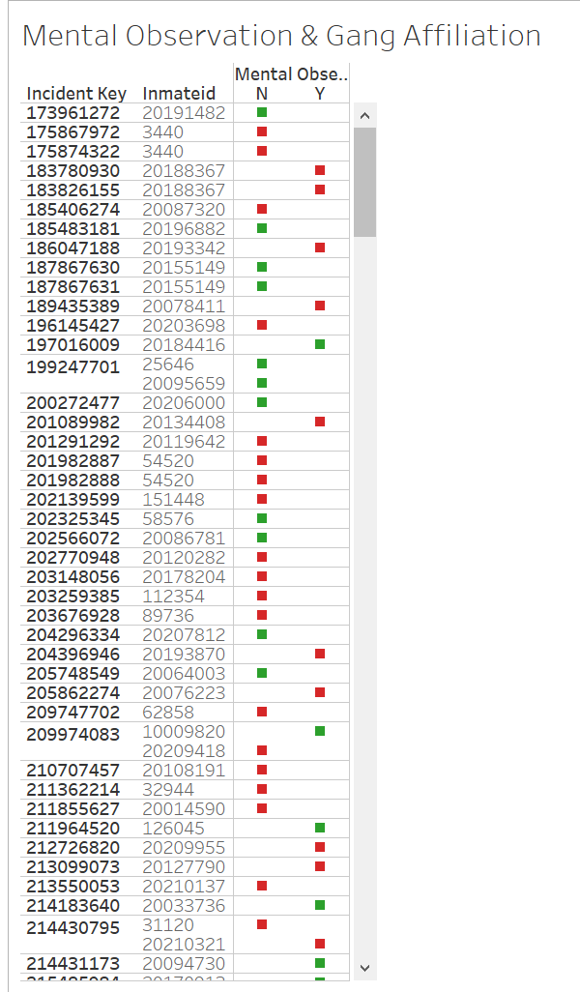
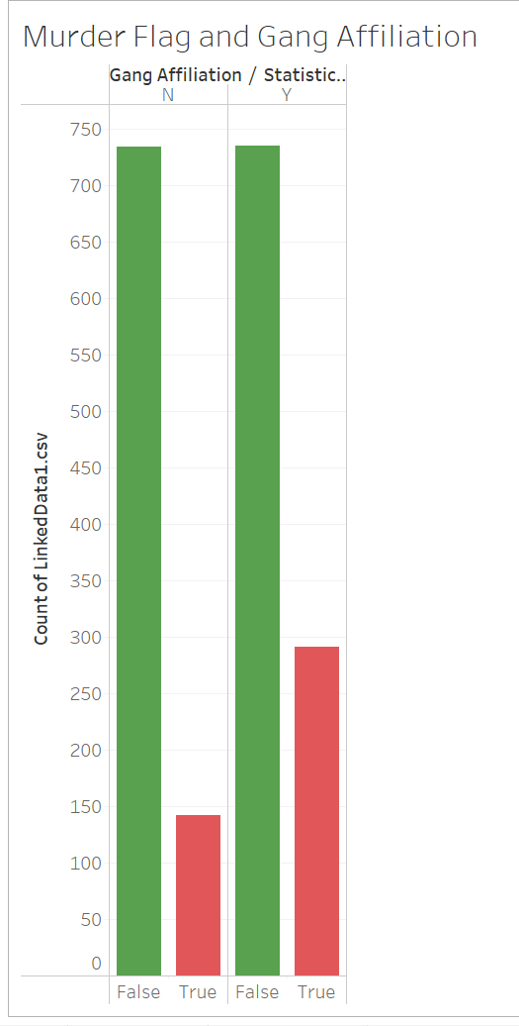
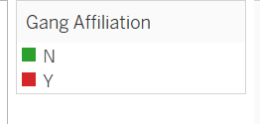
Fig: 1 Analyzing if the shooter has any affiliation with any Gang. Or if the perpetrators were kept under mental observation? Fig: 2 Analyzing murder probability based on gang affiliation.

Slide 11
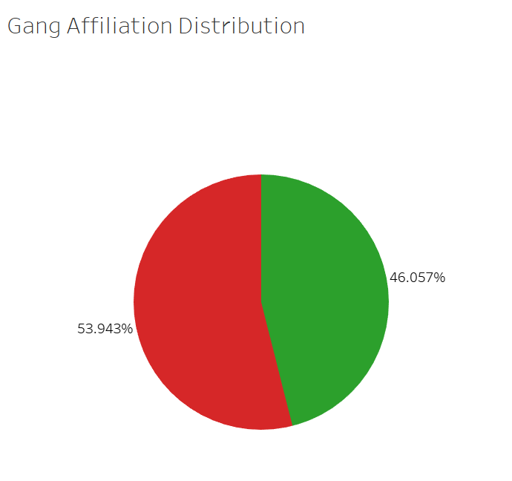
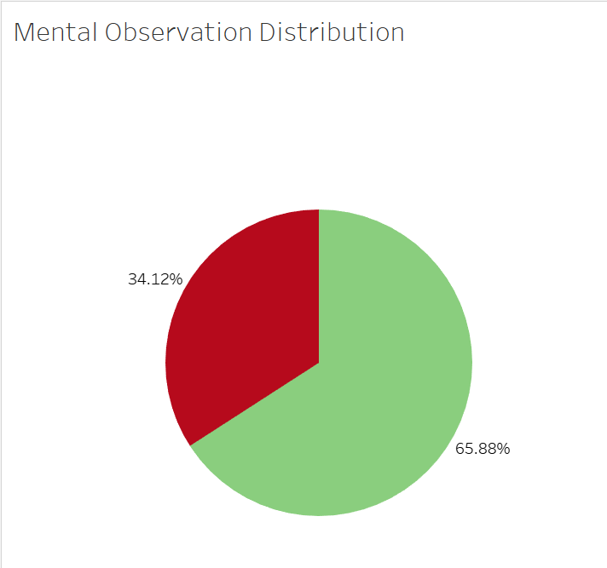
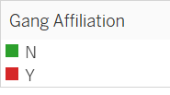

Distribution of Data based on Gang Affiliation and Mental Observation

Slide 12
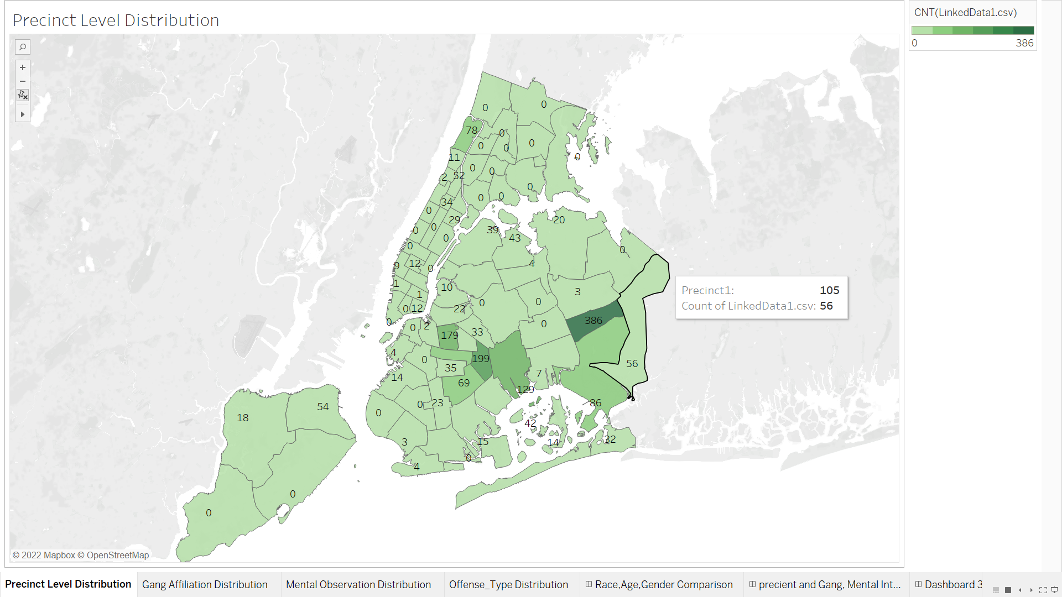
Distribution of Data at precinct level on NYC Map.

Slide 13
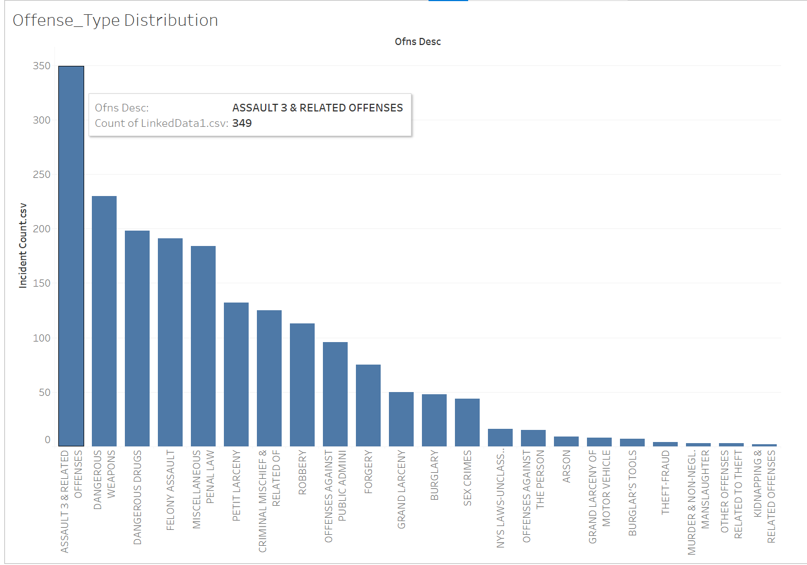
Distribution of Data based on Offense Description

Slide 14
Interactivity
Video here

Slide 15
Key Insights
Of the total initial data, we were able to find match for about 2% of the incidents occured.
Pre-existing biases is amplified after linking the datasets. All of the linked data is for Males only.
The inmates who are kept under mental observation are less likely to be affiliated with gangs and those who are not have high chances of being affiliated with a gang.
The inmates under mental supervision are likely to commit more crimes for drugs related reason while those who are not related to any gang commit small scale crimes.
Perperptors affiliated with a gang have resulted in more victim deaths than those who are not affiliated with a gang.

