Slide 1

Distance estimation using Multiple Camera, Dataset: Kitti, Model: Any deep learning model
By,
Kshitij Shrivastava
Chaitanya Patange
Nagarjuna Polisetti

Slide 2
OBJECTIVE
To estimate the distance of objects using multiple cameras and deep learning algorithms.
•Dataset: KITTI dataset (contains raw data for stereo vision and multi-camera setups).
•Why Important: Key application in autonomous driving, robotics, etc.

Slide 3
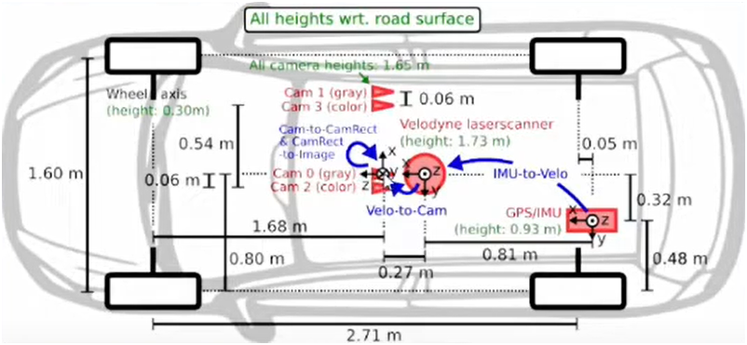
ARRANGEMENT
This is the top view of the vehicle equipped with 4 cameras, 2 of which are gray & 2 are coloured
Gray cameras are used for better depth perception and performance in low-light conditions
Colored cameras provide rich information for object detection, recognition, and contextual understanding based on RGB data.

Slide 4
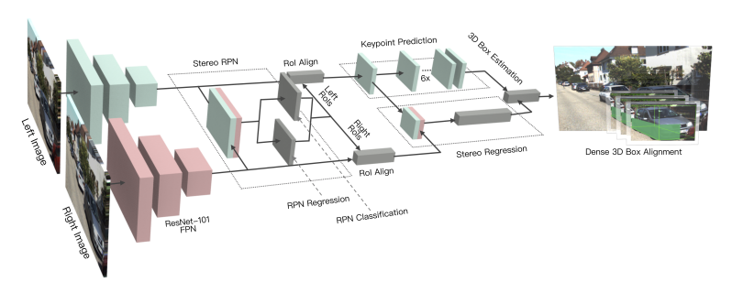
Multi-Camera Visual Odometry Approach
1. Stereo Camera Setup
2. Feature Detection & Matching
3. Motion Estimation
4. Building the Trajectory
5. Key Benefits
Only requires multiple cameras (no additional sensors).
· Works entirely based on image data for depth and motion estimation.

Slide 5
UNDERSTANDING PYTHON CODE
display_image_pair(): Loads 2 Images and displays it as Left Image and Right Image.
compute_disparity(): Calculates the disparity map between a pair images using either the Block Matching or Semi-Global Block Matching algorithm and displays the Image.
display_text_file(): Reads and prints the contents of a text file based on an index.
get_calibration_parameters(): Reads the calibration file and splits the values into each variable p_left, p_right, p_ro_rect, p_velo_to_cam, p_imu_to_velo.
decompose_projection_matrix(): Decomposes a projection matrix into the camera matrix, rotation matrix, and translation vectors and returns camera_matrix, rotation_matrix, translation_vector.
calculate_depth_map(): Computes a depth map from disparity, baseline, focal_length.
save_disparity_maps(): Computes the disparity, normalizes it and applies a colormap, and saves the resulting images to the output folder.
save_depth_maps(): Computes the disparity, calculates depth map using the provided baseline and focal length and saves it into the output folder.

Slide 6
UNDERSTANDING PYTHON CODE
get_bounding_box_center_frame(): Performs object detection on a given frame (image) extracts bounding box coordinates with a score above 0.5 and returns the list of bounding box coordinates.
calculate_distance(): Uses the Box coordinates to calculate the distance from the depth map.
ground_truth_bbox(): Uses labels to extract, It checks each object type to match the desired class, returns the bounding box coordinates and distance.
display_ground_truth(): Annotates and displays a frame with bounding boxes and distances extracted from ground truth data.
pipeline(): The pipeline function processes stereo images through a series of steps to obtain and return disparity map, frame and depth map
process_pipeline_images(): Calculates disparity_map_colored, frame_rgb, depth_map_colored using the pipeline function.
frames_to_video():Converts sequence of images to a MP4 video.
concatenate_videos_vertical(): Takes two videos, combines their frames vertically, and saves the result as a new video.

Slide 7
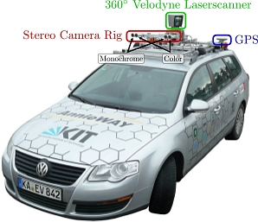

Reference
Stereo R-CNN based 3D Object Detection for Autonomous Driving
Peiliang Li1, Xiaozhi Chen2, and Shaojie Shen1
1The Hong Kong University of Science and Technology, 2DJI
https://arxiv.org/abs/1902.09738

Slide 8
THANK YOU

