Slide 1










MoodTunes

Slide 2
MEMBERS
Chaitanya Vijay Parab – (Leader)
Katheem Kizhar Ahmed
Shaikh Mohd Shoeb
Shaikh Mudasser Ali

Slide 3




INTRODUCTION
Music is an art form and cultural activity consisting of sounds and silence organized in time. It can be performed using instruments, vocalizations, or electronic means, and can evoke emotions and express ideas and stories. Music is found in many cultures and has been an important part of human history and experience. But with advancements of the time, the numbers of music have been increasing which leads to the issue of manually selecting each piece of music based on your feelings. This led to the need for some technology to automate this process of music selection. We can achieve this process by using Convolutional Neural Network (CNN) to first identify the user’s emotions and afterward play music based on obtained emotion as output. We will also discuss how our technology differs from those on market and how we can and will achieve that.

Slide 4
Problem Statement
In real-world situations, music can be used to deal with various problems such as depression, anxiety, and not only problems but it is also used for celebratory purposes. But with advancements in time, it is becoming increasingly difficult to find correct songs manually and play them. So our goal is to design a music recommendation system that incorporates emotion detection from facial expressions to personalize music recommendations for users.

Slide 5
Methodology
Train a machine learning model on the dataset to detect the emotional state of the user based on their facial expressions.
Integrate the trained model into a music recommendation system that provides personalized music recommendations based on the user's detected emotional state.
Evaluate the accuracy of the system's music recommendations through user testing and feedback..
Collect a dataset of facial expressions and corresponding music preferences.

Slide 6
Future Development
Integration with Virtual Reality: The app can be integrated with virtual reality (VR) technology, allowing users to experience music in a fully immersive environment. This can enhance the emotional connection between users and the music, providing a more personalized and impactful experience.
Advanced Emotion Detection: The app can be developed to detect more nuanced and complex emotions, allowing for even more personalized music recommendations.
Integration with Streaming Services: The app can be integrated with popular music streaming services, providing users with seamless access to a large library of music that they can use to express their emotions.
Machine Learning and AI: The app can incorporate machine learning and artificial intelligence (AI) to continually improve its recommendations, by analyzing users' listening habits, emotions, and feedback to refine its recommendations over time.

Slide 7
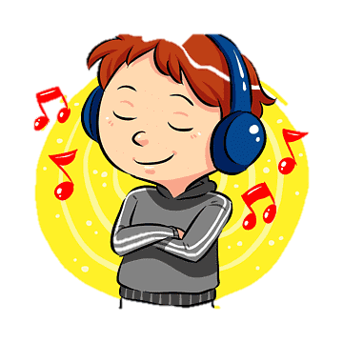
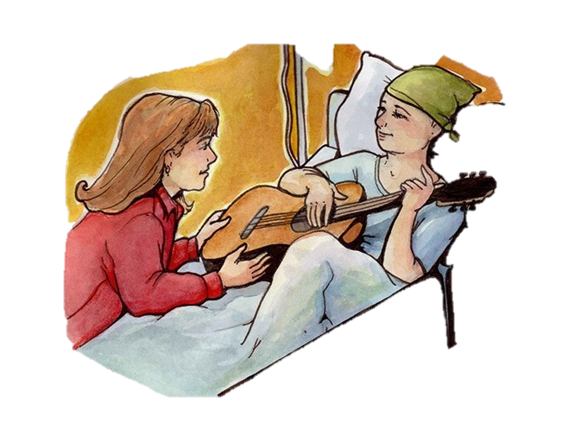


Use Cases
The app can use facial recognition technology to detect the user's current mood, and then recommend music that aligns with that mood, such as happy or energetic music for a positive mood and relaxing or soothing music for a more relaxed or calm mood.
Users can create custom playlists based on their emotional state. The app can analyze their facial expressions and select music that fits their current mood, allowing them to listen to music that they are most likely to enjoy.
The app can be used as an emotional therapy tool, helping users to manage their emotions by listening to music that matches their current mood and state of mind.
The app can help users gain a better understanding of their emotions by showing them which music aligns with their moods and how different types of music can affect their emotions.

Slide 8





Conclusion
Based on the results of facial emotion detection, one could recommend music to help improve or match a person's current emotional state.
For example: If the person is detected to be happy, you could recommend uplifting and energetic music to keep the person in a positive mood.
If the person is detected to be sad, you could recommend calming and soothing music to help them relax and feel better.
If the person is detected to be angry, you could recommend music with a slower tempo and relaxing melody to help them calm down.
If the person is detected to be afraid, you could recommend music with a positive and reassuring message to help them feel more secure.

Slide 9
THANK YOU!

