Slide 1
MACHINE LEARNING CAPSTONE | 23CSE301
Real-Time
Content Moderator
Review 2 — Classification Part B + Clustering
Team: [add team members] • Section: [add section] • Instructor: [add name]
10 CLASSIFIERS
2 CLUSTERING METHODS
METRICS + VISUALS
Review 2 | Academic Year 2026–27

Slide 2
Review 2 — required scope
OPTIONAL GUI +1
The deliverable extends the same Review 1 dataset and project, rather than restarting from scratch.
Classification Part B • 6 marks
Clustering track • 8 marks
Random Forest Classifier
AdaBoost Classifier
Gradient Boosting Classifier
Bagging Classifier (Decision Tree base estimator)
MLP Classifier (Neural Network)
One comparison table across all ten models
K-Means — Elbow curve to choose k
Agglomerative Hierarchical Clustering
Silhouette, Davies–Bouldin, Calinski–Harabasz
Dendrogram and linkage comparison
PCA plot for each required algorithm
t-SNE plot for at least one algorithm
Integration + viva • 11 marks
Clean notebooks • README + requirements • meaningful commits • presentable outputs • team-authored interpretation

Slide 3
Dataset and feature pipeline
Same Civil Comments sample used in Review 1. The classification and clustering tasks handle the labels differently.
50,000
45
92.1%
7.9%
records
columns
non-toxic labels
toxic labels
Classification features (10)
Classification flow
Comment length • word count • uppercase ratio • ! and ? counts • special-character count • digit count • unique-word ratio • average word length • time of day
CSV
Engineer
Split
Pipeline
Evaluate
›
›
›
›
50k rows
text features
80:20 stratified
impute + scale + encode
10 models
Clustering leakage safeguard
The target and toxicity labels are excluded from the clustering feature matrix. They are used only after clustering for optional descriptive validation. Clustering metrics use a reproducible 3,000-row sample; dendrogram and t-SNE plots use smaller documented samples.

Slide 4
Classification — all ten required algorithms
Part A models are retrained for the consolidated table; Part B completes the required classifier set.
REVIEW 1 • PART A
REVIEW 2 • PART B
01
Logistic Regression
06
Random Forest
linear baseline
bagging ensemble
02
K-Nearest Neighbors
07
AdaBoost
distance-based
adaptive boosting
03
Gaussian Naive Bayes
08
Gradient Boosting
probabilistic
sequential boosting
04
Decision Tree
09
Bagging (Decision Tree)
tree-based
bootstrap ensemble
05
Support Vector Classifier
10
MLP Classifier
maximum-margin
neural network
All ten share the same dataset, feature family, and stratified 80:20 test split for the consolidated comparison.

Slide 5
Classification — consolidated test-set results
Metrics are taken from the executed classification notebook; precision, recall and toxic F1 refer to class 1.
Model
Accuracy
Precision
Recall
F1 toxic
Weighted F1
ROC-AUC
Bagging (Decision Tree)
0.4601
0.0923
0.6608
0.1620
0.5670
0.5764
Gaussian Naive Bayes
0.8462
0.1128
0.1380
0.1241
0.8532
0.5637
K-Nearest Neighbors
0.9166
0.0926
0.0063
0.0118
0.8818
0.5215
Random Forest
0.9178
0.1000
0.0051
0.0096
0.8823
0.5521
Logistic Regression
0.9210
0.0000
0.0000
0.0000
0.8831
0.5593
Decision Tree
0.9202
0.0000
0.0000
0.0000
0.8827
0.5609
Support Vector Classifier
0.9210
0.0000
0.0000
0.0000
0.8831
0.5094
AdaBoost
0.9210
0.0000
0.0000
0.0000
0.8831
0.5571
Gradient Boosting
0.9210
0.0000
0.0000
0.0000
0.8831
0.5790
MLP Classifier
0.9210
0.0000
0.0000
0.0000
0.8831
0.5450
Readout prompt for the team: explain the metrics together; do not select a model using accuracy alone.

Slide 6
Hyperparameter tuning — Random Forest
GridSearchCV maximized toxic-class F1 on a training-only subset; the chosen configuration was then refit on all 40,000 training rows.
Search setup
Metric
Baseline RF
Tuned RF
Team explanation
Stratified parameter-search subset: 8,000 rows
Two-fold stratified CV for parameter search
Best parameters:
• n_estimators = 60
• max_depth = 8
• min_samples_leaf = 2
• class_weight = balanced_subsample
Final evaluation uses the held-out 10,000-row test set
Accuracy
0.9178
0.5462
Precision (toxic)
0.1000
0.0945
Explain the measured precision / recall / accuracy trade-off and whether the model behavior suits your moderation use case.
Recall (toxic)
0.0051
0.5532
F1 (toxic)
0.0096
0.1615
Weighted F1
0.8823
0.6473
ROC-AUC
0.5521
0.5764
The tuned output improves some toxic-class metrics while other metrics move down. Quote exact values from the table.

Slide 7
Clustering — method and internal metrics
Same dataset; ground-truth toxicity labels excluded from model fitting.
Workflow
Algorithm
k
Silhouette*
Davies–Bouldin
Calinski–Harabasz
1. Engineer numerical, comment-derived features.
2. Apply log1p to selected long-tailed count/length features and RobustScaler.
3. Use a reproducible 3,000-row sample for model comparison.
4. Plot K-Means inertia for k = 2…10; current heuristic suggestion: k = 5.
5. Fit K-Means and Agglomerative (Ward).
6. Compare Ward, complete and average linkages.
7. Inspect PCA, t-SNE, dendrograms and cluster sizes.
K-Means
5
0.2388
1.1301
711.1586
Agglomerative — Ward
5
0.2353
1.0557
646.7457
Agglomerative — Complete
5
0.6906
0.3252
173.8524
Agglomerative — Average
5
0.7499
0.1375
121.1419
*Silhouette is estimated on a reproducible sample of up to 2,000 points; Davies–Bouldin and Calinski–Harabasz use the 3,000-row clustering sample.
Team task: justify the selected k using the actual Elbow curve and include the measured cluster-size profile in your explanation.

Slide 8
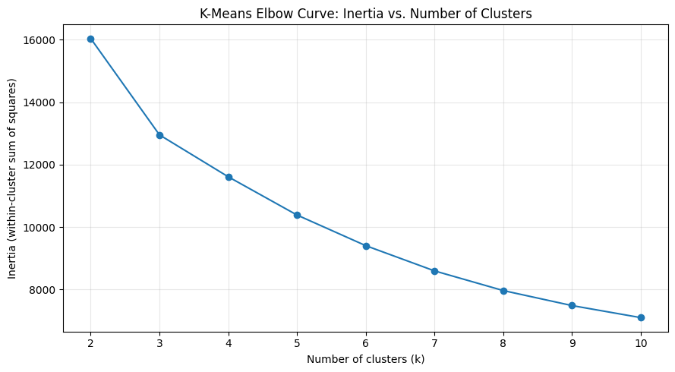
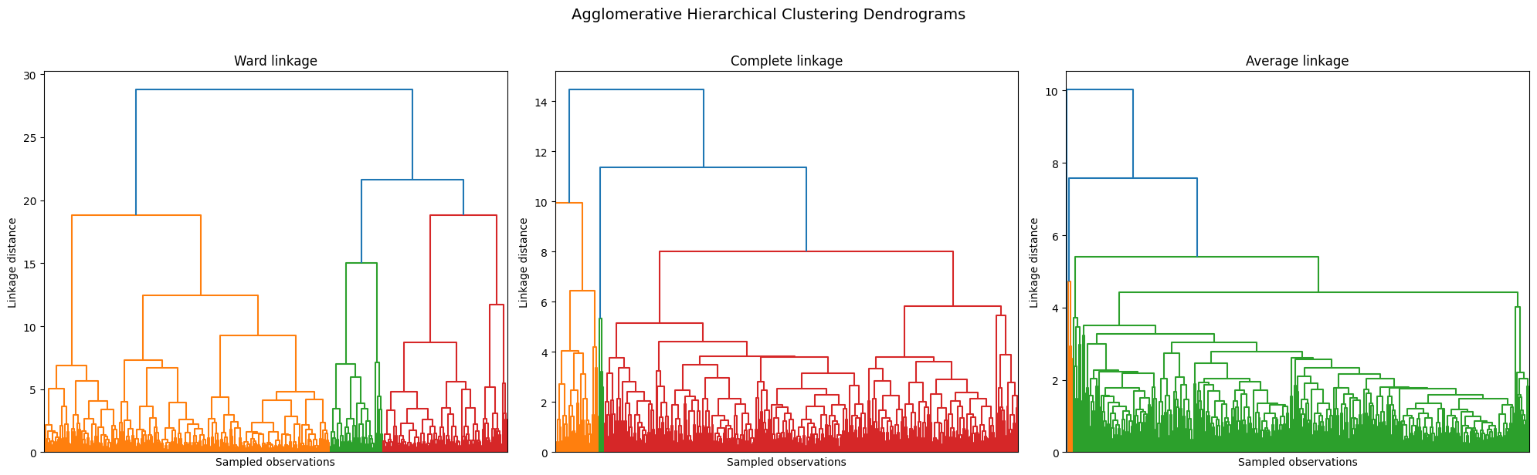
Required clustering visuals — Elbow and dendrograms
The plots are embedded from the executed clustering notebook.
K-Means Elbow curve
Agglomerative linkage comparison
Current code output: the elbow-knee heuristic suggests k = 5. Confirm the choice by inspecting the curve, then document the team’s justification.

Slide 9
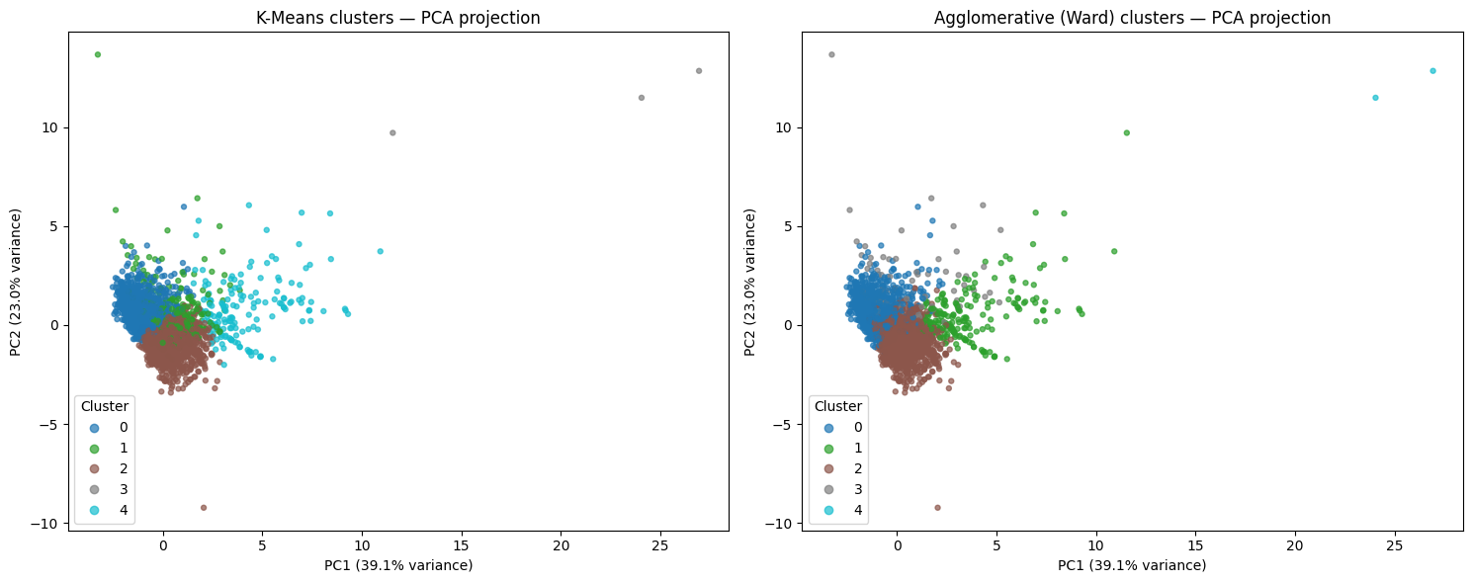
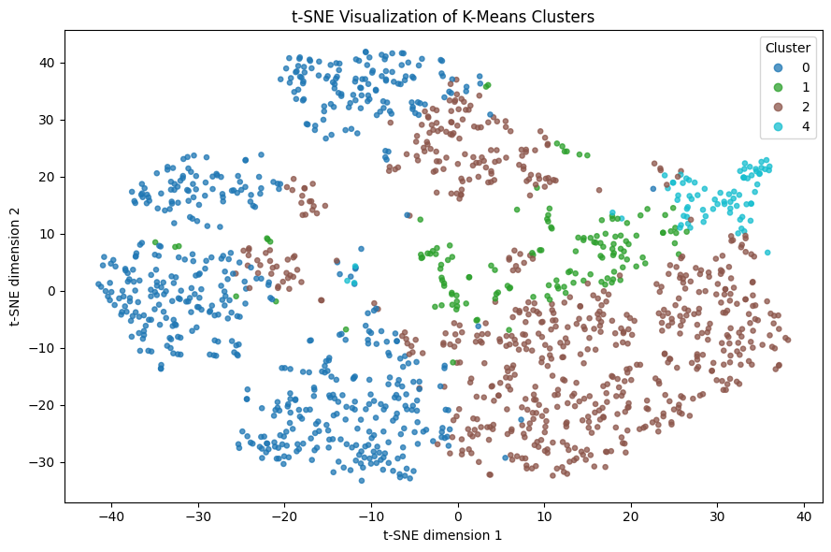
Required clustering visuals — PCA and t-SNE
Cluster colors come from the unsupervised model labels, not the toxicity target.
PCA — K-Means and Agglomerative (Ward)
t-SNE — K-Means sample
Cluster counts to discuss: K-Means [1,238; 283; 1,314; 3; 162] | Agglomerative (Ward) [1,190; 197; 1,541; 70; 2]
Add the team’s own observation about cluster sizes and overlap.

Slide 10
Submission package, GUI and final checks
Code outputs are generated; the team must add its interpretation, push to the remote repository and rehearse the viva.
Included in the package
Optional GUI demo
classification.ipynb — 10 models, comparison, CV, tuning
clustering.ipynb — metrics, Elbow, dendrogram, PCA, t-SNE
regression.ipynb — retained Review 1 track, re-run
README.md + requirements.txt + final checklist
Streamlit UI + saved classifier artifact
Install dependencies: pip install -r requirements.txt
Run: streamlit run app/streamlit_app.py
The app accepts comment text and returns a prediction.
It is a coursework prototype, not a production safety filter.
Public deployment has not been performed.
Before presenting
Write your own evidence-based interpretation of the classification and clustering outputs (course AI-use rule).
Inspect the Elbow curve and justify k; explain cluster size, metrics and the limitations of surface-level features.
Run all notebooks in your own environment and verify outputs; confirm the GUI locally if seeking the bonus.
Push the local milestone history to your actual GitHub repository; fill in team details on the title slide.

