Slide 1







SEATTLE UNIVERSITY
Project-Fetchfood
Analysis
Presented to: Prof. Elio Zhang
Course: DATA 5300
Presented by: Prateek Pagare
Mahek Patel
Chaitanya LNU

Slide 2


Topic Outline
1
Background and Purpose
4
Conclusions
2
Metrics and Methods
5
Recommendations
6
Future Considerations
3
Analysis

Slide 3
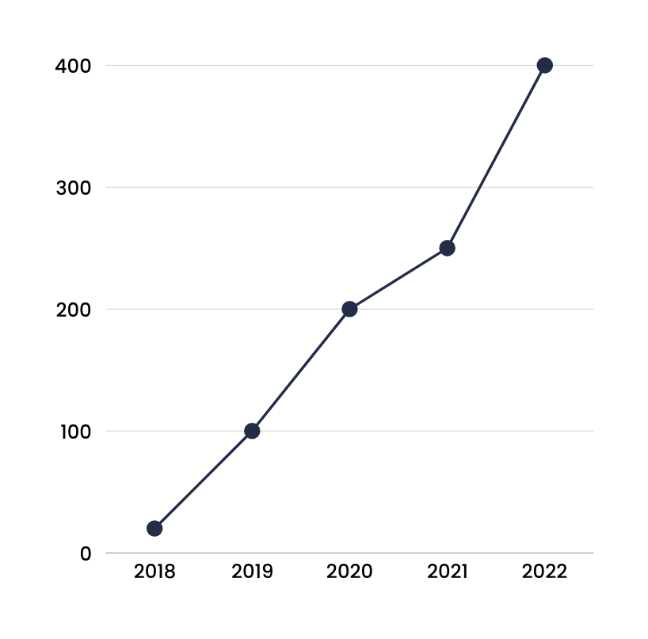
Background and Purpose
FetchFood wants to reduce driver cancellations because they financially impact both FetchFood and its partners (restaurants/grocery stores).
Three cancellation penalties were tested: $0 (control), $10 (treatment 1), and $20 (treatment 2).
The task is to determine which penalty balances short-term profit maximization with long-term growth.
Understand Driver and Customer behaviour to shape strategic decisions

Slide 4

Background and Purpose
Problem Statement
Issue: Frequent cancellations by drivers may create inconsistencies in service delivery.
Why It Matters: High cancellations affect profit margins and customer satisfaction and implementation of penalties may influence driver behavior but could pose challenges for driver retencion
Goal: Understand the trade-offs and identify solutions that benefit both customers and drivers

Slide 5
Background and Purpose
Our Primary Goal
As a data scientist, our primary task is to determine the optimal cancellation penalty to balance long-term growth and short-term profit maximization. Utilize A/B testing methodologies to ensure your analysis and conclusions are thorough, deep and robust.

Slide 6
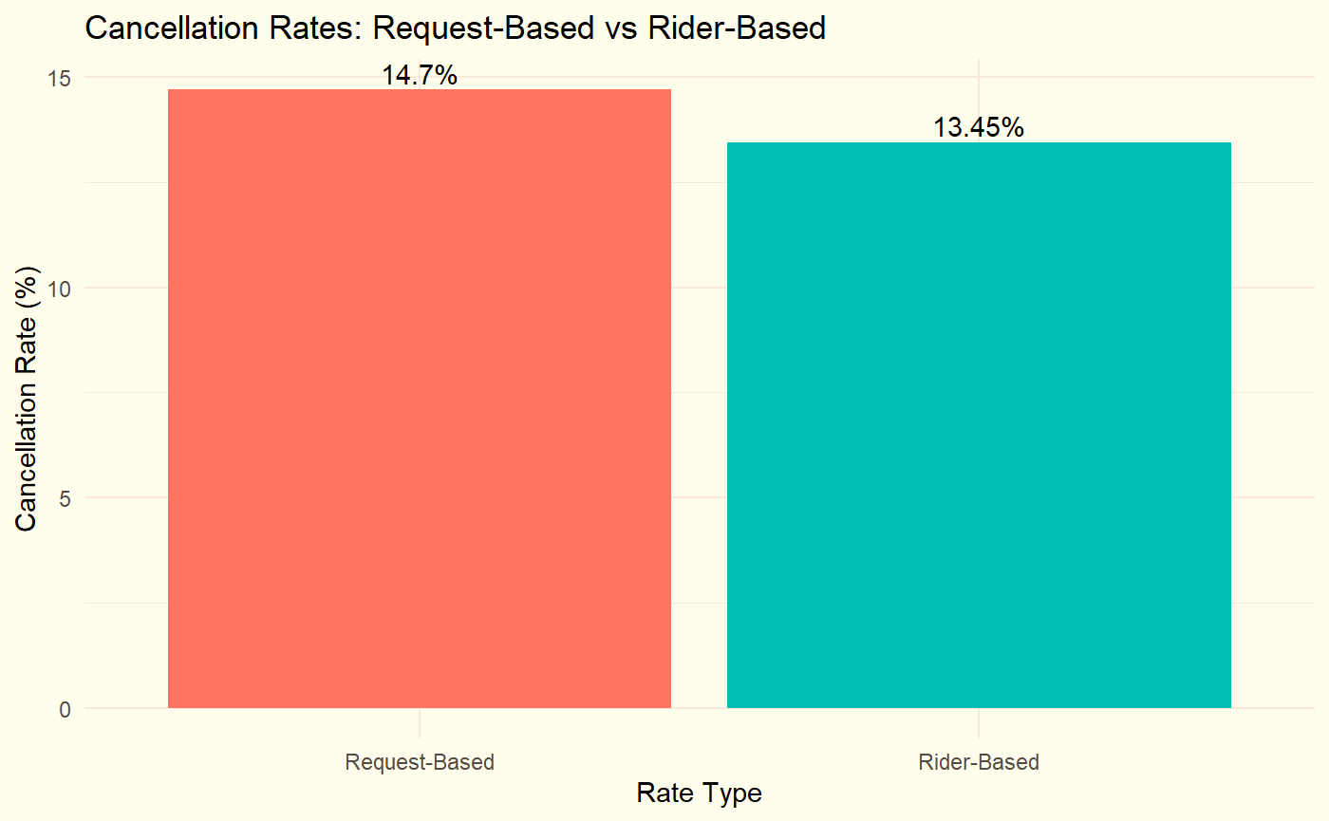
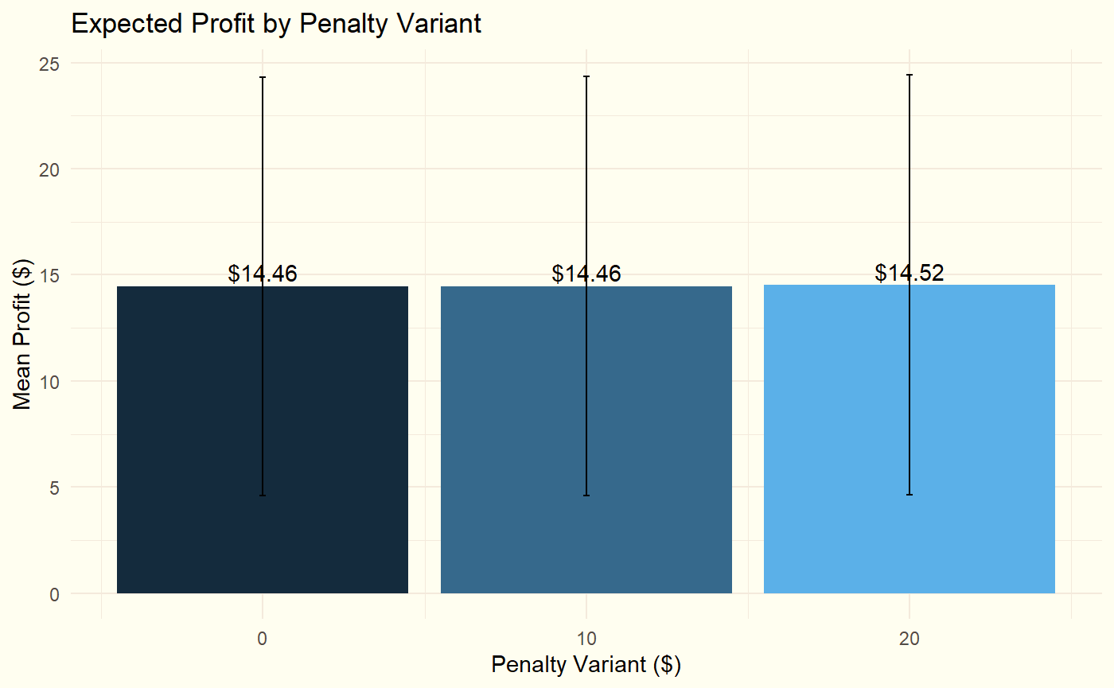

Metrics and Methods
Cancellation Rate (Request-Based vs Rider-Based) Cancellation Rate (%)=(Total Cancellations/Total Requests​)×100
Request-Based Rate: Shows how frequently requests are canceled at a
system level.
This means Overall cancellation rates on average were 14.7% of all delivery request.
Request-Based Rate reflects how often cancellations happen overall, which impacts operational efficiency and revenue.
Rider_Based: Reflects individual driver behavior trends.
The average cancellation rate per rider (driver) is 13.45%.
Rider-Based Rate provides insights into individual driver behavior,
which helps identify specific patterns or problematic drivers.
Expected Profit : Measures the average revenue expected from completed
deliveries.
Expected profits increase slightly with higher penalties.
Higher penalties reduce cancellations but may discourage drivers over
time.
Expected Profit= Total Revenue from Completed Orders/Total Requests

Slide 7
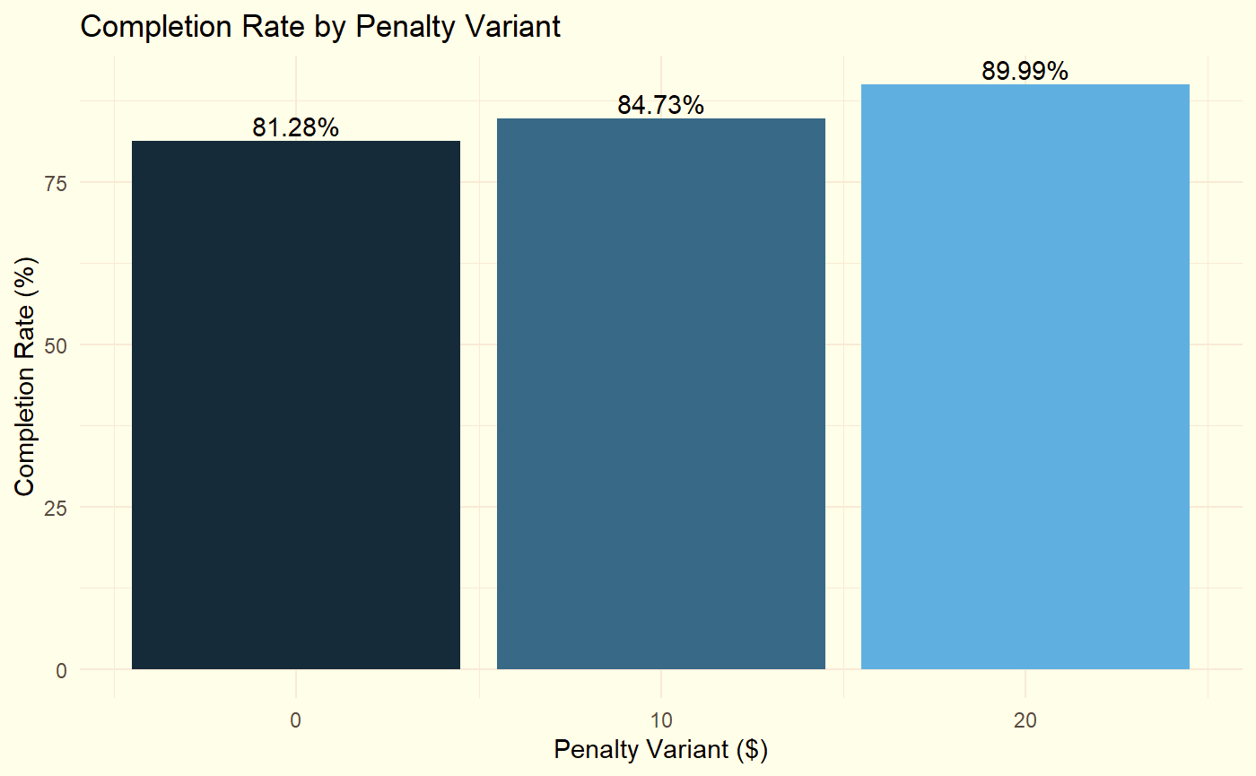
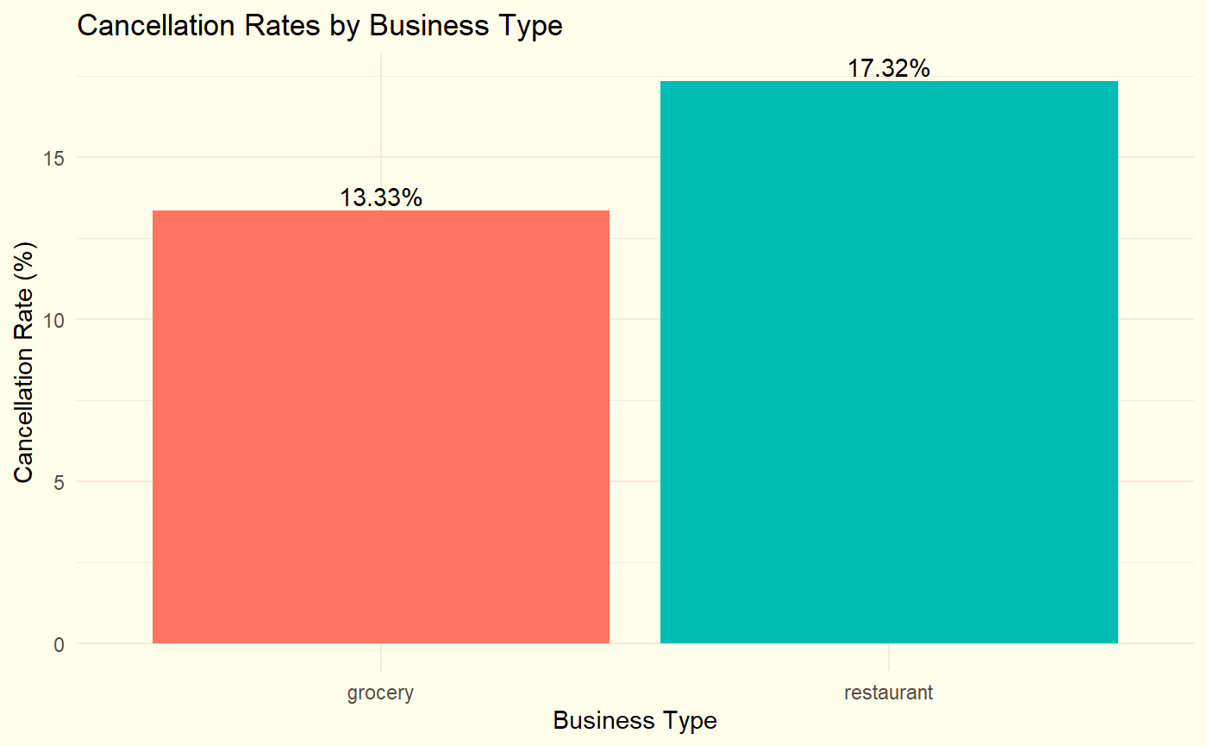
Metrics
Completion Rate by Penalty Variant
Completion Rate (%)=(Total Cancellations/Total Requests​)×100
Penalties improve completion rates, indicating operational efficiency.
Indicates delivery reliability and Demonstrates how penalties influence
driver behavior and ensure customer satisfaction.
Cancellation Proportion by Business Type:
Distribution of cancellations across business types
Restaurants face higher cancellation rates than groceries, suggesting
the need for targeted interventions.
Identifies operational inefficiencies specific to business segments.
Table
 | Unit | Business Impact
Cancellation Rate | Percentage | Operational efficiency; system vs. individual behavior.
Expected Profit | USD ($) | Financial performance under different penalty variants.
Completion Rate | Percentage | Reliability in ensuring successful deliveries.
Business-Type Cancellations | Percentage | Identifies inefficiencies in grocery and restaurant ops.

Slide 8
Statistical Methods
Chi-Square Test
Analyze the relationship between penalties (penalty.variant)
and cancellations (cancel.dummy).
ANOVA (F-Test)
Examine differences in expected.profit across penalty groups.
Multiple Testing (Bonferroni Correction)
Perform pairwise comparisons between penalty groups
to control for Type I error.
t-Test
Compare expected.profit between cancellation
groups (cancel.dummy).
Data Stratification
Breaking data into subsets(e.g. penalty level and cancellations) for
deeper insights
Adjusted Linear
Further analysis through adjusted model based on business.type
ANOVA
Bonferroni t-test
T-test (p-value)
Adjusted Model

Slide 9
Methodology
Hypothesis
Null: Penalties have no effect on cancellation rates or expected profits.
Alternate: Penalties reduce cancellations and increase expected profits.
Test Used:
Chi-square test for cancellation behavior across penalties.
ANOVA for differences in expected profits among penalty groups.
• Data Cleaning
Data includes 1,000,000+ entries with key variables: expected profit, penalty variant, and cancellation dummy.
Data is merged on driver.id and cleaned to remove missing values.
Major issue expected.profit column is in character format , and also has 140 rows with missing expected.profit values been removed for better optimization.
penalty.revenue: Revenue loss from cancellations.
completed.rides: Indicates whether an order was completed.

Slide 10
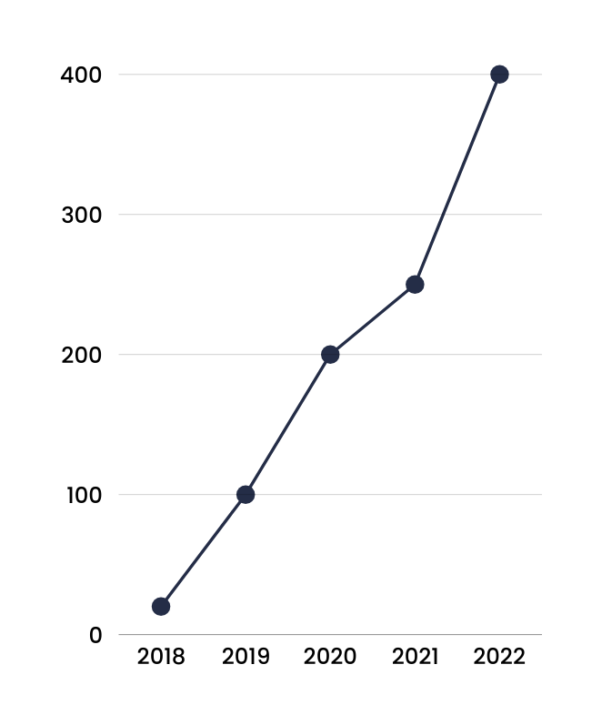
Analysis
Findings:
Average Expected Profit for non-cancellation orders on penalty
For 0$ : 14.4451 %
For 10$ : 14.449 %
For 20$ : 14.5118 %
Maximum and minimum profits by order
Completed orders: Max = $568.08, Min = $4.29.
Canceled orders: Max = $354.24, Min = $4.29.
2. ANOVA Test for Expected Profit and Penalty Variant:
(H0): There may no difference in expected profit across penalty variants.
(H1): There may a significant difference in expected profit across penalty variants.
Test Results:
F Value: 5..779 p-value: 0.0167
Conclusion: Since the p-value is below 0.05, we reject the null hypothesis, confirming there may be significant between 3 penalty groups

Slide 11
Analysis
3. Multiple Comparisons (Bonferroni Correction)
For further explore if which group is causing significance pairwise
Test Results:
0 vs. 10: p-value = 1.000 (not significant)
0 vs. 20: p-value = 0.0048 (significant)
10 vs. 20: p-value = 0.073 (not significant)
Difference Exist between 0 and 20, suggesting that increasing the penalty amount affects expected profit.
4. Chi-Square Test for Penalty Variant and Cancellation Status
Test if there is a relationship between the penalty variant and the cancellation status(cancel.dummy).
(H0): Penalty variant and cancellation status are independent.
(H1): There is an association between penalty variant and cancellation status.
Test Results:
x-squared = 10622, df = 2, p-value < 0.0001

Slide 12
Analysis
5. T-Test for Cancellation Status and Expected Profit
Check if cancellations affect expected profit by comparing the means of expected profit between canceled and non-canceled rides.
Test Results:
t-statistic: -1.3409 p-value: 0.18
Since the p-value is greater than 0.05, we fail to reject the null hypothesis, indicating that cancellation status does not significantly affect expected profit.
6. Cancellation Rates by Penalty Variant
Investigate if the cancellation rate decreases with increasing penalties.
Test Results:
Penalty 0: 0.19 (19%)
Penalty 10: 0.15 (15%)
Penalty 20: 0.12 (12%)
Cancellation rates decrease as the penalty amount increases. Higher penalties reduce the likelihood of cancellations.

Slide 13
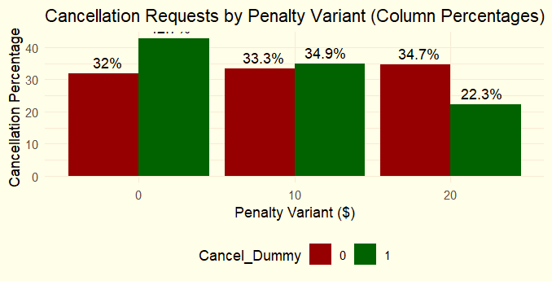
Analysis
7. Cancellation Rates by Penalty Variant (by column percentage)
Contingency Table: Include the table showing the frequencies and
column percentages of cancellations for each penalty variant.
Contingency Table of Penalty Variant vs Cancel Dummy:
Penalty Variant | Cancel = 0 (No Cancellation) | Cancel = 1 (Cancellation) | Column Percentage (Cancel = 0) | Column Percentage (Cancel = 1)
0 | 382,386 | 88,501 | 31.99% | 42.74%
10 | 398,114 | 72,335 | 33.31% | 34.94%
20 | 414,762 | 46,214 | 34.70% | 22.32%

Slide 14
Analysis Table
Test | Test Type | Results | Conclusion
ANOVA | F-Test | F = 5.779, p-value = 0.0162 | Reject H0: Penalty variants affect expected profit significantly.
Pairwise T-Test | Multiple Comparisons (Bonferroni) | 0 vs 10: p = 1.0, 0 vs 20: p = 0.00089, 10 vs 20: p = 0.02568 | Reject H0 for 0 vs 20 and 10 vs 20; No significant difference between 0 and 10.
Chi-Square | Association between Penalty Variant and Cancellation | X-squared = 10622.39, p < 0.0001 | Reject H0: There is a significant relationship between penalty and cancellation.
T-Test for Cancellation | Difference in Expected Profit between Canceled vs Non-Canceled | t = -2.037, p-value = 0.04165 | Reject H0: Significant difference in expected profit between canceled and non-canceled rides.
Cancellation Rate by Penalty Variant | Cancellation Rate Calculation | Penalty 0: 19%, Penalty 10: 15%, Penalty 20: 12% | Higher penalties reduce cancellations.

Slide 15

Conclusions
1
Effectiveness of Penalty Fees
Penalties reduce cancellation rates. Higher penalties ($20) have the greatest impact, but even $10 leads to a meaningful reduction.
2
Cost-Benefit Analysis
While a $20 penalty maximizes the reduction in cancellations, the business must consider potential backlash or driver dissatisfaction. A $10 penalty provides a significant improvement with less severe consequences.

Slide 16
Conclusions
3
Long-Term Growth Risks
Imposing higher penalties could deter drivers from continuing with the platform, potentially impacting long-term engagement.
4
Competition Strategies
If competition offers less penalties on violation, it may cause migration of employees to other platforms.

Slide 17

Strategic and Business Recommendations
• Short-term Strategies:
Offer driver bonuses for completing a minimum number of deliveries, reducing cancellations.
Launch targeted promotions and free trials to attract new customers.
• Long-term Objectives:
Implement paid memberships offering benefits like free or discounted deliveries to
encourage loyalty.
Use historical data to identify patterns in cancellations (e.g., zip codes, delivery distance
s) and optimize operations
Competitive Edge:
Differentiate from Uber Eats and Instacart with exclusive offers, loyalty
programs, and personalized incentives.
Profit-Oriented Approach:
Reduce revenue loss caused by cancellations.
Maximize customer lifetime value through retention strategies.

Slide 18

Future Consideration
1
Experiment on Penalty Effectiveness:
Test alternate penalty amounts (e.g., $5, $15) to find the optimal level that minimizes cancellations while maintaining driver satisfaction
2
Geographic Trends Analysis:
Conduct region-specific experiments to study how traffic, zip codes, and customer density impact cancellations and profits.

Slide 19
Future Consideration
3
Future Experiments
Test alternate penalty amounts (e.g., $5, $15) to find the optimal level that minimizes cancellations while maintaining driver satisfaction
4
Cancellation History
Develop machine learning models to predict cancellations based on historical data (e.g., traffic, delivery distance, driver history).

Slide 20

Thank you for listening!

