Slide 1
Travel Insurance Claim Prediction

Slide 2
63k Policies issued
26 Policy Products
40.72 Net sales on all policies
Insurance sold for travel to 149 Countries
26 Agencies selling our products (Online and Offline)

Slide 3
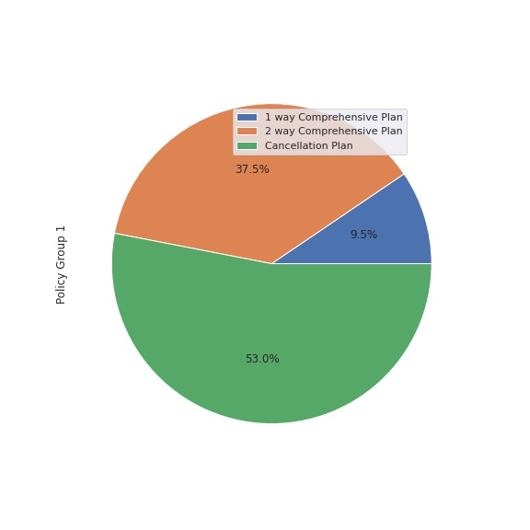
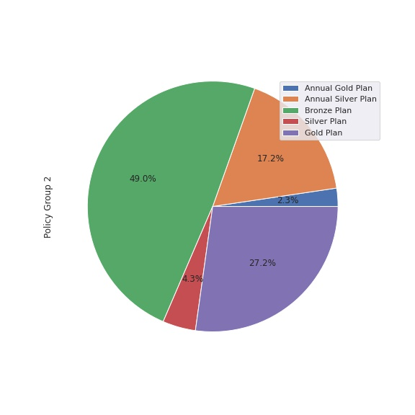
Policy Group Sales

Slide 4
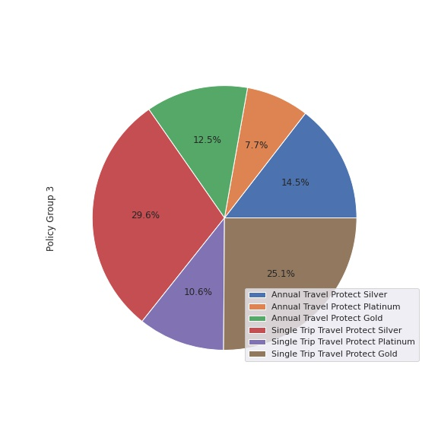
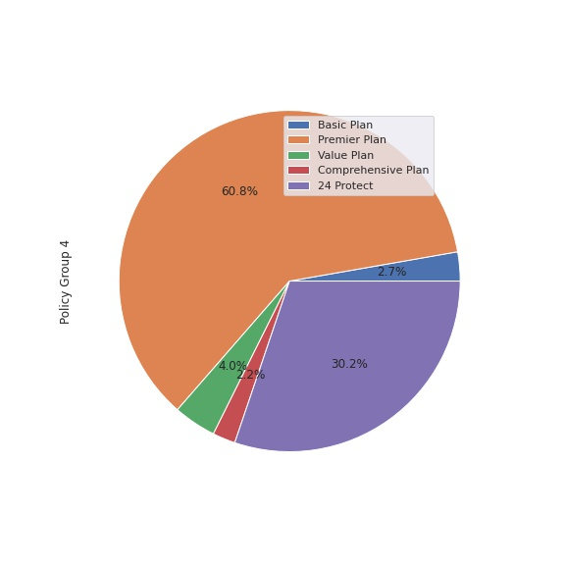
Policy Group Sales

Slide 5
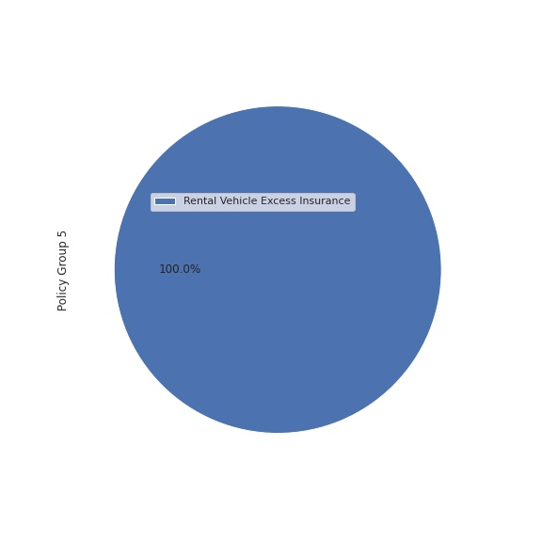
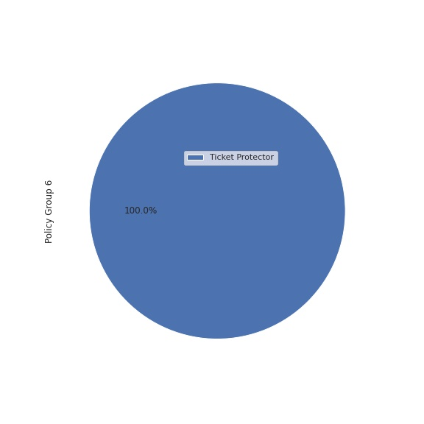
Policy Group Sales

Slide 6
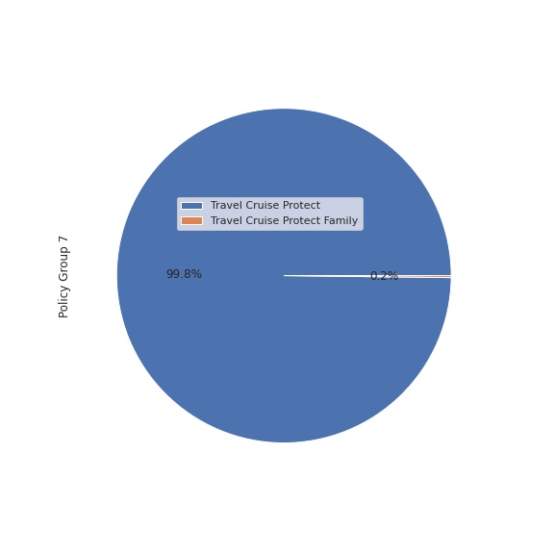
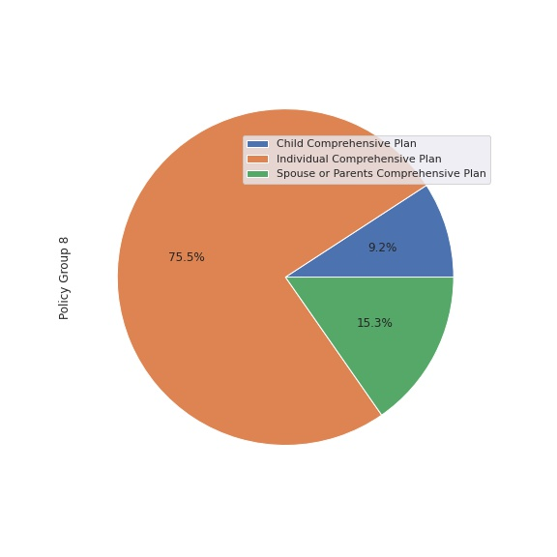
Policy Group Sales

Slide 7
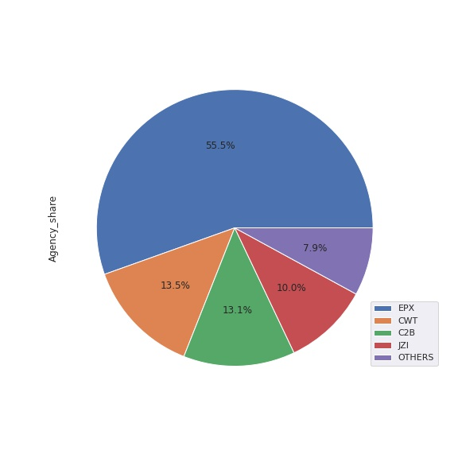
Agency Shares
Total 26 Agencies
92% of Sales are from 4 Agencies

Slide 8
1.46% Policies claimed

Slide 9
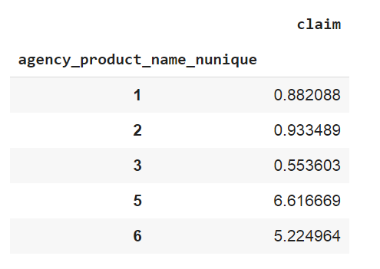
Higher Claim ratio is observed for:
Agencies which have Higher Average Net sales.
Agencies which have taken more than 3 products to sell have claim ratio> 5%
continued

Slide 10
Higher Claim ratio is observed for:
Agencies C2B(Airlines), LWC(Travel Agency) have significant claim ratio compared to others.
Agency | Product Name | Total Sales | Claimed Count | % Claim ratio
C2B | Annual Gold Plan | 194 | 21 | 10.8247
 | Annual Silver Plan | 1423 | 157 | 11.033
 | Bronze Plan | 4049 | 210 | 5.1865
 | Gold Plan | 352 | 18 | 5.1136
 | Silver Plan | 2249 | 141 | 6.2695
Agency | Product Name | Total Sales | Claimed Count | % Claim ratio
LWC | Annual Travel Protect Gold | 100 | 10 | 10
 | Annual Travel Protect Platinum | 53 | 3 | 5.6604
 | Annual Travel Protect Silver | 86 | 4 | 4.6512
 | Single Trip Travel Protect Gold | 204 | 10 | 4.902
 | Single Trip Travel Protect Platinum | 73 | 5 | 6.8493
 | Single Trip Travel Protect Silver | 173 | 4 | 2.3121

Slide 11
Higher Claim ratio is observed for:
As per previous slide, its clear that Annual Plans are having higher Claim ratio(~10%).
continued

Slide 12
Model to predict Claims
Data is highly imbalanced with less number of customer data who has claimed.
Xgboost Binary Classifier is built and below are the stats:
Note: 95% confidence intervals are yet to be shared
Dataset | AUC
Train | 87
Test | 83.6
continued

Slide 13
Additional Observations
EPX agency sells more than 50% of total insurances. The probable reason being the commission value is Zero indicating that EPX sells insurance without taking any commission for each policy. May be that's the reason, insurance company has given authorization to sell 2 most sold products to EPX
Commission values are higher for CWT(60%) and LWC(65% of Net sales). Others have less than 40%.
Although volumes are low, TTW is providing insurance with zero commission. All Products sold by TTW Agency are taken for around a year.
Out of 26 agencies, only 9 agencies are having only either Online or Offline services. Rest other 17 agencies have both services.
Out of 26 products, only 3 products are sold across by multiple agencies.
Products sold by SSI are having higher variation in duration. That's probably because of Ticket Protector Product taken by some customers for more than 10 years.
Products sold by C2B are also having higher variation and its because of Annual Silver Plan which is taken for higher durations.
C2B Agency booked insurance for customers going to Singapore only.
Most of customers(>95%) with age 118 have travelled to India
Customers who are taking insurance for more than 10 years are opting for Ticket Protector Product.
Product Name | Agencies
Comprehensive Plan | CBH, CSR, CCR
Premier Plan | KML, CCR, ADM, CSR, JZI, CBH
Value Plan | JZI, JWT, RAB, KML, ART, ADM
continued

Slide 14
Suggestions:
Restrict the authority to sell more than 3 products for C2B and LWC.
Many missing values in gender data. Better to get full data.
Clarity on negative net sales value would have helped.
Demographic, Geographic and Social Behavior details of Actual Customer who has taken the insurance would have helped to predict the model much better.
By looking at the product name, Annual Gold Plan seems to contain all the features of Annual Silver Plan and some additional benefits. But by looking at the purchase counts, its clear that customers are not attracted to those additional benefits and hence they are buying only Annual Silver Plan. Probably business can do further research on it and can either decrease the Annual Gold Plan Price or increase/change the benefits.
The same above analysis goes for Bronze, Silver and Gold Plan.
Considering the grouping of the Plans, I can see the below as one set of groups:
Basic Plan
Value Plan
Premier Plan
Comprehensive Plan
But they are sold in different combinations in different agencies. Is that because we haven't given authorization to them.
Also, Basic Plan is the most sold out from that group and that's being sold by single agency.
Can we give authorization to them to sell these?

Slide 15
Thank You

