Slide 1
Life Context Summarizer: NLP Email Analysis
By:
Kurapati Chaitanya Sai,
Bandi Dheeraj,
Veluru likhith kumar reddy

Slide 2
Problem Statement
Managing large volumes of emails is time-consuming and inefficient.
Email overload leads to missed deadlines, poor prioritization, and stress.
We need an AI-powered system to summarize, classify, and extract key insights from emails.

Slide 3
Project Objectives
1. Parse and clean real-world email datasets (Enron dataset).
2. Summarize emails using Transformer-based NLP models.
3. Perform sentiment analysis to understand communication tone.
4. Extract keywords for topic identification.
5. Cluster similar emails using KMeans for better organization.
6. Provide visual analytics for email trends.

Slide 4
Literature Review
# | Title / Authors / Year | Dataset(s) / Domain | Approach / What They Did | Findings / Strengths | Limitations / Relevance to Your Work
1 | PROMINET: An interpretable email response prediction model (published ~Oct 2023) | Enron corpus + an in-house Email Marketing corpus | Uses a model combining transformer encoder + graph structure (dependency parsing + GNN) + prototype learning to predict whether an email will get a response; includes interpretability via prototypes. | Improved performance (∼3 % F1-score gain) over baseline email response prediction models; also gives interpretable prototypes which help understand why a response is predicted. | Focused on response‐prediction (not summarization). May not directly address clustering or sentiment extraction; design could be complex to scale.
2 | Network and Sentiment Analysis of Enron Emails (Natnael Belay, 2024) | Enron email data | Combines network‐science (social graph / centrality / community detection) + sentiment analysis over time; studies how sentiment changes and how information flows among employees. | Helps understand organizational dynamics; shows that sentiment alone isn't enough to predict financial issues of Enron, but network structure + sentiment give insights; also shows threshold effects in defining “who talks to whom.” | Does not generate summaries; keyword/topic extraction is implicit; less focus on summarization / abstraction but strong for sentiment / clustering / networks.

Slide 5
3 | Comparative Investigation of Traditional ML Models and Transformer Models for Phishing Email Detection (René Meléndez, Michal Ptaszynski, Fumito Masui; 2024) | Large email datasets including public email corpora (possibly including Enron or similar) for phishing / non-phishing classification | Compares traditional ML methods (Logistic Regression, SVM, etc.) vs transformer models (BERT, RoBERTa, DistilBERT, etc.) for classifying phishing vs non-phishing emails. | Transformer models significantly outperform traditional ones; RoBERTa achieves ~0.9943 accuracy; shows that choice of model matters a lot especially for more nuanced email classification tasks. | Focus is on security (phishing detection) rather than summarization or topic clustering; less on extracting semantics or summarization, more discriminative classification. Might be useful if you want classification tasks.
4 | Deep Latent Position Topic Model (Deep-LPTM) (Rémi Boutin, Pierre Latouche, Charles Bouveyron; ~2023) | Enron emails (among other textual networks) | A model for jointly clustering nodes (people) and edges (text content) in a network: clustering based on textual edges + latent position embeddings to model both structure (who interacts with whom) and content (what topics). | Good for combining structure + content; gives both clusters of users and topic representations; useful for visualization / understanding clusters with textual meaning. | More complex; less about summarization or individual email summaries; more about higher‐level clustering + topic discovery. Might need adaptation for summarization.
5 | Decoding Corporate Culture through Sentiment: A Computational Analysis of Emotional Expression in Business Communication (Indah Rohmayani, 2024) | Enron email dataset | Performs sentiment analysis (polarity, subjectivity, etc.) on Enron emails to explore corporate culture: how emotion is expressed, how roles differ, how communication tone varies. | Offers insight into sentiments beyond just positive/negative; finds that many emails are neutral or professionally toned; helps understand tone variations by role, time, etc. | Doesn't do summarization or clustering per se; mostly sentiment and analysis of tone; weak on summarization pipeline or topic extraction beyond keywords.

Slide 6
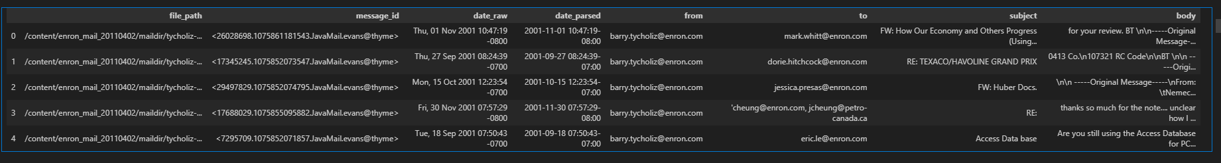
Dataset: Enron Emails
Source: Carnegie Mellon University (Enron email corpus).
500,000+ emails from 150 users, mainly Enron employees.
Real corporate communication dataset for NLP research.
We used a subset of 50000 emails for testing due to resource limits.

Slide 7
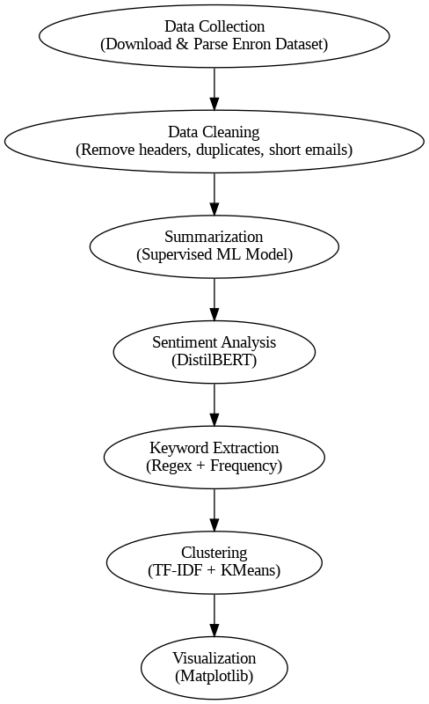
Methodology Pipeline
1. Data Collection: Download and parse Enron dataset.
2. Data Cleaning: Remove headers, duplicates, short emails.
3. Summarization: BART model summarization pipeline.
4. Sentiment Analysis: DistilBERT model classification.
5. Keyword Extraction: Regex-based + frequency analysis.
6. Clustering: TF-IDF vectors + KMeans to group similar emails.
7. Visualization: Matplotlib charts (sentiment, keywords, length).

Slide 8
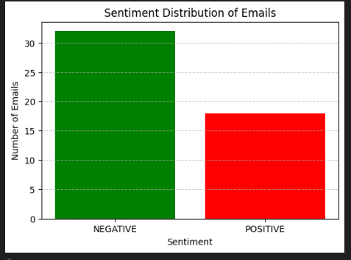
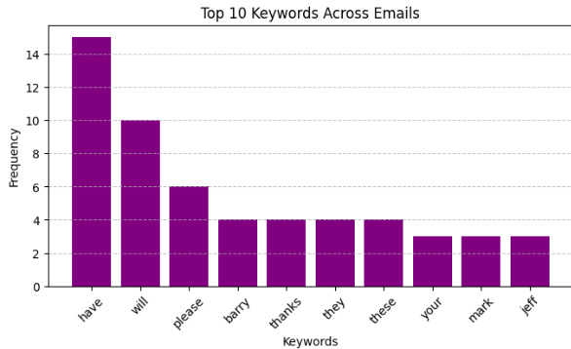
Results
Summaries generated for long emails (reducing reading time by ~70%).
Sentiment distribution shows neutral tone dominates corporate communication.
Top keywords identified recurring topics (e.g., contracts, pricing).
Clusters successfully group similar conversations.
Visualizations highlight sender activity and communication patterns.

Slide 9
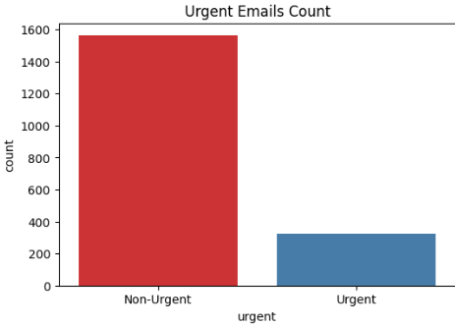
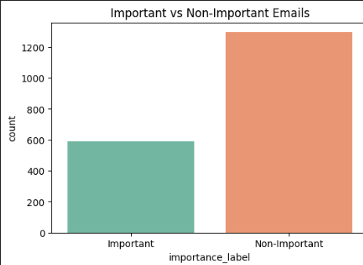
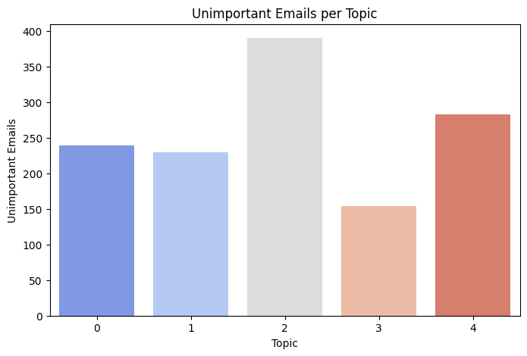
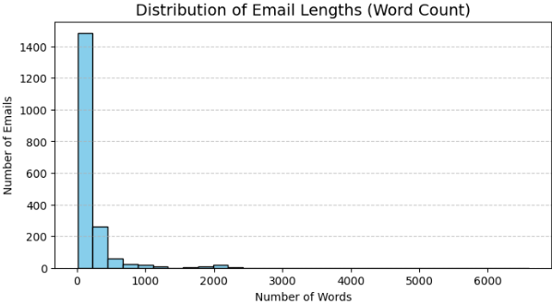

Slide 10
Novelty of the Project
Combines summarization, sentiment analysis, and clustering into one pipeline.
Real-world dataset ensures practical applicability.
Can be extended to a dashboard or integrated with enterprise tools.
Potential to save hours of email reading daily.

Slide 11
Future Enhancements
Develop a Streamlit or Flask web application for real-time use.
Add deep learning-based topic modeling (BERTopic, LDA).
Include multi-language support for global enterprises.
Integrate with corporate email servers (Gmail, Outlook).

Slide 12
References
A. Author(s), “PROMINET: An Interpretable Email Response Prediction Model,” arXiv preprint arXiv:2310.16753, Oct. 2023. [Online]. Available: https://arxiv.org/abs/2310.16753
N. Belay, “Network and Sentiment Analysis of Enron Emails,” arXiv preprint arXiv:2407.21063, Jul. 2024. [Online]. Available: https://arxiv.org/abs/2407.21063
R. Meléndez, M. Ptaszynski, and F. Masui, “Comparative Investigation of Traditional Machine-Learning Models and Transformer Models for Phishing Email Detection,” Electronics, vol. 13, no. 24, p. 4877, Dec. 2024. doi: 10.3390/electronics13244877
R. Boutin, P. Latouche, and C. Bouveyron, “Deep Latent Position Topic Model for Clustering and Representation of Networks with Textual Edges,” arXiv preprint arXiv:2304.08242, Apr. 2023. [Online]. Available: https://arxiv.org/abs/2304.08242
I. Rohmayani, “Decoding Corporate Culture through Sentiment: A Computational Analysis of Emotional Expression in Business Communication,” ResearchGate Preprint, 2024. [Online]. Available: https://www.researchgate.net/publication/385352935

