Slide 1

TEAM NAME : GO GREEN
TEAM MEMBERS : CHAITANYA SHIVARAJU
MYTHREYI U
DEEPA G
DEEPTHI NK

Slide 2
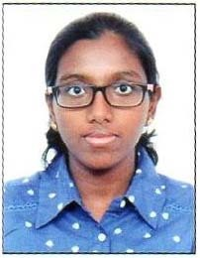
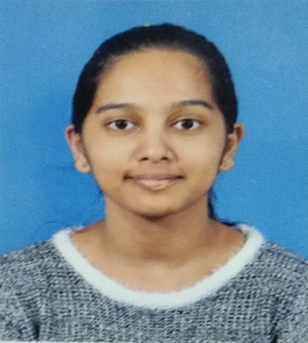
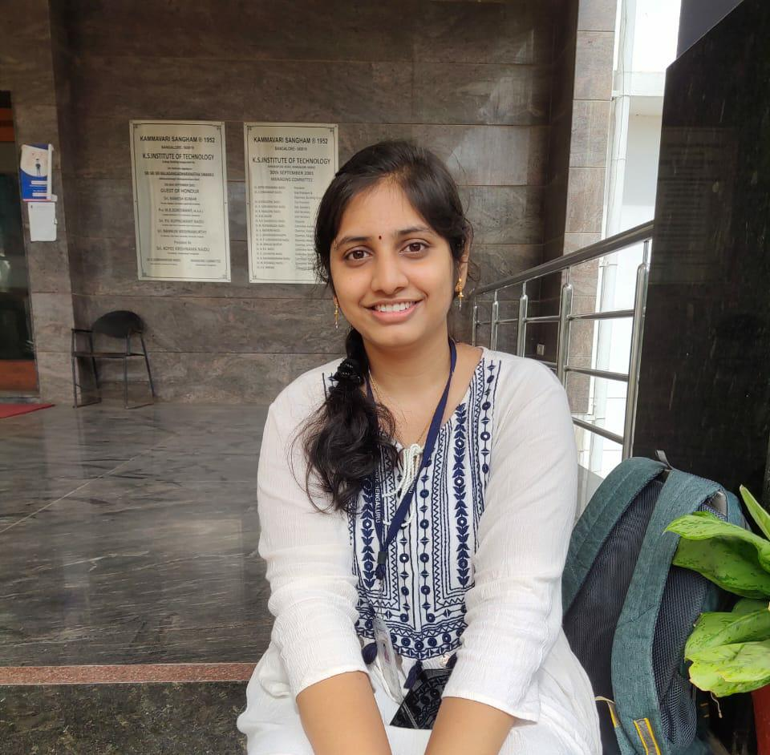
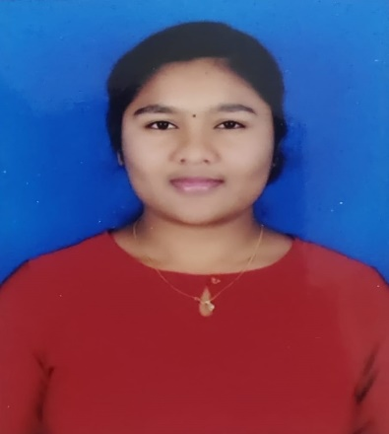
TEAM MEMBERS
CHAITANYA SHIVARAJU
MYTHREYI U
DEEPTHI N K
DEEPA G

Slide 3

Theme : Environmental challenge
TRACK : ENGINEERING TRACK

Slide 4
DESCRIPTION
To resolve this issue we are creating a user friendly website which is accessible to people around the world. Here we create an opportunity for people to join our committee which is formed to connect with various groups of people which engages the entire community in environmental and sustainable issues. This includes inviting the entire community to voice what they would like to see happen in the future. People around the world can post their issues in their respective areas related to environmental pollution. We also utilize the funds and the help offered by the committee members to reach the target in the specific domain. Student groups have an added advantage as they can join this committee which is beneficial for their future career as we provide certifications for completing any projects(day-to-day problems that are to be solved).The website also helps to increase the communities awareness by posting certain preventive measures to be taken care of .When an issue is identified funds can be raised to solve such issues by promoting the website through social media pages, through advertisements and donations can be made by the committee members on their willingness.

Slide 5


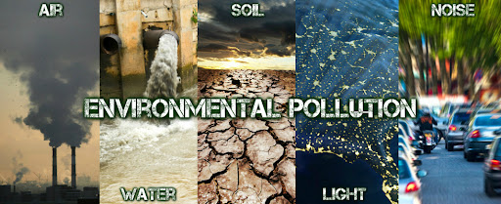

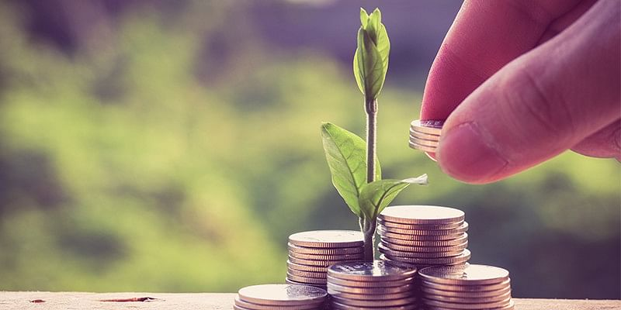


Slide 6
EXCLUSIVE FEATURES
Creating a bridge between people who need help and people who want to help.
A web page for accepting the issues request from the people.
Option for Joining the Committee.
Raising funds to resolve the issue requests.
Creating awareness through campaigns.
Certifications on completion of project (resolving an issue).

Slide 7
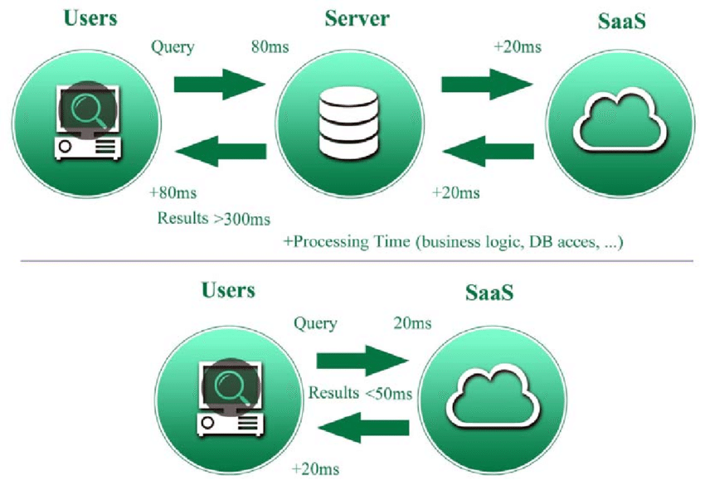
IMPLEMENTATION
Creating a website by using HTML ,CSS and java script at the front end so that users can directly interact with the website .For back end we use python and PHP.

Slide 8

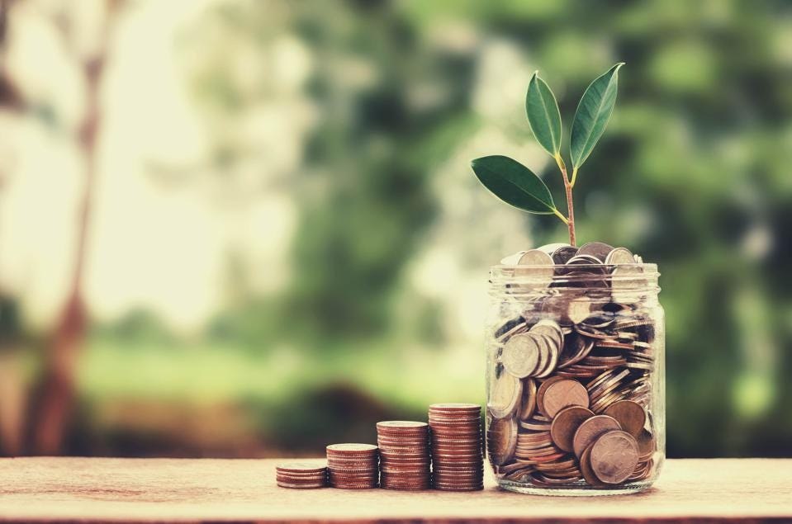


CONCLUSION

Slide 9


