Slide 1
To build a Content based Movie Recommendation system based on Movie tags
Naga Chaitanya S
Student Id: 1089173
Ms in Data Science
Liverpool John Moores University, UK
Thesis Presentation
2023

Slide 2
INTRODUCTION
Recommendation systems have become integral to our online experiences, guiding users in their interactions with a vast array of digital content, products, and services. These systems are particularly prominent in the domain of digital video libraries and Over-The-Top (OTT) platforms, such as Netflix, Amazon Prime Video, and Hulu. Traditional Movie recommendation systems have heavily relied on rich user profile data and item ratings to fine-tune their suggestions. By analysing user interactions and preferences, they provide users with personalized content recommendations that match their tastes . A significant challenge arises when new organizations venture into the highly competitive movie industry. These newcomers often find themselves without the wealth of historical user interactions and data that established companies possess. | This research aims to design and implement a robust content-based movie recommendation system tailored for newly established organizations, focusing on addressing the initial "cold start" problem through insights derived from Exploratory Data Analysis. Employing techniques like Chi-square and Pearson coefficient for feature selection and Investigating the impact of different feature combinations for creating tags along with features elected from above tests. on recommendation similarity . The seamless integration of the enhanced recommendation system into a website is envisioned to elevate the movie-watching experience for users, providing popular recommendations initially and progressively evolving to offer personalized suggestions based on user preferences,

Slide 3
Research Questions & Objectives
Research question
How does the selection and combination of different features from the dataset influence the accuracy of a content-based movie recommendation system?
How can the optimized system be effectively deployed on a website?
To what extent do features selected from Chi-square and Pearson correlation tests contribute to accurate movie recommendations when tags are created using those features?
How effectively do insights gained from Exploratory Data Analysis (EDA) aid in structuring and designing the homepage of an Over-The-Top (OTT) website?
AIM
The primary aim of this research is to develop a dynamic movie recommendation website that enhances user engagement by initially presenting popular movie recommendations and subsequently tailoring recommendations based on users' preferences. The system will utilize content-based filtering to achieve this
Objectives
Conduct exploratory data analysis (EDA) to gain insights into the structure, patterns, and potential issues within the movie dataset.
Develop a recommendation strategy to provide users with popular movie recommendations using Cosine Similarity, informed by EDA insights.
Explore feature engineering techniques, guided by EDA findings, to optimize the utilization of dataset features for improved recommendation accuracy.
Evaluate and compare the Similarity scores of various recommendation models by utilizing combinations of different tags within the pre-processed and explored dataset.
Validate the models using Cosine similarity or other appropriate techniques for feature selection based on the Similarity scores.
Optimize the selected recommendation model with weighted tags which also serves as a fine tined model.
Deploy the optimized recommendation model on the AWS platform, utilizing either the Django or Flask framework for seamless integration into the website.
Implement a user-friendly interface on the website that enables users to easily interact with the recommendation system using the insights from EDA.

Slide 4
Literature Review- Related works
Content Based Recommendation system
Content Based Recommendation system
(Havolli et al., 2022) used Netflix dataset and suggests Adamic-Adar measures are effective for recommending new item
(Kumaar et al., 2022) used utilized the IMDbPY Python library as dataset and compared recommendation based on just two features.
Hybrid Recommendation system
(Kannikaklang et al., 2022) used incorporated models such as User K-NN, Item K-NN, Matrix Factorization, and Biased Matrix Factorization, comparing their performance using metrics like RMSE and MAE. To develop a Hybrid Recommendation system
Collaborative Recommendation Systems
A study on Hyberid system (Bahl et al., 2020) primarily to improve accuracy achieved by matrix factorization technique.
(Rendle et al., 2020) revisit the comparison between Neural Collaborative Filtering (NCF) and traditional Matrix Factorization.
(Xue et al., 2019) took the root of ICF, by the interaction among all interacted item pairs by using nonlinear neural networks
Notes:
Havolli, A., Maraj, A. and Fetahu, L., (2022) Building a content-based recommendation engine model using Adamic Adar Measure; A Netflix case study. In: 2022 11th Mediterranean Conference on Embedded Computing (MECO). pp.1–8.
Kumaar, H., Srikumaran, S., Veni, S. and others, (2022) Content-based Movie Recommender System Using Keywords and Plot Overview. In: 2022 International Conference on Wireless Communications Signal Processing and Networking (WiSPNET). pp.49–53.
Koren, Y., Rendle, S. and Bell, R., (2021) Advances in collaborative filtering. Recommender systems handbook, pp.91–142.
Xue, F., He, X., Wang, X., Xu, J., Liu, K. and Hong, R., (2019) Deep item-based collaborative filtering for top-n recommendation. ACM Transactions on Information Systems (TOIS), 373, pp.1–25.
Bahl, D., Kain, V., Sharma, A. and Sharma, M., (2020) A novel hybrid approach towards movie recommender systems. Journal of Statistics and Management Systems, 236, pp.1049–1058.

Slide 5
Literature Review- Discussion
Relationships between movie features are less explored in various studies | None of the study have explored feature selection techniques such as Chi-Square or Improved Chi-Square | Adding weights to the Features will add novelty to this study while achieving CBRS

Slide 6
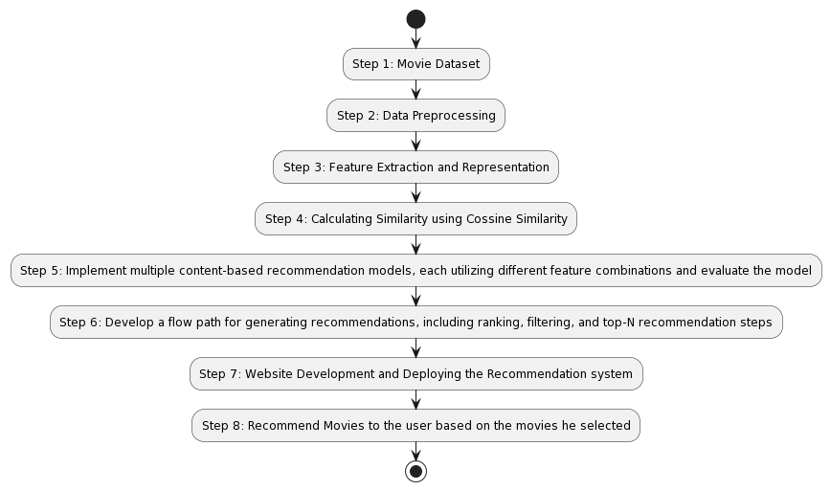
Methodology

Slide 7
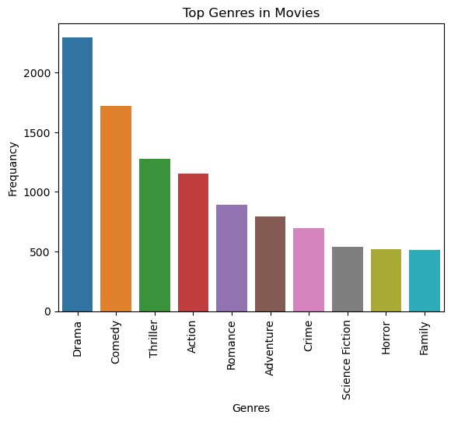
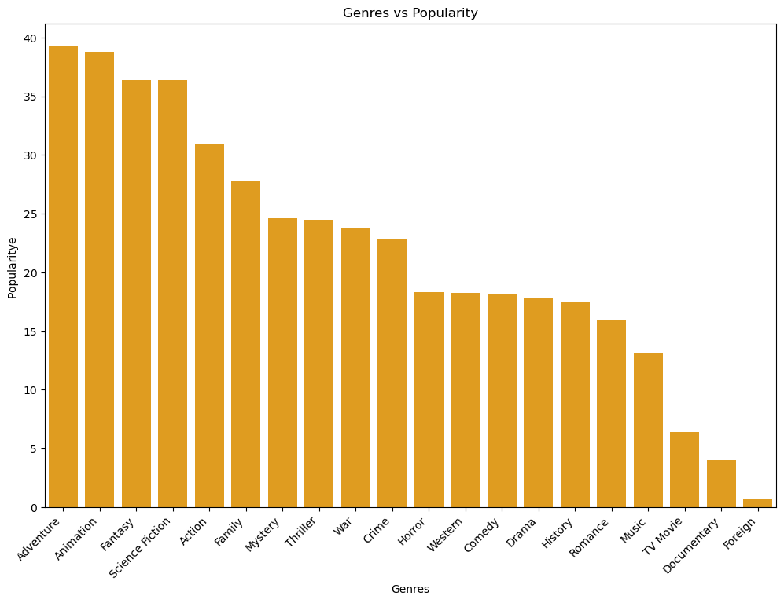
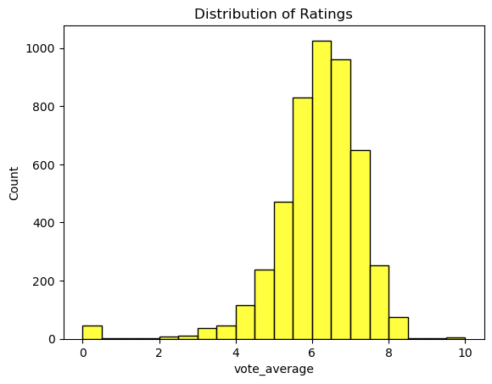
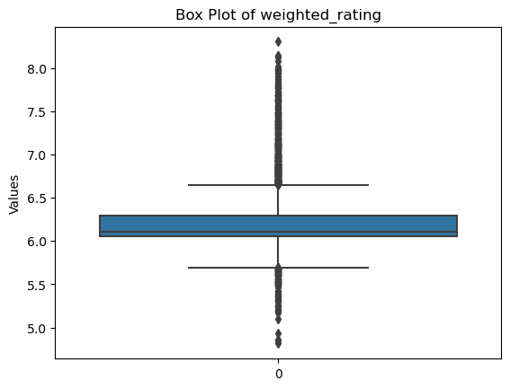
Implementation - Exploratory Data Analysis 1
Top four genres in the dataset with most number of movies, namely Drama, Comedy, Thriller, and Action
Genres
However, Adventure, Animation, Fantasy and science fiction have been identified as the most popular among users
Ratings provided in the dataset are prone to Outliers
Ratings vs Weighted Ratings
Weighted Rating is the new column created using True Bayesin Formula which is popularly being used in websites like IMDB

Slide 8
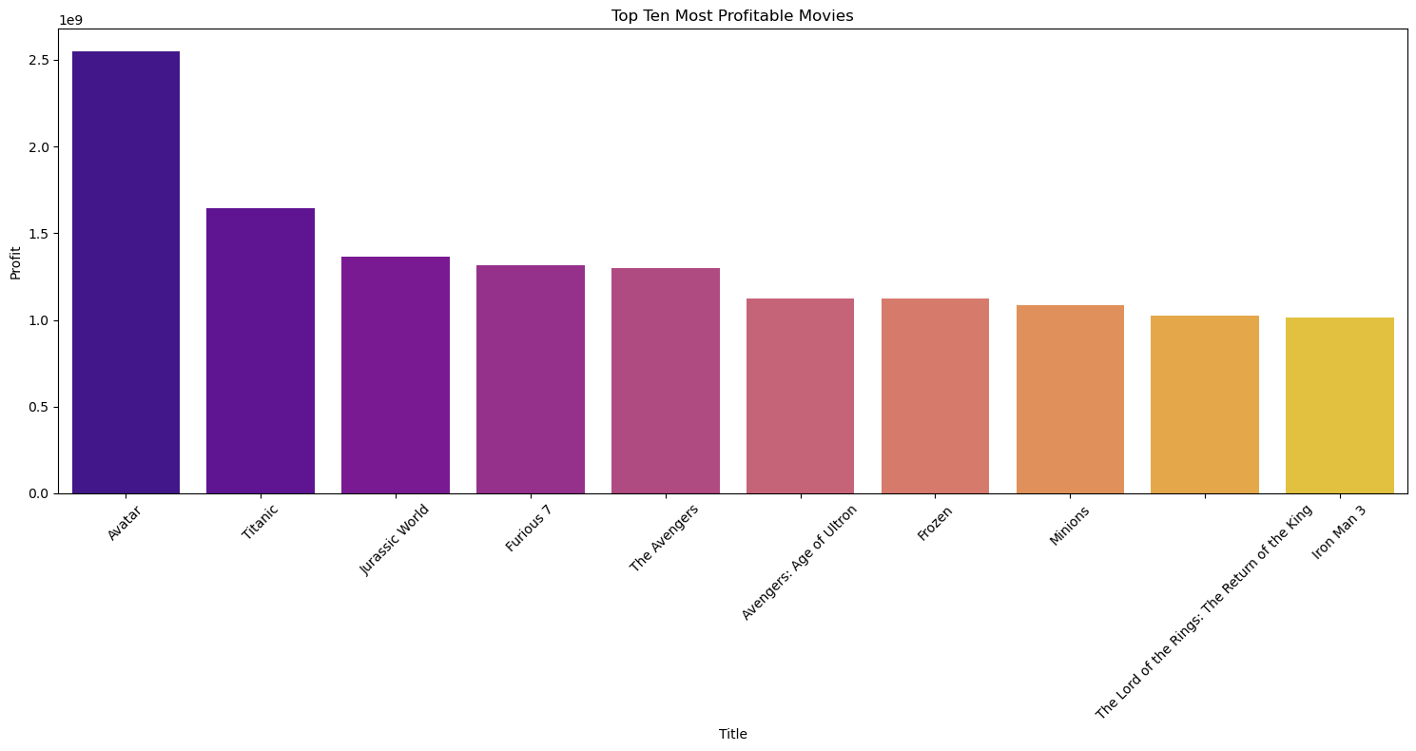
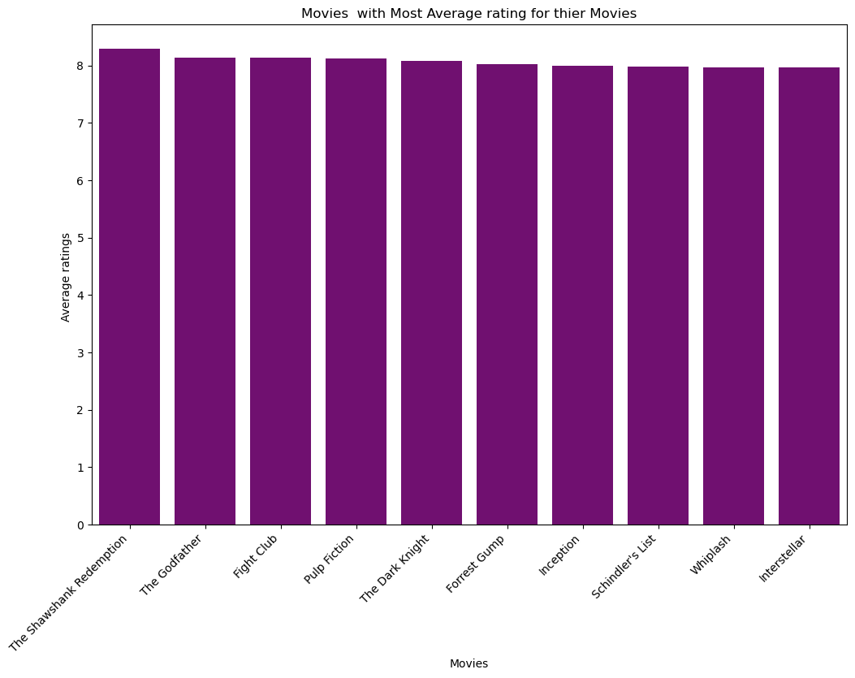
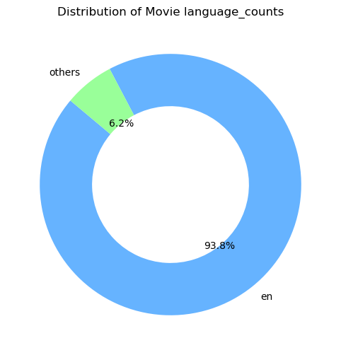
Implementation - Exploratory Data Analysis 2
Avatar, Titanic, Jurassic world and Furious are the movies with High revenue
Top rated movies in the dataset are ‘The Shawhank redemption’, The God Father, Fight Club and Pulp Fiction
Almost 94% of the movies present in the Dataset belongs to English

Slide 9
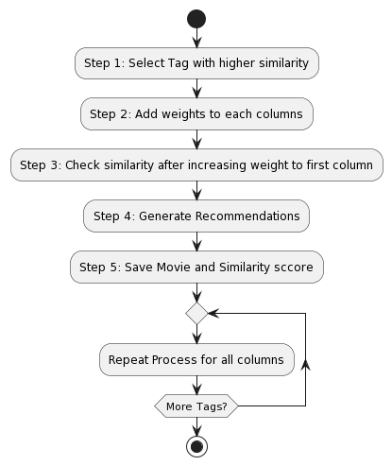
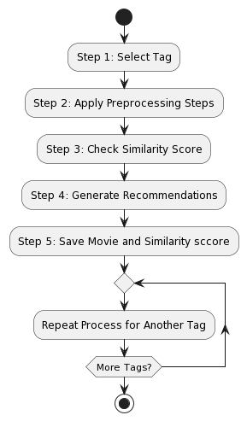
Implementation - Experiments
Fine tuning Recommendations by assigning weights to columns
Experiment 2
Pearson Correlation Coefficient Test on Numerical Columns
Experiment 1
Experiment 3:Feature Combinations
Chi-Square Test on Categorical Columns

Slide 10
Results
Test: Chi-square test.
Null Hypothesis H0: The ratings range is independent of Given Categorical Column.
Alternative Hypothesis H1: The ratings Range is associated with Given Categorical column.
α = 0.05
Test: Person correlation.
Null Hypothesis H0: The ratings range is independent of Given Categorical Column.
Alternative Hypothesis H1: The ratings Range is associated with Given Categorical column.
α = 0.05
Results from Chi-Square test
Results from Pearson Correlation Test
Variable | X2 | p_value
original language | 166.4046 | 0
new genres | 2886.774 | 0
production_countries | 1141.9735 | 0
production_companies | 7365.502 | 0.5519
Actor1 | 5433.799 | 0
Actor2 | 6280.1959 | 0
Actor3 | 6711.761 | 0
Director | 6286.137 | 0
spoken_languages | 1141.556 | 0.0338
Variable | r | p_value
popularity | 0.2756 | 0
vote_count | 0.3189 | 0
budget_in_mn | 0.0838 | 0
No_of_Genres | 0.0459 | 0.0015
No_of_keywords | 0.2819 | 0
overview_word_count | -0.0036 | 0.8032
revenue | 0.198 | 0
runtime | 0.3488 | 0

Slide 11
Tags
Weighted Tag
Tag1: Comprises all categorical features selected through the Chi-Square Test along with key features Movie overview and keywords.
Tag2: Solely relies on the Movie Overview and Keywords columns.
Tag3: adds another columns genre to Tag2
Tag 4: Incorporates a blend of essential features, including Cast, Movie Overview, Keywords, and Genres.
Tag 5: Is created only with feature keywords
Tag6: is created only with feature Overview
Tag7: includes all the numerical columns selected from Pearson Test added along with first tag. Numerical features are added after converting them to string type and separated by space at the end of first tag.
tag = weight[0]*df['overview']+ weight[1]*df['keywords'] + weight[2]*df['genres'] + weight[3]*df['production_companies'] + weight[4]*df['cast'] + weight[5]*df['Director'] +weight[6]*df['spoken_languages']

Slide 12
Results : Evaluating Recommendations- Avatar
selected from Chi-square and Pearson testFor the movie Avatar, best Similarity score is for the tag created with features
When weights added to each feature before generating recommendations, best similarity score is achieved when 10 weights are added to Director and Genre
TAG | Title | Score | TAG | Title | Score
1 | Falcon Rising | 0.234822 | 2 | Falcon Rising | 0.217152
 | Aliens | 0.229564 |  | Aliens | 0.214149
 | Aliens vs Predator: Requiem | 0.224796 |  | Battle: Los Angeles | 0.187805
 | Meet Dave | 0.204099 |  | Apollo 18 | 0.17316
 | Battle: Los Angeles | 0.198011 |  | Meet Dave | 0.162454
TAG | Title | Score | TAG | Title | Score
3 | Falcon Rising | 0.229226 | 4 | Falcon Rising | 0.231814
 | Aliens | 0.223156 |  | Aliens | 0.210539
 | Battle: Los Angeles | 0.197344 |  | Battle: Los Angeles | 0.200523
 | Apollo 18 | 0.177361 |  | Aliens vs Predator: Requiem | 0.193071
 | Meet Dave | 0.17534 |  | Apollo 18 | 0.180826
TAG | Title | Score | TAG | Title | Score
5 | Star Trek Into Darkness | 0.243402 | 6 | Apollo 18 | 0.250244
 | A Monster in Paris | 0.238914 |  | Tears of the Sun | 0.171047
 | The Blue Room | 0.196232 |  | The Adventures of Pluto Nash | 0.160715
 | Stranded | 0.167489 |  | Bucky Larson: Born to Be a Star | 0.136665
 | The Astronaut's Wife | 0.158843 |  | Life During Wartime | 0.134997
TAG | Title | Score
7 | Aliens | 0.253438
 | Falcon Rising | 0.219417
 | Aliens vs Predator: Requiem | 0.213516
 | Meet Dave | 0.190659
 | Battle: Los Angeles | 0.185273
Added 10 weights to Overview |  |  | Added 10 weights to Keywords
Title | Score |  | Title | Score
Apollo 18 | 0.221989 |  | A Monster in Paris | 0.24006
Tears of the Sun | 0.168576 |  | Star Trek Into Darkness | 0.226196
Dolphin Tale 2 | 0.149704 |  | The Blue Room | 0.210632
Life During Wartime | 0.146193 |  | Cargo | 0.191964
The Adventures of Pluto Nash | 0.139951 |  | Aliens | 0.172603
Added 10 weights to cast |  |  | Added 10 weights to Director
Title | Score |  | Title | Score
Backmask | 0.47467 |  | Aliens | 0.862454
Gods and Generals | 0.339771 |  | True Lies | 0.846721
Shadow Conspiracy | 0.27623 |  | The Abyss | 0.842505
Clash of the Titans | 0.273395 |  | Terminator 2: Judgment Day | 0.829105
Wrath of the Titans | 0.272414 |  | The Terminator | 0.815264
Added 10 weights to Genres |  |  | Added 10 weights to Production
Title | Score |  | Title | Score
Jupiter Ascending | 0.818902 |  | True Lies | 0.67103
Beastmaster 2: Through the Portal of Time | 0.787962 |  | Titanic | 0.588823
Small Soldiers | 0.775771 |  | The Abyss | 0.521708
Man of Steel | 0.77009 |  | Live Free or Die Hard | 0.46726
The Wolverine | 0.7634 |  | Fantastic 4: Rise of the Silver Surfer | 0.440731
Added 10 weights to languages
Title | Score
Morvern Callar | 0.700762
The Ten | 0.691219
Instructions Not Included | 0.691081
Mi America | 0.687505
Hands of Stone | 0.683496

Slide 13
Results: Evaluating Recommendations- Spider-Man 3
For the Movie Spider-Man 3, Tags1 and Tag 7 are better performed
And for weighted tags, Production companies, Director and genres are nest performed features
TAG | Title | Similiarity Score | TAG | Title | Similiarity Score
1 | Spider-Man | 0.553914 | 2 | Spider-Man | 0.474276
 | Spider-Man 2 | 0.49759 |  | Spider-Man 2 | 0.425032
 | Arachnophobia | 0.326598 |  | Arachnophobia | 0.357508
 | The Amazing Spider-Man 2 | 0.311498 |  | The Amazing Spider-Man | 0.297067
 | The Amazing Spider-Man | 0.291256 |  | The Amazing Spider-Man 2 | 0.294876
TAG | Title | Similiarity Score | TAG | Title | Similiarity Score
3 | Spider-Man | 0.480508 | 4 | Spider-Man | 0.512319
 | Spider-Man 2 | 0.434106 |  | Spider-Man 2 | 0.465573
 | Arachnophobia | 0.35376 |  | Arachnophobia | 0.338126
 | The Amazing Spider-Man | 0.30614 |  | The Amazing Spider-Man | 0.291952
 | The Amazing Spider-Man 2 | 0.305174 |  | The Amazing Spider-Man 2 | 0.287542
TAG | Title | Similiarity Score | TAG | Title | Similiarity Score
5 | Spider-Man 2 | 0.373638 | 6 | Spider-Man | 0.360956
 | Spider-Man | 0.290028 |  | Spider-Man 2 | 0.357898
 | The One | 0.288827 |  | The Amazing Spider-Man | 0.314955
 | Two Lovers | 0.269547 |  | Arachnophobia | 0.289726
 | You, Me and Dupree | 0.255087 |  | The Amazing Spider-Man 2 | 0.26169
TAG | Title | Similiarity Score
7 | Spider-Man | 0.541847
 | Spider-Man 2 | 0.494721
 | Arachnophobia | 0.326543
 | The Amazing Spider-Man 2 | 0.302411
 | The Amazing Spider-Man | 0.290747
Added 10 weights to Overview |  | Added 10 weights to Keywords
Title | Score | Title | Score
Spider-Man | 0.377689 | Spider-Man 2 | 0.436828
Spider-Man 2 | 0.36529 | Spider-Man | 0.317146
The Amazing Spider-Man | 0.322087 | Two Lovers | 0.279928
Arachnophobia | 0.294222 | The One | 0.277445
The Amazing Spider-Man 2 | 0.269742 | You, Me and Dupree | 0.260012
Added 10 weights to Cast |  | Added 10 weights to Director
Title | Score | Title | Score
Spider-Man | 0.739748 | Spider-Man | 0.89699
Spider-Man 2 | 0.719084 | Spider-Man 2 | 0.87373
Flyboys | 0.307386 | The Quick and the Dead | 0.807635
We Bought a Zoo | 0.304024 | The Evil Dead | 0.806518
Labor Day | 0.301475 | Oz: The Great and Powerful | 0.79484
Added 10 weights to Genres |  | Added 10 weights to Production
Title | Score | Title | Score
Spider-Man 2 | 0.782856 | Spider-Man 2 | 0.939975
Spider-Man | 0.716815 | Spider-Man | 0.691102
Krull | 0.706654 | The Amazing Spider-Man 2 | 0.638798
The Amazing Spider-Man 2 | 0.702198 | The Amazing Spider-Man | 0.570096
The Amazing Spider-Man | 0.666979 | The Butler | 0.430725
Added 10 weights to languages
Title | Score
Pink Narcissus | 0.607907
The House of Mirth | 0.599088
Nighthawks | 0.585881
Not Easily Broken | 0.577682
The Face of an Angel | 0.559921

Slide 14
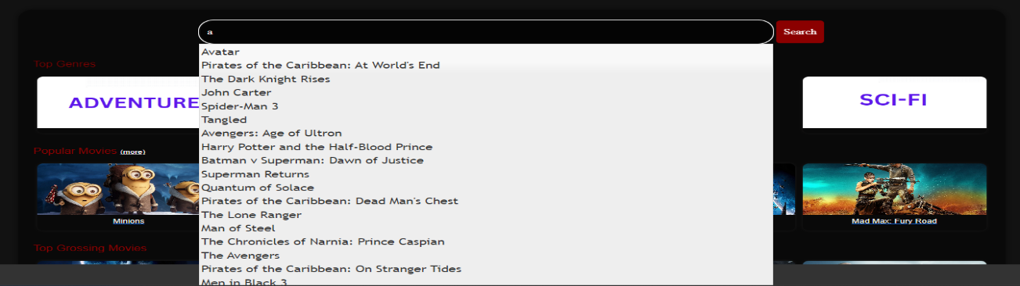
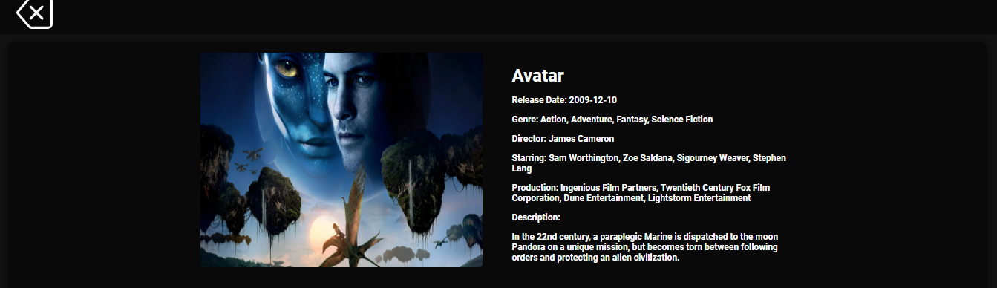
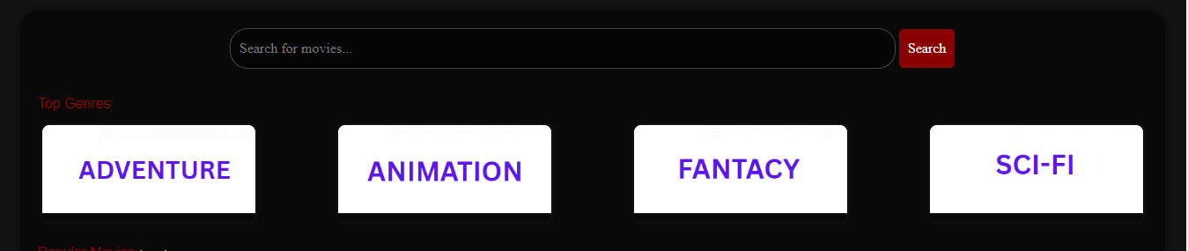
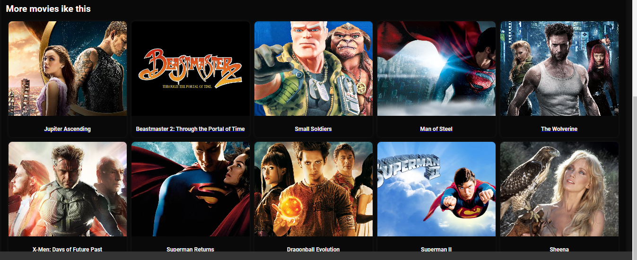
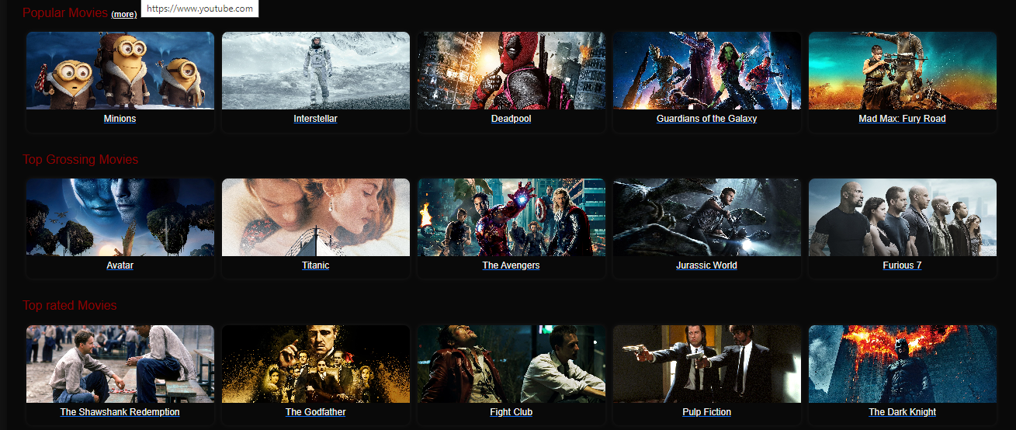
Results - Website Features and Recommendation Options

Slide 15
Conclusion
The utilization of Chi-square and Pearson-correlation tests for feature selection provided valuable insights into audience interests, particularly in relation to movie ratings. | Model incorporating tags derived from Chi-square and Pearson test have emerged as the most effective when overall similarity scores were compared with other feature combinations | Adding weights to the features before creating tags outperformed the performance by a margin | Exploratory data Analysis (EDA) played a pivotal role in system development, offering actionable insights that streamlined the design of the OTT platform's homepage, | The successful deployment of the recommendation system on AWS validated its real-world applicability, with observed recommendations aligning closely with those generated during testing on Jupyter notebooks.

Slide 16
Future Work
Future research could investigate the approach of fine-tuning the mechanisms for assigning weights to tags, exploring dynamic adjustments based on evolving user interactions and preferences | Considering the success of content-based approaches, future work could explore the integration of collaborative filtering techniques to develop a hybrid recommendation system | Conducting user-centric evaluation studies, such as surveys or user feedback sessions | As the recommendation system scales, exploring optimization strategies for enhanced scalability and improved computational efficiency will be crucial to maintain optimal performance | continuous model iteration and adaptation based on evolving user behaviours, preferences, and platform requirements

Slide 17
 | THANK YOU!

