Slide 1

Fitness Tracker
with AI Nutritionist
Presenter Names:
Chaitanya Srinivas Lavu(VU21CSEN0100408)
Amruth Dhulipalla(VU21CSEN0100452)
Srinidhi Lavu(VU21CSEN0100082)
P. Dheeraj Nandhan(VU21CSEN0100491)
Guide Name:
Mrs. Andavarapu Sravani
CSE, GST, Visakhapatnam

Slide 2

Contents
1. Abstract
2. Introduction
3. Literature Review
4. Requirement Analysis
5. Design Analysis
6. Methodology/ Tools/Methods to be used
7. Implementation
8. Screenshots of the project
9. Results & Discussions
10. Conclusion and Future Scope
References
CSE, GST, Visakhapatnam

Slide 3
1. ABSTRACT
Fitness Tracker with AI Nutritionist is an intelligent system that integrates calorie expenditure estimation with personalized dietary recommendations to enhance health and fitness management. It employs a Random Forest Regressor to predict calories burned based on gender, age, height, weight, exercise duration, heart rate, and body temperature. The estimated calories serve as a threshold for a linear programming-based optimization model, which recommends high-protein diets while maintaining calorie constraints. A user-friendly interface, developed with Gradio and Streamlit, allows users to input personal details and receive tailored advice instantly. Additionally, data visualization tools enable progress tracking, ensuring informed decision-making. By combining machine learning, mathematical optimization, and interactive design, this system provides a holistic AI-driven approach to fitness and nutrition management.
CSE, GST, Visakhapatnam

Slide 4
2. INTRODUCTION
In response to the growing emphasis on health and wellness, we present an AI-driven system that integrates fitness tracking with personalized dietary recommendations. Traditional methods of monitoring calorie expenditure and meal planning are often manual and lack optimization. Our solution leverages a Random Forest Regressor to estimate calories burned based on user-specific inputs and linear programming to generate meal plans that maximize protein intake while staying within calorie limits.
To enhance usability, the system features Gradio and Streamlit interfaces for seamless data input, real-time feedback, and interactive visualizations. By combining machine learning with optimization techniques, this solution empowers users with data-driven insights for better fitness and nutrition management.
CSE, GST, Visakhapatnam

Slide 5
3. LITERATURE REVIEW
Title : AI-Powered Nutrition Assistant and Step Tracker
Literature Review: Machine learning techniques, particularly neural networks and collaborative filtering, have shown great potential in generating personalized meal recommendations and dietary plans based on individual user preferences, health goals, and constraints. Researchers have explored various algorithms and data representations to enhance the accuracy and relevance of these recommendations. The integration of Internet of Things (IoT) technology has enabled the development of wearable devices and sensors for tracking physical activity levels, such as step counting and heart rate monitoring. Studies have demonstrated the effectiveness of these IoT-based solutions in promoting an active lifestyle and providing real- time fitness data.
Challenges: Data Privacy Concerns, Algorithm Bias, Connectivity Dependence, Integration Challenges, User Adoption and Compliance
Title : Building a Personalized Fitness Recommendation Application based on Sequential Information
Literature Review: In this paper, a recommendation system is proposed to help individuals choose suitable sports activities based on factors like heart rate, speed, and height. Using the FitRec dataset and the SPARK tool, the study groups individuals by their characteristics using the k-means method. This ensures tailored training recommendations for each group. The paper emphasizes the importance of proper sports practice for health and discusses big data analytics and related work. It concludes with implementation details and results, showcasing the system's ability to provide personalized training recommendations.
Challenges: Data Dependency, Complexity in Model Training, Scalability Issues, Bias in Recommendations, Requirement for Specific Equipment
CSE, GST, Visakhapatnam

Slide 6
3. LITERATURE REVIEW
3. Title: Machine Learning for Personalized Nutrition and Diet Recommendations
Literature Review: This study by Sarda, A., Almeida, M. explores the application of machine learning in personalized dietary recommendations based on individual user data. The research highlights the effectiveness of supervised learning techniques such as decision trees and neural networks in analyzing health conditions to generate tailored meal plans. The study also emphasizes the role of feature engineering in improving the accuracy of recommendation models by incorporating parameters such as calorie intake, macronutrient distribution, and dietary restrictions. The research concludes that machine learning-driven dietary recommendations can significantly improve adherence to nutrition plans and health outcomes.
Challenges: Data Dependency, Personalization Complexity, Model Interpretability, Need for Large-Scale Nutritional Data.
4. Title: AI Fitness Model using Deep Learning
Literature Review: In this paper, KH, Asha (2024) presents a deep learning-based AI fitness model that provides personalized fitness and health recommendations. The study investigates the use of convolutional neural networks (CNNs) in analyzing fitness data to optimize workout plans and dietary recommendations. By leveraging real-time inputs such as heart rate and metabolic rate, the model predicts optimal exercise intensity and meal intake. Furthermore, the paper explores the integration of wearable technology with deep learning models to enable continuous health monitoring. The study concludes that AI-powered fitness models improve engagement, adherence, and long-term health benefits by offering personalized, data-driven insights.
Challenges: Scalability Issues, Computational Complexity, Hardware Requirements, Model Overfitting, Bias in Training Data
CSE, GST, Visakhapatnam

Slide 7
4. REQUIREMENT ANALYSIS
Functional Requirements -
Data Handling: Import and merge exercise and nutritional data from CSV files. Process data by cleaning, filling missing values, and converting types.
Calorie Prediction and Exercise Analysis: Predict calories burned using a pre-trained Random Forest Regressor based on user inputs like gender, age, height, etc. (Implied) Analyze exercise form and track repetitions, leveraging pose estimation if applicable.
Dietary Optimization: Generate dietary plans optimized for calorie intake and nutritional balance using linear programming. Adjust dietary recommendations based on user's real-time data and goals.
User Interface: Provide interactive input and output handling through Gradio and Streamlit, allowing users to receive personalized fitness and dietary feedback.
Visualization and Monitoring: Visualize exercise and diet data to monitor progress and adjustments in dietary plans.
CSE, GST, Visakhapatnam

Slide 8
4. REQUIREMENT ANALYSIS
Non -Functional Requirements -
Performance: Ensure quick response times for data processing and user interactions.
Usability: Offer intuitive interfaces that non-technical users can easily navigate.
Scalability: Handle increasing volumes of data and user interactions efficiently.
Security: Securely manage sensitive user data, ensuring privacy and compliance with data protection laws.
Reliability: Provide a stable system with high availability, especially for web-based access.
Maintainability: Ensure the system is easy to update and maintain, with clear documentation and a modular design.
CSE, GST, Visakhapatnam

Slide 9
5. DESIGN ANALYSIS
Data Management -
Integration: Combines exercise and calorie data using pandas.
Preparation: Cleans and transforms data for analysis.
Machine Learning and Model Persistence
Model: Trains a Random Forest Regressor to predict calorie burn.
Validation: Evaluates model with accuracy metrics and saves it using joblib.
User Interaction
Gradio Interface: Provides real-time interactive predictions.
Streamlit Web App: Offers personalized diet plans and fitness tracking.
Optimization for Diet Planning
PuLP for Linear Programming: Maximizes protein within calorie constraints.
Diverse Recommendations: Iteratively generates multiple diet plans.
System Integration
Modular Design: Separates data management, predictive modeling, and user interfaces.
Python Ecosystem: Leverages robust libraries for comprehensive functionality.
CSE, GST, Visakhapatnam

Slide 10
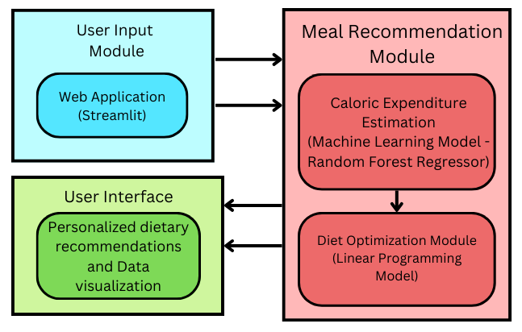
6. METHODOLOGY
Block Diagram Breakdown:
User Input Module
User enters details (age, gender, height, weight, exercise duration, heart rate, body temperature) through Gradio/Streamlit UI.
Caloric Expenditure Estimation
Machine Learning Model (Random Forest Regressor) predicts calories burned based on input parameters.
Diet Optimization Module
Linear Programming Model optimizes dietary recommendations by maximizing protein intake while staying within the estimated caloric burn.
User Interface
The system provides calorie estimation results and personalized dietary recommendations through an interactive UI.
Data visualization tools display progress over time.
CSE, GST, Visakhapatnam

Slide 11
7. IMPLEMENTATION
1. Data Collection & Preprocessing
User Inputs: The user provides key information such as height, weight, age, duration of workout, gender, and temperature to estimate calorie burn accurately.
Dataset Integration: The project uses a fitness activity dataset containing historical workout records and corresponding calorie expenditures.
2. Calorie Prediction Using Machine Learning
Model Selection: The project uses a Random Forest Regressor due to its robustness in handling complex, non-linear relationships between input parameters and calorie expenditure.
Training the Model: The dataset is split into training (80%) and testing (20%) subsets. The model is trained on features such as age, weight, height, gender, exercise duration, and temperature to predict calorie burn.
Performance Evaluation: The model's accuracy is assessed using R² score (coefficient of determination) and RMSE (Root Mean Square Error). Hyperparameter tuning (GridSearchCV) is performed to optimize results.
3. Meal Plan Optimization Using Linear Programming
Optimization Technique: PuLP (Linear Programming Solver) is used to find the best meal combination that meets calorie constraints while maximizing protein intake. The system iteratively generates multiple meal plans, allowing users to select their preferred option.
CSE, GST, Visakhapatnam

Slide 12
7. IMPLEMENTATION
4. Data Visualization & Weight Forecasting
Historical Trend Analysis: Users can visualize past fitness trends through graphs that track weight.
Weight Forecasting: Uses linear regression to predict future weight based on historical calorie intake and exercise levels. Users can adjust workout and diet parameters to see the projected impact on their weight over time.
Visualization Tools Used:
Matplotlib & Seaborn: Generate interactive charts and graphs for fitness progress tracking.
Streamlit Widgets: Allow users to adjust parameters dynamically and see real-time predictions.
5. Web Application Development & Deployment
User Interface (UI): The front end is built using Streamlit, allowing users to input fitness data, view calorie predictions, and receive meal plans in real time. Gradio provides an alternative interface for quick calorie burn estimation.
Deployment: The project is hosted on a localhost, but it can be hosted on a cloud platform making it accessible from any device with internet access. Continuous updates allow users to improve recommendations based on their progress and feedback.
CSE, GST, Visakhapatnam

Slide 13
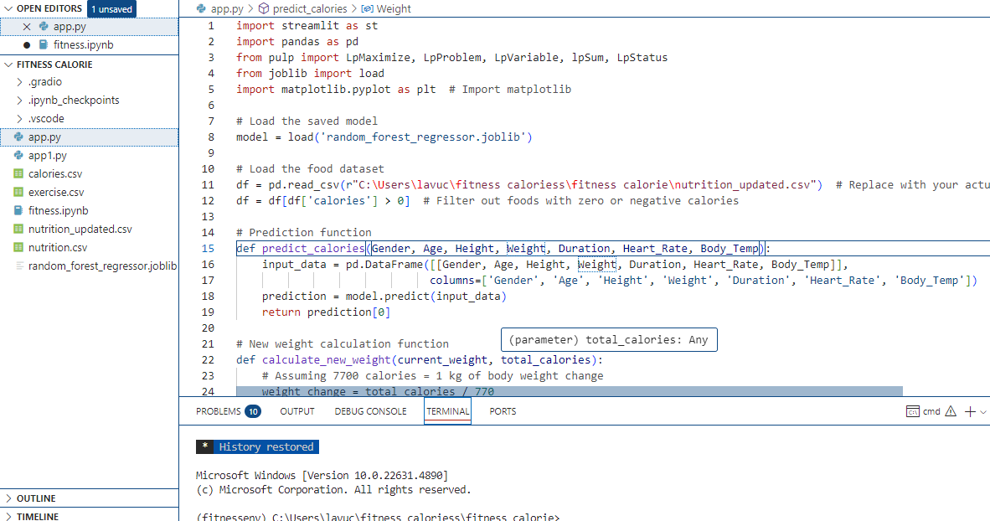
7. IMPLEMENTATION
CSE, GST, Visakhapatnam

Slide 14
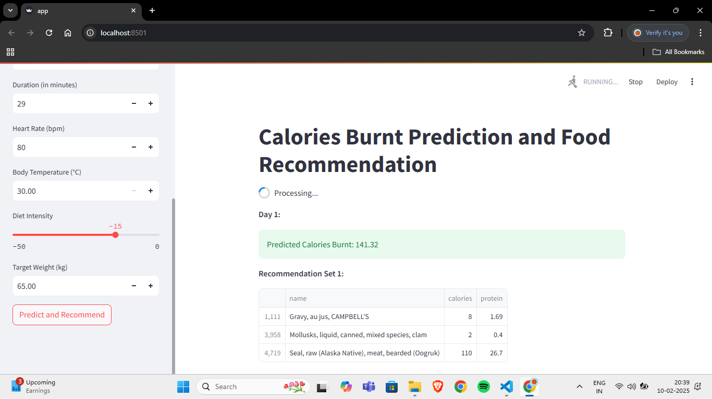
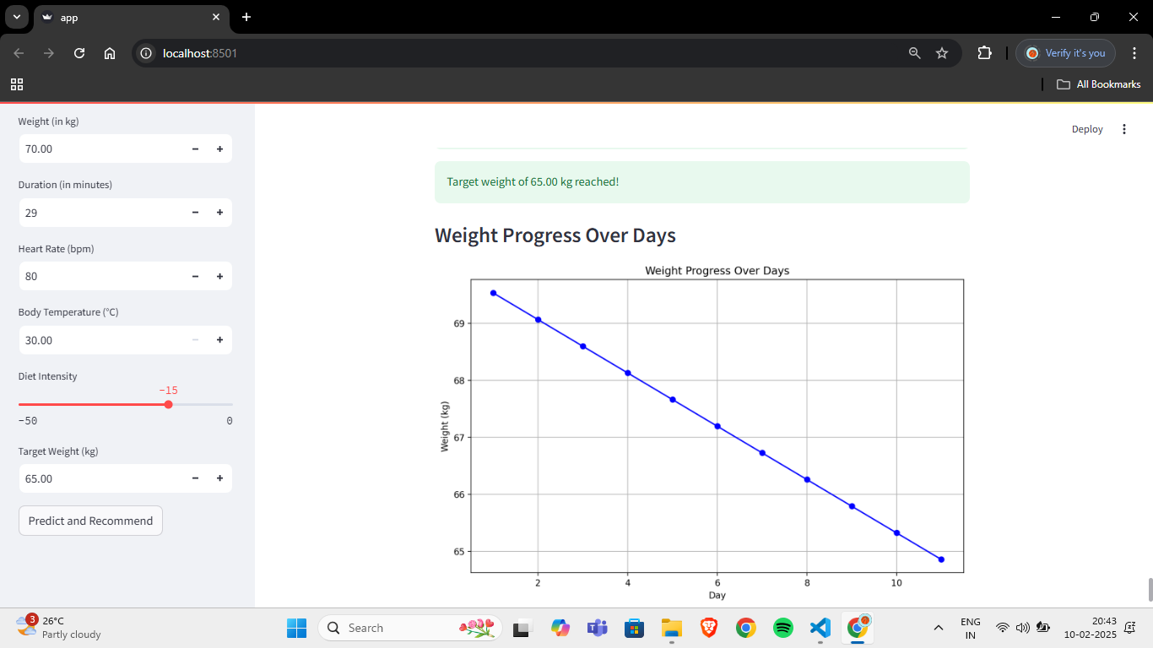
8. SCREENSHOTS OF PROJECT
CSE, GST, Visakhapatnam

Slide 15
9. RESULTS & DISCUSSION
1. Model Performance: The Random Forest model predicted calorie burn effectively, evidenced by robust accuracy metrics like R², MAE, and RMSE.
2. User Interaction: Interfaces built with Gradio and Streamlit facilitated real-time feedback and interactive tracking, enhancing user engagement and goal adherence.
3. Diet Optimization: Linear programming optimized meal plans focused on maximizing protein within calorie limits, offering diverse and balanced diet options.
4. System Integration and Scalability: Integration of various tools (pandas, PuLP) showcased the system’s robustness and potential for future enhancements, such as incorporating more detailed user preferences and real-time activity data.
5. Future Directions: Future improvements could focus on personalized adaptations based on ongoing user feedback and integration with wearable devices for enhanced accuracy in health metrics.
CSE, GST, Visakhapatnam

Slide 16
10. CONCLUSION & FUTURE SCOPE
CONCLUSION
The implemented diet recommendation system effectively combines machine learning with linear programming to predict calorie expenditure and optimize dietary intake, tailored to individual health and fitness goals. Utilizing a Random Forest model integrated with user-friendly interfaces such as Gradio and Streamlit, the system provides accurate predictions of calories burned based on various physical attributes and activity levels. It also offers optimized dietary suggestions that maximize nutritional intake without surpassing caloric needs, crucial for balanced diet maintenance. This interactive platform simplifies tracking fitness and dietary intake, enhancing user engagement through an accessible web interface. The system's design allows for scalability and future enhancements, such as integration with wearable technology and more detailed nutritional tracking, showing potential for personalized health management and improved public health outcomes.
FUTURE SCOPE
Integration with Wearable Devices: Enhancing data accuracy by syncing with wearable devices to monitor real-time activity and health stats.
Expanded Nutritional Database: Broadening the food database to include diverse dietary options, catering to various cultural and dietary preferences.
Advanced Machine Learning Models: Implementing more sophisticated algorithms to improve prediction accuracy for personalized recommendations.
User Engagement and Interaction: Introducing features like goal setting, progress tracking, and social sharing to boost user motivation and engagement.
Comprehensive Meal Planning: Developing tools for automated meal planning, including shopping lists and recipe suggestions tailored to user preferences.
Health Education Integration: Providing educational resources about nutrition and wellness to empower users with knowledge for better health decisions.
Predictive Health Analytics: Using data analytics to predict health risks and provide preventative recommendations.
Mobile App Development: Creating a mobile application for easier access and integration into users' daily routines.
Expansion to Healthcare Services: Adapting the system for use by healthcare providers to monitor and manage patient health more effectively.
CSE, GST, Visakhapatnam

Slide 17
REFERENCES
Dr. N K Sakthivel, Dr. S. Subasree, Mr. Surya Kannan Kumbhar, Mr. C. Jeffrey Hasan, Mr. G. Muruguraj, Mr. Shabin Sj, 2024, AI-Powered Nutrition Assistant and Step Tracker, INTERNATIONAL JOURNAL OF ENGINEERING RESEARCH & TECHNOLOGY (IJERT) Volume 13, Issue 04 (April 2024)
"AI-Powered Fitness App for Dynamic Workout Tracking and Personalized Exercise and Nutritional Plan Recommendations", International Journal of Emerging Technologies and Innovative Research (www.jetir.org), ISSN:2349-5162, Vol.11, Issue 5, page no.n464-n468, May-2024, Available :http://www.jetir.org/papers/JETIR2405D66.pdf
Machine Learning for Personalized Nutrition and Diet Recommendations, Sarda, A., Almeida, M., & Chen, J. (2019). Machine Learning Techniques for Personalized Nutrition Recommendation Systems. Journal of Nutritional Health. This paper discusses the role of machine learning in creating personalized dietary recommendations based on individual user data.
KH, Asha. (2024). Al Fitness Model using Deep Learning. International Journal of Advanced Research in Science Communication and Technology. 4. 459- 464. 10.48175/IJARSCT-15361.
Tsolakidis, D.; Gymnopoulos, L.P.; Dimitropoulos, K. Artificial Intelligence and Machine Learning Technologies for Personalized Nutrition: A Review. Informatics 2024, 11, 62. https://doi.org/10.3390/informatics11030062
CSE, GST, Visakhapatnam

Slide 18
Thank You
CSE, GST, Visakhapatnam

