Slide 1

Visualization and Analysis – Tutorial Presentation for Feedback

Slide 2
VISUALIZATION

Slide 3
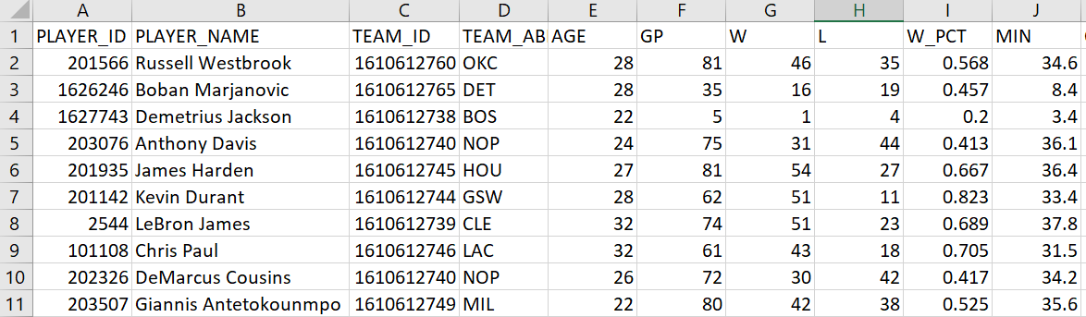
We are using the dataset DS028 and nba_2016_2017_100.csv to answer our Research Question “ Is there a correlation between Winning percentage and Age ? ”
“The dataset has 100 rows and the variables we are using are Winning percentage and Age”.

Slide 4
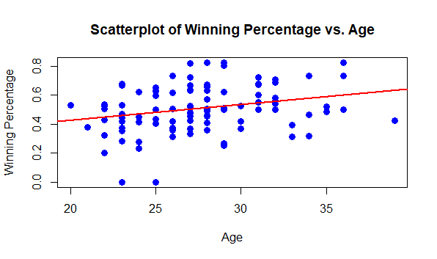
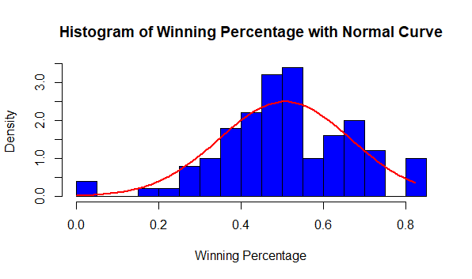
Correlation: we are including two visualizations

Slide 5
Analysis (building on our Visualizations)

Slide 6
Here is a Histogram showing the frequencies of our dependent variable to include the normal curve overlay.
Our RQ asks about Correlation
The normal curve overlay does not follow the shape of the underlying data, so for our analysis we use the non-parametric test for correlation that does not assume normality: Kendal’s Tau.
6
Notes:
6

Slide 7
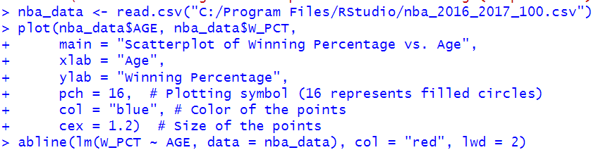
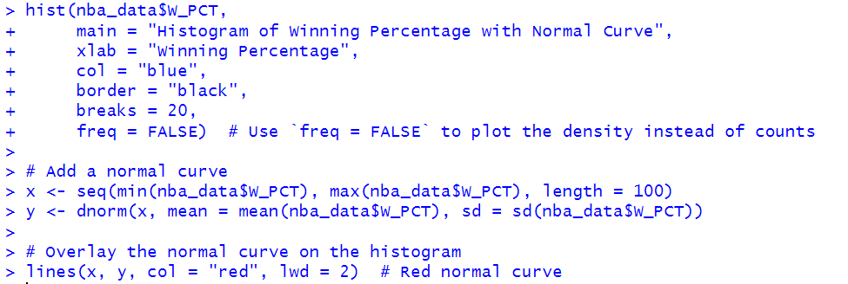
The Analysis
A snippet of the R code we used for scatterplot.
A snippet of the R code we used for histogram.
7
Notes:
7

Slide 8
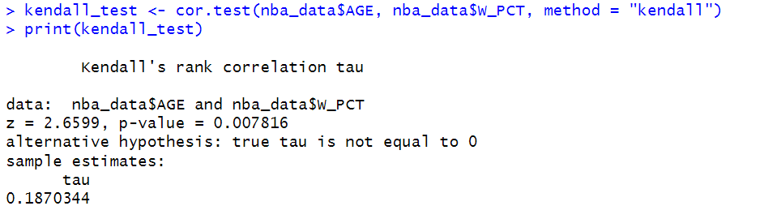
A snippet of the R code we used to calculate the test statistic.
The test statistic value is 2.6599
The P-value is < 0.05 and P-value is 0.007816.
The result is statistically significant as we got positive correlation 0.187.
We reject the null hypothesis as the P-value is less than 0.05.
In the larger picture, the marginally significant but substantial correlation between age and winning % indicates that player experience has a role, although a little one. More study involving other variables is required to completely understand what motivates team success. The discovery is a little component of bigger picture.

