Slide 1

Distributed Analytics in Fog Computing Platforms Using TensorFlow and Kubernetes
K Chaitanya VSH -120015054
Chaithanya B -120015017
P Sai Venkat Ramana -120015082
Guide:
Dr. V. Venkatesh.

Slide 2
Abstract
Very large amount of data is being generated with IoT based smart environments. The process of transferring this data to data centres requires high network support and infrastructure support.
Edge platform provides the network protocol infrastructure and the same environment on the edge as cloud.

Slide 3
Objective
To create an edge platform to pre process the data by distributed analytics platform.
Reduce security issues in transmission to the cloud.

Slide 4
Literature Survey
S.No | Title of the paper | Year | Critique
1 | Distributed Analytics in Fog Computing Platforms Using TensorFlow and Kubernetes | 2017 | Nowadays, large amount of data is usually analyzed by Machine Learning (ML) approaches, especially using Deep Learning (DL). However, DL is too complicated for a single IoT device. Hence, a platform supporting distributed analytics is required to solve the aforementioned issues

Slide 5
Design Configurations of existing systems
To create an edge platform the existing system making use of the kubernetes with 8 node configuration(K8s) along with Tensorflow for distributed platform
Using docker to build images and pull to remote registry(docker hub)

Slide 6
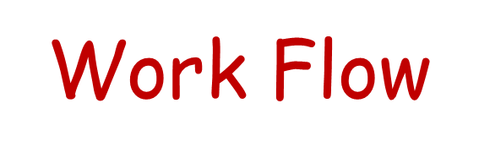
Create an edge platform using the containerisation tools
Deploy the application in the cluster
Pre process the data as per the requirements
Observe the processing speed, latency, Memory utilisations of the cluster
Comment on the results after using the cluster

Slide 7
Algorithm
To create an edge platform we made use of 3 techniques.
Tensorflow
Docker
Kubernetes
Tensorflow is used for numerical computations.
The architecture depicts the structure of a graph.

Slide 8
Algorithm
Each edge/fog device is a node , the data from the sensors to the devices are the edges.
Docker is used for creating containerised applications.
Kubernetes is for deployment and managing the docker containers.

Slide 9
Algorithm
We made use of YOLO application, this makes use of OPENCV library in python.
The fog devices are equipped with the camera sensors.
The data captured from these sensors is then sent to the kubernetes cluster , which gives the input for the YOLO and finds the category of the detected object.

Slide 10
Hardware and Software requirements
H/w.
Raspberry pi 3 b+ (2)
USB hub for power supply
Continues network connectivity in a closed LAN.
S/w.
Kubernetes
Docker
Tensorflow

Slide 11
Implementation steps
The entire implementation was divided into 3 steps
1. Creating the cluster using containerisation tools
2. Implementing the YOLO application to the cluster
3. Deploying the YOLO application on to the cluster

Slide 12
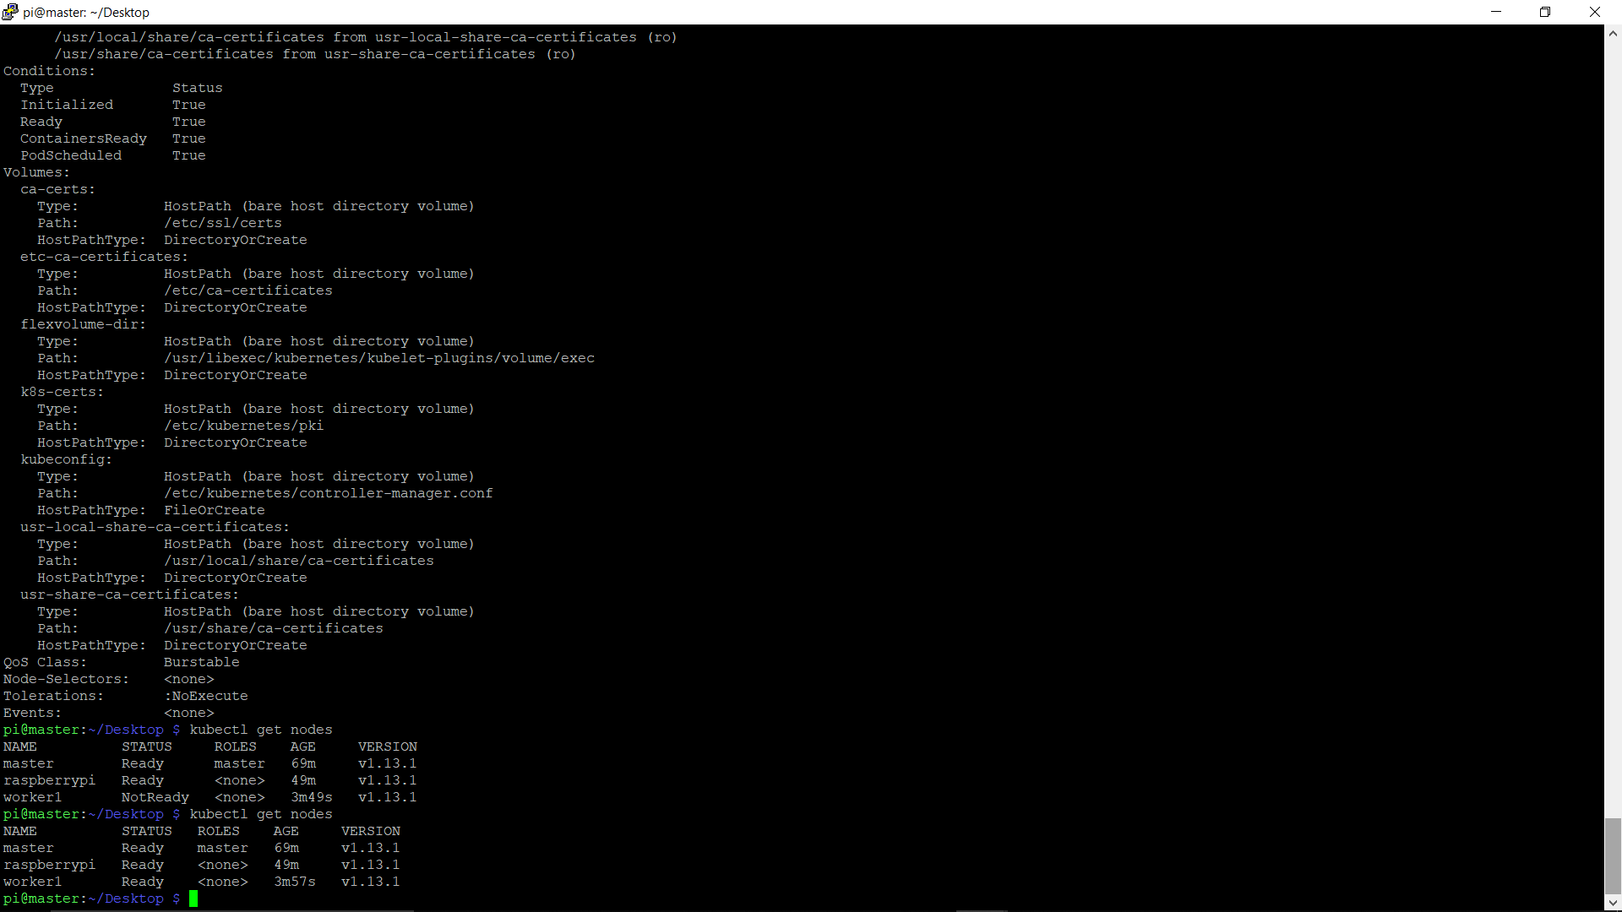
Implementation Results-1
The cluster is created using the kubernetes and docker

Slide 13
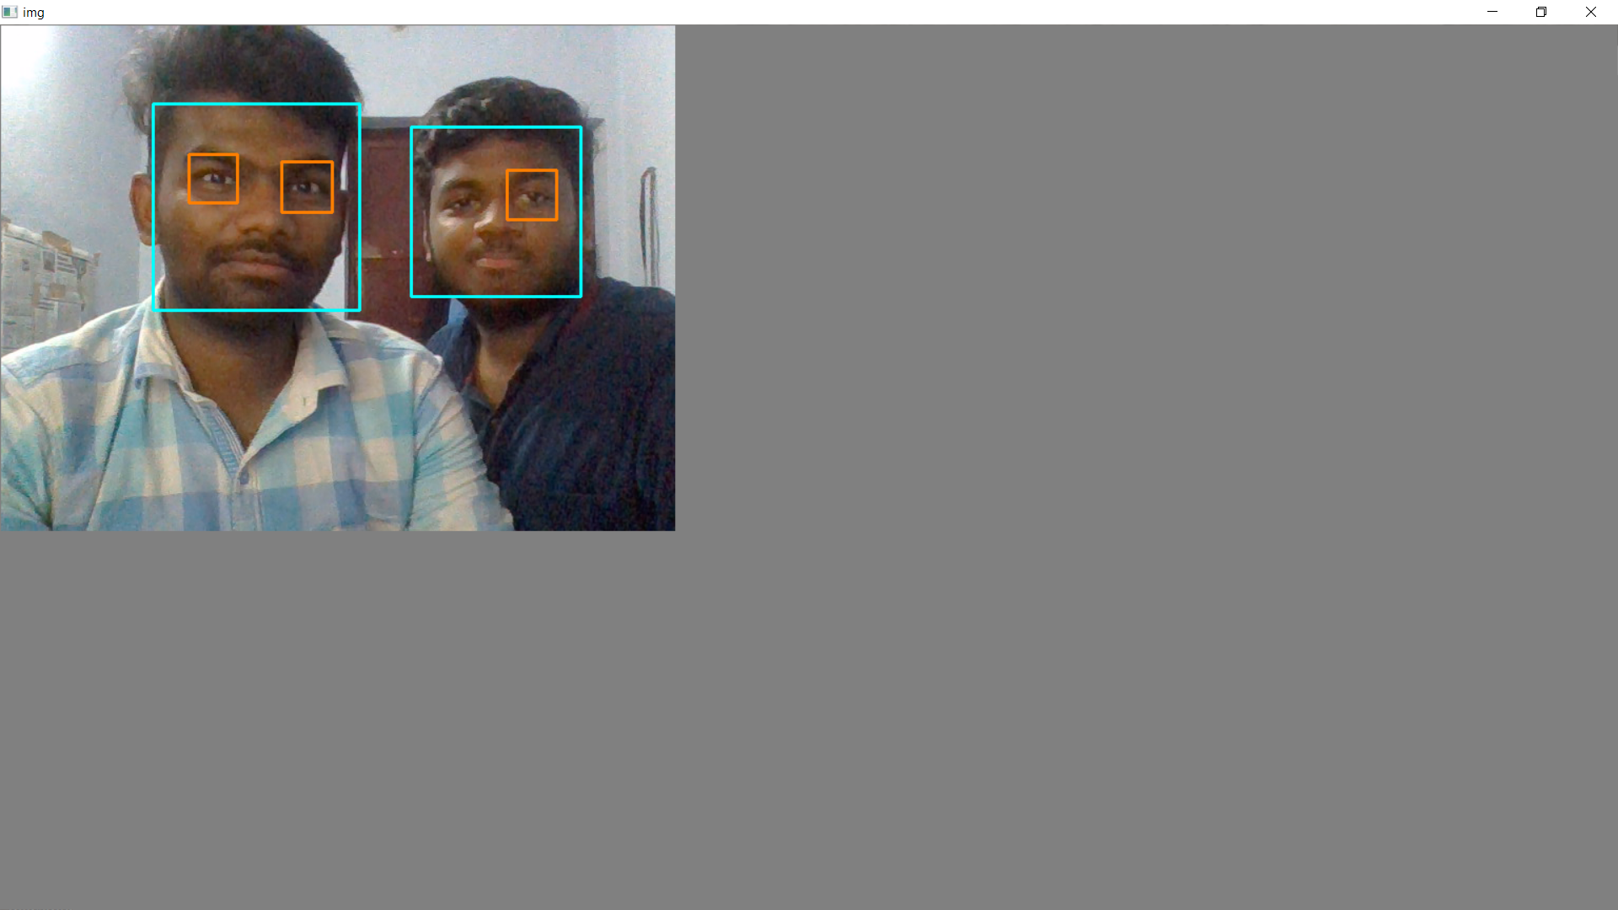
Implementation Results-2
The cluster is created using the kubernetes and docker

Slide 14
Open FaaS
This is the tunnel application deployed to the cluster
Each operator in a tensorflow acts as an operator
Each function can be accessed through the URL of the master node

Slide 15
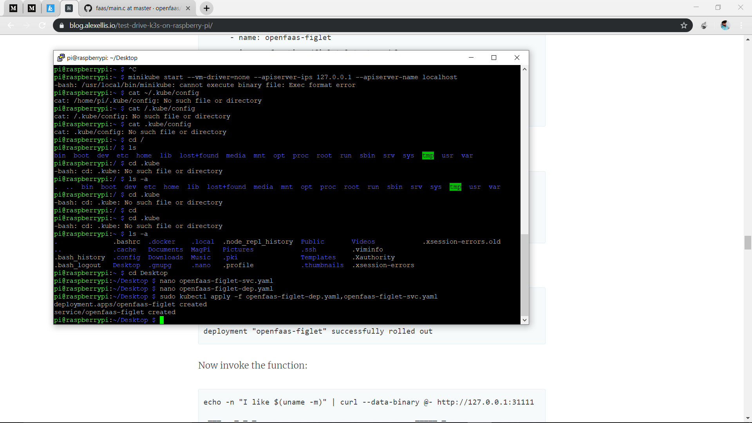
Open FaaS

Slide 16
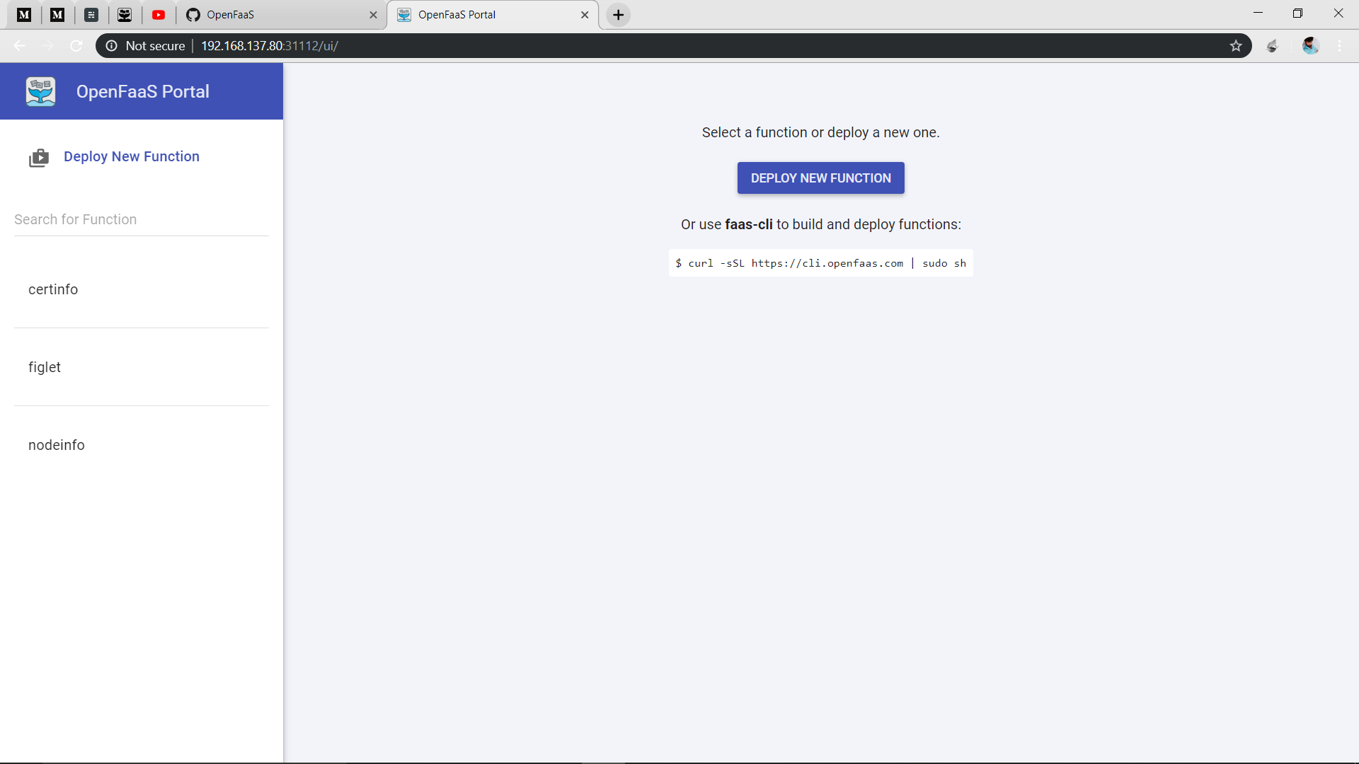
Open FaaS

Slide 17
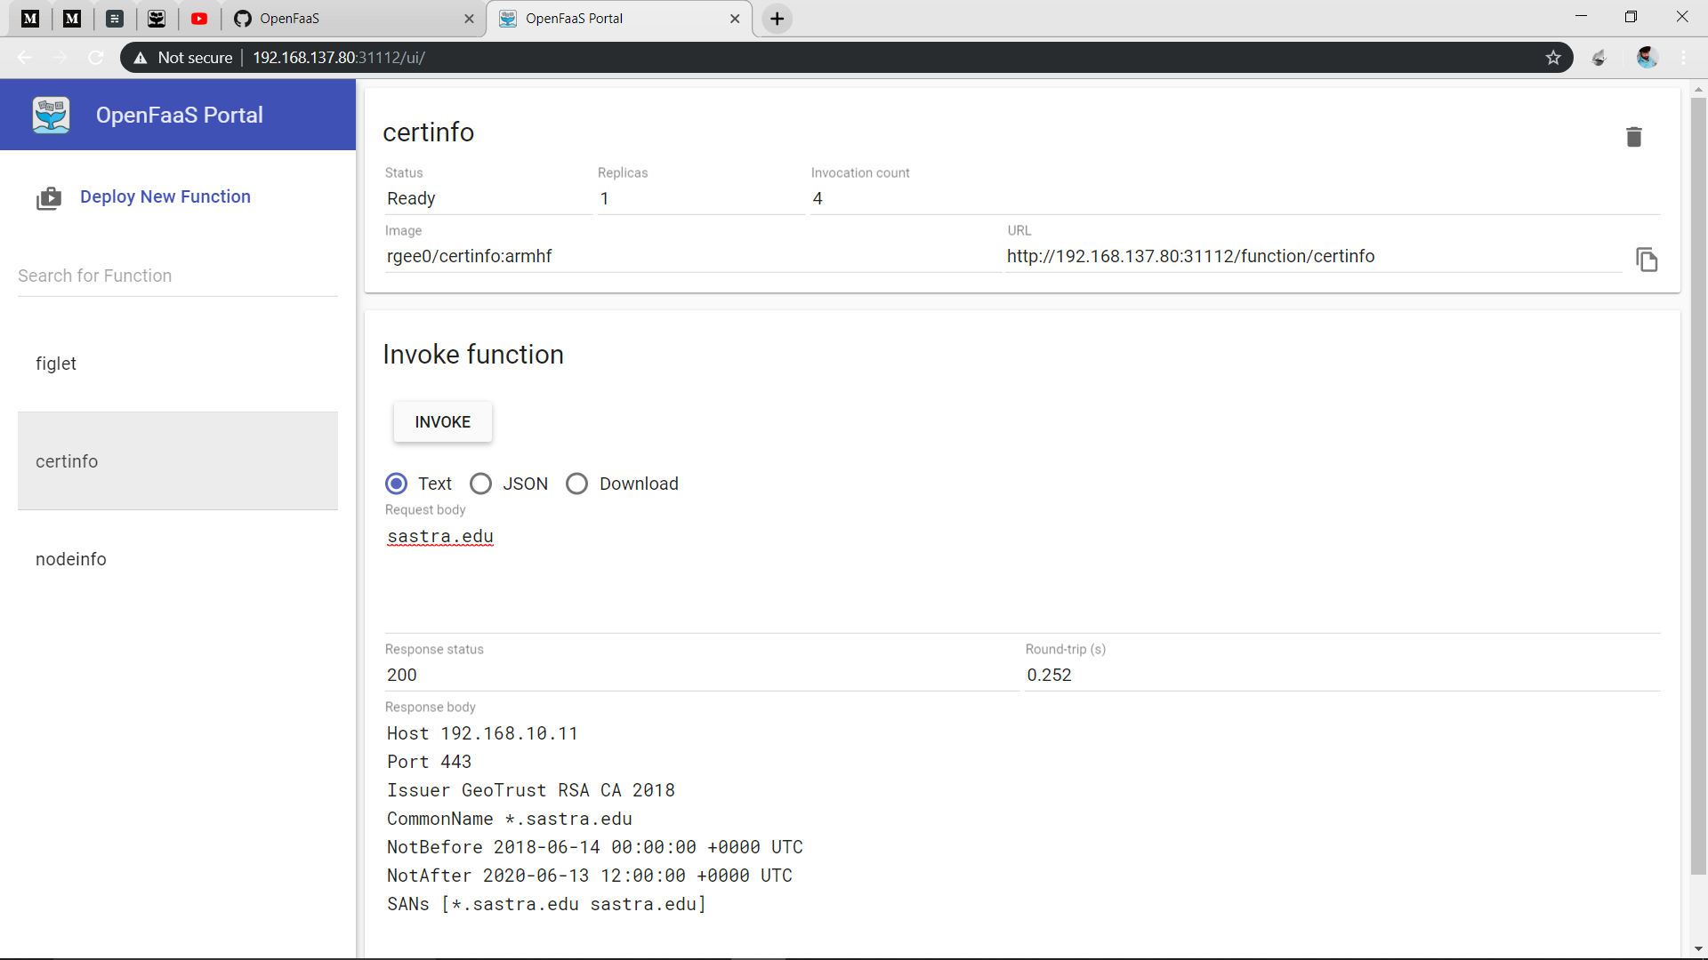
Open FaaS

Slide 18
References
Distributed Analytics in Fog Computing Platforms Using TensorFlow and Kubernetes – 2017 IEEE

