Slide 1
TARA
A place where talent meets the opportunity
Project Team – 18
Sai Chaitanya Dasari
Purvi Misal
Shivani Jain
Akshay Elavia
https://github.com/SJSUFall2019-CMPE272/Tara-A-place-where-talent-meets-opportunity

Slide 2
ACKNOWLEDGMENT
Concept and Advisory
Siva Sreeraman
We followed agile methodology by having weekly scrum with Siva and
it helped us in meeting the check points and deliver things at right time.

Slide 3
Cinema is one of the booming industry in terms of the number of films produced and the number of tickets sold,
with 3.5 billion tickets sold worldwide annually. Lot of revenue as well as opportunities are involved.
Problem
Having said that, If you are the person who has this
passion for pursuing your career in Cinema. Either it may be on-screen like a Lead actor, actress, junior artist or off-screen Direction of Photography, Director, Playback Singer, Dance Choreographer, etc..

Slide 4
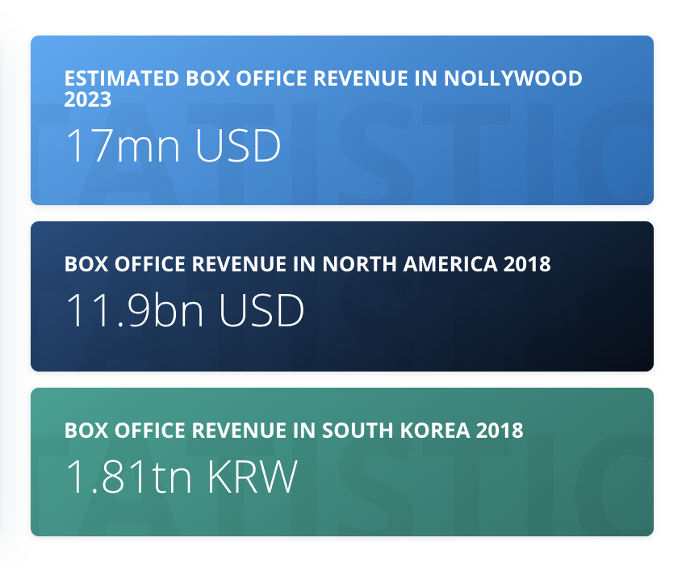
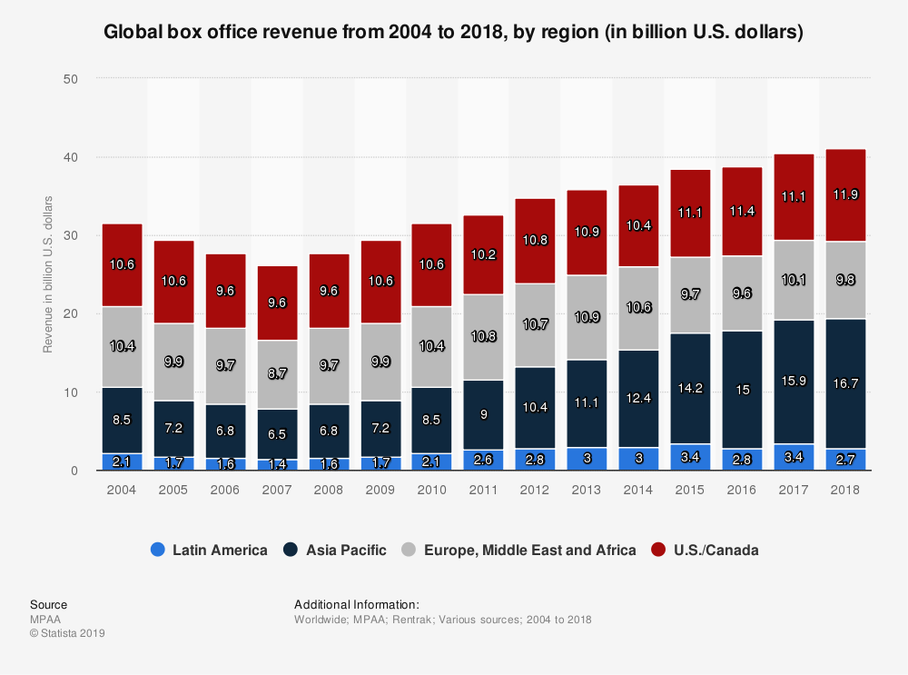
MARKET ANALYSIS
REVENUE STATISTICS

Slide 5
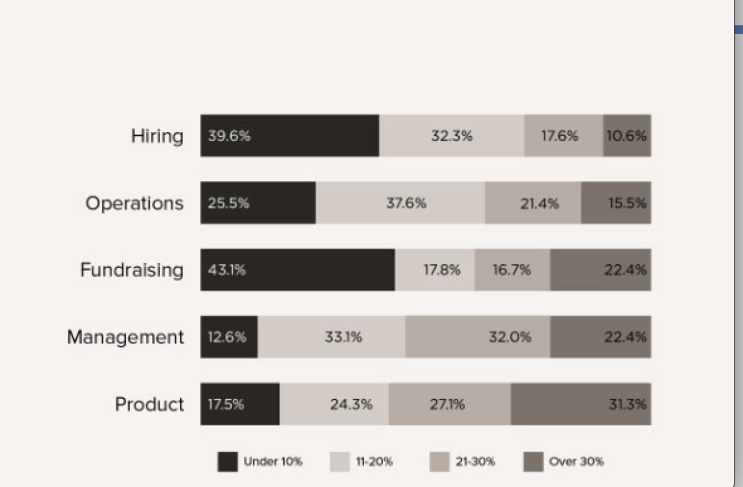
TIME ALLOCATED BY PRODUCTION HOUSE FOR A PROJECT IN %
HOW MUCH IS THE COST FACTOR
FOR JOB SEARCH CURRENTLY FOR
A PRODUCTION HOUSE ?
Money:
Nearly on an average each
Production Company is spending
25M USD annually.
Time :
They are using 35 working days
to get right talent for casting in their project.

Slide 6

HOW MUCH IS THE COST FACTOR
FOR SEARCH CURRENTLY FOR
A TALENT?
Money:
Nearly they are investing
1600 USD annually for applications,
travel, food, album making etc..
Time :
They are sending average of 60 days to get right job for casting in any project. Few are not still left without job.

Slide 7
Tara is a real-time entertainment-industry brand aimed at connecting local performing talent, with a special focus on casting, job opportunities, and much more.
Solution
TARA is here .. Come build your dream future with us.

Slide 8
Hill Statement
Tara: Bringing together Talent and Opportunity in the Performing Arts
industries through a common platform in real time.
Persona/Target Users:
Talent(Mukesh):
Performing artist and backstage professional looking for work in film,
television, theater, commercials, voiceover, radio, gaming and other mediums
who seek opportunity to find their next role and manage their careers.
Opportunity(Purvi Productions):
Casting directors and recruiters looking to hire the perfect artistic talent
and professional backstage crew for their projects.

Slide 9
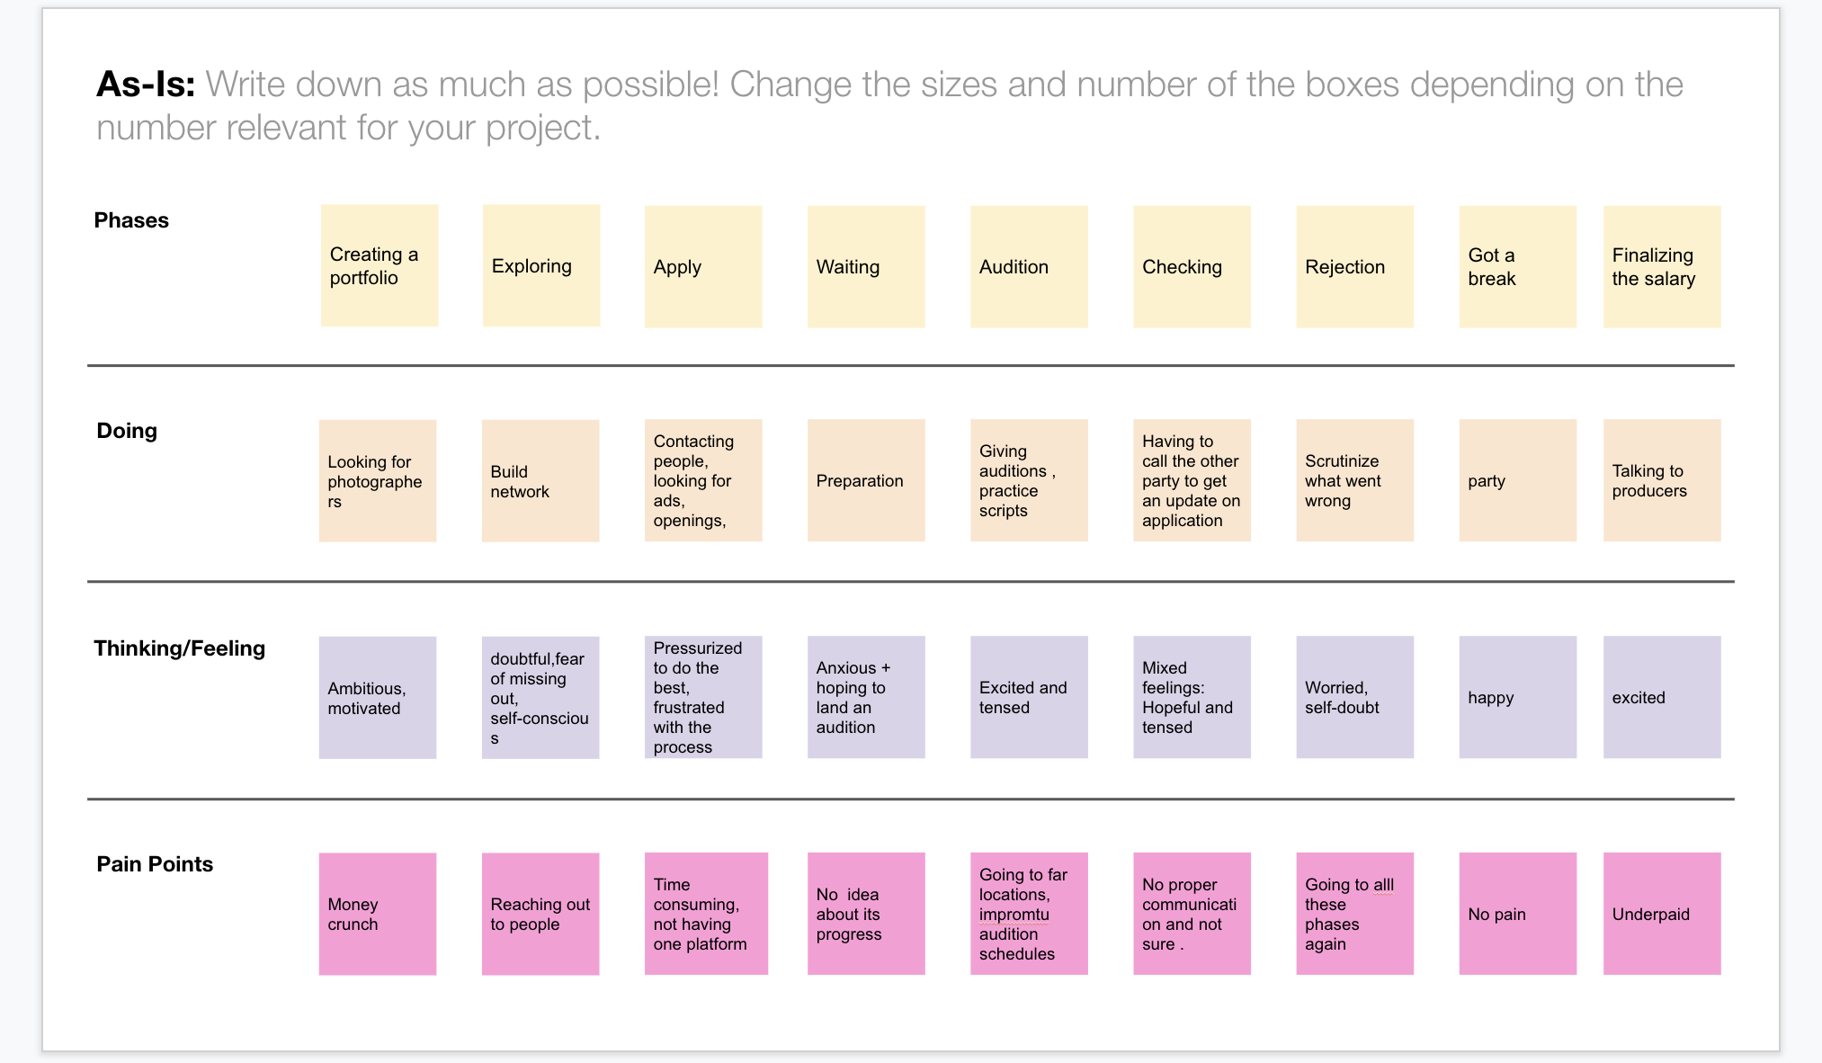
DESIGN THINKING
As-Is

Slide 10
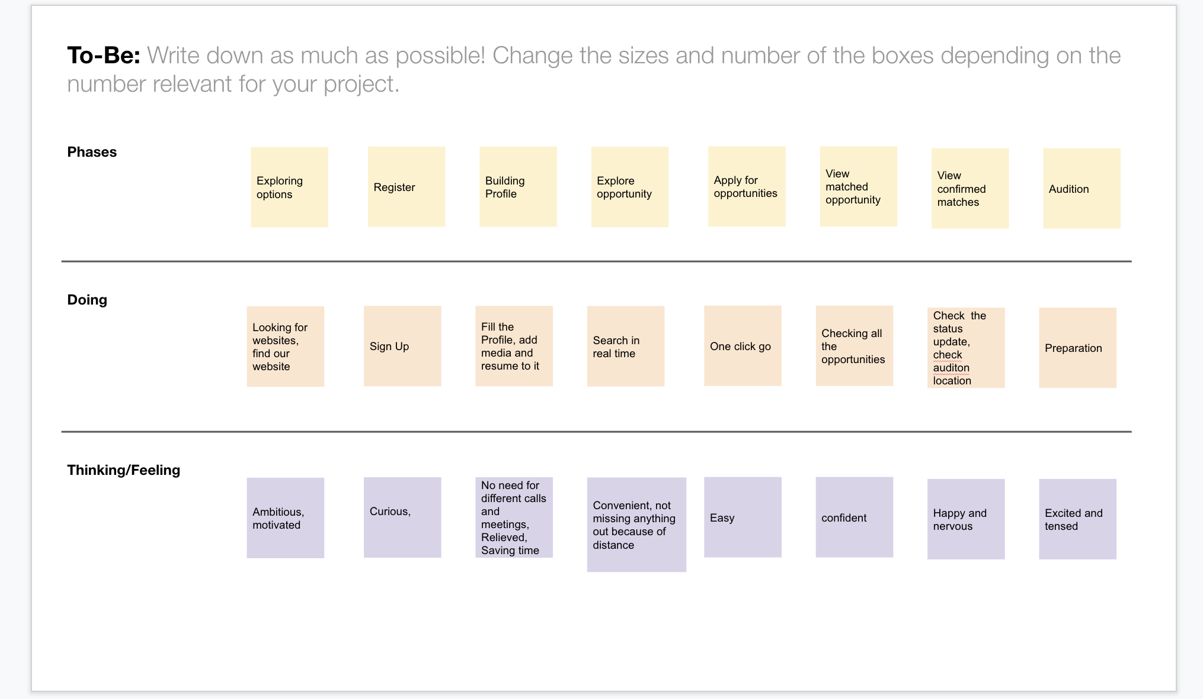
Design Thinking
To-Be

Slide 11
HOW MUCH ARE WE SAVING ?
TALENT
RECRUITER
TIME :
TIME:
We are saving their 60 days in getting right job
for casting in any project.
Also helping out those who are not having job with right talent
by connecting them.
They are using 20 working days
to get right job for casting in any project.
MONEY:
MONEY
Nearly they will save
3200 USD annually using this application
Nearly on an average each
Production Company is spending
25M USD annually on hiring right talent.

Slide 12
How TARA works

Slide 13
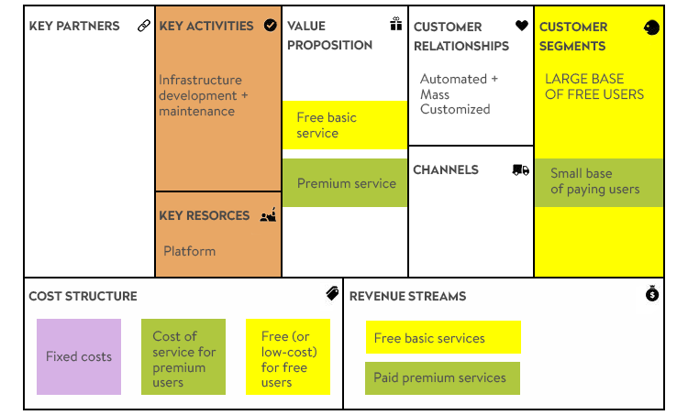
BUSINESS MODEL

Slide 14
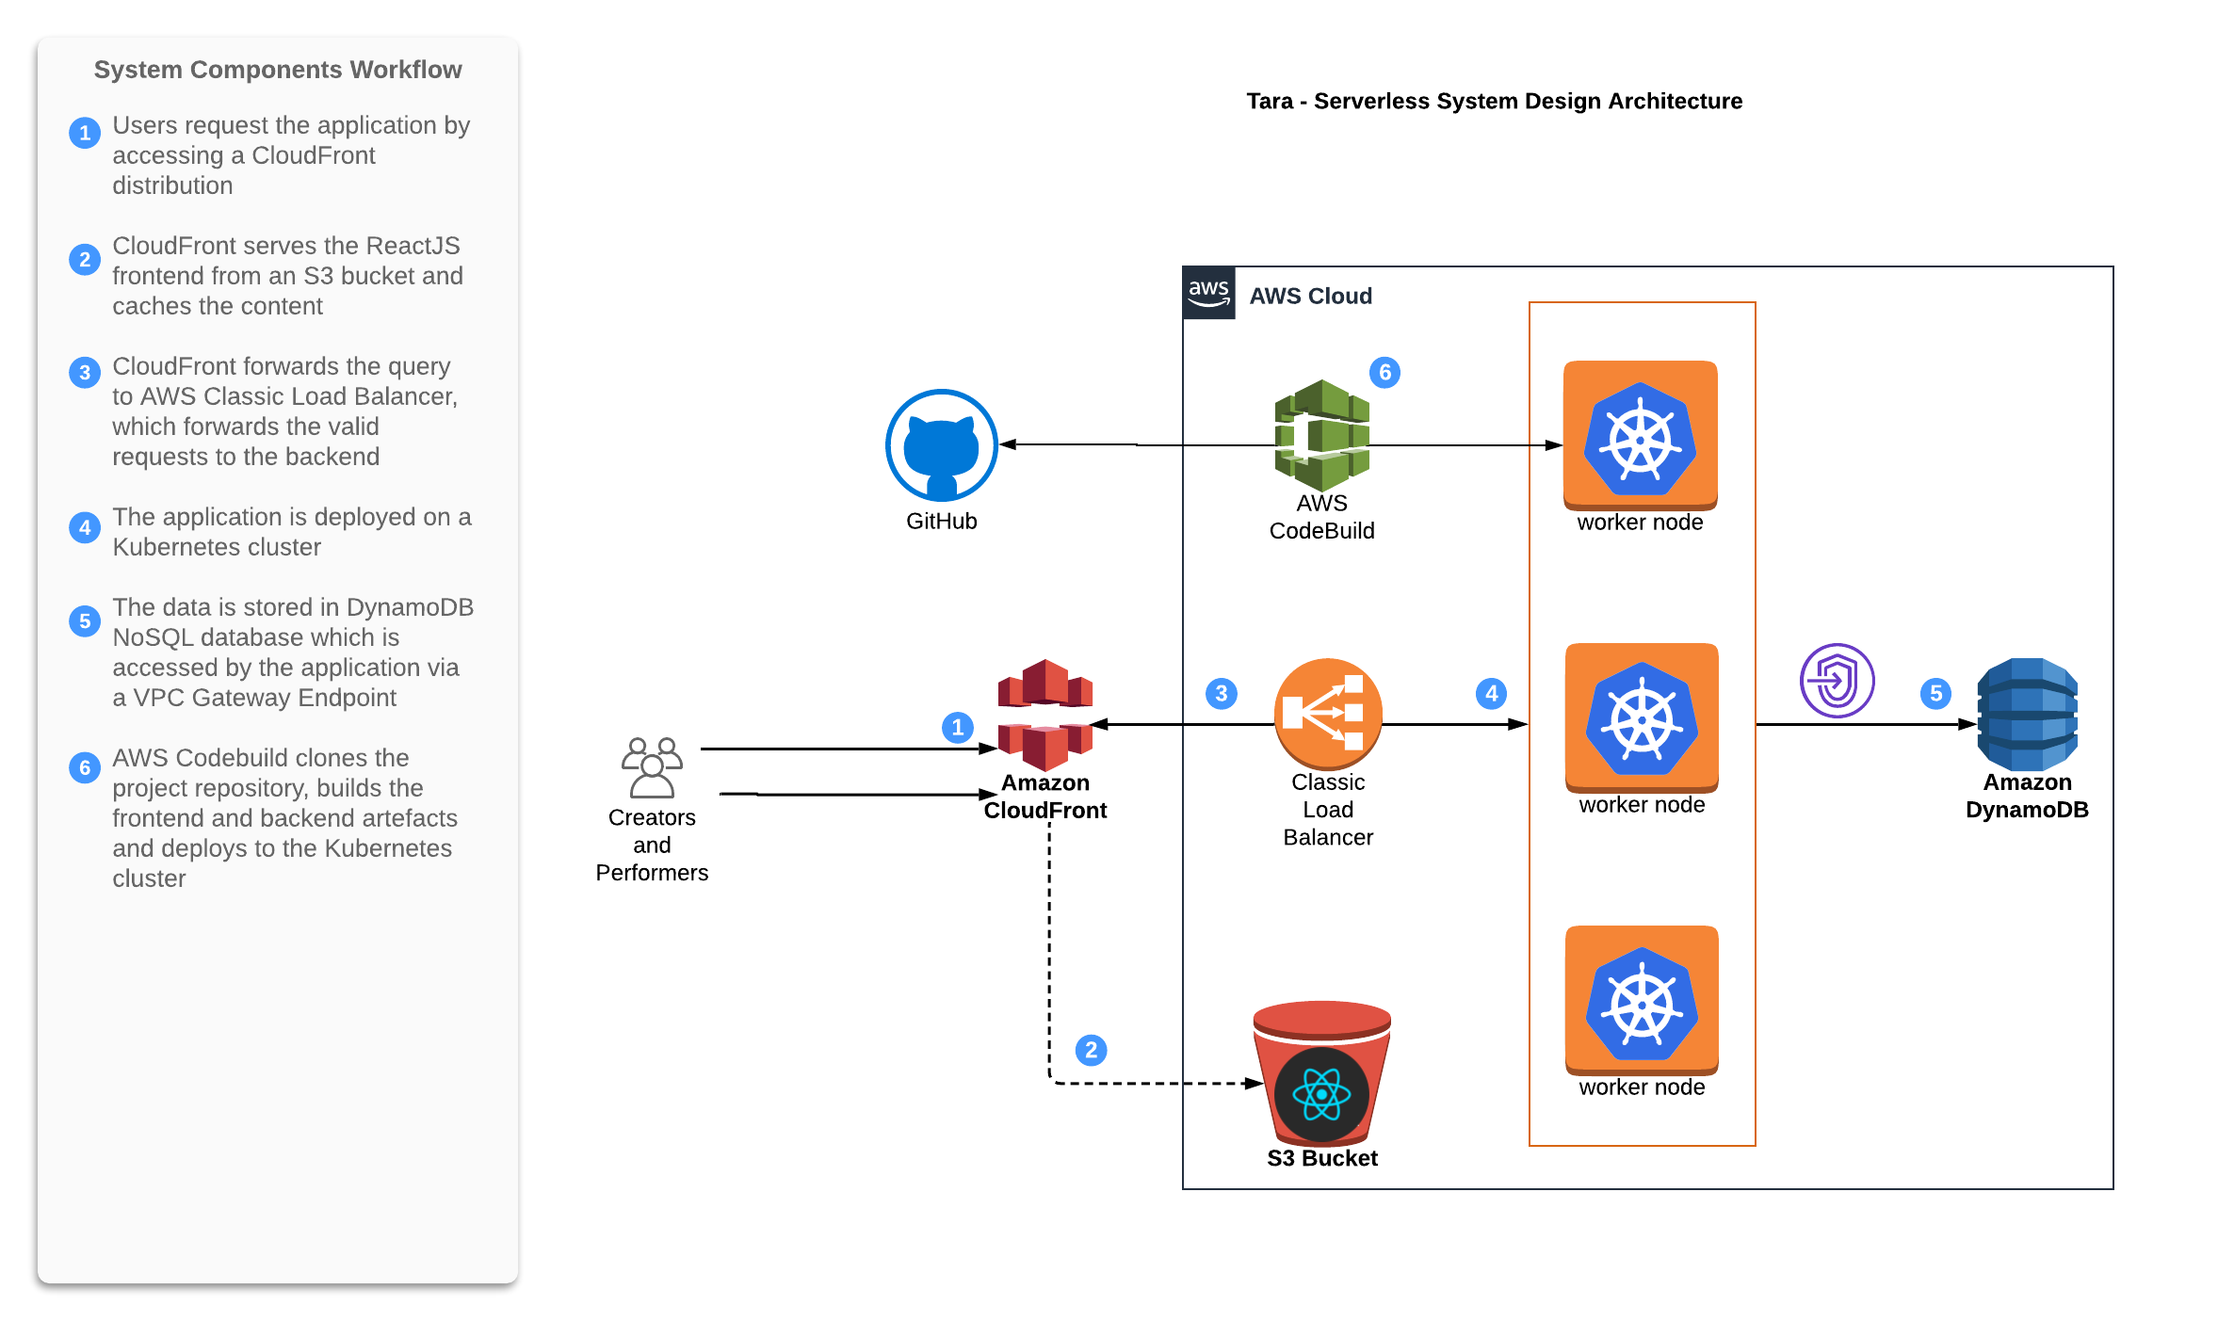
Architecture

Slide 15
TARA DEMO

Slide 16
THANK YOU

