Slide 1
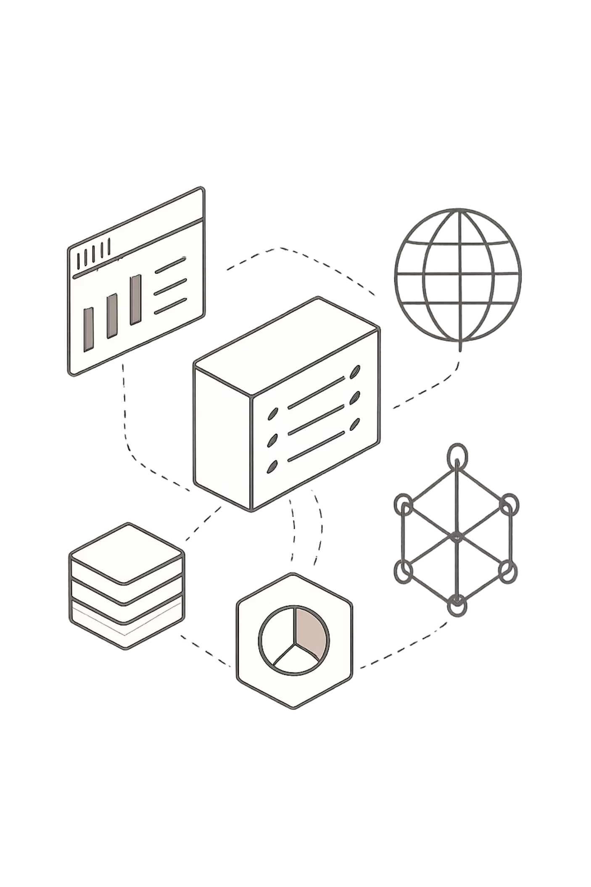
LeadFlow CRM
Enterprise Architecture & System Design Blueprint
A production-grade CRM platform built for concurrency safety, role-based access control, and full audit observability engineered from the ground up with Node.js, Express.js, PostgreSQL, and React 19.
NODE.JS
EXPRESS.JS
POSTGRESQL
REACT 19
SUPABASE POOLER

Slide 2
ARCHITECTURE
Multi-Layer Service Architecture
Clean separation of concerns across the entire request-response lifecycle. Each layer has a single responsibility, making the codebase testable, maintainable, and resilient to change.
Routing Layer
Service Layer
*.routes.js files expose REST endpoints, register parameter validation chains, and apply authentication guards before any business logic executes.
*.service.js houses core business rules, database transaction blocks, and triggers background logging and notification tasks.
Controller Layer
Database Layer
*.controller.js decouples HTTP concerns (params, query, body) from service execution, translating raw requests into typed service calls.
config/db.js manages connections via pg.Pool, enabling efficient concurrent connection handling through Supabase Postgres Pooler.

Slide 3
CODEBASE
Codebase Layout & Directory Tree
A modular, domain-driven structure with dedicated feature spaces. Each module is self-contained, grouping routes, controllers, and services by business capability.
Global Infrastructure
Domain Modules
Shared configuration and middleware live outside domain modules, ensuring a single source of truth for cross-cutting concerns.
Feature modules inside src/modules/ follow a consistent triad pattern — routes, controller, and service — keeping each domain isolated and independently testable.
src/config/ — db.js, mailer.js, swagger.js
src/middleware/ — auth.js, roleCheck.js, rateLimiter.js, auditLogger.js
src/utils/ — emailService.js
auth/ — auth.routes.js, auth.controller.js, auth.service.js
leads/ — leads.routes.js, leads.controller.js, leads.service.js
activity/ — activity.routes.js, activity.controller.js, activity.service.js

Slide 4

SECURITY
Stateless JWT Session Security
Encrypted session handshakes and dynamic role gates protect every endpoint without server-side session storage, enabling horizontal scalability.
Stateless Bearer JWT
Request credentials are validated using signed headers decrypted dynamically in the Express pipeline. No server-side session store is required, eliminating sticky-session constraints.
RBAC Decorator Guards
Custom allowRoles(...) factory middleware prevents unauthorized access based on user roles — Admin, Manager, or Agent — applied per-route with surgical precision.
Brute Force Protection
Two-tier rate limiting: authLimiter (10 req/15 min) guards login endpoints; apiLimiter (100 req/1 min) protects general API throughput against abuse.
HTTP Security Headers
The helmet middleware hardens HTTP response headers to mitigate XSS, clickjacking, and MIME-type sniffing attacks across all endpoints.

Slide 5
DATABASE
Relational Normalization & Data Retention
The schema is optimized for third-normal-form integrity, fast indexed lookups, and complete audit persistence — even when records are "deleted."
Schema Design Principles
Performance & Retention
1
Third Normal Form (3NF)
1
Index Optimization
Users, leads, and activity_logs are fully normalized into separate resources, eliminating update anomalies and data duplication.
Targeted indexes on leads(status), leads(assigned_to), and activity_logs(lead_id) accelerate the most common query paths.
2
Referential Integrity
2
Soft Delete Retention
Foreign key constraints with defensive cascade actions — ON DELETE SET NULL and ON DELETE CASCADE — enforce relational consistency at the database level.
Leads are flagged with deleted_at rather than hard-deleted, preventing cascading wipes of matching activity_logs and preserving full audit trails.

Slide 6

CONCURRENCY
Concurrency-Safe Workload Balancing
Lead auto-assignment uses a least-loaded algorithm with PostgreSQL advisory locks to prevent race conditions under concurrent request bursts.
Calculate Load
Compute workloads; pick least-loaded; oldest tie-break
Commit & Release
Begin & Lock
BEGIN; pg_advisory_xact_lock(1001)
COMMIT; lock released automatically
Under default Read Committed isolation, concurrent lead creations could read identical workload snapshots, assigning multiple leads to the same agent. The advisory lock serializes workload checks within the transaction boundary, guaranteeing balanced distribution even under high concurrency.

Slide 7
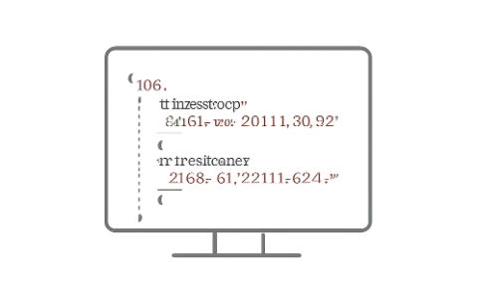
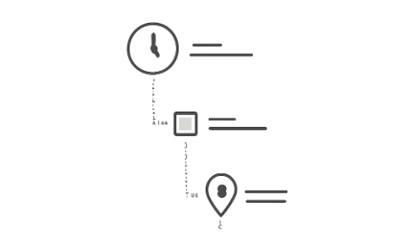

OBSERVABILITY
Structured Logs & Non-Blocking Events
Production-ready logging and resilient system integrations ensure every action is traceable without compromising API response times.
Audit Logger Middleware
Detailed Activity Timelines
Asynchronous Mail Resiliency
Every completed HTTP response is converted into a structured JSON record capturing path, method, user ID, role, status code, IP address, and timestamp — enabling full forensic traceability.
Status updates and field changes are logged with performer metadata, rendering a chronological activity timeline for each lead — critical for compliance and dispute resolution.
SMTP alerts (welcome emails, assignment notifications) execute in non-blocking promise wrappers. Transporter failures are logged but never block the client's API response.

Slide 8
ENGINEERING
Technical Hurdles & Practical Resolutions
Three core architectural challenges were identified and resolved during development, each with a pragmatic, production-viable solution.
Stateless JWT Logouts
SMTP Server Blockage
Concurrency Overlap
Challenge: Stateless tokens cannot be invalidated server-side without introducing storage.
Resolution: Client-side token disposal combined with short expiration windows (7 days) limits the blast radius of a compromised token.
Challenge: Network latency on SMTP handshakes was blocking REST API response threads, degrading throughput.
Resolution: Mail delivery was decoupled from the request-response thread using fire-and-forget promise wrappers.
Challenge: Concurrent lead creation requests caused load-balancing drift, assigning multiple leads to the same agent.
Resolution: PostgreSQL transactional advisory locks serialize assignment blocks, eliminating race conditions at the database level.

Slide 9
ROADMAP
Production Enhancements & Scalability Roadmap
Architectural upgrades planned to support high-velocity enterprise traffic, horizontal scaling, and real-time user experiences.
Distributed Caching
Cookie Token Rotation
Migrate rate limiters and session caches to a Redis cluster, enabling horizontal scaling of the API layer without shared-state bottlenecks.
Migrate JWT tokens from browser local storage to secure HttpOnly cookie exchange routes, eliminating XSS attack surface and enabling silent token refresh cycles.
WebSockets & Live Updates
Background Worker Queues
Integrate Socket.io to push real-time lead updates and assignment notifications directly to agent dashboards, eliminating polling latency and improving UX responsiveness.
Introduce BullMQ + Redis to guarantee asynchronous email delivery with retry logic, dead-letter queues, and observable job state — removing all fire-and-forget risk. (Not implemented)

