Slide 1
Dynamic Intelligent Q/A systems
By…
Team7:
Chaitanya Kumar Peravalli,
Kalyan Kilaru,
SaiJyothi Gudibandi

Slide 2
Introduction:
Question-Answering system which supports natural language processing provides the users with a human-machine interface.
This system is in similar type the way how the people ask questions to the search engine and it has more advantage compared to traditional search engines by understanding the purpose of the question and respond accordingly.

Slide 3
Significance:
Using Question Answer system searching become easy and it will give accurate and relevant answers for the questions, we can improve the document and knowledge management.
These kind of system will be very useful in case of helping desks, knowledge management systems and E-libraries.

Slide 4
Technologies:
Frameworks:
JAVA
SCALA
SPARK
IntelliJ
Protégé()ontology

Slide 5
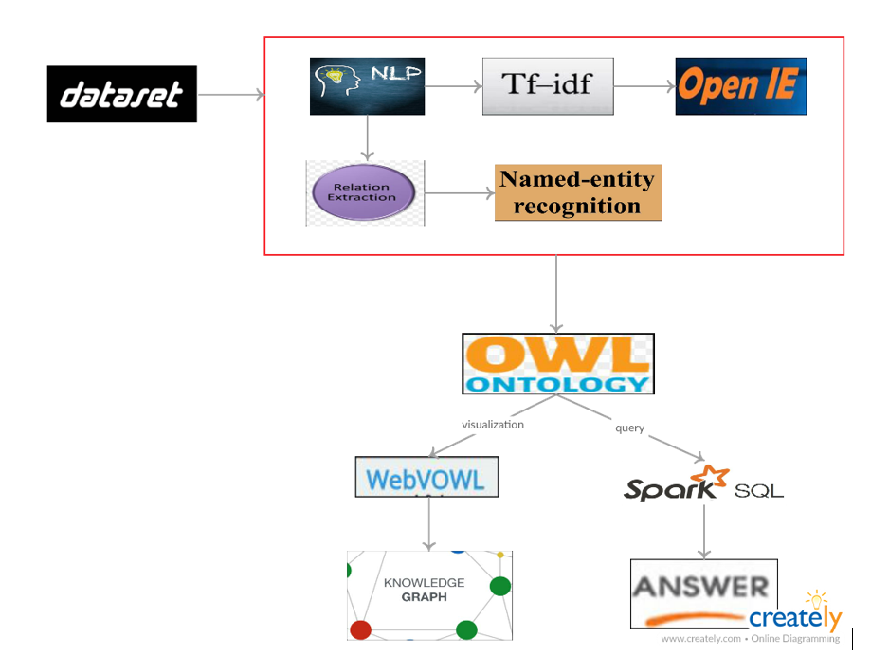
Project Work Flow:

Slide 6
NLP:
Lemmatization
Tokenization
NER Tagging

Slide 7
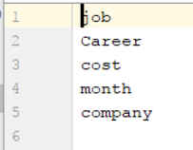
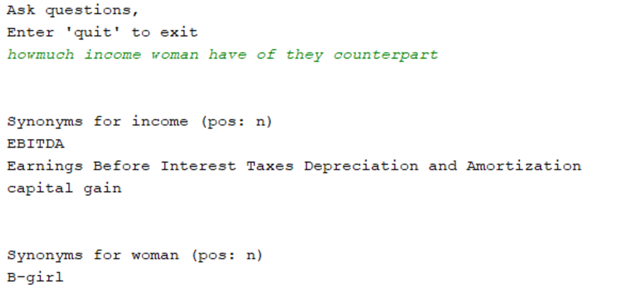
Feature Generation using Information Retrieval:
TFIDF
Word2Vec

Slide 8
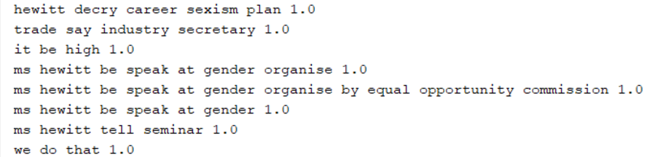
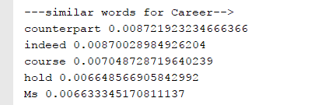
Information Extraction:
OpenIE
WordNet

Slide 9
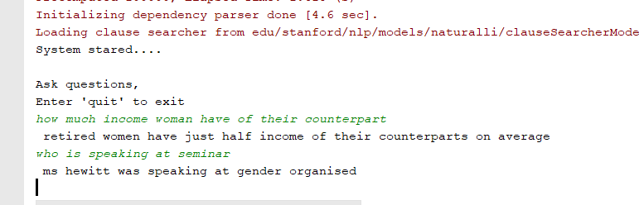
Final Question Answer

Slide 10
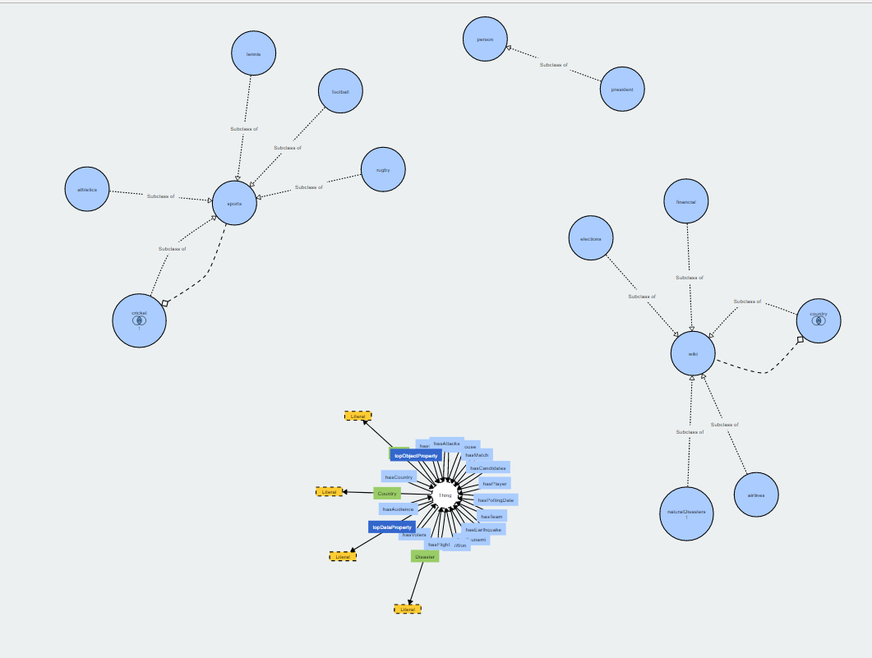
Knowledge Graph:
Ontology
Tool: OWL:
SparQL
DL

Slide 11
Demo

Slide 12


