Slide 1
Lending Club Case Study
Ali Abdullrahaman
Krishna Chaitanya

Slide 2
Introduction
This case study will give us an idea of how real business problems are solved using EDA. we will develop a basic understanding of risk analytics in banking and financial services and understand how data is used to minimize the risk of losing money while lending to customers.

Slide 3
Business Understanding
The objective is to help with taken a decision whenever they receive a loan application whether to reject or approve based on certain variables depending on the analysis.
Dataset Details:
The data contains information about past loan applicants and whether they ‘defaulted’ or not. The aim is to identify patterns that indicate if a person is likely to default, which may be used for taking actions such as denying the loan, reducing the amount of the loan, lending (to risky applicants) at a higher interest rate, etc.

Slide 4
Cleaning the Data and preparation process:
1-Importing the Data. 2-Removing columns which are more than 90% empty.
3-Removing single-valued columns that can’t contribute to our analysis.
4-Removing some more columns based on the type of information they provide: A- id, and member_id are just conventional columns, zip_code, addr_state, emp_title, url, desc, and purpose can also be removed as they don’t contribute to finding loan defaults.
B- mths_since_last_delinq is less useful than delinq_2yrs, but delinq_2yrs is highly skewed and more than 38k values are between 0-3 times, by which we can’t judge the default tendency of the borrower.
C- recoveries and collection_recovery_fee are duplicates, so one can be removed.
D- out_prncp, chargeoff_within_12_mths, total_rec_late_fee, last_pymnt_amnt, revol_bal are uncorrelated to the case statement and can be removed.
5-Removing the rows with more the 5 empty values among 31 columns.
6-Removing/Fixing null values
7-Correcting data types and deriving new columns
8-Removing outliers.

Slide 5
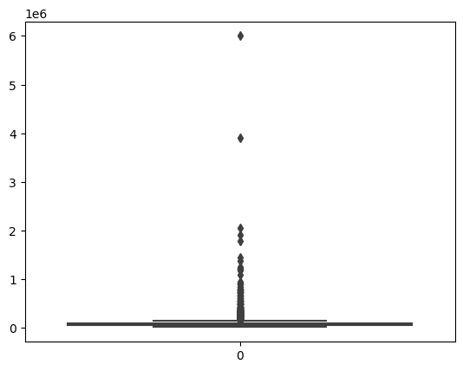
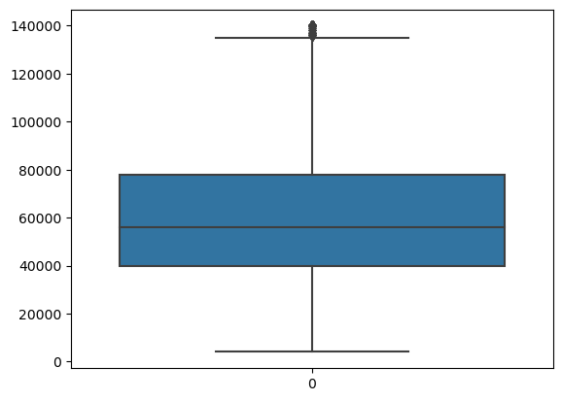
Cleaning the Data and preparation process:
Example for Removing outliers for the annual_inc column
Annual Inc.: Before the outliers removal.
Annual Inc.: After the outliers removal.

Slide 6
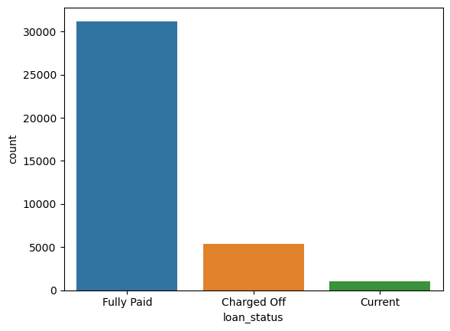
Analysis and Visualisation with Univariate:
After the cleaning we start the analysis, we are aiming to find the potential defaulter let’s consider only Charged_off for now.
Loan Status: The charged Off loans are much smaller compared to the total count.

Slide 7
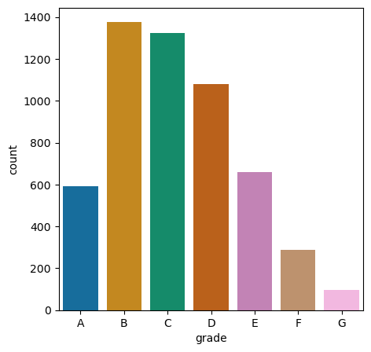
Analysis and Visualisation with Univariate:
Analysis of Charged_off wrt grade.

Slide 8
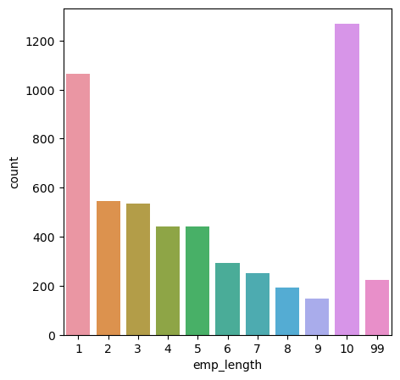
Analysis and Visualisation with Univariate:
Analysis of Charged_off wrt emp_length.

Slide 9
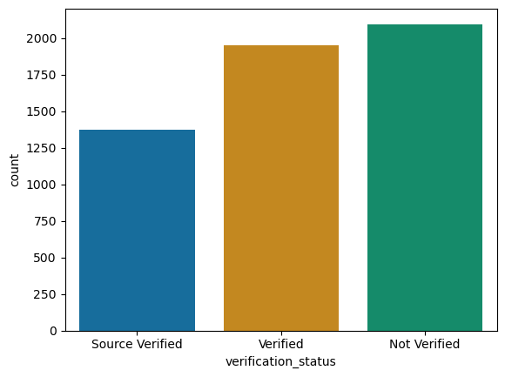
Analysis and Visualisation with Univariate:
Analysis of Charged_off wrt verification_status.

Slide 10
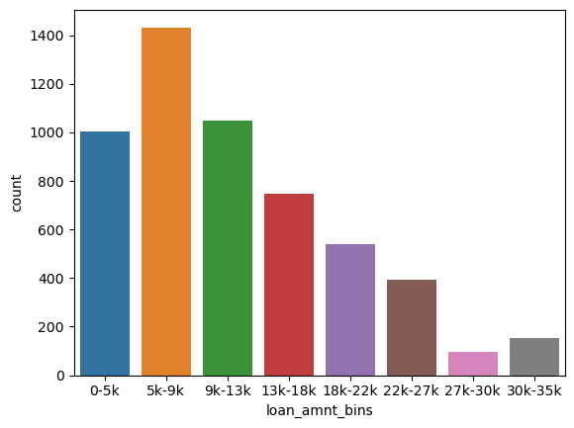
Analysis and Visualisation with Univariate:
Analysis of Charged_off wrt loan_amnt.

Slide 11
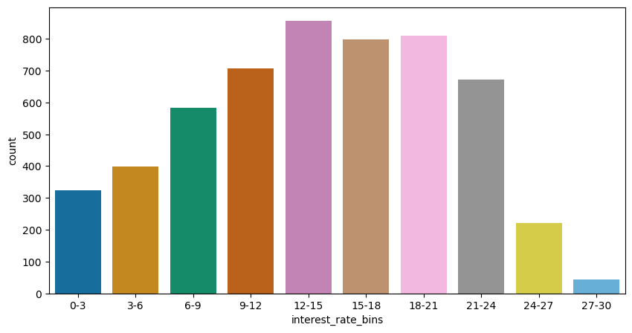
Analysis and Visualisation with Univariate:
Analysis of Charged_off wrt interest_rate.

Slide 12
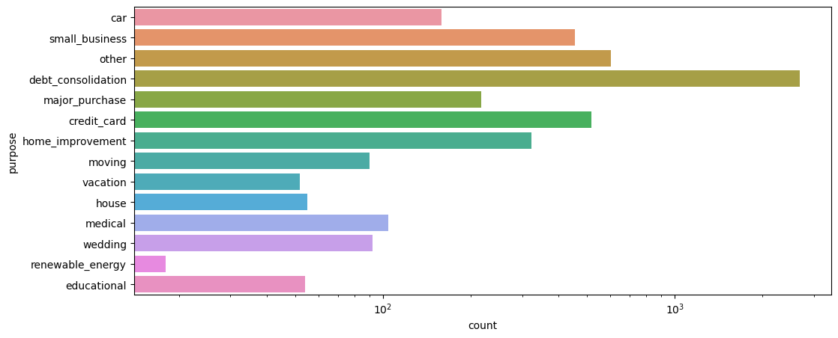
Analysis and Visualisation with Univariate:
Analysis of Charged_off wrt purpose.

Slide 13
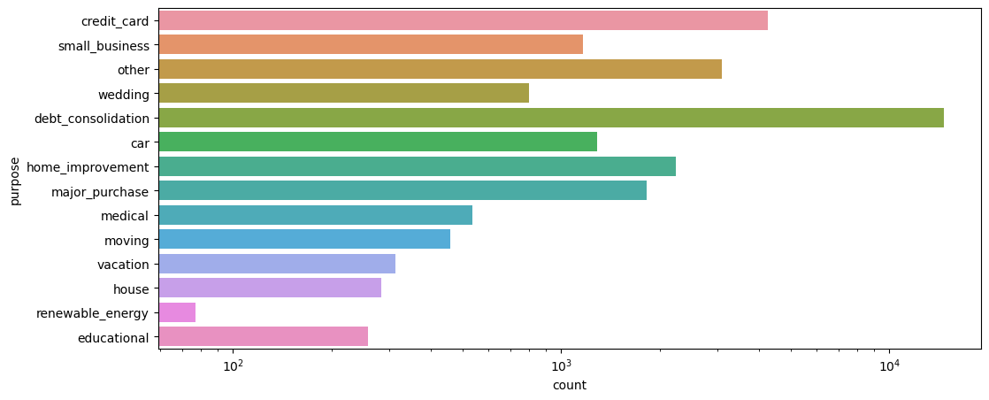
Analysis and Visualisation with Univariate:
Analysis of Fully Paid wrt purpose.

Slide 14
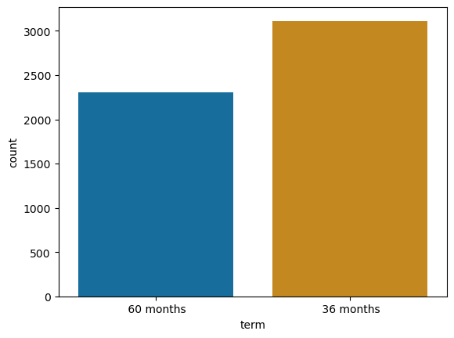
Analysis and Visualisation with Univariate:
Analysis of Charged_off wrt term.

Slide 15
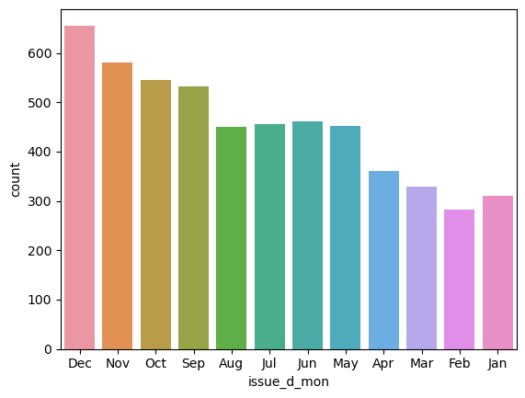
Analysis and Visualisation with Univariate:
Analysis of Charged Off wrt issue_d_mon.

Slide 16
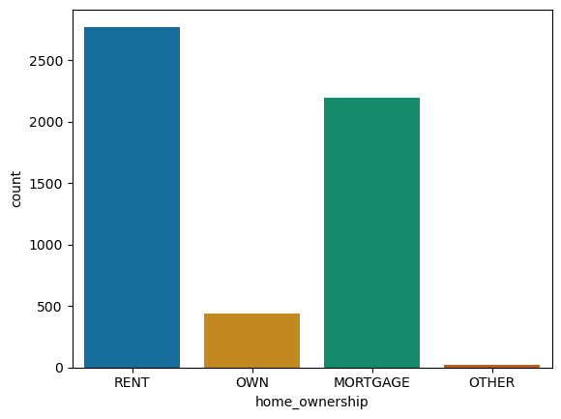
Analysis and Visualisation with Univariate:
Analysis of Charged Off wrt home_ownership.

Slide 17
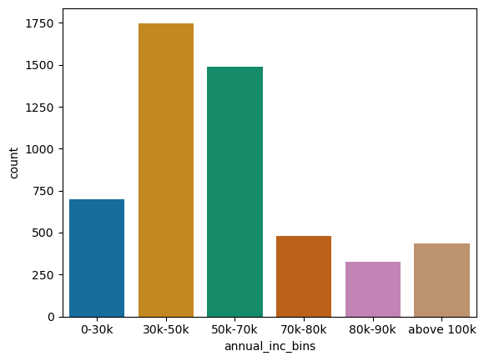
Analysis and Visualisation with Univariate:
Analysis of Charged Off wrt annual_inc.

Slide 18
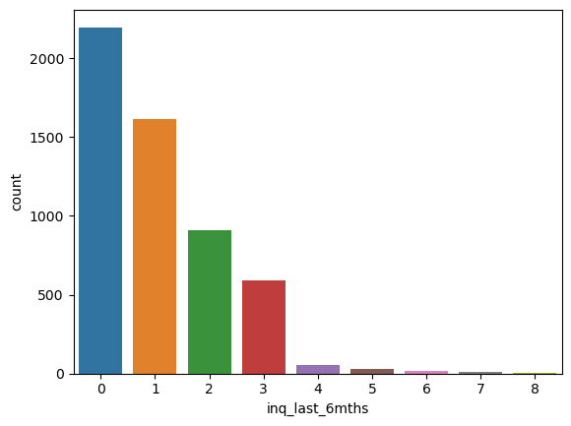
Analysis and Visualisation with Univariate:
Analysis of Charged Off wrt inq_last_6mths.

Slide 19
Conclusions of the Analysis with Univariate:
The defaulting potential is more under the following cases:
When the annual income of the borrower is in the range of 30k to 70k.
When the borrower is on either RENT or having a MORTGAGE. Also, people who own a house have a very low chance of defaults.
The term of 36 months has more chance of delinquency.
When the number of inquiries in the last 6 months is 0.
When the interest rates are from 12% to 20% the chances are more.
Grade is B or C.
When the loan amount is 5k-9k, delinquency is high.
When the loan status is Not verified.
When the reason is to clear off other debts/loans.
When the borrower’s employment length is 10+.
For some reason, there is a steady increase in default possibility wrt the months across all 4 years (Jan<Feb<....<Dec).

Slide 20
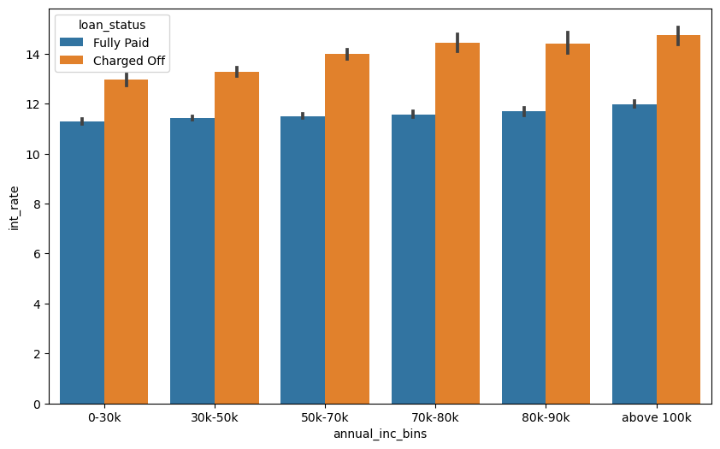
Analysis and Visualisation with Bivariate:
Analysis of loan_status with Fully Paid and Charged Off with discard the Current.

Slide 21
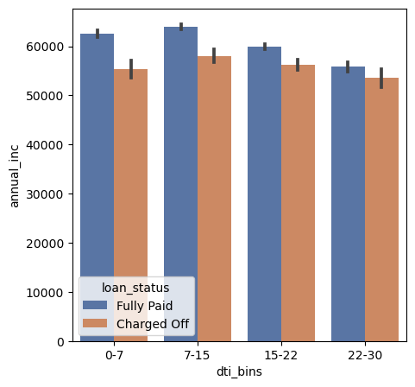
Analysis and Visualisation with Bivariate:
Analysis of loan_status with annual_inc and DTI.

Slide 22
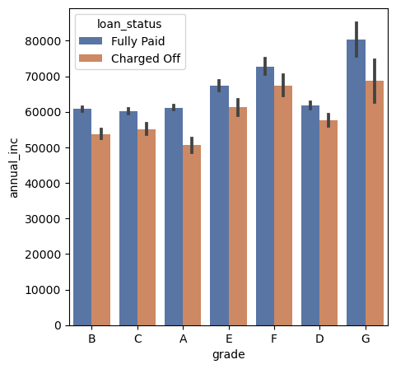
Analysis and Visualisation with Bivariate:
Analysis of loan_status with annual_inc and grade.

Slide 23
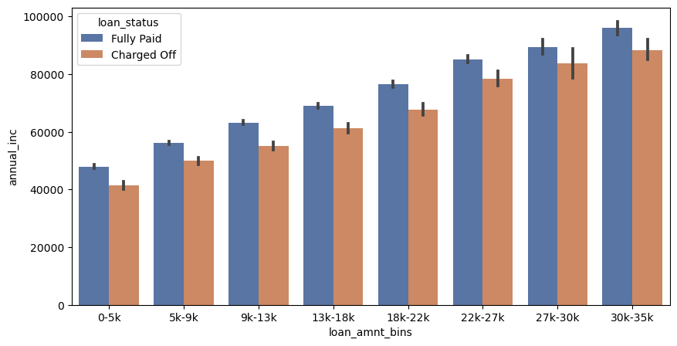
Analysis and Visualisation with Bivariate:
Analysis of loan_status with annual_inc and loan_amnt_bins.

Slide 24
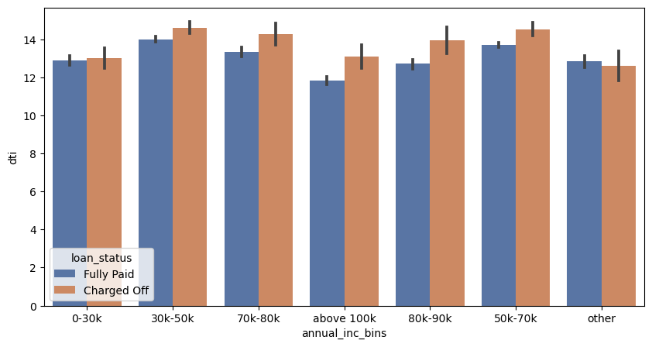
Analysis and Visualisation with Bivariate:
Analysis of loan_status with DTI and annual_inc.

Slide 25
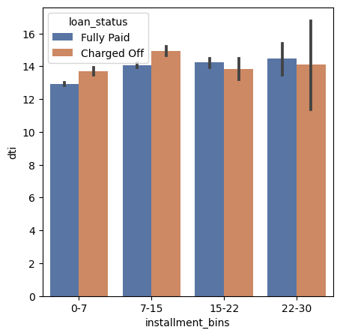
Analysis and Visualisation with Bivariate:
Analysis of loan_status with DTI and installment_bins.

Slide 26
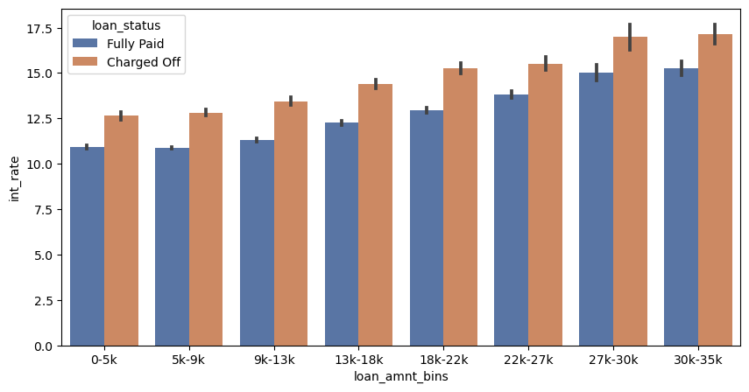
Analysis and Visualisation with Bivariate:
Analysis of loan_status with int_rate and loan_amnt.

Slide 27
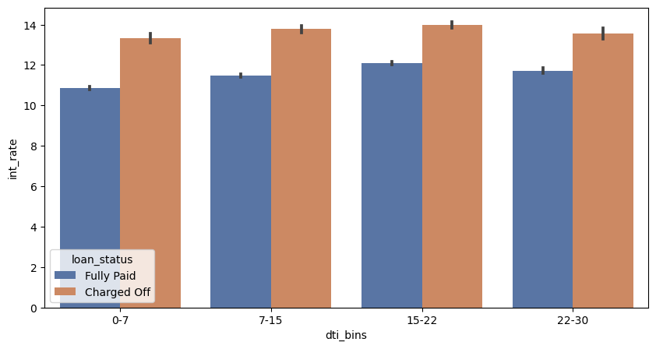
Analysis and Visualisation with Bivariate:
Analysis of loan_status with int_rate and DTI.

Slide 28
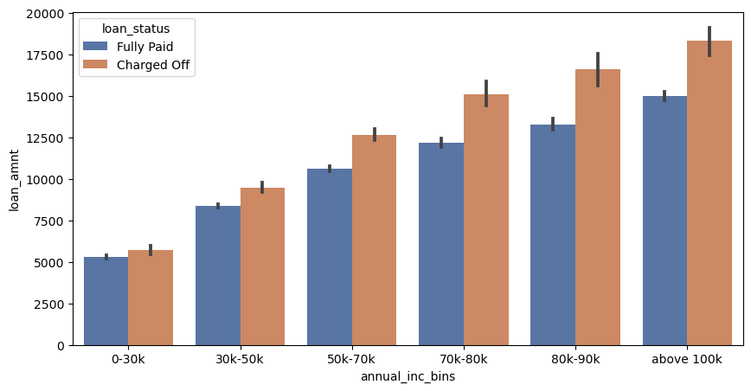
Analysis and Visualisation with Bivariate:
Analysis of loan_status with loan_amnt and annual_inc.

Slide 29
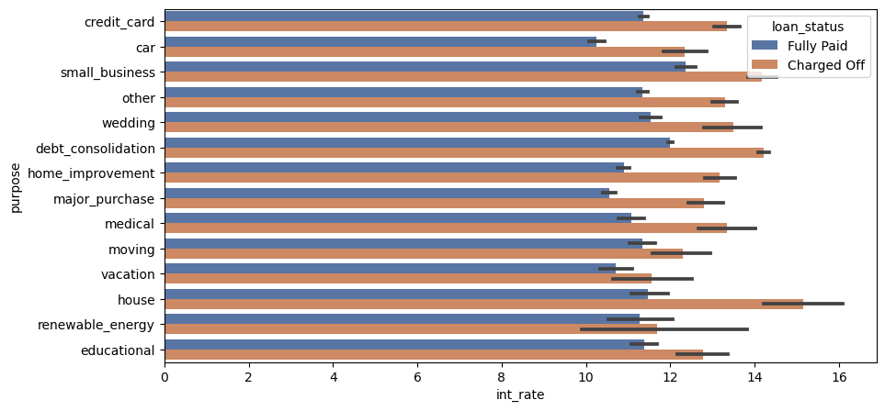
Analysis and Visualisation with Bivariate:
Analysis of loan_status with purpose and int_rate.

Slide 30
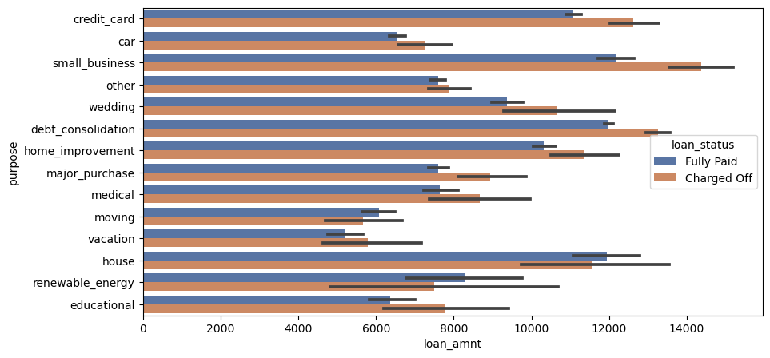
Analysis and Visualisation with Bivariate:
Analysis of loan_status with loan_amnt and purpose.

Slide 31
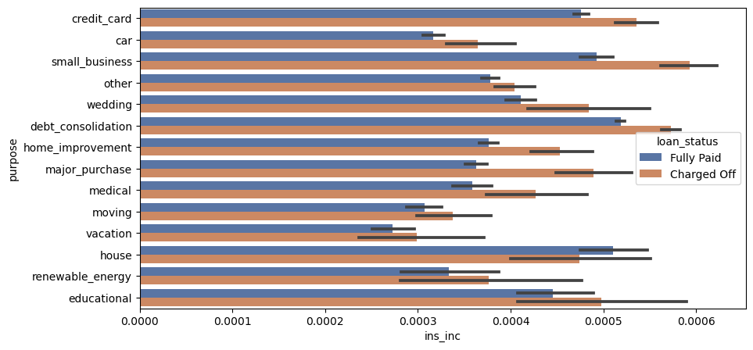
Analysis and Visualisation with Bivariate:
Analysis of loan_status with ins_inc and purpose.

Slide 32
Observations
In all groups whenever the interest rate is high the possibility of defaulting is also high.
Whenever the DTI is high, the possibility of defaulting is high. Also true for all brackets/groups.
Borrowers of Grade G and higher income are less likely to default.
Across all the variables, the higher the loan granted more is the possibility to default. So finding out the max amount which can be granted for each category would be helpful.
Borrowers who are of small business and taking a loan of more than 12k are more likely to default.
Borrowers with education loans of more than 6k are having a hard time closing it. Mostly student loan defaulters.
Borrowers whose interest rate is more than 11% and who is taking a home loan are more likely to default.
Borrowers with purpose debt repayment and interest rate of more than 12% are more likely to default.
Only for home loans, if the ratio of installments to monthly income are high, then more likely the loan will be paid. It’s False for all other loan purposes.

