Slide 1

Introduction
"Hello everyone, my name is L. Chaitanya Simha, and I am an intern at Zidio Development. Today, I am excited to present my project on customer segmentation. This project aims to identify distinct customer groups within two datasets: an e-commerce dataset and a mall customer dataset. Through data preprocessing, exploratory data analysis, and clustering using the K-Means algorithm, we successfully identified optimal clusters for both datasets. Let’s dive into the details."

Slide 2
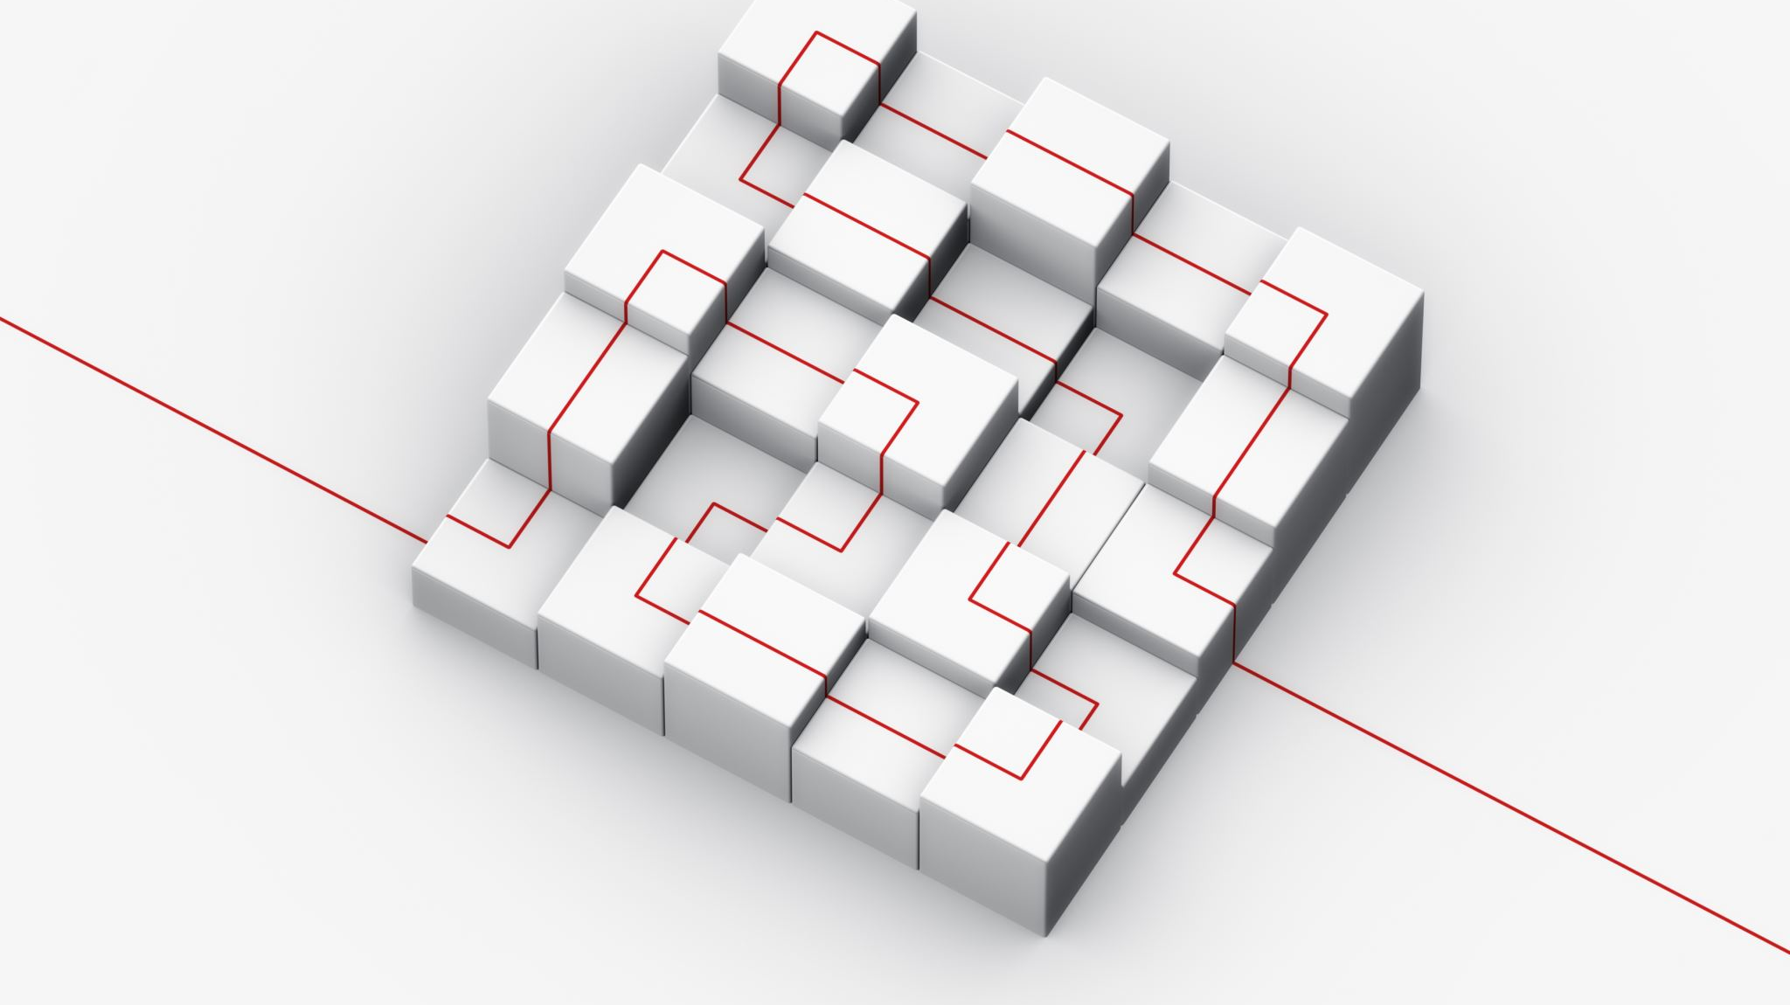
Project Structure Overview
"The structure of this project is divided into several key components: data preprocessing, exploratory data analysis (EDA), clustering, and insights. We'll start with data preprocessing."

Slide 3
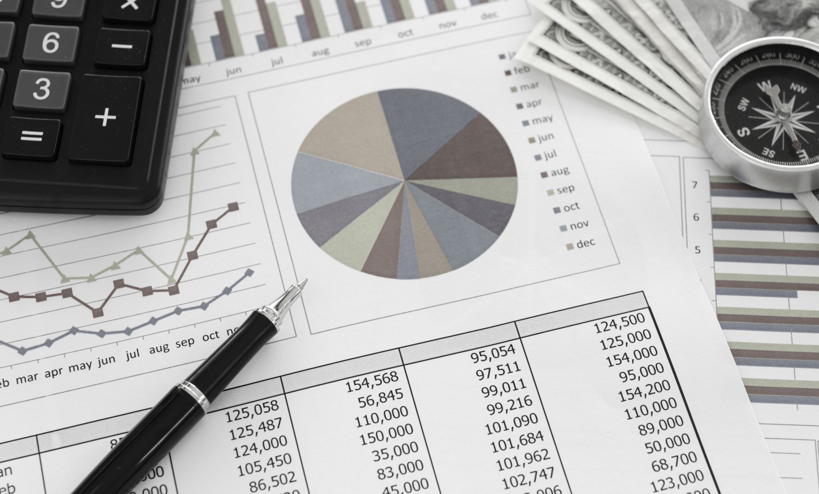
Exploratory Data Analysis (EDA)
"Exploratory Data Analysis helped us understand the patterns and trends in customer behavior. We analyzed distributions of orders, purchases, age, and spending scores."

Slide 4
E-Commerce Data Insights
"For the e-commerce dataset, we observed the following:
Distribution of Orders: The data showed a right-skewed distribution, indicating that most customers place few orders while a small number place many. The scatter plot confirms distinct clusters, likely representing high-frequency buyers and infrequent buyers.
Distribution of Jordan Purchases: The majority did not purchase Jordan products, indicating niche market behavior. The clusters show varied interest, with some segments showing significant Jordan product purchases."

Slide 5
Mall Customers Data Insights
"For the mall customer dataset, the key insights include:
Distribution of Age: Peaks around mid-20s to early 30s, the most common age group. Cluster visualization confirms varied age distribution among different spending and income levels.
Distribution of Annual Income: Slightly right-skewed with a peak around the average income range. The scatter plot shows diverse income levels across clusters."

Slide 6
Clustering with K-Means
"Next, we applied the K-Means clustering algorithm. Using the Elbow Method and Silhouette Score, we determined that 5 clusters were optimal for both datasets. Here is the code for implementing K-Means and the resulting cluster visualizations."

Slide 7

Cluster Analysis
"The clustering analysis revealed clear segmentation of customers, with each cluster exhibiting unique characteristics. These insights can help in targeted marketing and personalized customer service strategies. The Silhouette Scores indicated a good level of separation between clusters, validating the effectiveness of our approach."

Slide 8

Combined Insights
"Combining the theoretical analysis and visual data, we identified optimal clusters and customer segments:
E-Commerce: High-frequency buyers, moderate buyers with specific product interests, and infrequent buyers.
Mall Customers: High-income high-spenders, high-income low-spenders, low-income high-spenders, and moderate-income moderate-spenders."

Slide 9
Actionable Insights and Future Work
"Our actionable insights include:
Targeted Campaigns: Personalized offers for high spenders and loyalty programs for low spenders.
Inventory Management: Align stock with cluster preferences to optimize inventory turnover.
Future work could involve exploring other clustering techniques like hierarchical clustering or DBSCAN to compare results. Additionally, incorporating more features and external data could enhance the segmentation and provide deeper insights."

Slide 10

Conclusion
"To conclude, this project demonstrates the value of customer segmentation in understanding and serving different customer groups more effectively. The integration of data preprocessing, exploratory data analysis, and clustering techniques provided a comprehensive view of customer behavior and preferences. Thank you for your attention, and I welcome any questions you may have."

