Slide 1

TheLocalShop
HANDCRAFTED LOCALLY

Slide 2

Team Members:
Chaitanya Sravan Sidda
Sesha Satya Sai Seeni

Slide 3

What is TheLocalShop?
Definition: A platform designed to connect local artisans with customers globally.
Goal: Empower artisans to showcase their crafts while enabling customers to access unique handmade goods.
Vision: To make locally made products accessible worldwide and uplift artisan communities.

Slide 4

The Problem
Artisans often lack resources and access to global markets. Over-reliance on middlemen reduces their profits.
Customers find it hard to discover authentic, local handmade goods globally.
Purpose: Define the pain points for artisans and customers, highlighting the need for a solution like TheLocalShop.
Notes:
When comi9ng to the problem,
From sellers end, artisans often lack resources and also they depend more on the middlemen which inturn reduces the profits.
When comin to customers view, They find it hard to reach the handmade goods and also their authenticity.

Slide 5
Our Solution: TheLocalShop
Simplified registration and onboarding process. Tools to manage products, stock, and orders effectively. Transparent profit-sharing and direct access to customers.
For Customers: Diverse and authentic handmade products.
Verified sellers for quality assurance.
User-friendly interface for a seamless shopping experience.

Slide 6

Platform Features:
For Customers:
Explore handcrafted products by categories.
User-friendly interface with search and filter options.
Secure checkout and wishlist functionality.
For Sellers:
Register and manage their shop.
Add, edit, and monitor product inventory.
Analytics dashboard to track sales.

Slide 7
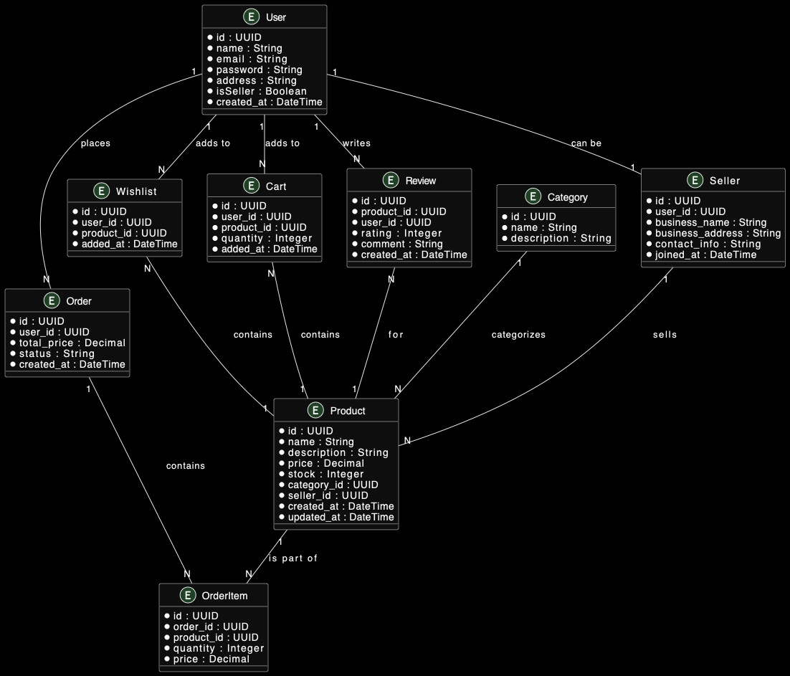
Use-Case Diagram:

Slide 8
Technology Stack
Frontend | Next.js (React framework for fast, server-rendered applications). -TailwindCSS for styling.
Backend | Node.js and Express.js for server-side logic.
Authentication | JSON Web Tokens (JWT) for secure user and seller sessions.
Database | MongoDB for efficient data storage and retrieval.
Hosting | [e.g., Vercel, AWS] for reliable deployment.

Slide 9
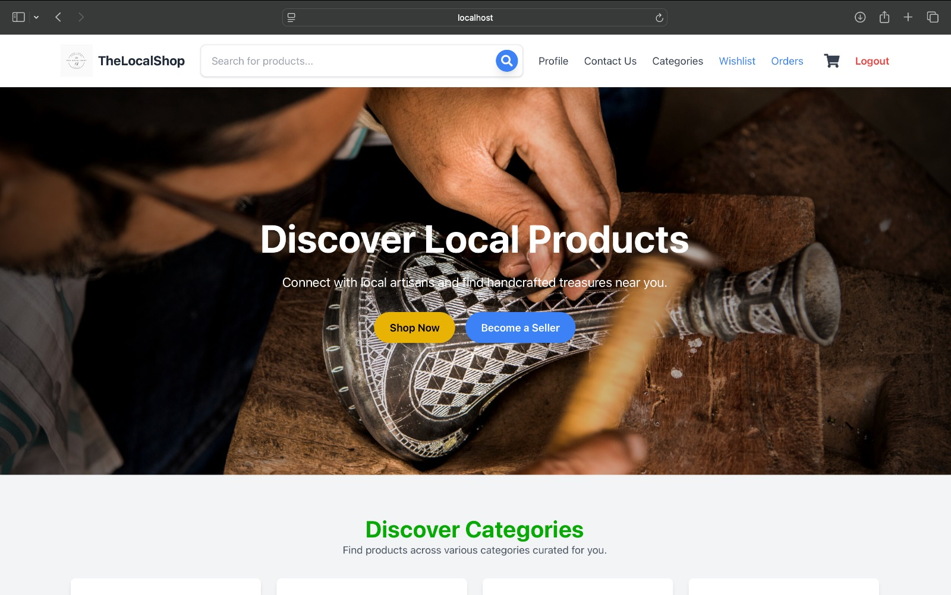
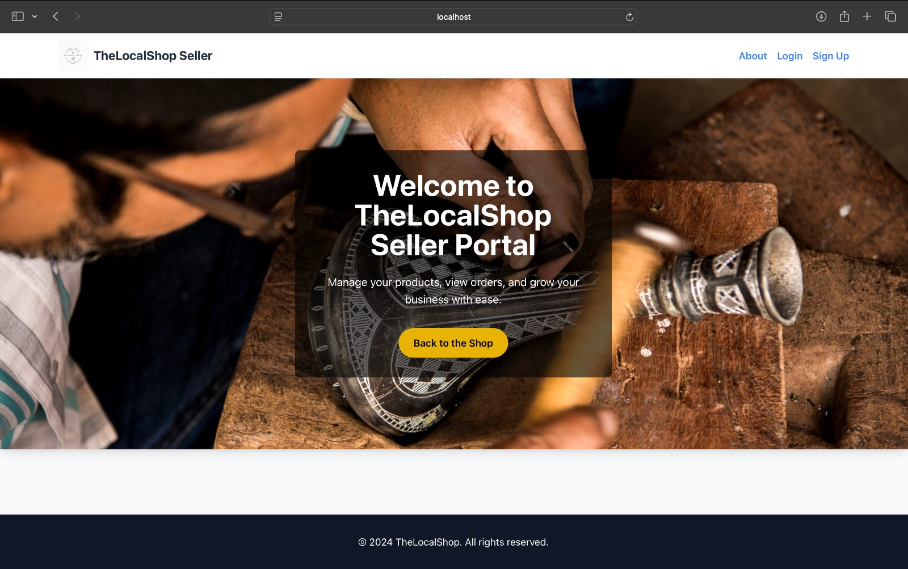
Walkthrough of the platform

Slide 10
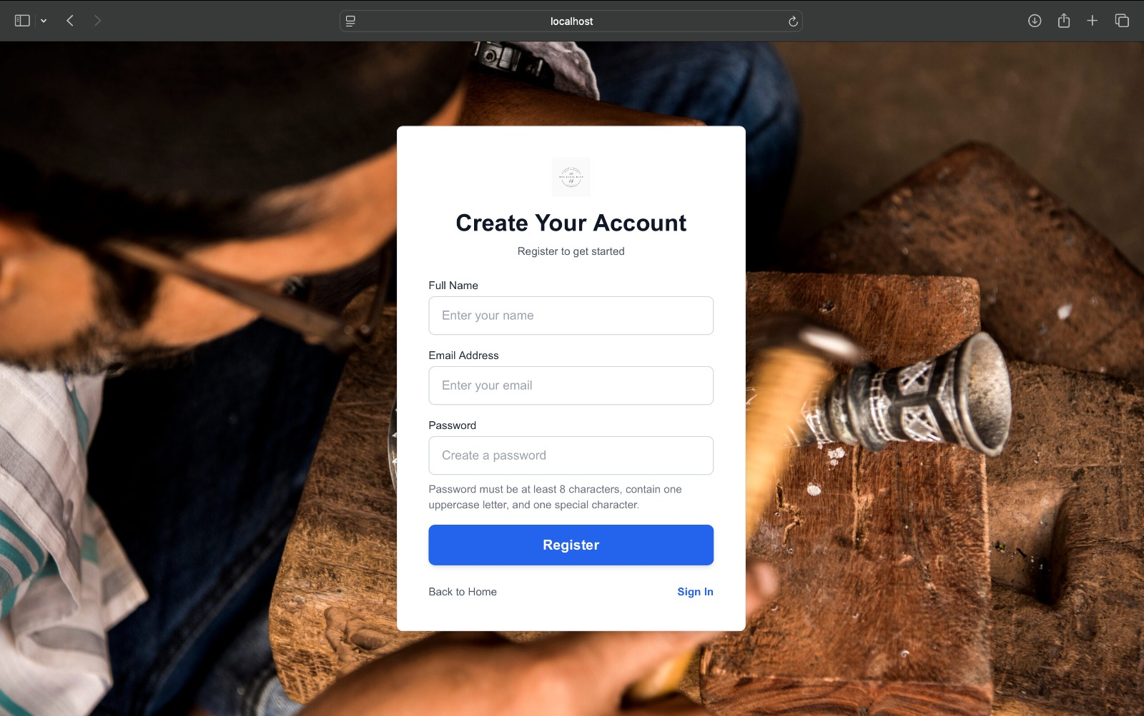
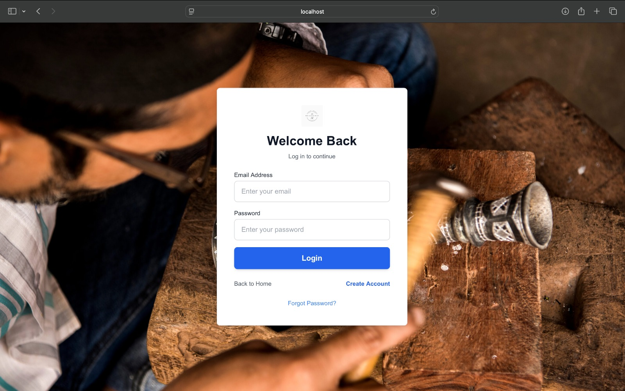
Walkthrough of the platform

Slide 11
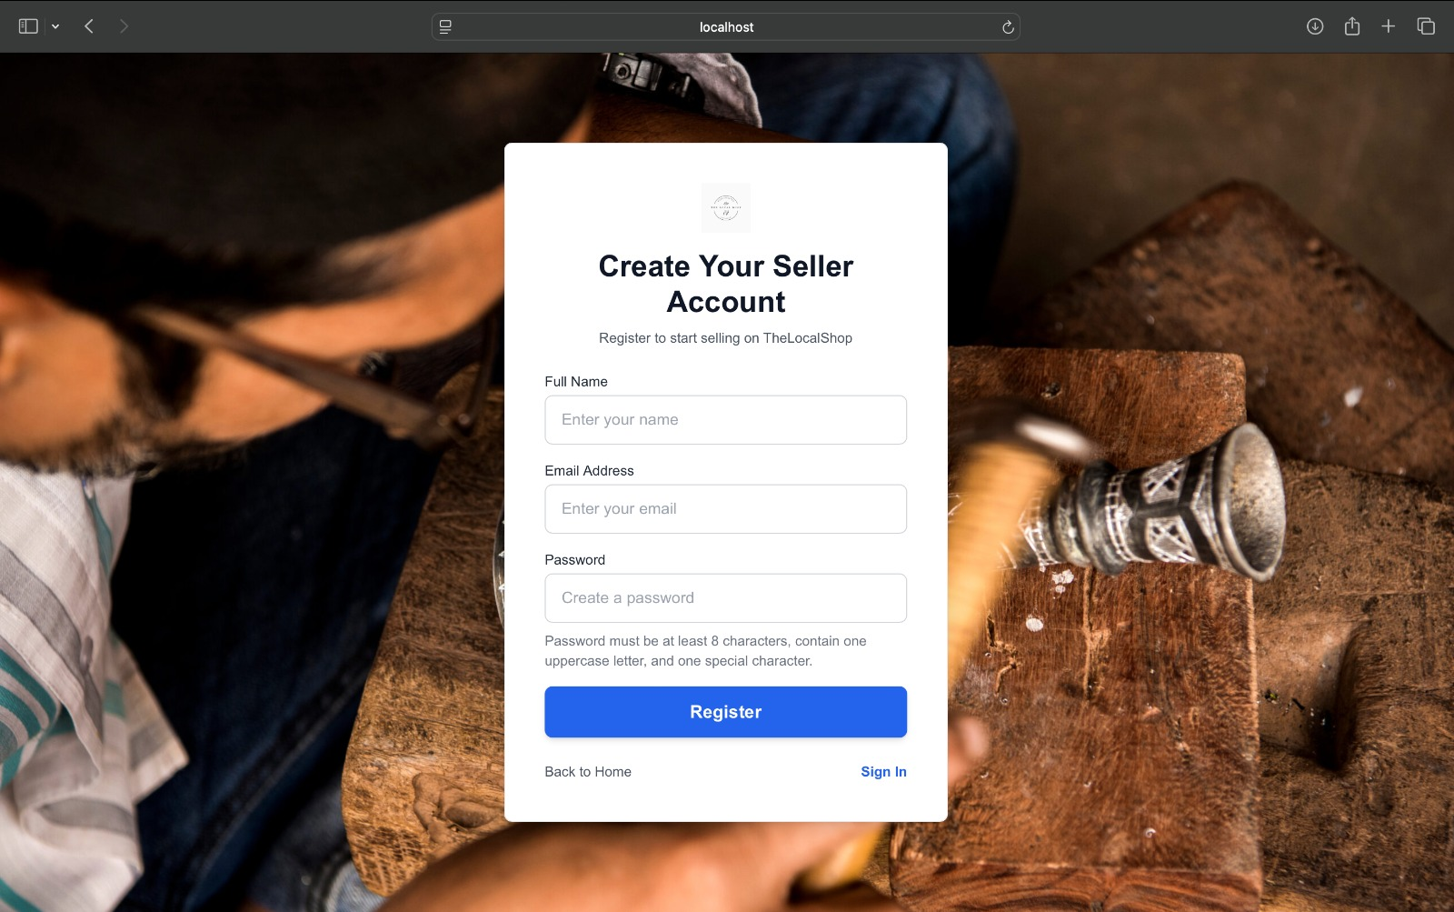
Walkthrough of the platform

Slide 12
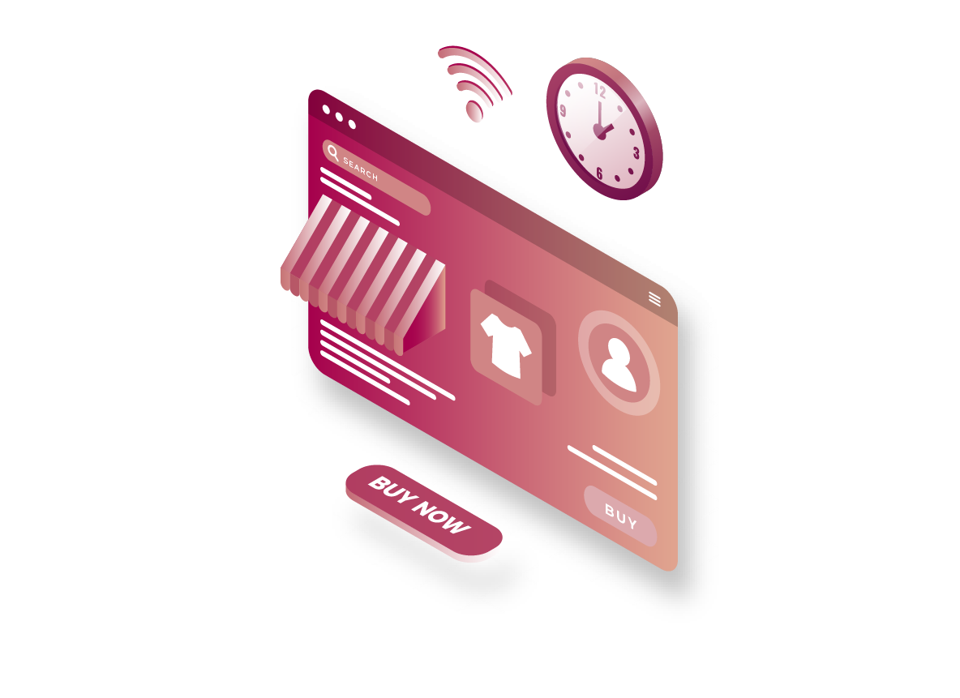
The Impact of TheLocalShop
Empowered local artisans by connecting them to a broader audience.
Promoted cultural exchange through authentic handcrafted goods.
Enhanced customer experience with access to unique products.
Boosted local economies by eliminating middlemen.

Slide 13
Challenges Faced:
Technical Challenges:
Integrating seller and customer functionality seamlessly.
Handling multiple user roles (admin, seller, customer) with appropriate access controls.
Managing database relationships between users, products, and orders.
Non-technical Challenges:
Ensuring the platform remains intuitive and user-friendly.
Familiarizing with new technologies like Next.js and implementing best practices for production-level applications.
Understanding advanced concepts in backend development, such as token-based authentication and middleware.

Slide 14
What’s Next?
Secure Payments: Integrate a safe and reliable payment gateway.
Platform Deployment: Launch online with optimized scalability and performance.
Mobile App: Enhance accessibility with a dedicated app for customers and sellers.
AI Recommendations: Personalized product suggestions to boost customer engagement.
Courier Partnerships: Enable faster deliveries with live tracking.
Community Features: Foster artisan forums and workshops for collaboration and growth.

Slide 15
Conclusion
TheLocalShop bridges the gap between artisans and global customers.
Benefits:
Empowers artisans by removing intermediaries.
Offers customers access to diverse and unique crafts.
Strengthens local economies and promotes sustainability.
"Empowering Local Artisans Globally.“

Slide 16

THANK YOU

