Slide 1
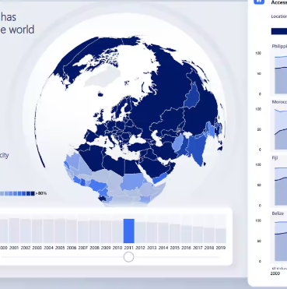
Infosys Springboard – Virtual Internship 6.0
ElectViz: Election Data Visualization for Media
Mentor: Mrs. Nithyasri S J
Interns: Chaithra R
Dronadula Srilekha
Moumita Mukherjee
Boomika B
Dishant Gangwar

Slide 2




Project Objective and Description
Introduction Dashboard:
National Overview :
State-wise Analysis
Party Performance :
Vote Share Trends :
EVM vs Postal Votes :
Dynamic Dashboards
Voting Mode Insights
Decision Support
Performance Analysis

Slide 3
Project Execution Milestones
Milestone 1
Data Acquisition & Cleaning:
Collected and refined the Lok Sabha election dataset, removing inconsistencies and formatting data for Power BI integration.
Milestone 2
Data Modeling:
Built relationships between multiple tables, defined DAX measures, and ensured seamless data flow for accurate analysis.
Milestone 3
Dashboard Development:
Designed interactive visuals for national, state, and party-level insights with a focus on clarity and usability.
Milestone 4 :
Review & Optimization:
Conducted internal reviews, incorporated mentor feedback, and enhanced visual storytelling and performance.
Dataset Used:
Lok Sabha 2024 Results & Candidates (from Kaggle)
The project was executed through four structured milestones to ensure systematic progress and analytical accuracy.

Slide 4
Challenges Faced and Resolution
Resolution 1: We divided data-cleaning tasks among members, used Excel and Power Query for preprocessing, and reviewed results collaboratively to ensure consistency.
Resolution 2: Conducted short peer-learning sessions and shared test visuals to validate formulas and interpretations together.
Resolution 3: Weekly progress meetings and task delegation helped maintain accountability and smooth workflow.
Each challenge strengthened our coordination, problem-solving, and collective understanding of real-world project dynamics.
1. Data Integration & Cleaning
The raw election dataset contained inconsistent constituency names, missing values, and formatting differences across states.
3. Communication & Time Management
Coordinating virtually while managing academic deadlines led to timing overlaps.
2. Technical Alignment in Power BI
Some members initially struggled with DAX functions and relationship modeling.

Slide 5
Future Enhancements
Key Insights:
The dashboard revealed clear regional variations in voter turnout and party dominance across states.
Major national parties showed concentrated influence in specific zones, while smaller parties gained localized traction.
States with higher turnout often correlated with narrower winning margins, indicating stronger competition.
Integrate real-time election feeds using APIs
Add predictive analytics for forecasting outcomes
Enable mobile-friendly Power BI deployment
Include demographic analysis for deeper insights

Slide 6
Conclusion
The ElectViz project successfully transformed raw election datasets into interactive and meaningful insights. During our internship, we developed strong technical skills in data modeling, DAX (Power BI), data cleaning and transformation using Excel, analytical storytelling, visualization design, and KPI-driven insight reporting. Alongside these, we enhanced our soft skills, including problem-solving under time constraints, effective communication, teamwork, and presentation abilities. Overall, this internship bridged our academic knowledge with practical, industry-oriented analytics experience. This experience reinforced the value of structured data analytics in creating informed, data-driven narratives.

Slide 7

Acknowledgements and References
We would like to express our heartfelt gratitude to:
Infosys Springboard Team – for organizing this valuable internship opportunity.
Our Mentor – for her continuous support and feedback.
My Teammates – for collaboration, encouragement, and insights
This internship has been a significant step in our professional growth and technical journey.
References:
Election Dataset (Election Commission of India / Kaggle source)
Microsoft Power BI Documentation
Infosys Springboard Virtual Internship course materials

Slide 8
Thank you

