Slide 1
OS Interface Generator
Project Demo
Notes:
1

Slide 2
Agenda
Project Team
Project Requirements
Project Solution
Documentation
Conclusion
Notes:
2

Slide 3
Project Team
Mentors
Kishora Reddy
Harshith Kumar
Dev Team
Bhagya Jyothi M Patil
Chaithali K N
Chaithra H S
J Sweta
Katravath Raja
Notes:
3

Slide 4
Project Overview
OS Interface files have many properties whose structure is organized in a format that needs to validated and converted to JSON and/or CSV.
There are 2 formats of OS Interface files scoped for the current sprint
-) .SCL
-) .AWL
The file structure needs to be validated with certain rules before converted it to JSON or CSV
Notes:
4

Slide 5
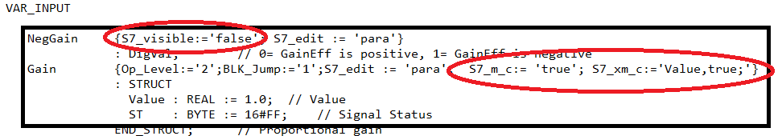
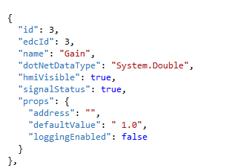

Expected Output
Notes:
5

Slide 6
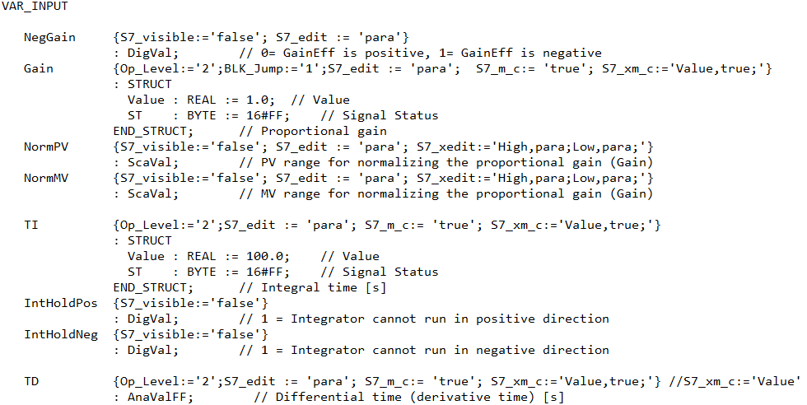
Project Requirement – 1 (.SCL format)
Notes:
6

Slide 7
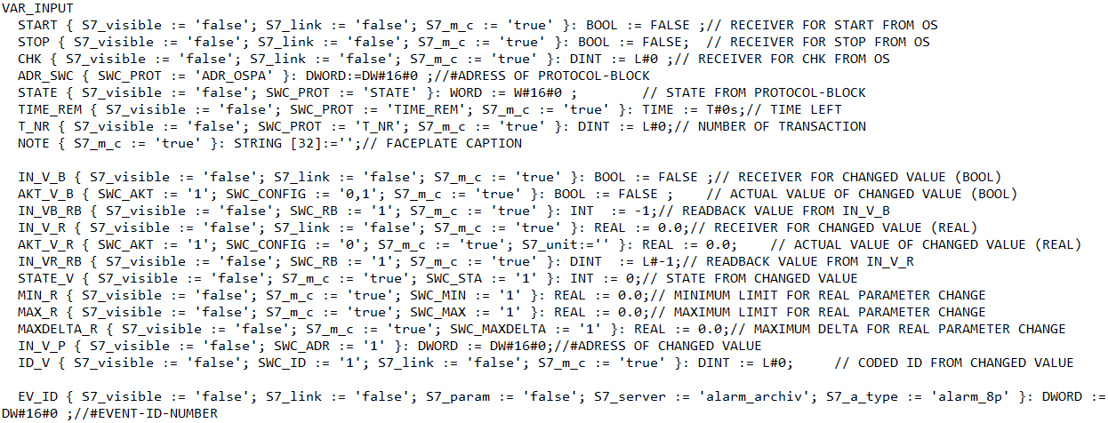
Project Requirement – 2 (.AWL format)
Notes:
7

Slide 8
Domain Rules - 1
Property | Description
id | Auto generated, self incrementing value which starts from 2.
edcId | Value remains same as id.
hmiVisible | ‘true’ by default, ‘false’ if S7_visible is ‘false’.
signalStatus | ‘false’ by default, ‘true’ if S7_xm_c is ‘Value,true’.
loginEnabled | ‘false’ by default.

Slide 9
Domain Rules - 2
Variable type | dotNetDataType | Default value
Real, AnaValFF, AnaVal | System.Double | 0.0
Bool, DigValFF,DigVal | System.Boolean | false
INT | System.Int16 | 0
BYTE | System.Byte | 0
DWORD | System.UInt32 | 0.0
STRING[32] | System.String | “”

Slide 10
Solution Approach
Input and output contents has been read from SCL file.
Properties whose S7_m_c is true has been extracted from SCL File.
Mapping of SCL file and JSON file has been done.
Attributes for the properties has been extracted from SCL file.
A list of objects has been created with attributes.
The list has been written in .csv and .json format.
Windows Form has been created for the tool.
Documentation has been done for the project.
Notes:
10

Slide 11
Software Requirements
Tools
Visual Studio
Programming
C#
Windows Forms
Libraries
Newtonsoft.Json
Notes:
11

Slide 12
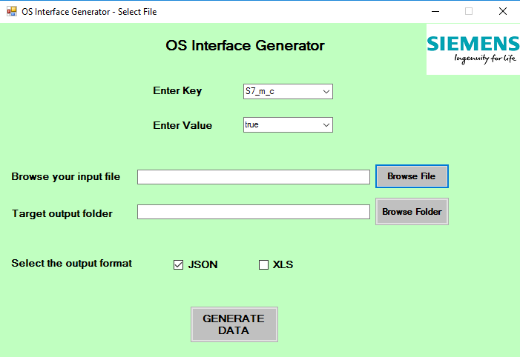
Project Solution (UI)
Notes:
12

Slide 13
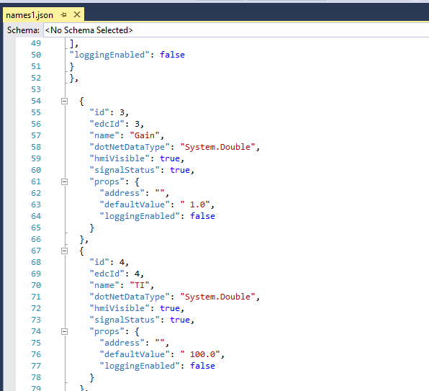
Project Solution (JSON format)
Notes:
13

Slide 14
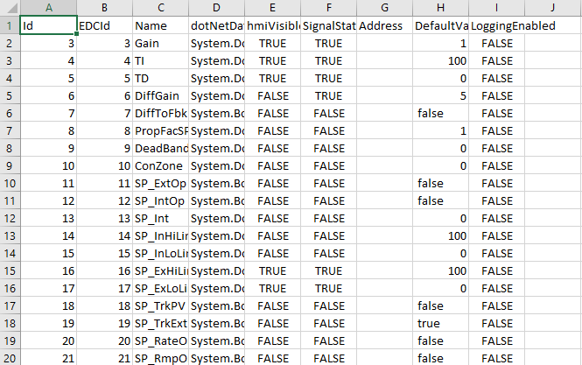
Project Solution (CSV format)
Notes:
14

Slide 15
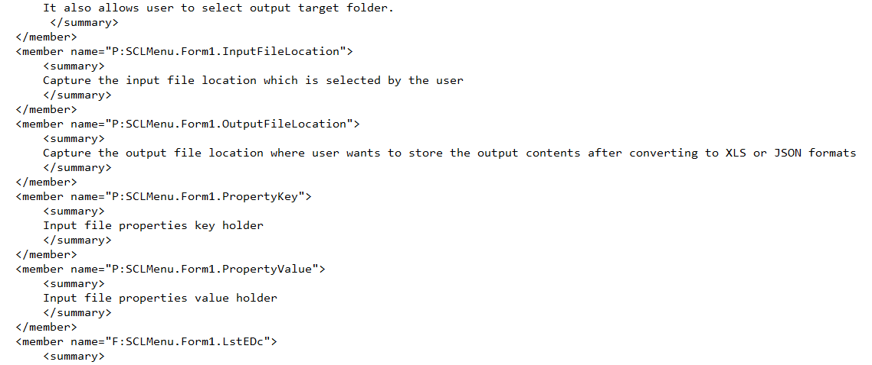
Project Documentation
Notes:
15

Slide 16
Conclusion
Able to read given source file and extract the input and output variables.
Extracted values for the properties of variables which contains given key-value pair (e.g. S7_m_c:=‘true’) and stored them as list of objects.
List of objects are written into .csv and .json files
Notes:
16

Slide 17
Thank You
Any Questions ???
Notes:
17

