Slide 1

CB
Civic Ballot
Secure Online Voting System
Project Explanation – Simple English
Main idea
Two users
Security idea
A web-based voting demo where voters can log in, choose a candidate, submit a ballot, and receive a receipt.
Voter: casts a vote and checks results. Admin: manages the election, voters, candidates, results, and audit trail.
The demo uses SHA-256 hashes and chained audit records to show vote integrity and tamper evidence.
Goutham -- 2500030402
Irfan -- 2500030913
Chaithanya -- 2500031199
Civic Ballot • Secure Online Voting Demo 1

Slide 2
1. Project Overview
What is Civic Ballot?
Civic Ballot is a secure online voting demonstration.
It provides separate login areas for voters and administrators.
Voters can select one candidate and submit a ballot.
After voting, the system creates a receipt with a SHA-256 hash.
Administrators can manage the election and view the audit trail.
Election
The default election is “2026 General Election” and can be changed by the admin.
Candidates
The demo starts with three candidates and allows the admin to add more.
Results
Vote counts and turnout are calculated from submitted ballots.
Civic Ballot • Secure Online Voting Demo 2

Slide 3
2. Problem and Objectives
Why this project?
Problem
Objectives
Traditional voting can require physical polling places, manual counting, and paper records. An online system needs strong identity checks, vote integrity, clear results, and an audit history.
• Provide easy voter login
• Allow one ballot per registered voter
• Record votes and show live tally
• Give the voter a verification receipt
• Keep an audit trail using chained SHA-256 hashes
• Give administrators control over the election
Civic Ballot • Secure Online Voting Demo 3

Slide 4
3. Existing Online Voting Platforms
ElectionBuddy – Secure online elections with email/SMS notifications and different voting options.
Simply Voting – Hosted online voting used by organizations such as universities and municipalities.
Polyas – Uses encryption and mathematical methods to help make online voting secure.

Slide 5
4. What Civic Ballot Solves
Prevents Unauthorized Voting – Only admin-approved email addresses can register, with a 6-digit OTP for verification.
Makes Voting More Transparent – A SHA-256 hash receipt helps the voter verify that the ballot was recorded.
Prevents Admin Misuse – Important admin actions are recorded using a chained hash audit trail.
Makes Voting Convenient – Users can vote remotely from a phone, laptop, or other device. Vote changes can be allowed before the election closes.
Reduces Counting Errors – Votes are counted automatically, saving time and reducing manual counting errors.

Slide 6
3. System Users and Modules
Who uses the system?
Voter Module
Admin Module
1. Voter login
2. View official ballot
3. Select a candidate
4. Seal and submit vote
5. View voting receipt
6. View live results
1. Admin login
2. Election setup and schedule
3. Add candidates
4. Register voters
5. View results and turnout
6. Announce results
7. View audit trail
Civic Ballot • Secure Online Voting Demo 4

Slide 7
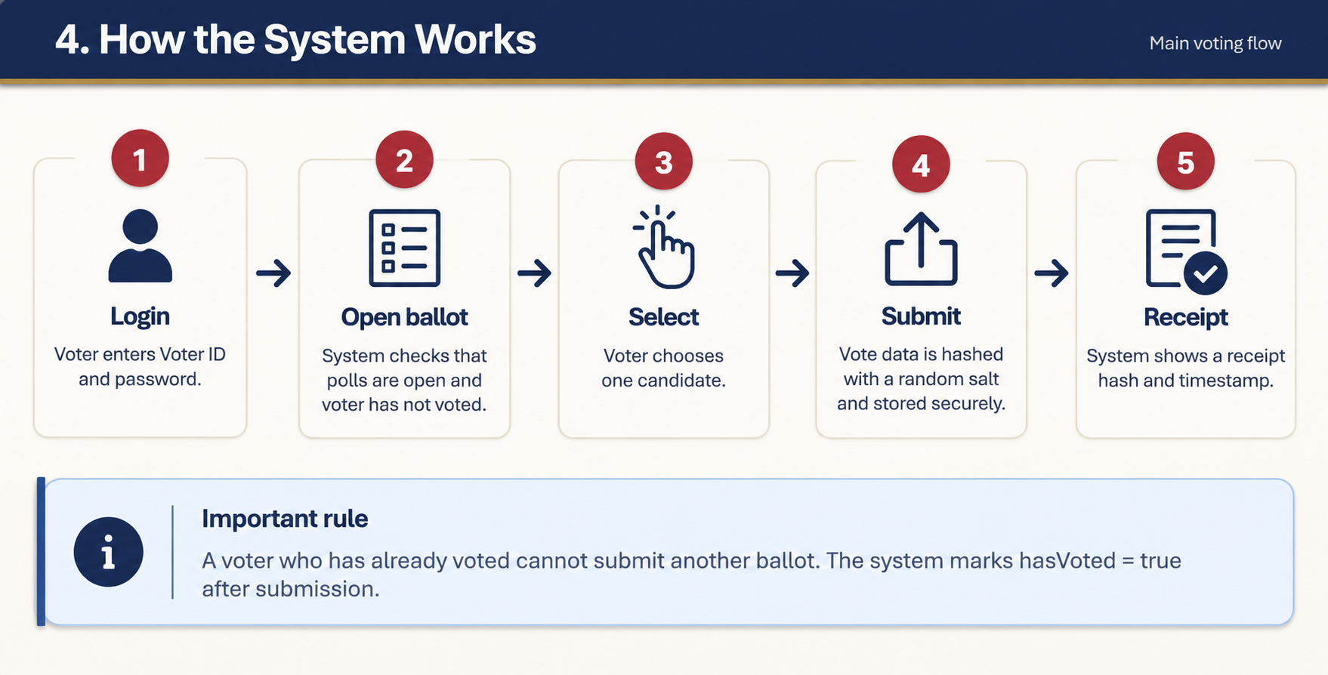
4. How the System Works
Main voting flow
1
2
3
4
5
Login
Open ballot
Select
Submit
Receipt
Voter enters Voter ID and password.
System checks that polls are open and voter has not voted.
Vote data is hashed with a random salt and stored.
System shows a receipt hash and timestamp.
Voter chooses one candidate.
Important rule
A voter who has already voted cannot submit another ballot. The system marks hasVoted = true after submission.
Civic Ballot • Secure Online Voting Demo 5

Slide 8
5. Voter Features
What the voter can do
2026 General Election
Voter login uses a Voter ID and password.
The ballot shows the candidate name and party/description.
The submit button becomes available after a candidate is selected.
After submission, the voter can open “My Receipt”.
The voter can also view live results.
Amara Osei
Civic Unity Party
Daniel Reyes
Progress Alliance
Meera Kapoor
Independent
Seal & submit vote
Civic Ballot • Secure Online Voting Demo 6

Slide 9
6. Admin Features
Election management
Election Setup
Candidate Management
Voter Registry
Change election name, open/close status, and voting dates.
Add a candidate or proposal with a party or description.
Register voters with a Voter ID and temporary password.
Results & Tally
Announce Results
Audit Trail
See ballots cast, registered voters, turnout, and votes per candidate.
Admin can mark the results as certified and announced to voters.
Shows registrations, settings changes, logins, and ballot submissions.
Civic Ballot • Secure Online Voting Demo 7

Slide 10
7. Security and Integrity
How trust is demonstrated
SHA-256 Hash
Salted Vote Hash
Receipt
The project uses the Web Crypto API to calculate a SHA-256 hash.
The submitted vote is combined with voter ID, time, and a random salt before hashing.
The voter receives the hash and timestamp as proof that the ballot was recorded.
Chained Audit Log
One Vote Per Voter
Each audit record stores the previous record’s hash. If an earlier record changes, the chain no longer matches.
The voter is marked as having voted after submission, so another ballot cannot be submitted in the same demo session.
Civic Ballot • Secure Online Voting Demo 8

Slide 11
8. Technologies Used
Simple technology stack
HTML
CSS
JavaScript
Creates the pages and user interface:
• Login screen
• Ballot
• Receipt
• Results
• Admin pages
Controls the design and layout:
• Colors
• Cards
• Buttons
• Tables
• Responsive layout
Controls the application logic:
• Login
• Voting
• Results
• Voter registry
• SHA-256 hashing
• Audit trail
Civic Ballot • Secure Online Voting Demo 9

Slide 12
9. Suggested Demo
How to explain it live
Voter Demo
Admin Demo
1. Open the login page.
2. Use the demo voter credentials from the project.
3. Select a candidate.
4. Click “Seal & submit vote”.
5. Open “My Receipt”.
6. Show the SHA-256 receipt hash.
7. Open “Live Results” to show the updated tally.
1. Log in as administrator.
2. Open Election Setup.
3. Show candidates and election status.
4. Open Voter Registry.
5. Open Results & Tally.
6. Open Audit Trail.
7. Show that actions are recorded with hashes.
Civic Ballot • Secure Online Voting Demo 10

Slide 13
10. Advantages and Limitations
What the demo shows
Advantages
Limitations of this demo
• Easy-to-use voter interface
• Separate voter and admin roles
• One-vote rule in the demo
• Live vote counting
• Receipt for verification
• Tamper-evident audit chain
• Responsive web layout
• Data is stored only in memory and resets when the page is reloaded.
• The code comments describe the vote hash as an “encryption” demonstration; technically, SHA-256 hashing is not encryption.
• It is a project/demo, not a production-ready national election system.
• A real system would need secure backend storage, stronger authentication, key management, and independent security testing.
Civic Ballot • Secure Online Voting Demo 11

Slide 14
Conclusion
In simple words
Civic Ballot is a web-based voting demonstration. A voter logs in, chooses a candidate, submits one ballot, and gets a receipt. The administrator manages the election and can check results and a tamper-evident audit trail.
Key takeaway
Project focus
Security + transparency + easy voting
SHA-256 hashing + audit trail + role-based interface
Based on the uploaded Civic Ballot HTML/JavaScript project.
Civic Ballot • Secure Online Voting Demo 12

Slide 15
Project documentation :
Github link :
https://github.com/Chaithanya-ai1261/CGI_ELECTOINS_PROJECT=
Linkedin article:
https://www.linkedin.com/pulse/online-voting-systems-how-work-security-challenges-road-krishna-wsgpf/

Slide 16


