Slide 1
Optimized K-means using firefly Algorithm
Chaithanya Chikkannaswamy(SUID: 387781563)
Gahan Gurumurthy(SUID: 532778218)

Slide 2
Problem Statement
Using the firefly algorithm to optimize k-means clustering.
k-means clustering is a method of vector quantization, originally from signal processing, that aims to partition n observations into k clusters in which each observation belongs to the cluster with the nearest mean (cluster centers or cluster centroid), serving as a prototype of the cluster
The “firefly algorithm” (FFA) is a modern metaheuristic algorithm, inspired by the behavior of fireflies

Slide 3
More about Firefly Algorithm
FA was developed by Xin-She Yang at Cambridge University in 2007.
There are about two thousand firefly species, and most fireflies produce short and rhythmic flashes
The pattern of flashes is often unique for a particular species.
Two fundamental functions of such flashes are:
to attract mating partners (communication)
to attract potential prey
Females respond to a male’s unique pattern of flashing in the same species.
We know that the light intensity at a particular distance ‘r’ from the light source obeys the inverse square law.
The air absorbs light which becomes weaker and weaker as the distance increases.
The flashing light can be formulated in such a way that it is associated with the objective function.
Notes:
In science, an inverse-square law is any scientific law stating that a specified physical quantity is inversely proportional to the square of the distance from the source of that physical quantity.

Slide 4
Assumptions about firefly in our Firefly Algorithm
For simplicity in describing our new FA we now use the following three idealized rules:
all fireflies are unisex so that one firefly will be attracted to other fireflies regardless of their sex
Attractiveness is proportional to their brightness, thus for any two flashing fireflies, the less brighter one will move towards the brighter one. If there is no brighter one than a particular firefly, it will move randomly
The brightness of a firefly is affected or determined by the landscape of the objective function. For a maximization problem, the brightness can simply be proportional to the value of the objective function

Slide 5
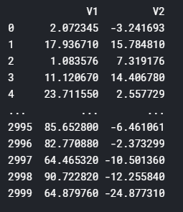
More about the dataset we have used
Dataset - xclara: Bivariate Data Set with 3 Clusters
(https://www.kaggle.com/ukveteran/bivariate-data-set-with-3-clusters)
Description : An artificial data set consisting of 3000 points in 3 well-separated clusters of size 1000 each.
Format : A data frame with 3000 observations on 2 numeric variables giving the x and y coordinates of the points, respectively.

Slide 6
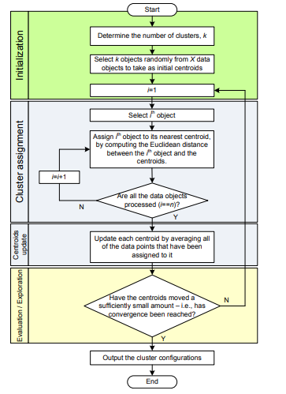
How K-means clustering works?
Two key factors in achieving good K-means clustering results:
The ability to find good centroid locations at the start.
The ability to explore global optima beyond the local ones
Need for optimization:
To obtain the best clustering results, the K-means algorithm is often applied many times to different random initiations.
However, this is done at the cost of increased computation and training time. Each individual random trial is independent and no guarantee in finding the best result
Notes:
For the first factor, the initial centroids should be distributed in such a way that the clusters formed upon them will achieve a global optimum. In clustering, the global optimum can be regarded as having maximum intrasimilarities and minimum inter-similarities. However, without knowing where the global optimal is, it is computationally very difficult to find one in a large search space. K-means algorithms cluster data into non-overlapping convex groups and always converge, which is its merit, although not necessarily to the global optimum. As with any partitional clustering algorithm, they are highly sensitive to the initial parameters: the number k of clusters and their centroids, respectively

Slide 7
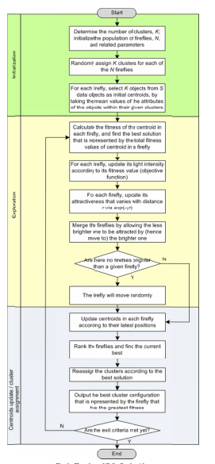
Optimizing K-means with Firefly Algorithm
The FA model performs the search operation according to the foraging behaviors of fireflies . In FA, a swarm of fireflies is initiated randomly, and each firefly denotes one initial solution. A fitness score is calculated based on the objective function of each firefly, which is then assigned as the light intensity. According to Yang, fireflies with lower light intensities are attracted to those with strong illuminations in the neighbourhood, defined as,
Where i and j denote fireflies with lower and higher light intensities, respectively, while and denote the current positions of fireflies i and j at the t^{th} iteration, respectively. Parameter β₀ is the initial attractiveness while γ is the light absorption coefficient, and r_{ij} denotes the distance between fireflies i and j. In addition,α_{t} is a randomization coefficient, while ε_{t} is a vector of random numbers drawn from a Gaussian distribution or a uniform distribution.

Slide 8
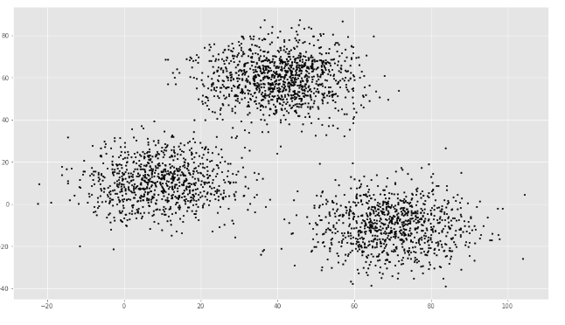
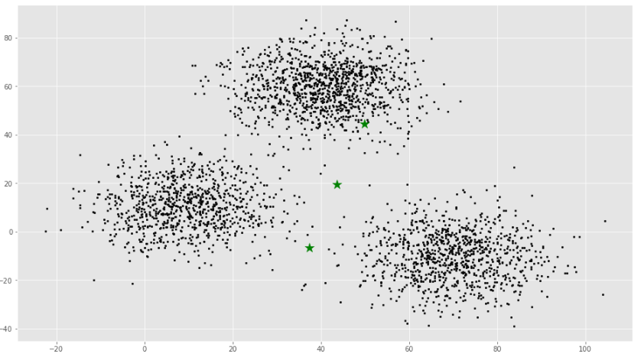
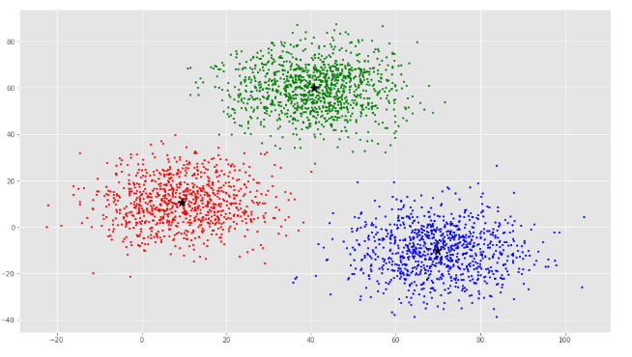
Results: How firefly optimizes the k-means clusters
Initial Data representation
Initial Centroid Representation
Final FA optimized K-means plot

Slide 9
How K-means compares to FA optimized K-means
Objective Function Value
 | Best | Worst | Average
K-means | 78.9451 | 152.3638 | 127.8941
Firefly optimized K-means | 78.9408 | 81.3302 | 79.72
Firefly Inputs
α (randomness): 0.5
0.2 γ (absorption): 1.0
β = 0
β0 = 1
Population: 3000
CPU time
 | Best | Worst | Average
K-means | 51.21 | 51.67 | 51.44
Firefly optimized K-means | 142.89 | 177.7 | 167l24

Slide 10
Conclusion
Firefly algorithm has been used to initialize the centroids for K-Means to improve the performance of the K-Means algorithm in the xclara dataset
identify centroid values of traditional K- Mean’s clustering algorithm using Firefly optimization method.
In the traditional K-Means clustering algorithm, the centroid values are randomly selected. By using the proposed Firefly algorithm the best values for the initial cluster centroids can be obtained.
The firefly K-Means clustering algorithm gives the better result in terms of classification

Slide 11
Other application areas of Firefly Algorithms
• Digital image compression and image processing
• Feature Selection and fault detection
• Antenna design
• Structural design
• Scheduling
• Chemical phase equilibrium
• Dynamic problems
• Clustering

Slide 12
References
https://towardsdatascience.com/k-means-clustering-algorithm-applications-evaluation-methods-and-drawbacks-aa03e644b48a
https://www.periyaruniversity.ac.in/ijcii/issue/Vol5No4March2016/IJCII%205-4-322.pdf
A_New_Hybrid_Approach_for_Data_Clustering_using_Fi by Prof. Mohammad Reza Meybodi

Slide 13
Thank you

