Slide 1

Table design using divs and spans without using <table> tag
K.CHAITHANYA KRISHNA BVRIT 21211A05D4

Slide 2
<table>Table Layout</table> vs <div><span>Div/span Layout </span></div>
Introduction
Traditional web design often relies on the <table> tag for structuring tabular data.
However, in modern web development, there's a shift towards using more flexible and semantic HTML elements.

Slide 3
<table>TABLE LAYOUT</table>
Table layout is one of the least suggested layout in HTML because of its complexity. As it name suggests it is based on <table> element. <table> element provides the functionality of arranging data in the form of rows and columns.
The <table> tag is also a container tag i.e. it has both opening and ending tag. Inside <table> element we can use more than one HTML element but there are three meta tags which is necessary to use in order to arrange data into the table.
First one is <tr> tag which means table row and it adds the new row in table.
Second one is <th> tag which stands for table heading and it stores the heading of the table of the table. And the last one is <td> i.e. table data that stores the information or data of the table.
Designing tables using <div> and <span> elements instead of the <table> tag is a common practice in modern web development, especially in scenarios where you need more flexibility and control over the layout and styling.

Slide 4
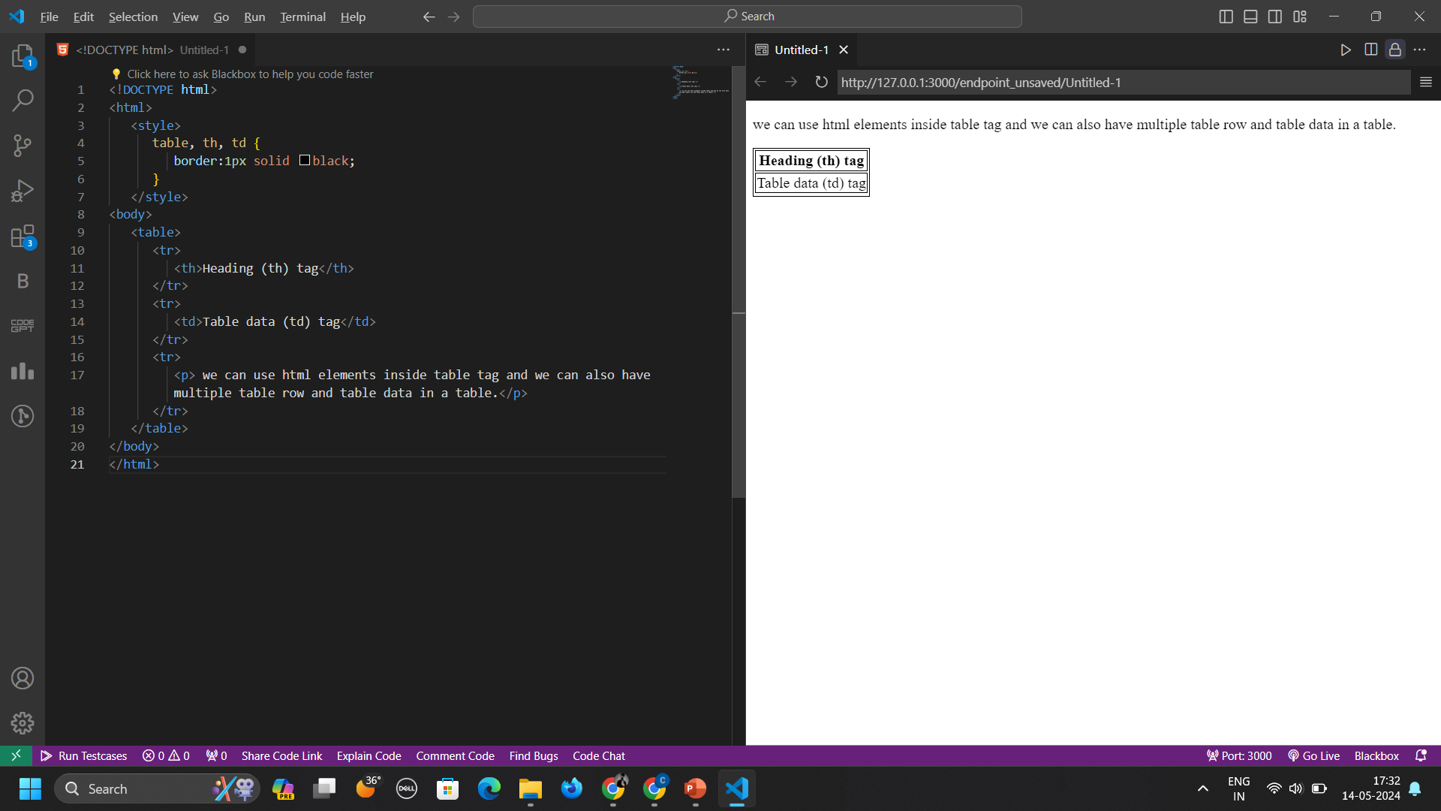
TABLE LAYOUT
- Neil Armstrong

Slide 5
<div><span> DIV’S AND SPAN’S LAYOUT </span></div>
DIVS (<div>)
The <div> element acts as a foundational building block, enabling developers to create structured sections within a webpage. Serving as a block-level container, <div> elements are adept at grouping related content and delineating distinct areas of a layout. Whether it's defining header, footer, sidebar, or main content sections, <div> elements offer flexibility in structuring webpage layouts, fostering clean and organized code.
SPANS(<span>) Conversely, the <span> element operates at an inline level, allowing developers to apply targeted styles or functionality to specific segments of text or inline elements within a document. Often used for fine-grained styling or scripting purposes, <span> elements facilitate the isolation and customization of individual elements or text fragments within larger content blocks.
In modern web development, the layout structure is predominantly crafted using <div> and <span> elements in HTML, empowered by CSS styling. These elements offer a versatile and semantic approach to organizing content and design on webpages.

Slide 6
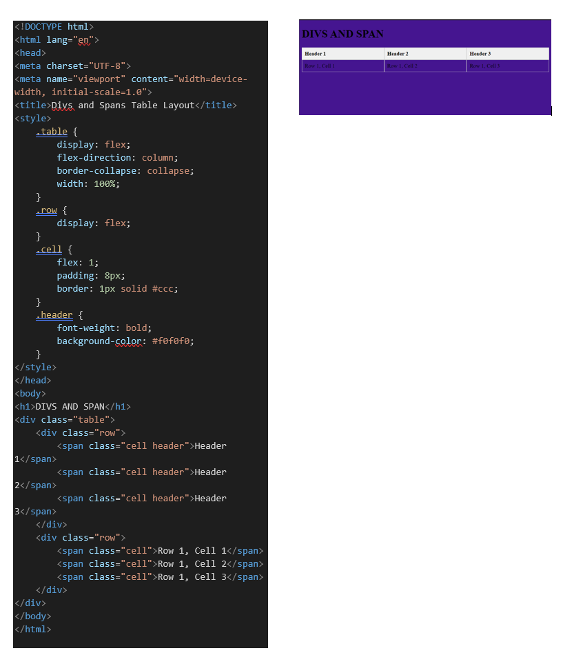
DIV & SPAN LAYOUT

Slide 7
DIV & SPAN V/S TABLE LAYOUT
Aspect | Div-span Layout | Table Layout
Structure and Semantics | Utilizes <div> and <span> elements for structural hierarchy. Offers semantic markup for content organization. | Relies on <table>, <tr>, <th>, <td> elements for data presentation. Primarily designed for tabular data representation.
Flexibility | Provides flexibility in layout design and responsiveness. Allows greater control over styling with CSS. | Less flexible, rigid structure designed for tabular data. Challenging to adapt for responsive design.
Accessibility | Enhances accessibility by providing clear document structure. Facilitates interpretation by assistive technologies. | May present accessibility challenges, especially for screen readers. Requires careful markup for accessibility compliance.

Slide 8
DIV & SPAN V/S TABLE LAYOUT
Aspect | Div-span Layout | Table Layout
Responsiveness | Enables fluid adaptation to different screen sizes and devices. Well-suited for responsive design principles. | Prone to difficulties in achieving responsiveness due to rigid structure. Requires additional effort for responsive layouts.
Maintainability | Offers modular and semantic structure for easier maintenance. Simplifies layout modifications with cleaner codebase. | Can become unwieldy and difficult to maintain as complexity increases. May require substantial restructuring for modifications.
Styling | Provides fine-grained control over styling through CSS. Allows customization of individual elements for unique designs. | Styling options may be limited and less predictable with CSS. Requires workarounds for complex layouts or design variations.

Slide 9
Conclusion
Div-Span Layout: Offers flexibility, accessibility, and ease of maintenance. Ideal for modern web design, providing semantic structure and responsive capabilities.
Table Layout: Suited for tabular data but lacks flexibility and accessibility. Challenging for responsive design and may hinder maintainability.
In today's web development landscape, embracing div-span layout empowers developers to create dynamic, accessible, and visually appealing websites, ensuring an optimal user experience across devices.

Slide 10
THANK YOU !!

