Slide 1

HTML DATA ATTRIBUTE
K.CHAITHANYA KRISHNA BVRIT 21211A05D4

Slide 2
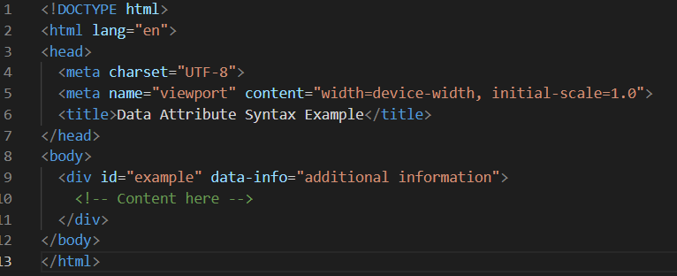
<h2> Syntax of Data Attributes</h2>
<p> Data attributes are defined using the ‘data-’ prefix followed by a meaningful name.</p>
<p>They can contain any string of characters</p>
<p>Below code snippet demonstrates the syntax of data attribute</p>
<img>
</img>

Slide 3

<h2> Common Use Cases</h2>
Storing information
Passing data to JavaScript functions:
Customizing styles or behavior
Data attributes are commonly used to store additional information about HTML elements
Data attributes can be used to pass data from HTML elements to JavaScript functions, enabling dynamic behavior based on user interaction. clicking the button triggers a JavaScript function "performAction", passing the value of the data attribute "data-action" as an argument. This allows the function to perform different actions based on the value of the data attribute.
Data attributes can be used to customize styles or behavior of HTML elements dynamically.
JavaScript or CSS can then be used to apply specific styles or behavior based on the value of this data attribute, such as changing the background color or displaying additional content.

Slide 4
<h2> Benefits of Data Attributes</h2>
<dl>
<dt>Enhanced readability and maintainability:</dt>
<dd>By using descriptive names for data attributes, developers can improve the readability of the HTML code, making it easier for others to understand the purpose of each element.
</dd>
<dt>Improved accessibility and compatibility:</dt>
<dd>By providing meaningful labels or descriptions for data attributes, developers can ensure that users with disabilities can access and interact with the content effectively.
</dd>
<dt>Separation of concerns between HTML and JavaScript/CSS:</dt>
<dd>This separation enhances code organization and maintainability, as it isolates the data related concerns from the presentation and behavior concerns.
</dd>
</dl>

Slide 5
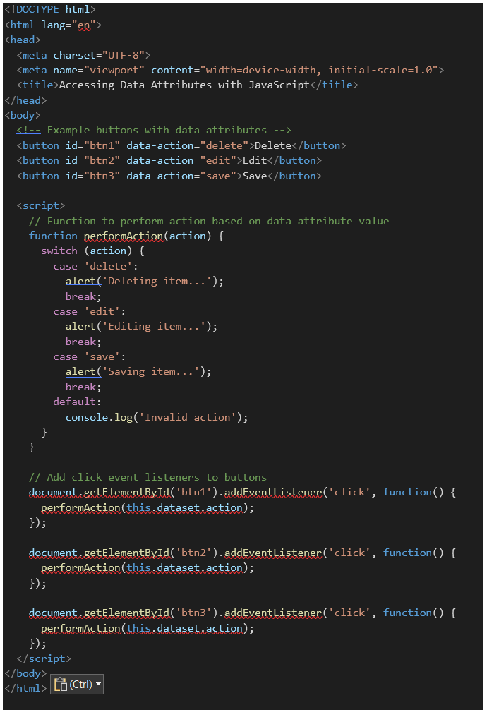
<h2> JavaScript |Data Attribute</h2>
In this example, we have three buttons with different actions: "Delete", "Edit", and "Save". Each button has a corresponding data attribute (data-action) indicating the action it performs.
We define a JavaScript function performAction(action) to perform different actions based on the value of the data-action attribute.
Event listeners are attached to each button using addEventListener. When a button is clicked, it triggers the performAction function with the value of its data-action attribute as an argument.
Depending on the value of data-action, the function displays an alert message indicating the action to be performed.

Slide 6
<h1> THANK YOU! </h1>

