Slide 1

Energy consumption and monitoring analysis
Project-1
Group 20
Suvroneil Ghosh
Chaithanya Gudipati

Slide 2
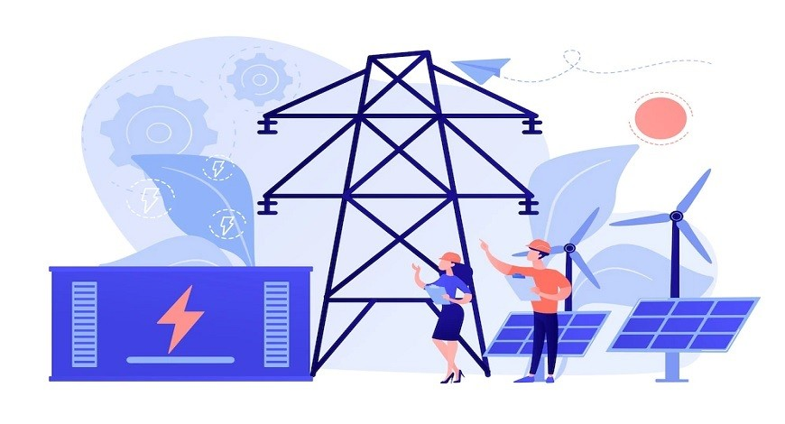
Introduction
Energy consumption and analysis stand at the forefront of our pursuit for a sustainable and efficient future. Understanding and analyzing energy consumption patterns are crucial endeavors, providing a holistic view of how resources are utilized. This insight is paramount for informed decision-making, resource optimization, and, ultimately, fostering a responsible and resilient approach to energy management.

Slide 3
Problem Statement
The goal of this project is to develop and put into operation a reliable data warehouse system for gathering, processing, and analyzing data on energy usage. The objective is to offer stakeholders a consistent platform to access, study, and derive useful insights from this data, facilitating a comprehensive understanding of energy consumption trends in the process

Slide 4
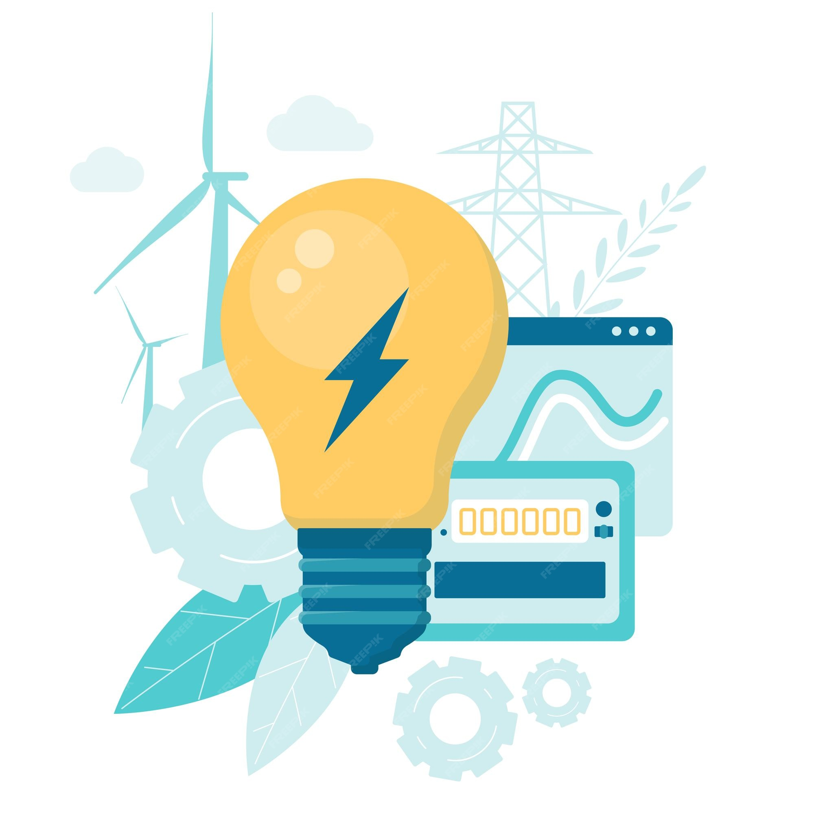
What are we analyzing?
Total energy Consumption
Top energy consumers across the world
Distribution of energy consumption for the top consumer country and which is highest consumed energy and how it changed over years
Total Electricity Generation, Sources of electricity generation
How the major source of electricity generation changed over years

Slide 5
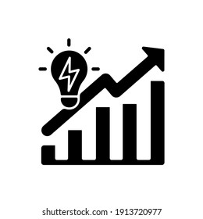
LET’S DIVE INTO DASHBOARD TO GAIN INSIGHTS

Slide 6
AWS PIPELINE FOR BOSTON UTILITY CONSUMPTION
Project-2

Slide 7
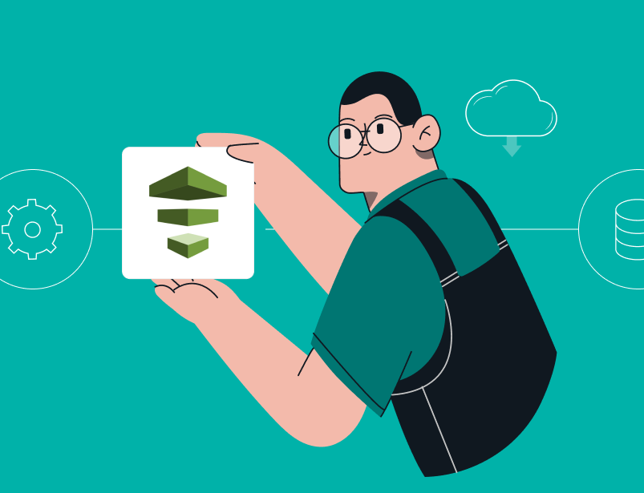
Problem Statement
The objective of this project is to develop an end-to-end, comprehensive and automated data pipeline for Boston's utility consumption leveraging the AWS platform. The goal is to provide valuable insights to customers to effectively monitor and optimize their energy consumption

Slide 8
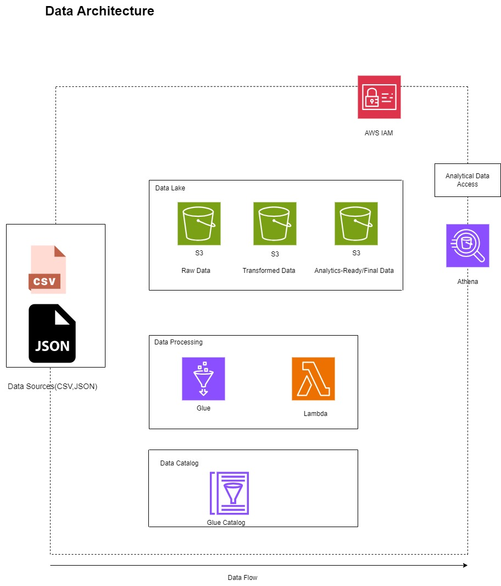
Architecture Diagram

Slide 9
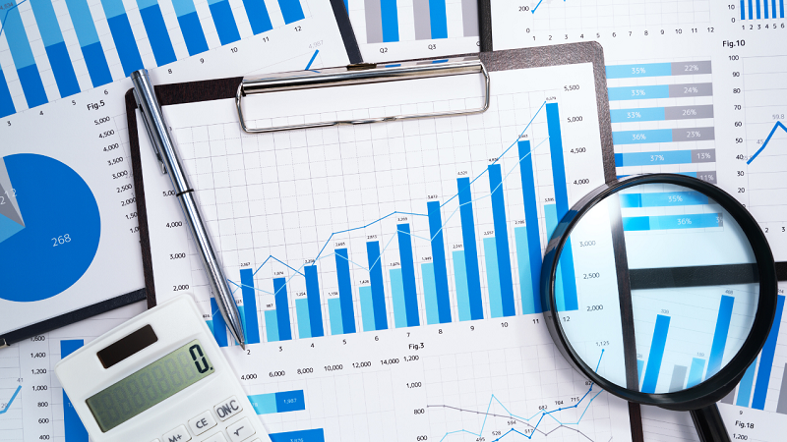
What are we analyzing?
Total energy consumption across Boston and how it changed over years
Department-wise energy consumption
Maximum monthly energy demand
Median cost of utility
Average utility cost per week

Slide 10


