Slide 1

HR Employee Attrition Analysis
Unlocking Workforce Insights to Understand Attrition, Salary Trends, and Employee Behavior

Slide 2
Problem Statement
Employee attrition is a major challenge impacting productivity, cost, and team stability. This project aims to analyze employee data to uncover patterns in workforce distribution, salary, experience, and demographics to help HR make data-driven decisions to reduce attrition.
Objectives
Understand workforce distribution
Identify high-paying roles and salary patterns
Analyze experience levels across departments
Explore demographic trends (age, gender)

Slide 3
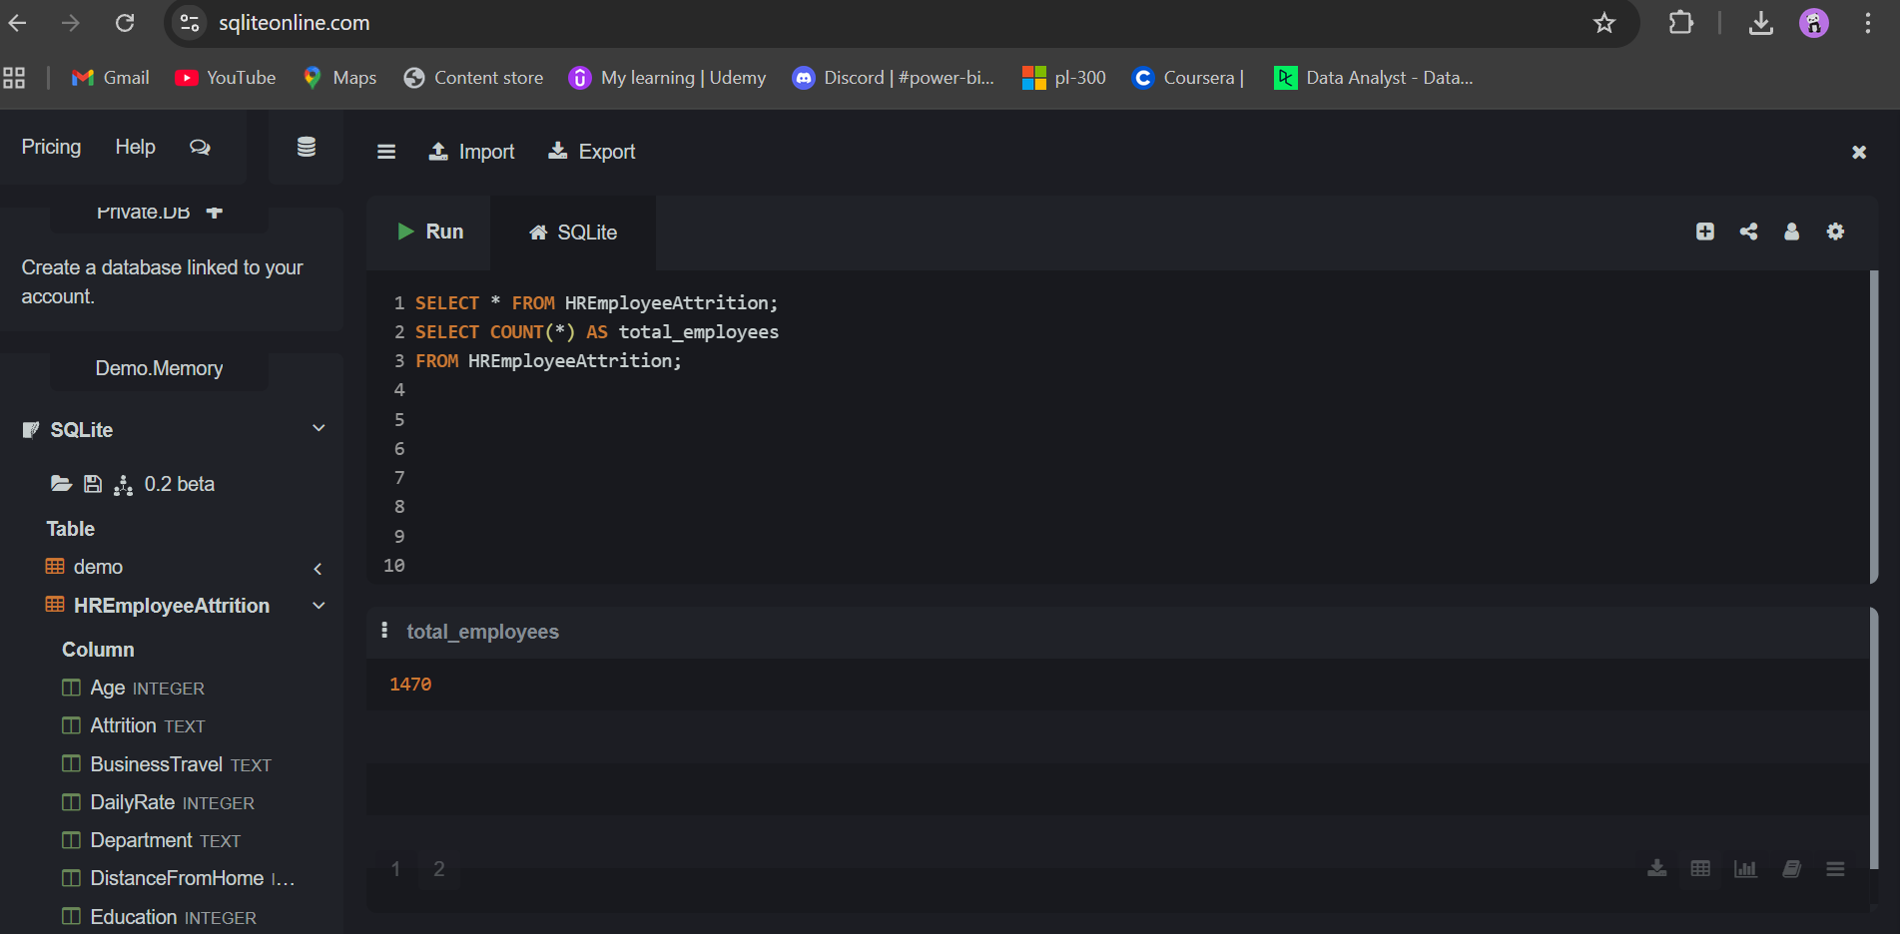
Q1. How many total employees are in the company?
Answer: 1470 employees
Insight:
The company has a moderately large workforce, allowing meaningful segmentation.
This dataset size is sufficient for identifying reliable HR trends.

Slide 4
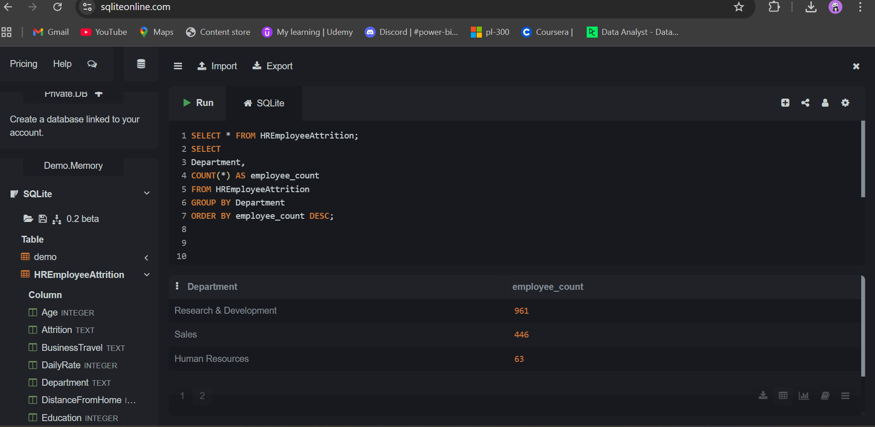
Q2. How many employees are there in each department?
Answer:
Research & Development → 961
Sales → 446
Human Resources → 63
Insight:
R&D dominates (~65%) of workforce → core business function
HR is very small → may lead to overload in HR operations
Sales is the second largest → revenue-driving team

Slide 5
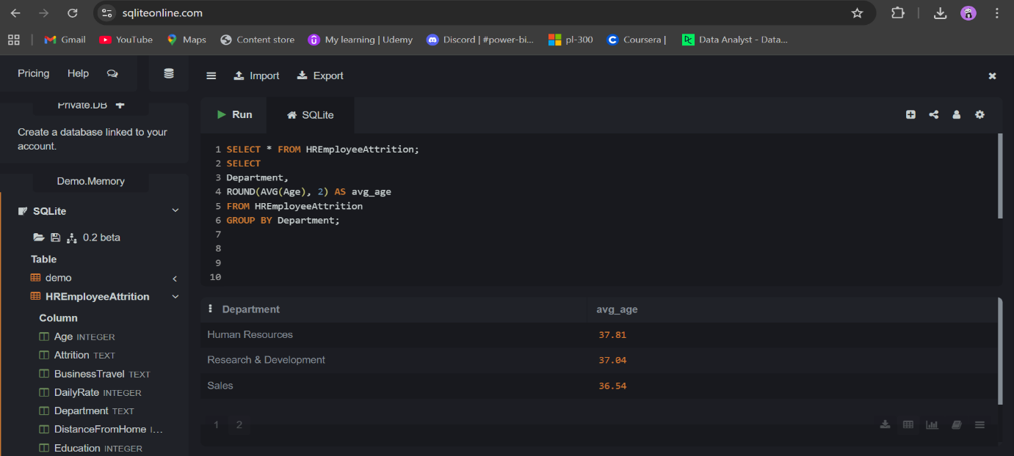
Q3. What is the average age of employees by department?
Answer:
Human Resources → 37.81
Research & Development → 37.04
Sales → 36.54
Insight:
Age distribution is very balanced across departments
Slightly older workforce in HR → possibly more experienced roles
No major age bias → good organizational diversity

Slide 6
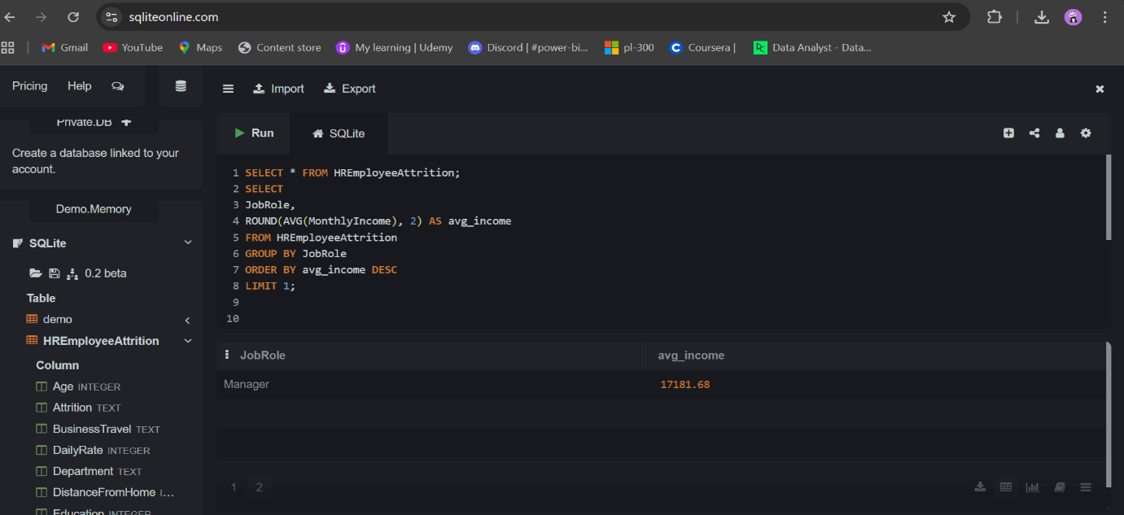
Q4. Which job role has the highest average monthly income?
Answer: Manager (~17,000+)
Insight:
Managers earn significantly higher → reflects leadership premium
Indicates hierarchical salary structure
Useful for understanding career growth incentives

Slide 7
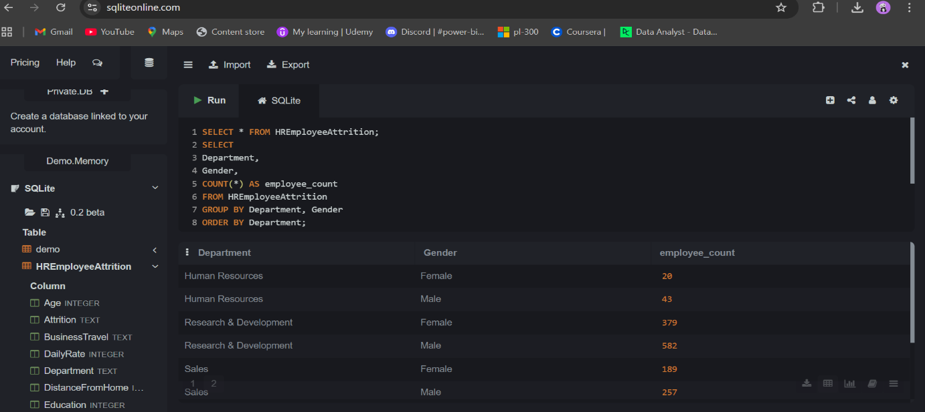
Q5. What is the gender distribution across departments?
Answer (observed pattern):
R&D → More males than females
Sales → Balanced but male-dominant
HR → More balanced / slightly female-dominant
Insight:
Gender imbalance exists in technical roles (R&D)
HR shows better gender diversity
Opportunity to improve inclusion in technical teams

Slide 8
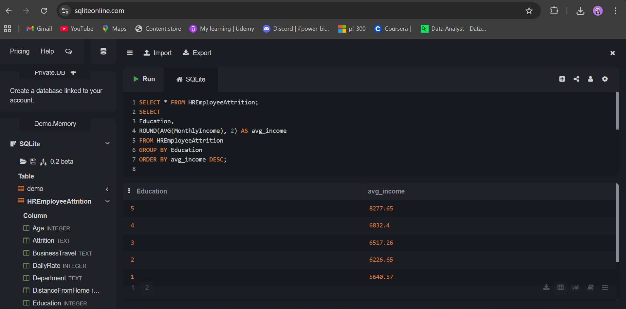
Q6. Average monthly income by education level?
Answer:
Level 5 → Highest (~8277)
Level 4 → ~6832
Level 3 → ~6517
Level 2 → ~6226
Level 1 → Lowest (~5640)
Insight:
Strong positive correlation between education and salary
Higher education = higher earning potential
Supports investment in employee upskilling programs

Slide 9
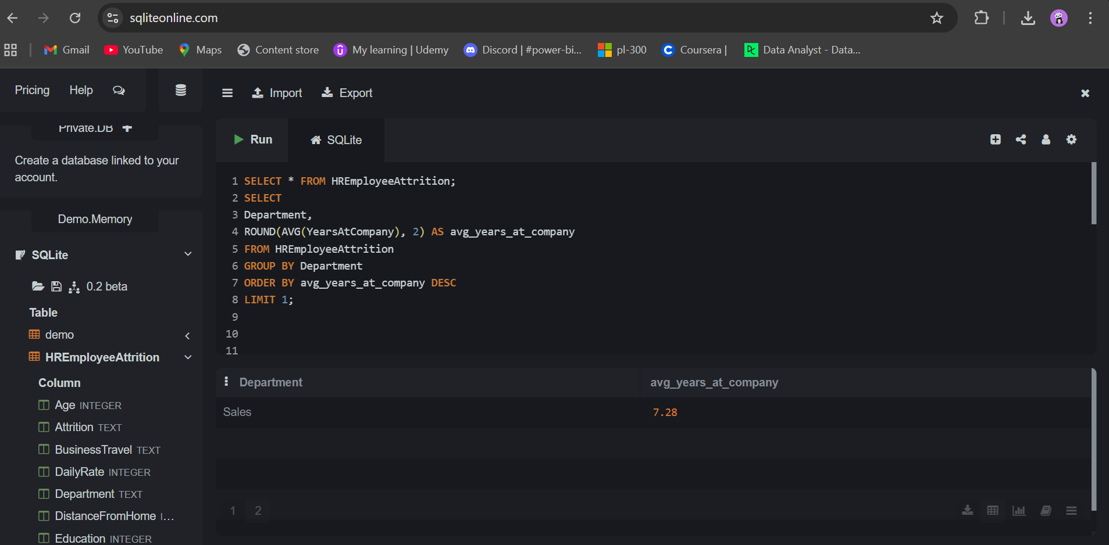
Q7. Which department has the most experienced employees on average?
Answer: Sales (~7.28 years)
Insight:
Sales team has the highest average tenure
Indicates:
Strong retention OR
Experience-heavy roles
R&D might have higher turnover or younger employees

Slide 10
Recommendations
Improve gender diversity in R&D
Expand HR team to handle employee lifecycle better
Create career growth paths to retain talent
Invest in training & education programs
Monitor R&D attrition closely
Conclusion
This analysis highlights critical workforce patterns in department distribution, salary structure, and experience levels. The company shows strong stability in Sales and structured salary growth, but needs improvement in HR capacity and diversity in technical roles. Data-driven HR strategies can significantly improve employee retention and organizational efficiency.

