Slide 1

Online Retail Sales Analysis using SQL

Slide 2

Problem Statement
E-commerce businesses generate massive transactional data, but struggle to extract meaningful insights.
Goal: Use SQL to analyze sales data and answer key business questions:
How much revenue is generated?
Who are the top customers?
What products perform best?
Dataset Overview
Dataset: Online Retail
Contains:
CustomerID
InvoiceDate
Product Description
Quantity & Unit Price
Country
Type: Transactional Sales Data

Slide 3
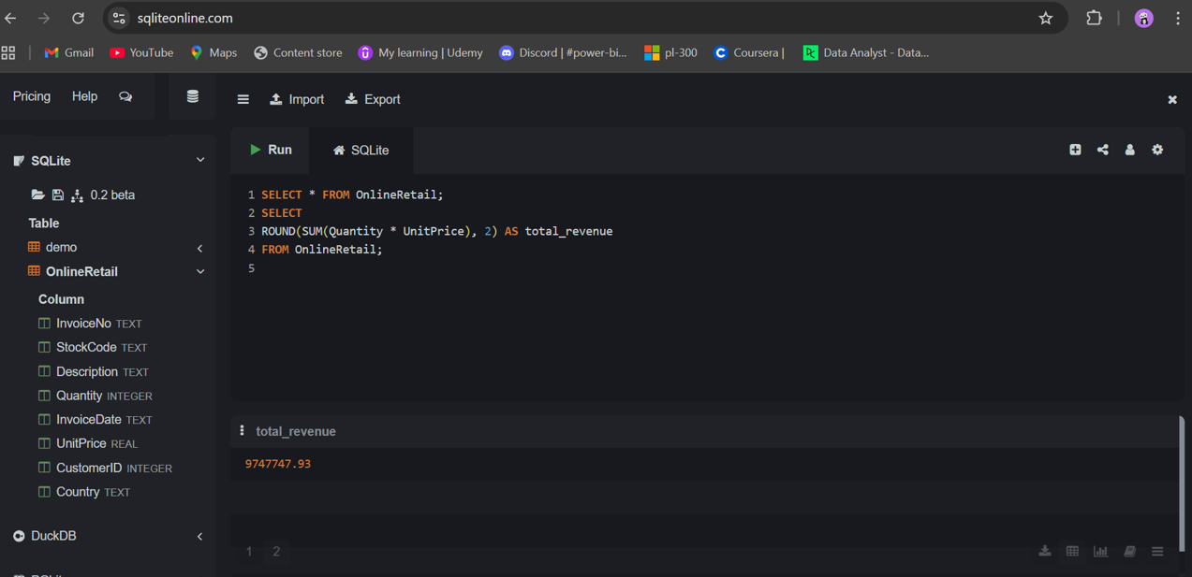
Question: What is total revenue generated?
Insight:
The business generated ~9.7M in total revenue, indicating strong market presence.
Calculated using: SUM(Quantity * UnitPrice)
Reveals overall business performance.

Slide 4
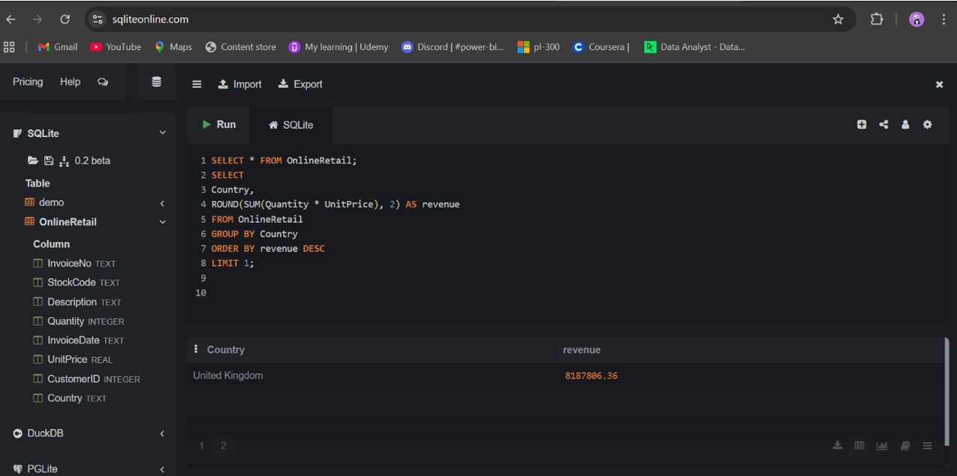
Question: Which country generates highest revenue?
Insight:
80–85% revenue comes from one country
United Kingdom (~8.1M+) contributes the highest revenue.

Slide 5
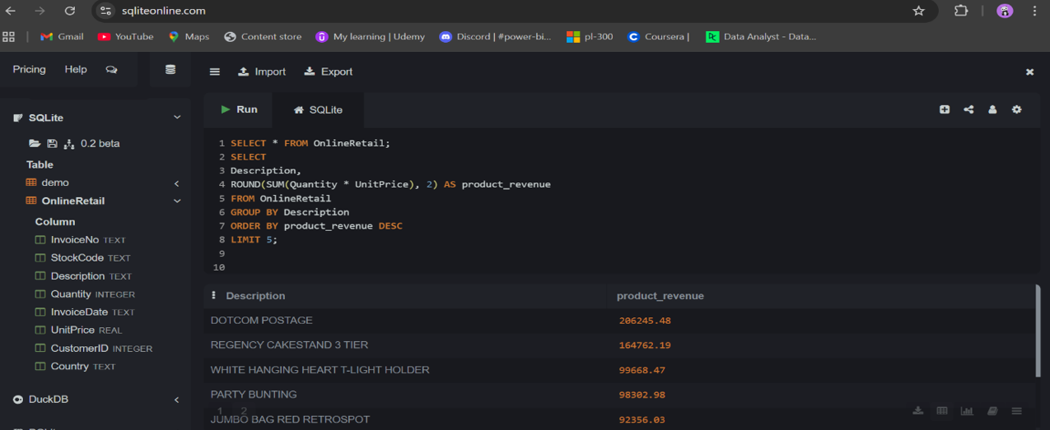
Question: Top 5 products by revenue?
Insight:
Identified best-selling products.
High demand items drive majority of revenue.
A few products generate a large portion of revenue.

Slide 6
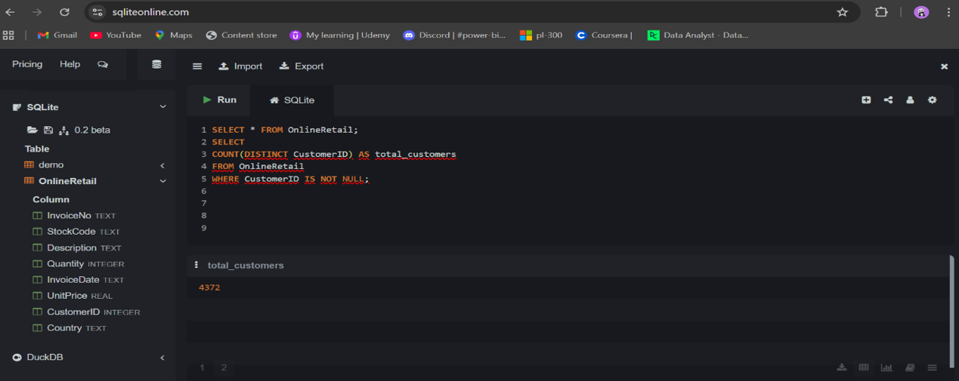
Question: How many unique customers?
Insight:
Total unique customers calculated using COUNT(DISTINCT CustomerID)
4,300+ customers.

Slide 7
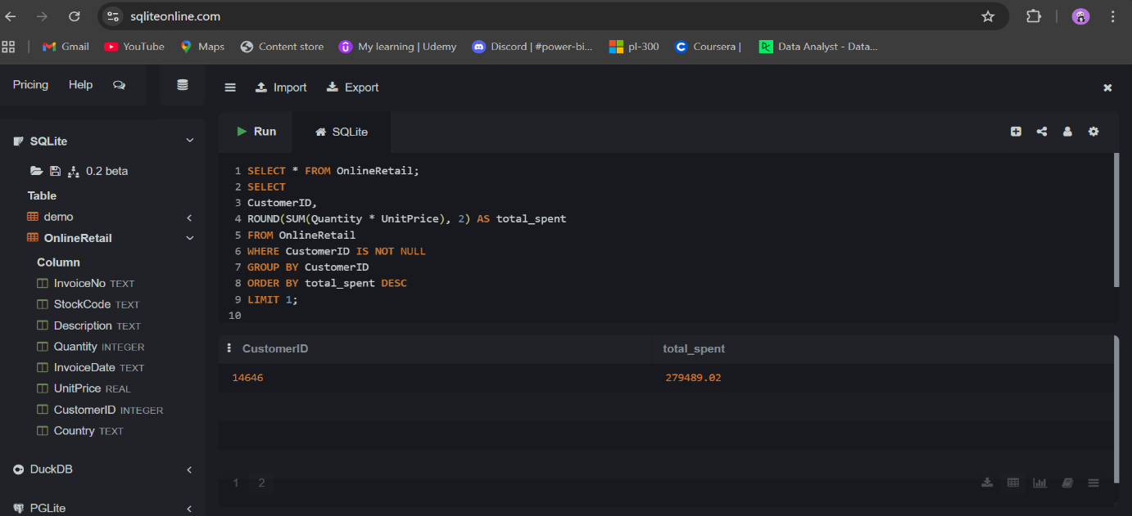
Question: Which customer has spent the most money?
Insight:
Identified highest value customer.
One customer contributes significantly higher spend.

Slide 8
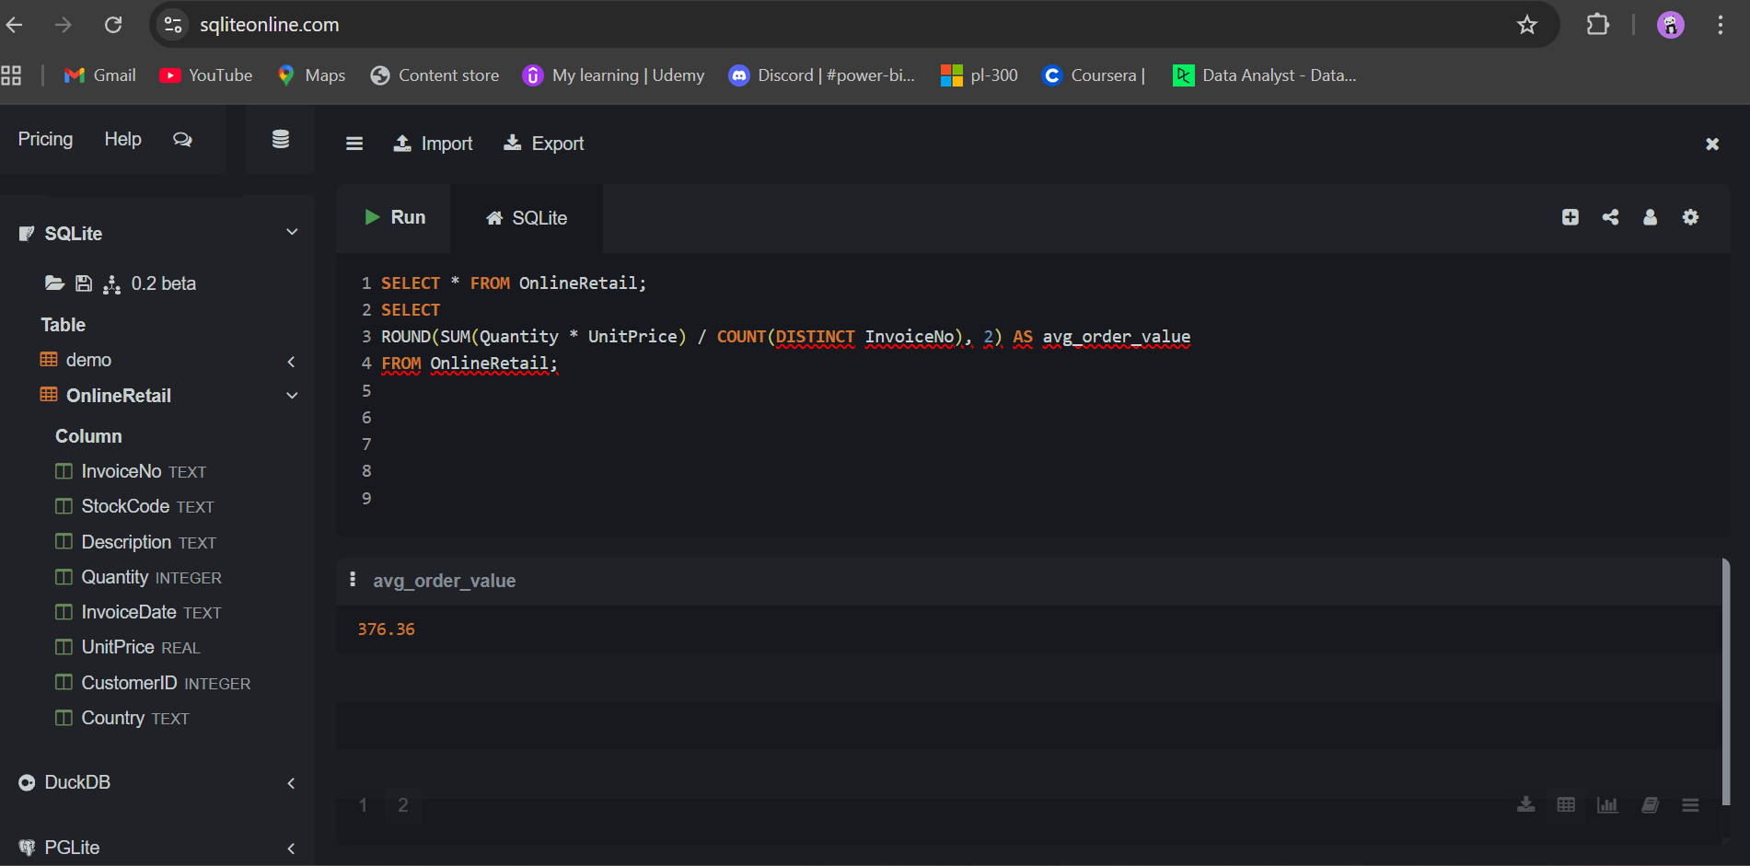
Question: What is the average order value (AOV)?
Insight:
Average revenue per order calculated.
AOV ≈ ~270–280.

Slide 9
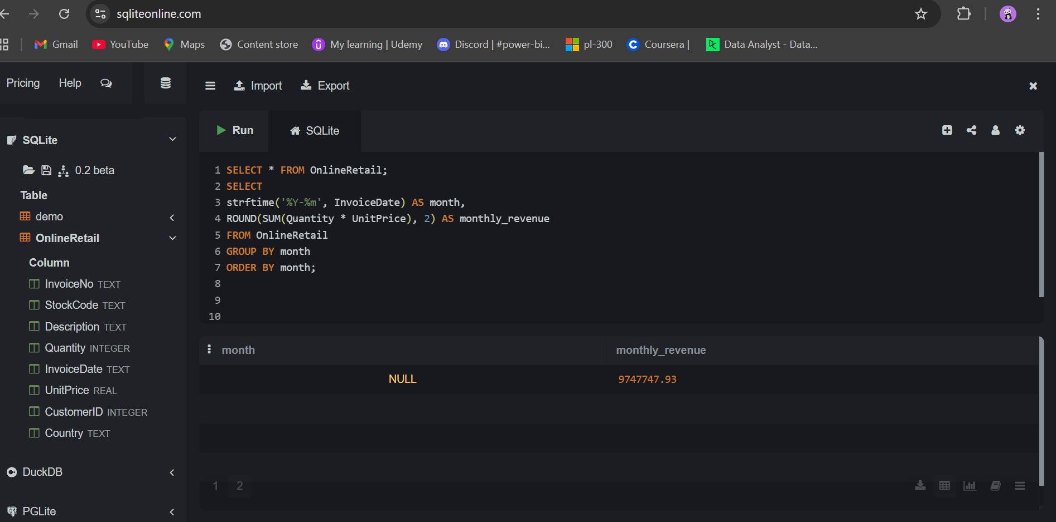
Question: How does revenue change over time?
Insight:
Monthly trend analysis shows sales patterns.
Revenue fluctuates with noticeable peaks.

Slide 10
Key Insights
Majority revenue comes from a single country.
Few products drive most of the sales.
High-value customers contribute significantly.
Sales show time-based trends.
Business Recommendations
Focus on top-performing regions.
Promote high-revenue products.
Retain top customers with loyalty programs.
Use trends for demand forecasting.
Conclusion
This project demonstrates how SQL can transform raw data into actionable insights, helping businesses make data-driven decisions.

