Slide 1

Sales Data Analysis using SQL
Extracting Insights from Transactional Data

Slide 2


🎯 Problem Statement
Businesses generate large volumes of sales data, but without analysis, it’s difficult to understand performance, customer behavior, and growth opportunities.
👉 Goal: Use SQL to answer key business questions and uncover actionable insights from the sales data.
Objective
Analyze sales dataset using SQL queries
Answer key business questions around revenue, customers, and trends
Convert raw data into actionable insights
Dataset Overview
Dataset: sales_data_sample
Includes: Orders, Customers, Products, Countries
Key metrics: Sales, Quantity, Order Date, Status

Slide 3
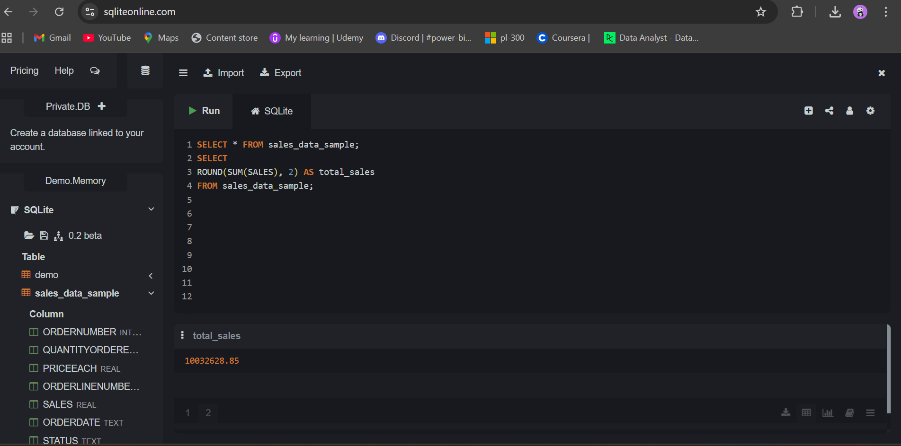
Q1: What is the total sales amount?
Answer: 10,032,628.85
Insight:
- The business has generated over 10M in revenue, indicating strong overall performance. - This acts as a benchmark for evaluating growth and success.

Slide 4
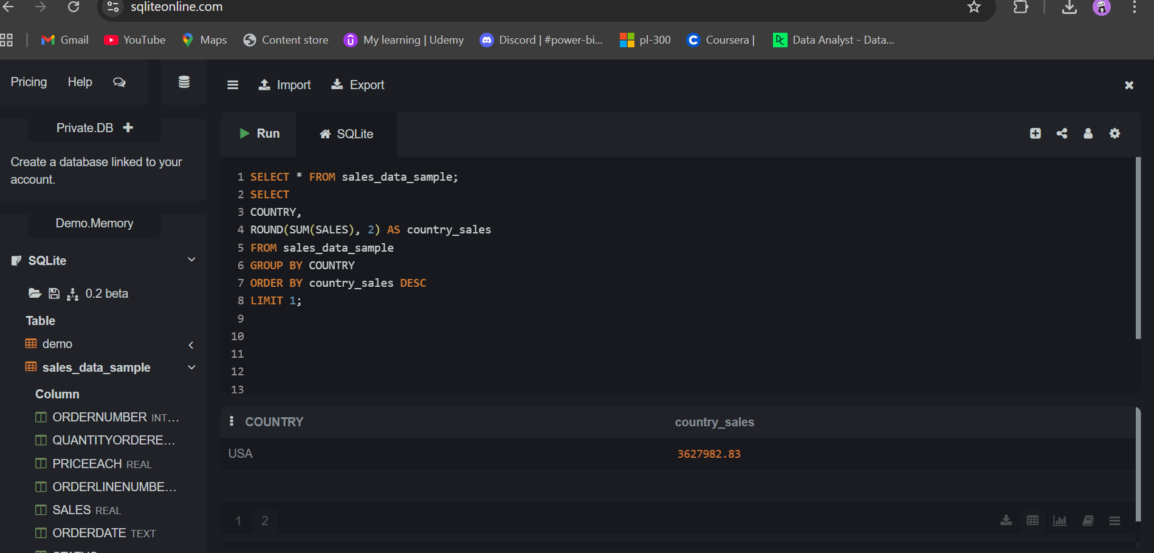
Q2: Which country generates the highest sales?
Answer: USA
Insight: - The USA is the top revenue contributor. - Suggests strong market demand → focus marketing & retention strategies here.

Slide 5
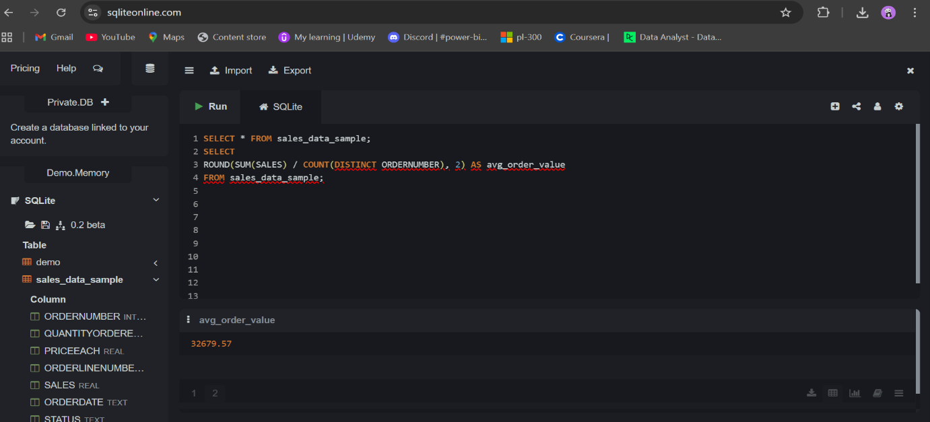
Q3: What is the average order value?
Answer: 32679.57
Insight: - Shows how much customers spend per order. - Helps evaluate pricing strategy and customer purchasing behavior. - Higher AOV = better revenue efficiency.

Slide 6
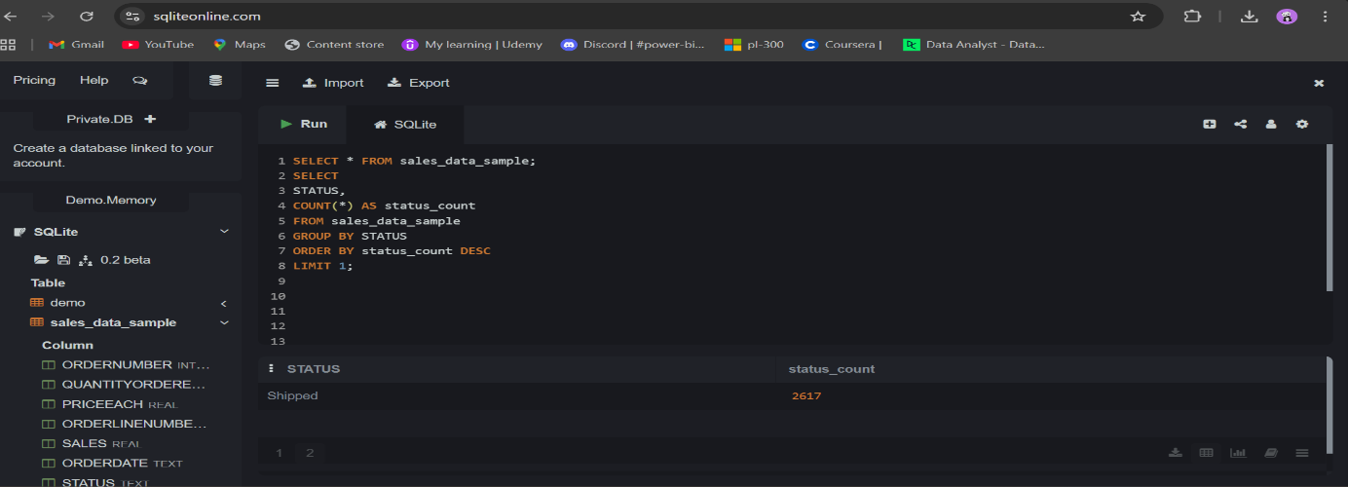
Q4: Which order status occurs most frequently?
Answer: Shipped
Insight: - Majority of orders are successfully completed. - Indicates efficient operations and fulfillment process.

Slide 7
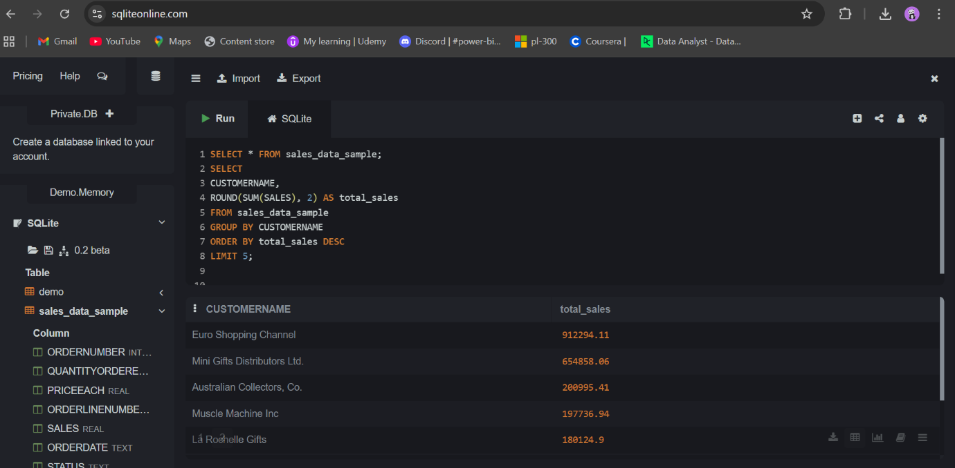
Q5: Who are the top 5 customers by total sales?
Answer: Euro Shopping Channel, Mini Gifts Distributions Ltd, Australian Collectors. Co,
Muscle Machine Inc, La Rochelle Gifts.
Insight: - A small group of customers contributes a large portion of revenue. - Highlights high-value customers → ideal for loyalty programs & retention.

Slide 8
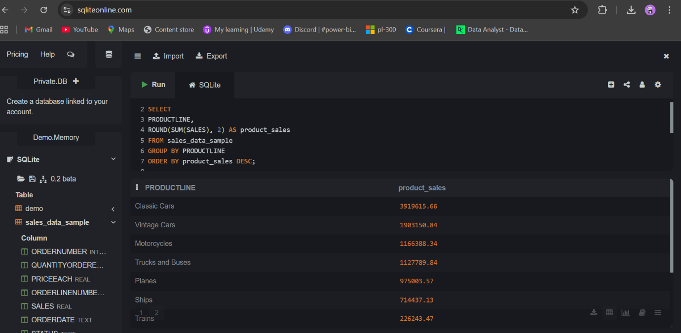
Q6: How are sales distributed by product line?
Answer: Classic cars, Vintage cars, Motorcycles, Trucks & Buses, Planes, Ships, Trains.
Insight: - Some product lines outperform others. - Helps identify best-selling vs low-performing categories. - Supports inventory and marketing decisions.

Slide 9
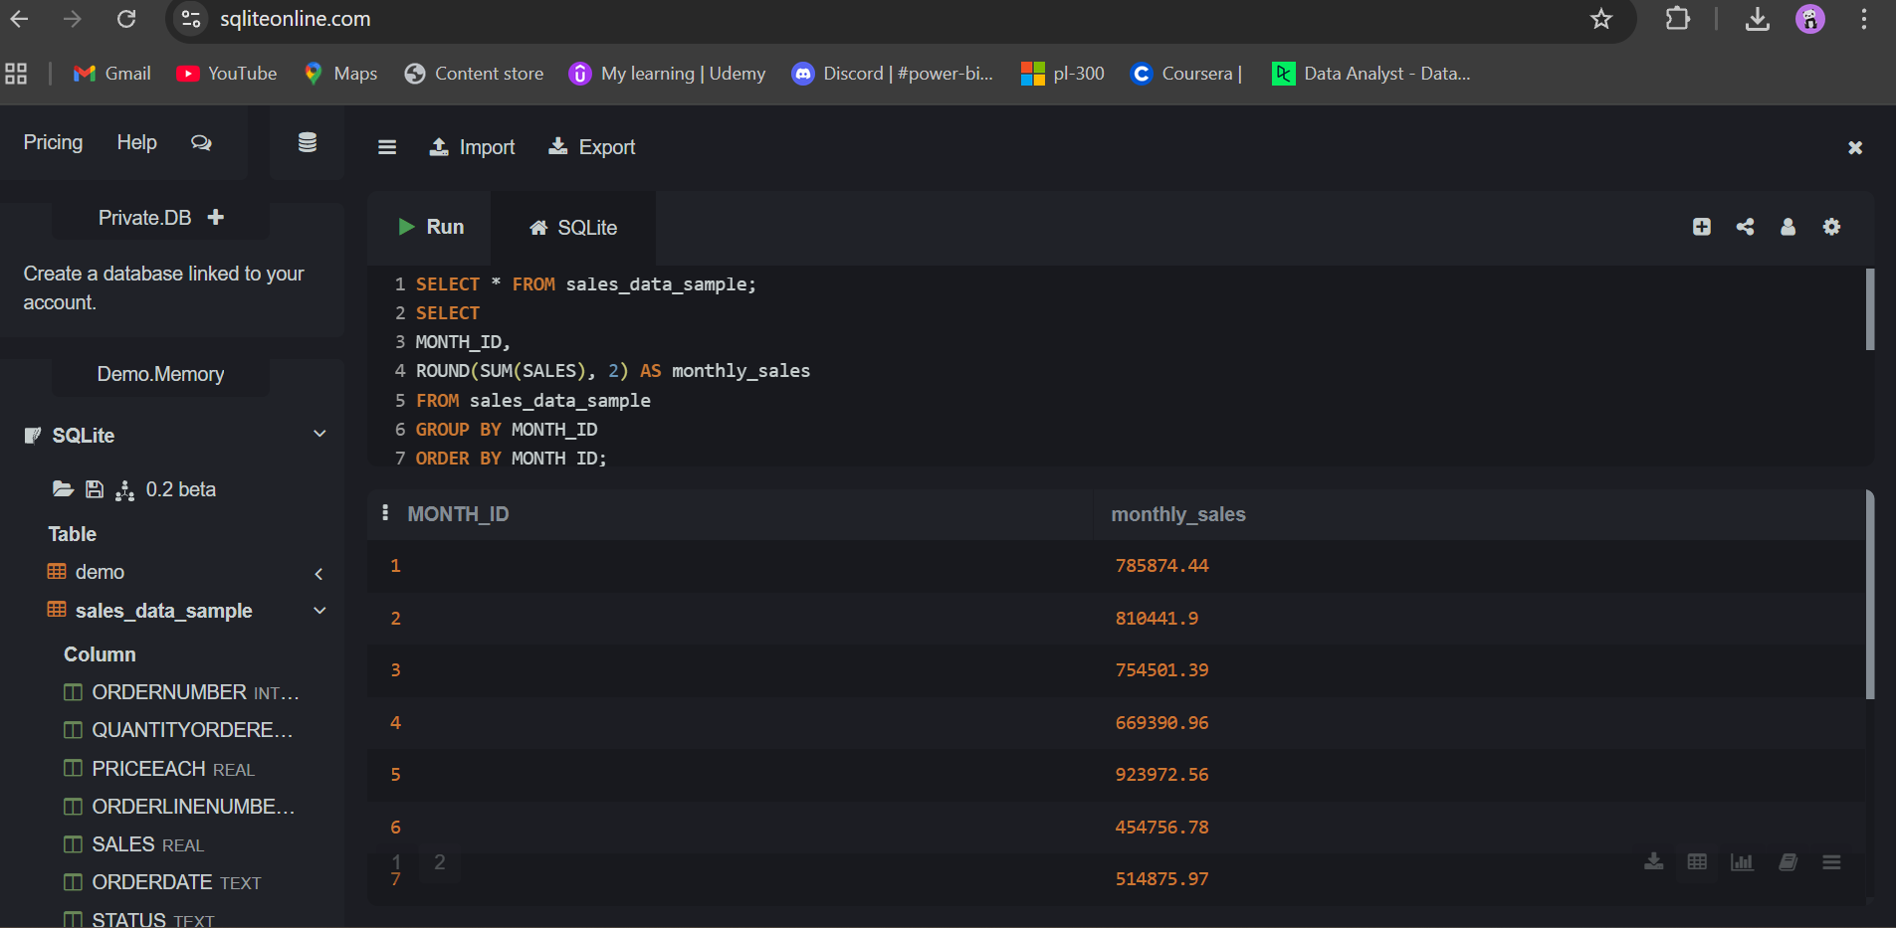
Q7: What is the monthly sales trend?
Answer: Sales increase steadily over time, peaking in the final months—indicating
strong seasonality and year-end demand.
Insight: - Sales fluctuate across months → indicates seasonality. - Useful for forecasting and campaign planning.

Slide 10
Final Business Insights
Revenue exceeds 10M+
USA dominates sales contribution.
Few customers drive major revenue.
Strong order fulfillment performance.
Clear seasonal trends in sales.
Conclusion
This analysis demonstrates how SQL can transform raw sales data into meaningful business insights.
- The business has achieved over 10M in revenue, with strong performance
driven by key markets like the USA. - A small group of customers contributes significantly to sales, highlighting the
importance of customer retention strategies. - Product performance and monthly trends reveal clear opportunities for
optimization and growth. - The noticeable year-end sales peak indicates strong seasonality, useful for
future planning.

