Slide 1

SIDDAGANGA INSTITUTE OF TECHNOLOGY
ARTIFICIAL INTELLIGENCE AND DATA SCIENCE
Mini Project on
AI ENHANCED PERSONAL SAFETY APPLICATION
PROJECT ASSOCIATES:
D Tejasree (1SI22AD010)
Falak Taj (1SI22AD015)
Maanya M (1SI22AD024)
Under the Guidance of
Dr. Y.S. Nijagunarya, Ph.D Professor
BATCH NO. : G3

Slide 2
AGENDA
Aim / Objective
Introduction
Literature Survey
Proposed System/Architecture
Requirements to develop the project
Applications
Conclusions
References

Slide 3
OBJECTIVE
With the increasing number of crimes and safety risks faced by individuals, especially women, it has become crucial to provide a real-time safety monitoring solution. Traditional methods like personal alarms or emergency contacts fail to address the ever-changing risks in real-time and based on location. Our project aims to develop an AI-enhanced personal safety application that not only tracks the user's location but also evaluates real-time environmental and crime data to provide a dynamic safety score and suggest safer routes or emergency actions along with the basic features like SOS alerts. Main motto is to design a responsive and intelligent application that provides real-time safety monitoring, to integrate voice recognition for emergency alerts, to leverage location-based risk analysis by continuously tracking user’s location, and to enhance emergency response by notifying emergency contacts based on the user’s current risk profile.

Slide 4
INTRODUCTION
In today’s world, personal safety is a major concern, especially in high-crime areas or vulnerable situations. Our proposed system uses AI and location-based services to continuously monitor the user’s location and evaluate real-time risks. The app calculates a dynamic safety score based on factors such as nearby crime data, lighting, time of day, and proximity to emergency services. In the event of danger, the user can instantly send an SOS alert, activate voice-activated emergency commands, or trigger an automatic call to emergency contacts. This system will also offer safer routes and suggest preventive measures based on risk analysis. Users will benefit from tailored safety tips, alerts about recent incidents in their vicinity, and access to resources like nearby safe zones or emergency services. By combining individual and collective insights, the "AI Enhanced Personal Safety Application" empowers users to make informed decisions about their safety.

Slide 5
LITERATURE SURVEY
Title of the Paper | Author/Year | Work Done
"AI-Powered Personal Safety and Security Systems" | John Doe, Jane Smith (2022) | This paper focuses on the integration of AI algorithms for real-time threat detection in personal safety applications. It outlines AI's use in identifying suspicious behavior and providing alerts via mobile apps, which play a crucial role in personal safety in urban environments.
"Edge AI for Real-Time Public Safety Monitoring" | Daniel K., Sarah W. (2021) | This research discusses the use of edge AI to process surveillance camera footage in real time, ensuring faster responses to safety threats while maintaining privacy by minimizing data transmission. This is directly relevant to AI-powered personal safety devices, which need to process data locally for efficiency and privacy.

Slide 6
Title of the Paper | Author/Year | Work Done
"AI-Enhanced Surveillance Systems for Urban Safety" | A. Brown et al. (2023) | This paper examines how AI can be leveraged for smarter city surveillance,It highlights the development of AI algorithms for detecting incidents like attacks or suspicious gatherings, offering valuable insights into applying AI for public safety.
"Privacy Concerns and AI in Public Safety Applications" | Emily H. (2022) | This study highlights the balance between privacy and the need for enhanced public safety through AI. It outlines the ethical challenges of using AI in monitoring systems, including facial recognition and behavioral tracking, while ensuring that personal data is not misused
"AI in Personal Safety Apps: A Survey" | George L., Min J. (2021) | This paper surveys existing personal safety apps enhanced by AI, focusing on features like real-time location tracking, emergency SOS alerts, and integrating predictive algorithms to assess potential risks based on crime data and user movement patterns.

Slide 7
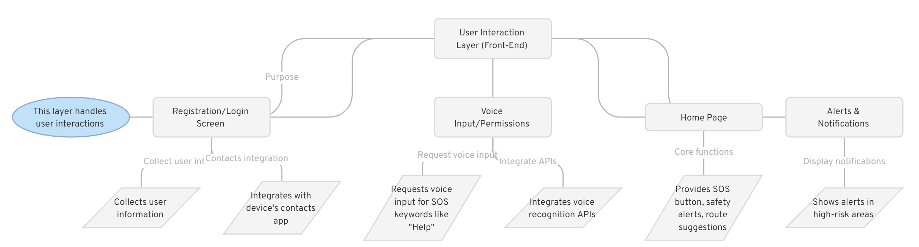
ARCHITECTURE

Slide 8
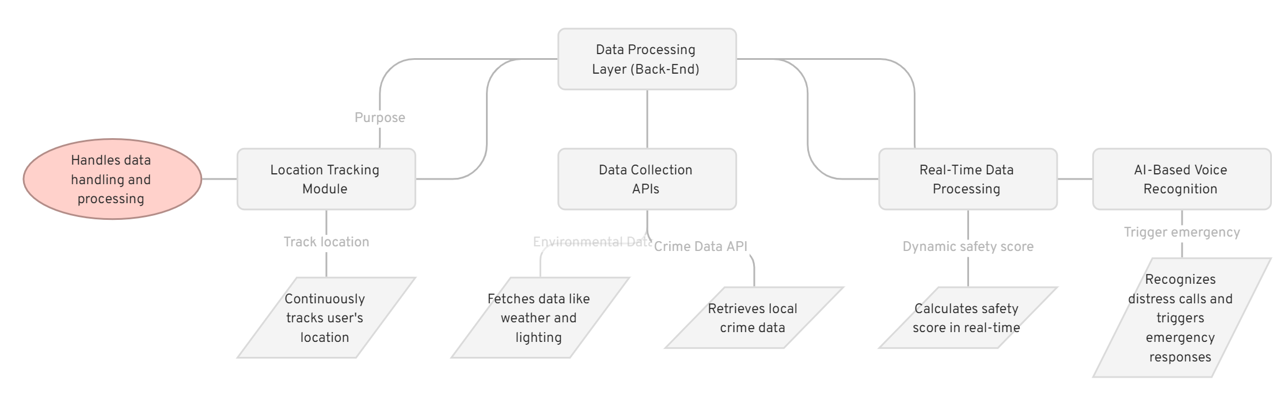
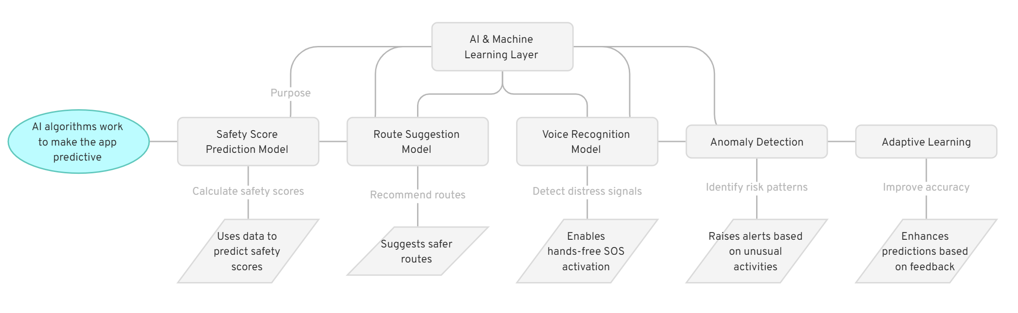

Slide 9
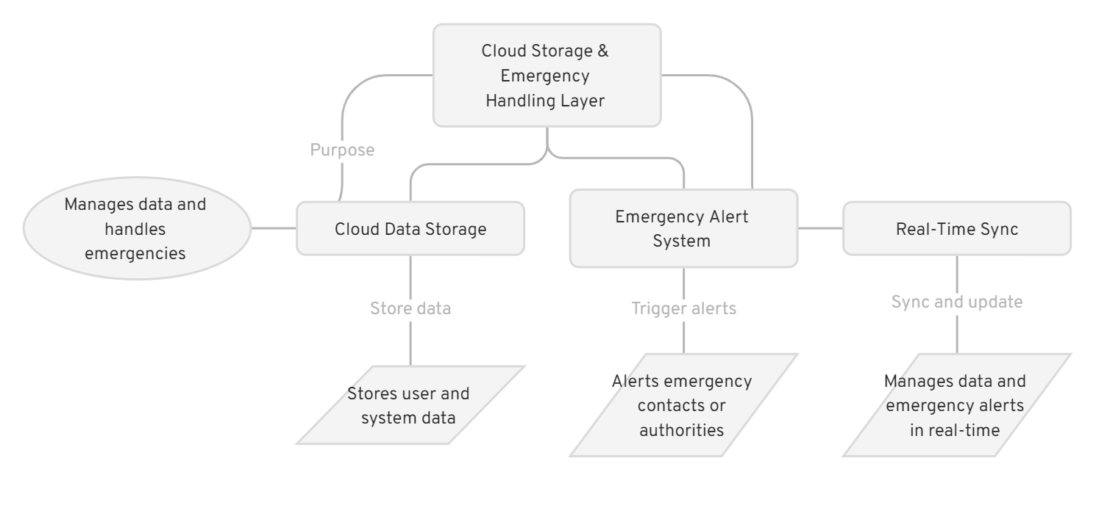

Slide 10
REQUIREMENTS
HARDWARE REQUIREMENTS :
Mobile Device:
RAM: 4GB+ for real-time processing.
Sensors: GPS, microphone, ambient light sensor for tracking and voice inputs.
SOFTWARE REQUIREMENTS :
Cross-Platform Development:
Flutter or React Native for Android/iOS apps.
AI/ML Libraries:
TensorFlow Lite, PyTorch Mobile for on-device AI.
Google Speech-to-Text API for SOS voice recognition.
GPS & Maps API:
Google Maps for real-time location and route suggestions.
Cloud Platforms:
Firebase, AWS Amplify for real-time processing, storage, and notifications.
Backend:
Node.js or Python (Flask/Django) for handling user data and APIs.
Push Notifications:
Firebase Cloud Messaging for alerts.

Slide 11
APPLICATIONS
Personal Safety Monitoring: Real-time monitoring of the user’s location, continuously evaluating safety scores based on nearby crime data.
SOS Alerts: Immediate triggering of alerts to emergency contacts or local authorities through voice commands or manual input.
Emergency Contact Access: Seamless integration with the user’s contacts app for easy selection of emergency contacts.
Route Suggestions: Dynamic recommendations of safer routes based on crime statistics, environmental data, and local time.
Voice-activated Assistance: Use of voice recognition to activate emergency actions like calling contacts or sending SOS alerts in distress situations.
Real-time Risk Analysis: Continuous analysis of crime rates, local lighting conditions, and emergency service proximity to give a real-time risk score.

Slide 12
CONCLUSION
The AI-enhanced personal safety application will revolutionize personal safety by not only responding to emergency situations but also providing proactive, real-time risk analysis.
By integrating location tracking, crime data, and voice recognition, this application will empower users with information and timely alerts to ensure their safety in high-risk areas.
Through seamless access to emergency contacts and safe route suggestions, the app creates a comprehensive, user-friendly solution to personal safety challenges.

Slide 13
REFERENCES
"AI-Powered Personal Safety and Security Systems“- John Doe, Jane Smith (2022)
"Edge AI for Real-Time Public Safety Monitoring“- Daniel K., Sarah W. (2021)
"AI-Enhanced Surveillance Systems for Urban Safety“- A. Brown et al. (2023)
"Privacy Concerns and AI in Public Safety Applications“- Emily H. (2022)
"AI in Personal Safety Apps: A Survey“- George L., Min J. (2021)
"AI Application in Surveillance for Public Safety: Adverse Risks for Contemporary Societies" (2020), by Ellora Thadaney Israni.

Slide 14
THANK YOU

