Slide 1
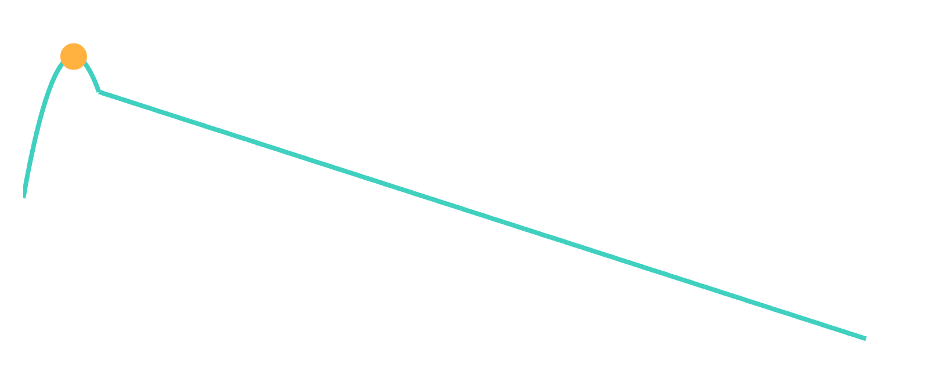
FCA MID-SEMESTER HACKATHON
CATCH THE
ROCKET
Mission Control
Real-Time Telemetry on an ESP32
TEAM BYTEFORCE
Chaithra Gana G · Sindhu GV · Samudra Kar · Brunda M
ESP32
240 MHz · 100,000 samples · 4096 B state
Notes:
SAY: "Good morning. We're Team ByteForce. Our project is Catch the Rocket – an ESP32 ground station that has to understand a whole rocket flight while it is still arriving, sample by sample. We reached Level 5 and verified it on the Official Tracker and Practice Tracker B."
VISUAL: The teal curve is the Official Tracker flight rebuilt from our verified results – climb, apogee (amber), parachute descent. The chip is the ESP32 we ran it on.
KEY POINT: The whole project is a hardware-constraint problem first and a rocket-physics problem second.
LIKELY QUESTION: What exactly did you build?
ANSWER: An autonomous ESP32 ground station: it ingests 100,000 altitude readings, filters sensor glitches and answers serial commands (G, APOGEE, DEPLOY, DESCENT, LAND, GLITCHES, ALT t) with no hard-coded flight constants.

Slide 2
01 / THE ENGINEERING CHALLENGE
100,000 READINGS.
4 KB OF STATE.
12,000 CYCLES PER SAMPLE.
100,000
20,000
4096 B
12,000
240 MHz
telemetry samples
readings / sec (spec)
max persistent state
cycles / sample
ESP32 CPU
100,000 calls = 100 s simulated flight (1 reading / simulated ms) · 240 MHz × 50 µs = 12,000 cycles
full flight as floats: 100,000 × 4 B ≈ 400,000 bytes
allowed state: 4096 B (≈ 1% of that, same scale)
Don't store the history. Store the information extracted from the history.
Notes:
SAY: "The biggest problem was not the rocket physics. It was the hardware constraint. We get 100,000 altitude readings. We may keep only 4096 bytes of persistent state, and each reading must be processed in 12,000 clock cycles – 50 microseconds on a 240 MHz ESP32. Storing the flight as floats would take about 400,000 bytes, a hundred times too much. So we don't store the history; we store the information extracted from it."
VISUAL: Five hard limits. Below, the whole flight as 4-byte floats against our allowed state at the same scale.
KEY POINT: Two budgets – memory (4096 B) and time (12,000 cycles) – must hold together for every sample. Online processing: running sums, compressed state, and a ring buffer only where history is needed.
LIKELY QUESTION: Why can't you store all 100,000 readings, and is the sampling rate consistent with a 100-second flight?
ANSWER: 100,000 x 4 B is about 400 KB against 4096 B, and flash/lookup tables/large flight arrays are forbidden. Timing: each nextAltitude() call advances the tracker by 1 ms of simulated flight (code: t++, heights in ms), so 100,000 calls = a 100 s simulated flight. The 20,000 readings/s and 50 us figures come from the problem statement as quoted in our report; the sketch itself does not pace the calls, so we cannot show a measured delivery rate.

Slide 3
02 / MISSION CONTROL ARCHITECTURE
FROM SENSOR READING TO FLIGHT INTELLIGENCE
ESP32 · 240 MHz · ONE STRUCT ≤ 4096 B
1
2
3
4
5
6
7
8
Incoming
altitude
5-point causal
median
Glitch
detection
Compressed state /
accumulators
Trajectory
models
Deployment
detection
Cached
coefficients
Serial
commands
100,000 readings
10 B window
>20 m → replace
running sums
line + parabola
actual vs ballistic
fit once
G · ALT t · …
EVERY SAMPLE
AFTER THE FLIGHT
filter → accumulate → watch for deployment.
Peak cost observed: 6502 cycles (budget 12,000).
fit once → cache coefficients → answer queries
from cached results.
Notes:
SAY: "Here is the whole system. Each altitude reading enters on the left, goes through a five-point median to catch glitches, updates a small set of running sums, and is gone. The models are fitted from those sums and the coefficients are cached, so the serial commands on the right answer from cached results."
VISUAL: The dashed outline is the ESP32 and its single 4096-byte state struct. Data flows left to right; nothing accumulates as a giant dataset.
KEY POINT: Per sample we filter, accumulate and watch for deployment. The expensive fit happens once, after the flight, and is then cached.
LIKELY QUESTION: How does the ESP32 process each sample?
ANSWER: Causal 5-point median -> glitch check (>20 m deviation, replace with the median) -> update running sums and the 1024-entry ring buffer -> compare actual vs ballistic drop for deployment. All of it peaked at 6502 cycles.

Slide 4
03 / BUILT INCREMENTALLY
LEVEL 0 → LEVEL 5
worst reading cycles: Official / Practice B
FINAL LEVEL REACHED: 5 · verified on Official + Practice B
LEVEL 5
LEVEL 4
Optimization +
Code Freeze
LEVEL 3
Glitch
Rejection
Compression +
Deployment
closed-form sums · cached fit
LEVEL 2
Gravity +
Apogee
median-5 · 2048 B ring buffer
LEVEL 1
Descent +
Landing
100 blocks · curve intersection
LEVEL 0
Bring-up
parabolic fit · int64 sums
online linear regression
serial parser · cycle counter
RAM 44 B
RAM 88 B
RAM 136 B
RAM 2096 B
RAM 2336 B
RAM 2336 B
cyc 903
cyc 992
cyc 2404 / 3343
cyc 2662
cyc 6416 / 6501
cyc 6418 / 6502
Notes:
SAY: "We never wrote the final system in one go. Each level added one capability and we measured RAM and worst-case cycles after every step. We reached Level 5 on both trackers. RAM jumped when we added the 2048-byte ring buffer in Level 4, and cycles roughly doubled once glitch filtering and deployment detection ran on every sample – but we finished at 6502 cycles."
VISUAL: A staircase. Each step lists the new capability, the state RAM and the worst per-reading cycles (Official / Practice B where they differ). Every value is from the serial-monitor capture for that level.
KEY POINT: Final level achieved: Level 5, verified on the Official Tracker and Practice Tracker B. Level 5 added no RAM and almost no cycles – it was optimization, profiling and code freeze.
LIKELY QUESTION: How did resource use change across levels?
ANSWER: State RAM went 44 -> 88 -> 136 -> 2096 -> 2336 -> 2336 B; worst cycles 903 -> 992 -> 2404/3343 -> 2662 -> 6416/6501 -> 6418/6502 (Official/Practice B).

Slide 5
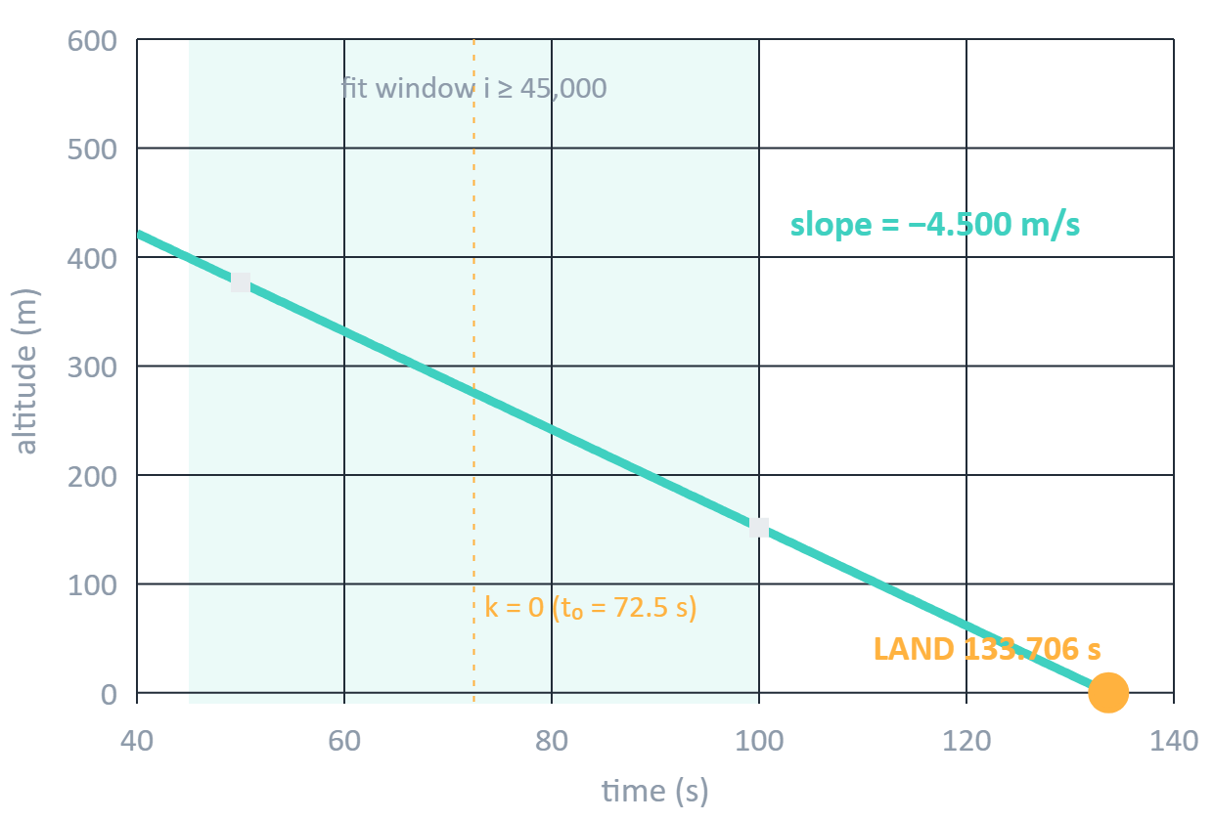
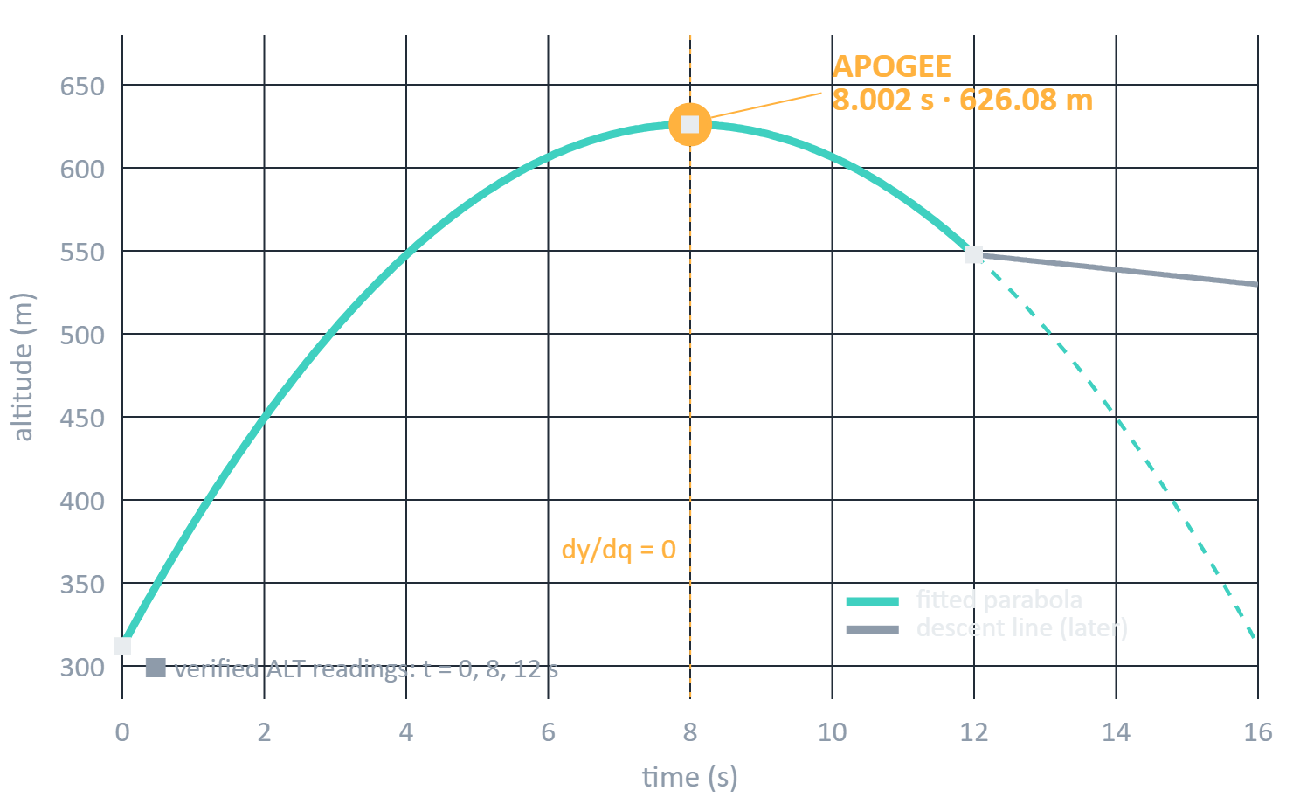
04 / THE MATH: ONE LINE, ONE PARABOLA
TURNING A STREAM INTO TWO MODELS
LEVEL 1 · DESCENT = LINE
LEVEL 2 · COAST = PARABOLA
y = A + Bk
y = A + Bq + Cq²
k = i − 72500 ms
q = 2i − 7999
slope B → v_D = 10 B
C → accel → g = −80000 C
y = 0 → k = −A / B → landing
dy/dq = 0 → q = −B/(2C)
5 sums: N, Σk, Σy, Σk², Σky
C tells us how strongly the altitude curve bends; the vertex of the parabola is the apogee.
Plots drawn from verified Official results · ■ verified ALT readings · ● apogee, landing
WHY THIS MATTERS FOR FCA Instead of storing thousands of readings, the ESP32 stores a few accumulated statistics: 5 sums for the line, a handful of int64 sums for the parabola. Centred time keeps them small enough for int64; double holds the fitted coefficients.
Notes:
SAY: "Two flight phases, two simple models. After 45 seconds under parachute, altitude is a straight line, y = A + Bk: the slope is the descent velocity and where it hits zero is the landing time. During the first 8 seconds only gravity acts, so altitude is a parabola, y = A + Bq + Cq squared. The coefficient C is how strongly the curve bends – the acceleration – so g equals minus 80,000 times C, and the vertex, where the slope is zero, is the apogee. Neither model needs the raw samples; both are built from a few running sums."
VISUAL: Left, the descent line fitted from verified results; right, the coast parabola with the apogee marked. Squares are verified ALT readings.
KEY POINT: Time is centred (k = i - 72500 ms, q = 2i - 7999) so sums stay small; q is symmetric so odd sums cancel, but sums of q^4 reach about 10^19, so we use int64 sums and double coefficients.
LIKELY QUESTION: Why does the quadratic coefficient give gravity, and how do you find apogee?
ANSWER: d2y/dt2 = C x (dq/dt)^2 = C x 2000^2 = 4x10^6 C cm/s^2, so g = -80000 C m/s^2. Apogee is where dy/dq = B + 2Cq = 0, so q = -B/(2C) and t = (7999 + q)/2000 s. Running sums for the line: N, sum k, sum y, sum k^2, sum ky.

Slide 6
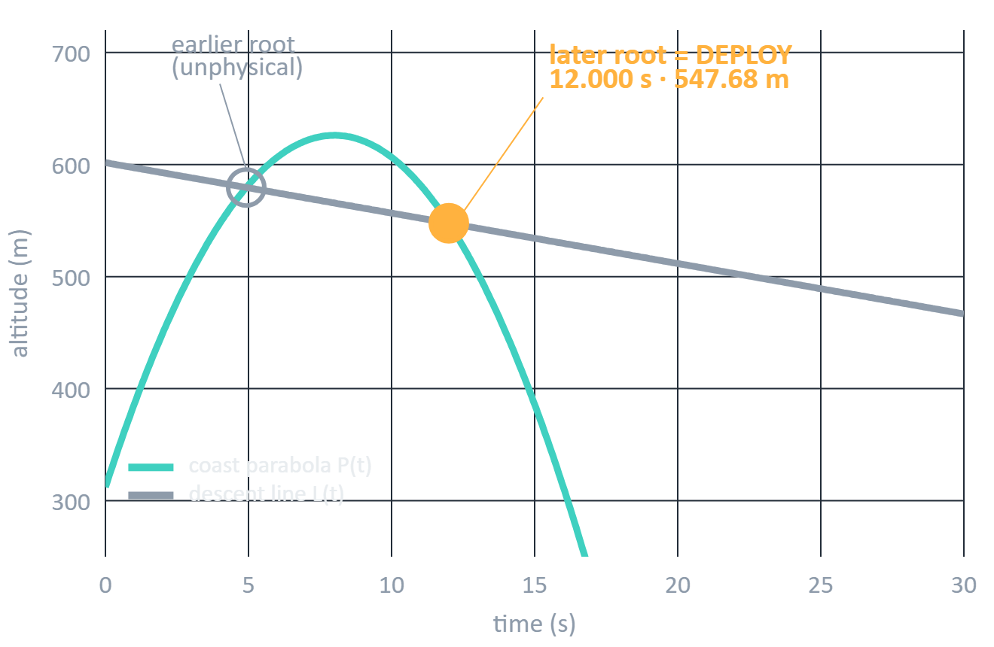
05 / LEVEL 3 · COMPRESSION + DEPLOYMENT
WHEN 100,000 SAMPLES BECOME A FEW NUMBERS
LEVEL 3 BLOCK COMPRESSION
100 blocks · 1000 samples / block (1 s)
1000 raw samples
s₀ · s₁ · s₂
s₀ int32 400 B
s₁ int64 800 B
s₂ int64 800 B
≈ 2000 B
Two models, two flight phases. The later physical root is selected.
COAST PARABOLA × DESCENT LINE → INTERSECTION → DEPLOYMENT
INTERMEDIATE DESIGN The 100-block representation was the Level 3 approach. The final firmware uses running accumulators and a quantized ring buffer.
P(t) − L(t) = 0 → quadratic, two roots
Notes:
SAY: "In Level 3 we compressed the stream into 100 blocks of 1000 readings – one second each – keeping just three moments per block. That was 2000 bytes instead of hundreds of kilobytes. From those we fit a coast parabola and a descent line. Where they cross is a deployment candidate; the earlier crossing is just the line extended backwards, so we pick the later root."
VISUAL: Left: 1000 raw samples collapse into three moments. Right: the two curves cross twice; the later crossing is deployment (12.000 s, 547.68 m on the Official Tracker).
KEY POINT: Two models describe two flight phases; their intersection gives the transition. The 100-block representation was the intermediate Level 3 design; the final firmware (state slide) uses running accumulators and the ring buffer instead of the block arrays (the Level 5 sketch contains no block code).
LIKELY QUESTION: How is deployment detected?
ANSWER: Two ways working together: the real-time trigger compares actual vs ballistic altitude drop (>500 cm), and the curve intersection P(t) - L(t) = 0 - taking the later root - gives the exact time and altitude.

Slide 7
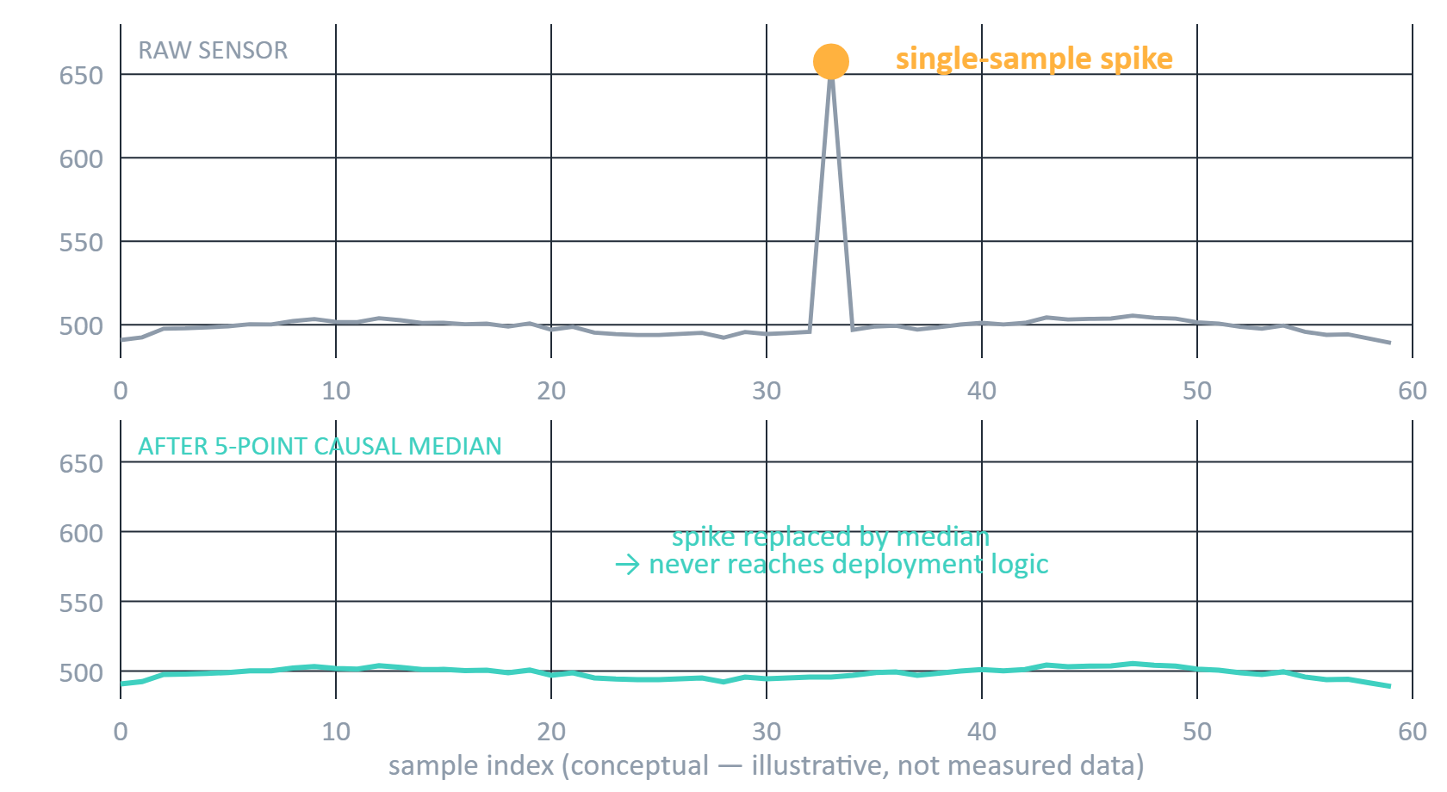
06 / LEVEL 4 · GLITCHES
THE SENSOR CAN LIE
r[i−4]
r[i−3]
r[i−2]
r[i−1]
r[i]
causal 5-sample window · no lookahead
median of 5 values
20 m deviation → GLITCH
glitches: 50–300 m
normal noise: ±2 m
Official: 739 glitches detected
Practice B: 727
CONCEPTUAL VISUALIZATION
Notes:
SAY: "In Level 4 the tracker injects glitches: single readings that jump by 50 to 300 metres. Normal noise is only about two metres. We can't wait for future samples in a live stream, so we use a causal five-point median over the last five readings. If a reading differs from that median by more than 20 metres, it's a glitch – we count it and replace it with the median."
VISUAL: Top trace is raw with one huge spike; bottom is after the filter. This plot is conceptual (synthetic) and is labelled so – it is not measured data.
KEY POINT: The median runs BEFORE the ring buffer and the deployment logic, so an isolated spike can never be mistaken for the parachute opening. In the code the glitch check is active from reading 1000 on (glitches only start after t = 1000 ms).
LIKELY QUESTION: Why use a causal median filter, and why 5 samples?
ANSWER: Causal because future readings aren't available in real time. Median because it ignores outliers. Five: the report specifies a 5-sample window and guarantees glitches are at least 10 clean readings apart, so a 5-sample window never holds more than one spike (our reasoning). The code computes the median with a small insertion sort over 5 values (the report mentions a sorting network; the sketch does not use one). Official run: 739 glitches caught; Practice B: 727.

Slide 8
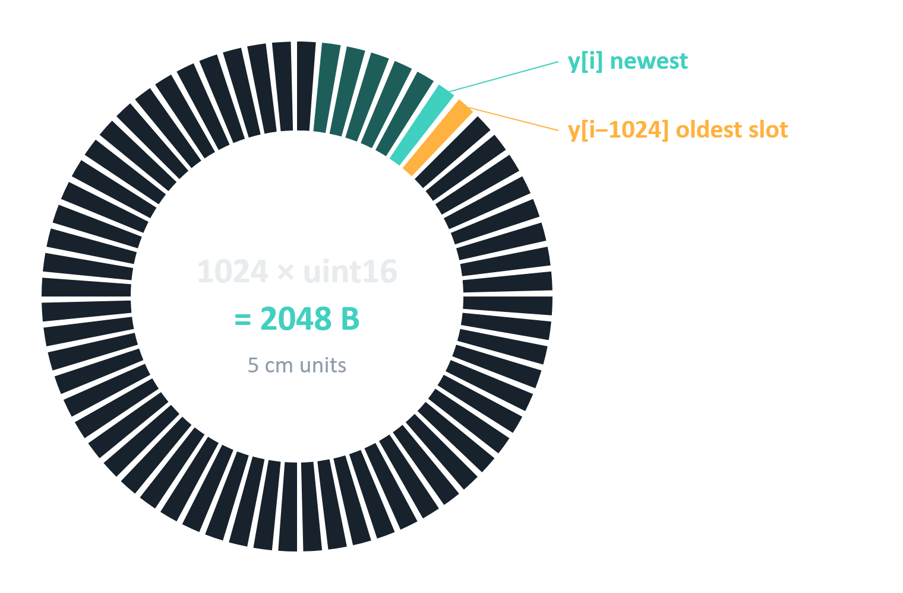
07 / LEVEL 4 · RING BUFFER + DEPLOYMENT TRIGGER
WE NEEDED HISTORY. WE COULDN'T AFFORD IT.
NOT AFFORDABLE
1024 × float = 4096 B (whole budget)
WHAT WE BUILT
1024 × uint16 = 2048 B
5 cm units: v = (h + 2) / 5
rounding ≤ 2.5 cm · uint16 range 3276 m, code clamps at 3000 m
DEPLOYMENT TRIGGER
Actual altitude drop
vs.
Ballistic predicted drop
Δ_actual − Δ_predicted > 500 cm → DEPLOYMENT
TRANSITION FREEZE Transitional samples are excluded from both fits so deceleration doesn't distort the models.
Notes:
SAY: "To detect deployment in real time we need to compare the altitude now with the altitude 1024 samples ago. That's history – exactly what we can't afford. A ring buffer of 1024 floats would eat 4096 bytes, our entire budget. Quantizing altitude to 5 cm lets each entry fit in 16 bits, so the ring is 2048 bytes. Precision is lost only in that rounding – at most 2.5 cm per stored reading – far below the plus or minus 2 m noise."
VISUAL: The circle is the 1024-slot circular buffer; the newest sample overwrites the oldest. Right: the float-versus-uint16 cost and the trigger rule.
KEY POINT: Trigger: (actual drop over 1024 samples) - (ballistic predicted drop) > 500 cm, checked every 16th sample. When it fires, the firmware freezes the transition window so those transitional samples don't distort either curve fit. The ring stores CLEAN (median-filtered) readings only.
LIKELY QUESTION: What happens during the deployment transition, and why uint16?
ANSWER: Clean ballistic samples keep feeding the coast accumulators with a 1024-sample delay, post-transition samples feed the descent accumulators, and the transitional samples are excluded, because the parachute's deceleration fits neither the parabola nor the line. uint16 at 5 cm covers 65535 x 5 cm = 3276 m; the code clamps at 60000 units (3000 m).

Slide 9
08 / THE STATE STRUCT
2336 BYTES. EVERY FIELD, AND WHY.
ring 2048 B
USED 2336 B (57.0%) · FREE 1760 B
Group | Fields | Types | Bytes | Why
Counters | readingsReceived, worstCycles | uint32 × 2 | 8 | sample count; STATS
First-fit sums (0–8 s) | firstN · Σq², Σy, Σqy, Σq²y · A, B, C · firstReady | u32; int64 × 4; double × 3; bool | 61 | gravity + apogee fit
Coast sums | coastN · ΣY, ΣXY, ΣX²Y · coastLastIndex | u32; int64 × 3; u32 | 32 | coast curve refit
Descent sums | paraN · ΣY, ΣX, ΣX², ΣXY | u32; int64 × 4 | 36 | descent line
Ring buffer | ring[1024] | uint16 × 1024 | 2048 | deployment test history
Median window | rawHistory[5] · count · pos | uint16 × 5; uint8 × 2 | 12 | causal 5-value median
Glitch counter | glitchCount | uint32 | 4 | GLITCHES command
Deployment state | detected, finalized · detectionIndex, frozenStart · time, altitude | bool × 2; u32 × 2; double × 2 | 26 | trigger, freeze, result
Cached coefficients | coastA, B, C, Center · paraA, B, Center | double × 7 | 56 | fast command answers
Serial parser | commandBuffer[32] · length · overflow | char × 32; uint8; bool | 34 | non-blocking input
Σ fields 2317 + padding 19 (derived) |  |  | 2336 | = STATS: 2336 of 4096
Source: GroundState in LEVEL_5_OFFICIAL.ino; total from the Level 5 STATS output. static_assert(sizeof(GroundState) <= 4096) enforces the limit.
Notes:
SAY: "This is the memory map of our final firmware – one C struct, 2336 bytes out of 4096 – and every field in it. The ring buffer is the big block at 2048 bytes. The rest are accumulators for the three curve fits, the median window, deployment state, cached coefficients and the serial command buffer. The declared fields add up to 2317 bytes; the compiler reports 2336, so 19 bytes are alignment padding. A static_assert makes the compiler enforce the 4096-byte limit."
VISUAL: The bar is the 4096-byte budget drawn to scale. The table lists each group of fields with its type, byte cost and purpose, straight from GroundState in LEVEL_5_OFFICIAL.ino.
KEY POINT: No raw history except the 1024-entry quantized ring; everything else is a fixed set of sums, coefficients and flags. The 19 B of padding is derived (2336 minus the 2317 B sum of declared fields).
LIKELY QUESTION: Why int64 for sums and double for coefficients? How much RAM is used and how was it verified?
ANSWER: Sums of q^4 reach about 10^19 and would lose precision in 32-bit floats, so sums are int64 and fitted coefficients are double; time is centred to keep sums small. RAM: STATS prints 'bytes used: 2336 of 4096' on both trackers (57.0%, 1760 B free).

Slide 10
09 / REAL-TIME CPU BUDGET + COMMAND LATENCY
THE CLOCK WAS OUR SECOND CONSTRAINT
USED 6502 · 54.2%
FREE 5498 · 45.8%
0
12,000 cycles
240 MHz → 50 µs → 12,000 cycles
Command (after flight) | Official | Practice B | ≈ µs
STATS | 10 | 10 | 0.04
GLITCHES | 13 | 13 | 0.05
DEPLOY | 57 | 57 | 0.24
DESCENT | 61 | 61 | 0.25
LAND | 391 | 391 | 1.6
ALT t (6 queries) | 632–1212 | 657–1212 | 2.6–5.1
APOGEE | 2244 | 2175 | 9.4
G (first call) | 104337 | 104186 | 434.7
worst reading: Official 6418 · Practice B 6502
uint32_t start = ESP.getCycleCount();
/* process one reading */
cycles = ESP.getCycleCount() - start;
Simplified. The tracker call is outside the measured section.
POST-FLIGHT, NOT PER-READING
The ~104k-cycle first G occurs after flight completion and does not consume the per-reading budget.
cycles per command · µs = cycles ÷ 240 (derived) · source: Level 5 serial captures
Notes:
SAY: "Memory was the first constraint; the clock was the second. At 240 MHz, a 50-microsecond interval gives 12,000 cycles per reading. We measured our own processing with the ESP32 cycle counter around every reading, with the tracker call outside the measured section. The worst reading we ever saw was 6502 cycles – 54.2 percent of the budget, 5498 cycles to spare. The table shows the measured cost of every command after the flight."
VISUAL: The long bar is 0 to 12,000 cycles. The table is the cycles each serial command took in the Level 5 captures; microseconds are cycles divided by 240.
KEY POINT: The first G command takes about 104,000 cycles because it does the final matrix fit AFTER the flight, so it is outside the per-sample budget. Other commands cost from 10 to about 2,200 cycles; the report's claim of under 100 cycles for all cached commands is true only for DEPLOY, DESCENT, GLITCHES and STATS.
LIKELY QUESTION: Does the 104,000-cycle G command violate the timing constraint?
ANSWER: No. The limit is 12,000 cycles per incoming reading during ingestion. The G fit happens after all readings have arrived, so no reading is delayed. Measured: G = 104337 cycles (Official), 104186 (Practice B), about 435 us.

Slide 11
10 / FINAL HARDWARE RESULTS
HARDWARE VERIFIED: MEASURED VS TRUTH
Metric | Official | truth | Δ | Practice B | truth | Δ | Limit (judging)
Gravity (m/s²) | 9.810 | 9.810 | 0.000 | 3.711 | 3.710 | +0.001 | ±0.02
Apogee time (s) | 8.002 | 8.002 | 0.000 | 11.321 | 11.321 | 0.000 | ±0.02
Apogee altitude (m) | 626.08 | 626.08 | 0.00 | 1737.75 | 1737.74 | +0.01 | ±0.25
Deployment time (s) | 12.000 | 12.000 | 0.000 | 23.999 | 24.000 | −0.001 | ±0.02
Deployment altitude (m) | 547.68 | 547.68 | 0.00 | 1439.54 | 1439.52 | +0.02 | ±0.25
Descent velocity (m/s) | −4.500 | −4.500 | 0.000 | −8.500 | −8.500 | 0.000 | ±0.01
Landing time (s) | 133.706 | 133.707 | −0.001 | 193.351 | 193.355 | −0.004 | ±0.50
ALT 0 s (m) | 311.99 | 312.00 | −0.01 | 1499.95 | 1500.00 | −0.05 | ±0.25
Glitches detected | 739 | 739 | exact | 727 | 727 | exact | exact
ALT 8/12/20/50/100 s Official: 626.08 · 547.68 · 511.68 · 376.68 · 151.68 m
ALT 8/12/20/50/100 s Practice B: 1717.29 · 1736.90 · 1598.00 · 1218.53 · 793.51 m
HOW WE VERIFIED Flash sketch → tracker feeds 100,000 readings → send STATS, G, APOGEE, DEPLOY, DESCENT, LAND, GLITCHES, ALT t over serial → compare with the tracker model → read worst cycles from STATS. Glitch-free run (Level 3, TRACKER_GLITCHES 0): Official 9.811 m/s², 11.999 s, 547.69 m, 133.705 s; Practice B 3.711, 23.999 s, 1439.54 m, 193.351 s. Glitch-enabled runs (Levels 4–5, TRACKER_GLITCHES 1) are the table above. Tracker seeds: Official 20261001, Practice B 4242.
Truth = tracker secrets (report Q1; same as the sketch tracker model; the firmware never reads them). Measured = Level 5 captures. Limits = judging tolerances (report Table 1). All within limits.
Notes:
SAY: "These are the outputs from the ESP32 with glitches enabled, next to what the tracker's own flight model says they should be. On the Official Tracker gravity is 9.810 against 9.81, apogee 8.002 seconds and 626.08 metres, deployment at exactly 12.000 seconds, descent minus 4.5. On Practice Tracker B, a different flight, every value is within a few hundredths. The only precision loss is the 5 cm quantization, at most 2.5 cm, plus the plus or minus 2 m noise that the regressions average out."
VISUAL: Measured values are from the Level 5 serial captures. Expected values are the noise-free model in the tracker function inside the sketches (H0, V0, G, TD, VD) – the firmware never reads those constants. The two trackers are never mixed.
KEY POINT: Same unchanged firmware, two different flights, no hard-coded flight constants, same 2336 B and at most 6502 cycles per reading. Verification procedure: flash the sketch, let the tracker feed 100,000 readings with glitches on, send the commands over serial, compare with the tracker model, read worst cycles from STATS. Glitch-free runs were Level 3; glitch-enabled runs are Levels 4 and 5.
LIKELY QUESTION: Why are some Practice Tracker B results different, and was there an unseen tracker?
ANSWER: Practice Tracker B simulates a different flight (gravity 3.71, descent -8.5, later apogee and deployment), so outputs differ while the code is identical. We have no unseen-tracker output in our evidence, so we do not claim one.

Slide 12
11 / WHAT DIDN'T WORK, WHAT WE LEARNED
WHAT WE CHANGED, WHAT'S LIMITED
WHAT FAILED → WHAT WE CHANGED
KNOWN LIMITATIONS
WHAT WE LEARNED
Float fit: g came out ≈ −45.2 or +112 m/s² (Σq⁴ ≈ 10¹⁹) → int64 sums + double → 9.814
Ring of 2048 floats = 8192 B, struct 8640 B → 1024 × uint16 at 5 cm = 2048 B
Fits across the opening: descent ≈ −5.1 m/s → 1024-reading exclusion window → −4.500
Level 3 G = 1.25 M / 2.1 M cycles → closed-form sums + cached fit ≈ 104 k
Altitude clamps at 3000 m (uint16, 5 cm units)
Glitch check starts at reading 1000
First G ≈ 104 k cycles (after the flight)
Tested on Official + Practice B only; no unseen-tracker evidence
Memory: 1024 floats = the whole 4096 B; 5 cm uint16 halves it
Representation: centred time + int64 sums prevent overflow
Computation: closed-form sums and cached coefficients cut G ≈ 12× (Official)
Measure cycles; don't guess
Sources: final report §12 (failures); Level 3 vs Level 5 serial captures; sketch constants (clamp 60000 × 5 cm, glitch gate 1000).
Notes:
SAY: "We changed three things because they did not work. First, a float-based quadratic fit lost precision because the sums reach ten to the nineteen, so we moved to int64 sums and double coefficients. Second, the Level 3 G command cost over a million cycles, so we switched to closed-form power sums and cached coefficients, and it dropped to about 104 thousand. Third, our Skeptic spotted that a single 300-metre glitch could look like deployment, so the median runs before the ring buffer and the detector. The limitations are honest: altitude clamps at 3000 metres, glitch checks start at reading 1000, the first G costs 104 thousand cycles after the flight, and we only tested two trackers."
VISUAL: Left, documented changes with the measured effect; middle, limitations; right, lessons about memory, data representation and computation.
KEY POINT: Only changes documented in the report and visible in our outputs are listed: Level 3 G cost 1,247,112 (Official) and 2,118,771 (Practice B) cycles; Level 5 G cost 104,337 and 104,186.
LIKELY QUESTION: What failed and what did you learn?
ANSWER: Float precision loss, the slow first fit, and the glitch-versus-deployment confusion. We learned that a float ring buffer would take the whole 4096 B, that centring time and int64 sums prevent overflow, and that closed-form sums plus cached coefficients keep both the per-reading and the command costs low.
TEAM TO CONFIRM: add any other real failed attempts from the team log; none beyond those above are documented in the report.

Slide 13
12 / LLM USE AND VERIFICATION
WHERE AN LLM HELPED, AND WHERE IT WAS WRONG
Task | LLM suggestion | How we verified | What happened
Power-sum identities | Faulhaber polynomial formulas for Σk², Σk³, Σk⁴ | Gana: on paper + desktop C++ | Used in final code
5-value median | 9-comparator branchless sorting network | Sindhu: 100,000 random vectors; cut to 7 | Final sketch uses a simple 5-value sort
Report layout | booktabs table formatting | Compiled and checked by Brunda | Used in the report
WRONG ANSWER: ROLLING-VARIANCE DEPLOYMENT DETECTOR
LLM SAID
HOW WE TESTED
WHAT HAPPENED
THE FIX WE KEPT
Deployment can be detected by a sudden spike in rolling variance.
Run on the ESP32 board against the tracker stream.
Failed completely: normal ±2 m noise caused continuous false triggers. Discarded by Gana.
Compare the real altitude drop over 1024 samples with the drop predicted by the coast parabola. Trigger when the gap exceeds 500 cm.
The fix is in the final code: 500 cm threshold, 1024-sample window, checked every 16th reading.
Source: final report §13, Table 11 (LLM audit log); sketch detection code.
Notes:
SAY: "We used an LLM only for mathematical verification and formatting, and Brunda kept the audit log. It gave us the closed-form power-sum formulas; Gana checked them on paper and in desktop C++ before we used them. It was wrong about deployment detection: it claimed a sudden spike in rolling variance would show the parachute opening. On the board, normal plus or minus 2 metre noise caused continuous false triggers, so Gana discarded it and we use trajectory lag instead: the real altitude drop over 1024 samples against the drop our coast parabola predicts, triggering above 500 centimetres."
VISUAL: Top, the logged LLM entries from the final report (Table 11). Below, the one wrong answer: what the LLM said, how it was tested, what happened, and the fix we kept.
KEY POINT: Every LLM suggestion was tested independently before use. The fix is in the final code: DETECT_THRESHOLD_CM 500, a 1024-sample window, checked every 16th reading.
LIKELY QUESTION: Give one helpful and one wrong or unhelpful LLM result.
ANSWER: Helpful: closed-form power sums, verified on paper and in desktop C++, used in the final code. Wrong: the rolling-variance deployment detector - normal plus or minus 2 m noise caused continuous false triggers on the board, so it was discarded in favour of the trajectory-divergence trigger.
CARE: the report says the sorting network was optimised to 7 comparators, but the final sketch computes the median with a small insertion sort - say 'we tested a sorting network; the final code uses a simple 5-value sort'. Do not claim a measured false-trigger time.

Slide 14
13 / THE RESULT
THE RESULT
100,000
samples
ONLINE
PROCESSING
FILTERED +
COMPRESSED
TRAJECTORY
MODEL
FLIGHT
INTELLIGENCE
2336 / 4096 B
6502 / 12,000
1760 B
>5400
57.0% RAM utilization
54.2% budget utilization
RAM free
cycles of headroom per sample
One ESP32.
One compact state structure.
100,000 telemetry readings.
Real-time flight analysis.
FINAL LEVEL: 5 · Official + Practice B
TEAM BYTEFORCE
Notes:
SAY: "To summarize: 100,000 samples flow through online processing, get filtered and compressed into a trajectory model, and come out as flight intelligence. We reached Level 5. We used 2336 of 4096 bytes and 6502 of 12,000 cycles, verified on hardware on two trackers. One ESP32, one compact state structure, 100,000 readings, real-time flight analysis. Thank you – we're happy to take questions."
VISUAL: The flow compresses the whole story; the four readouts are the verified resource numbers.
KEY POINT: This is a computer-architecture problem: memory capacity, cycle budget, data path and numerical design had to be solved together.
LIKELY QUESTION: What is the main takeaway?
ANSWER: Don't store the data - store what the data means. Online processing with a few accumulators, a causal filter, and a quantized ring buffer let a 4 KB, 240 MHz microcontroller do real-time flight analysis with 1760 B and over 5400 cycles to spare.
----- Q&A BACKUP (see SPEAKER_QA.md for the full 20) -----
Speaking split (suggested, by report roles): Brunda M (Scribe) slides 1-3 and 13 (she kept the LLM log); Sindhu GV (Builder) slides 4-6; Chaithra Gana G (Skeptic and Code Integrate) slides 7-9 and 12; Samudra Kar (Measurer) slides 10-11 and 14.

