Slide 1
PREDICTING CONTRIBUTING FACTORS FOR ROAD ACCIDENTS IN CHICAGO
Under the guidance of:
Professor David Anastasiu
Team Members: (Group #10)
Chaithra Lakshmi Sathyanarayana
Sayali Pisal
Thaijasa Badrinath Vijendranath
CMPE-255
San Jose State University
Department of Computer Engineering

Slide 2
INTRODUCTION
Increase in number of vehicles => Increase in number of accidents
Contributing factors could be several
Example: weather conditions, road conditions, traffic conditions etc.
Analysis and evaluation of traffic accidents helps government
to implement better traffic regulations
enhance road safety measures.
Traffic Accidents and Causes

Slide 3
OBJECTIVE
Predict the primary contributing factors for traffic accidents.
Evaluation using classification metrics.
Comparison and contrast of different algorithms.
Why this project?

Slide 4
DATASET
Source: Chicago Data Portal
Number of Files: 3
File Size: Traffic_Crashes: 234867 * 48
Traffic_Vehicles: 474635 * 71
Traffic_People: 512318 * 29
Number of Classes: 38

Slide 5
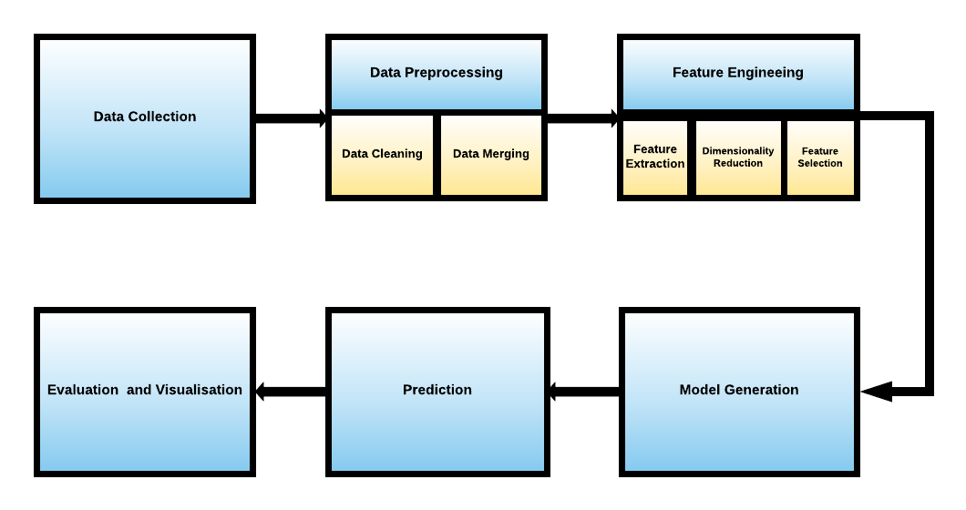
WORKFLOW

Slide 6
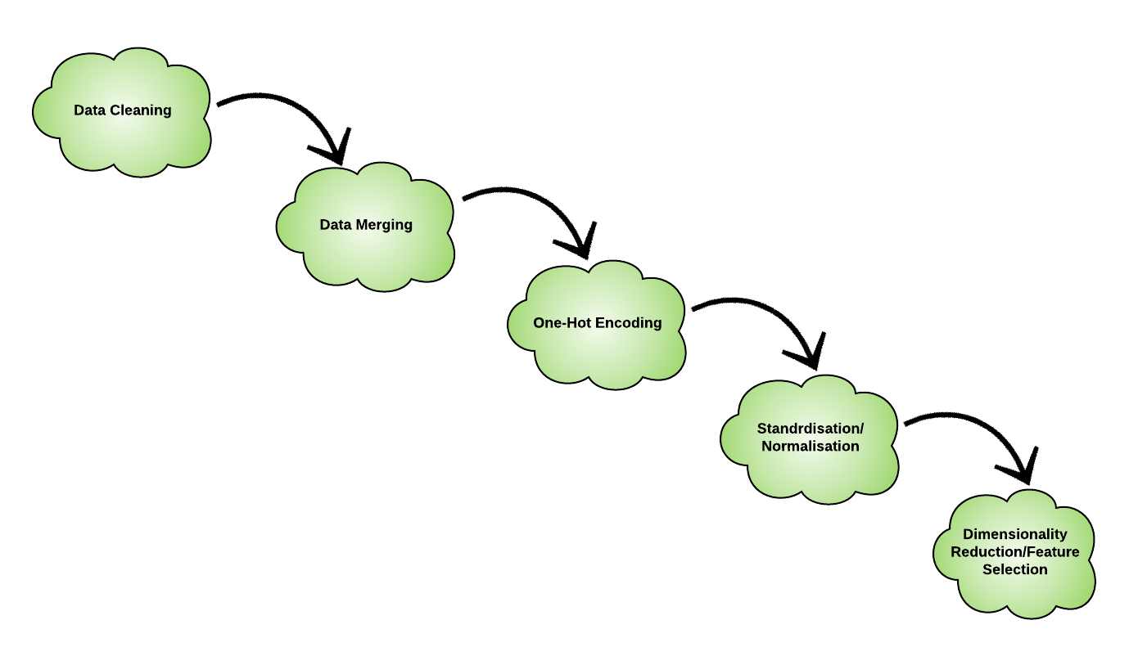
PRE-PROCESSING
File Size after One-Hot Encoding 234584 * 929
Crashes
Vehicles
People
PCA
SVD
VT

Slide 7
ALGORITHMS
with Sampling and without Sampling
Ada-boost Classifier | Multi-Layer Perceptron | Gaussian Naive Bayes
Logistic Regression | Bagging Classifiers (K Nearest Neighbors, Decision Trees Classifier, Extra Trees Classifier, Linear Discriminant Analysis Classifier and Random Forest Classifier ) | Linear Discriminant Analysis
Extra Trees Classifier | Random Forest | Decision Tree Classifier

Slide 8
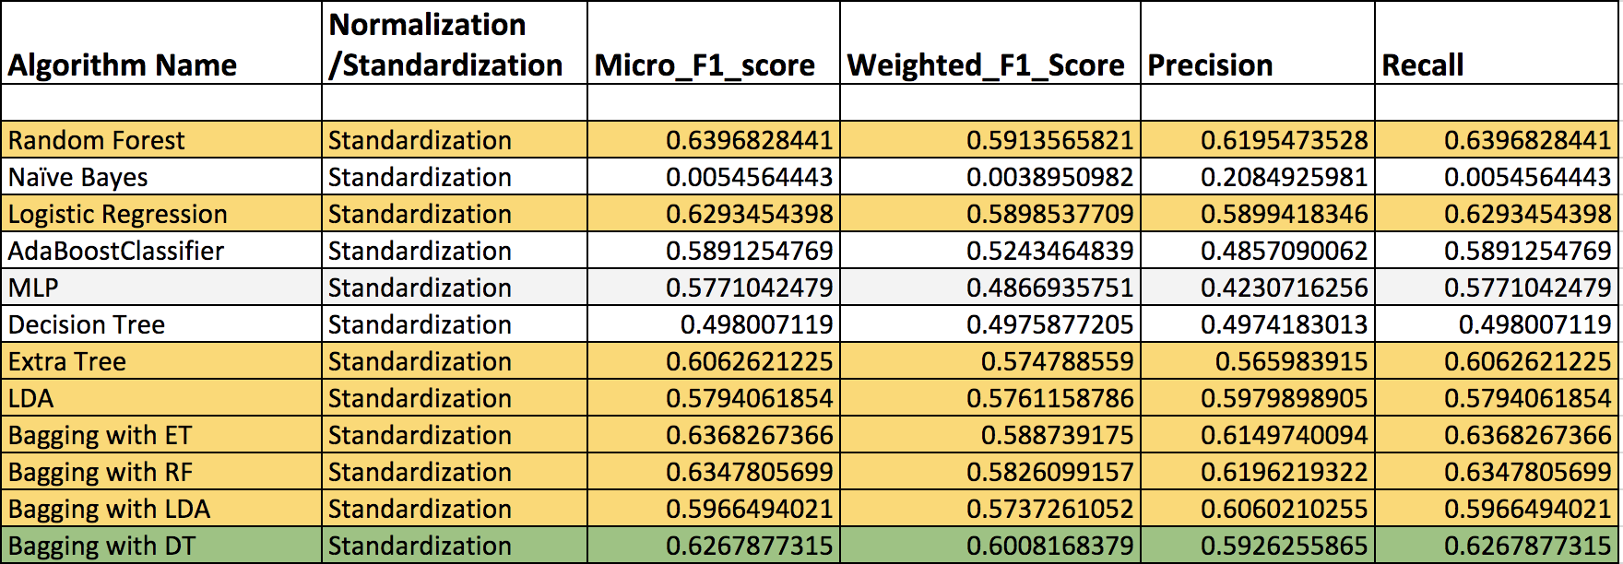
RESULTS
Numerical Analysis
F1_micro, F1_weighted, Precision and Recall scores for various classifiers. Data is standardized and dimensionality is reduced using Variance Threshold

Slide 9
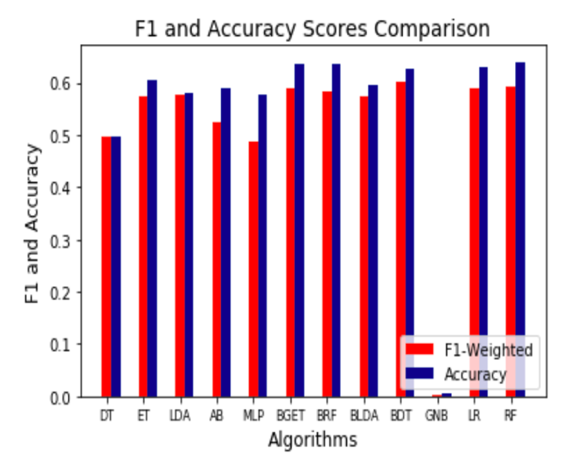
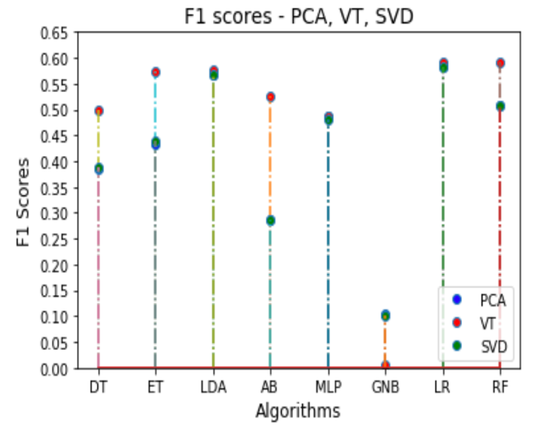
RESULTS
Graphical Analysis
Comparison between F1 and Accuracy
Comparison between PCA, SVD, VT

Slide 10
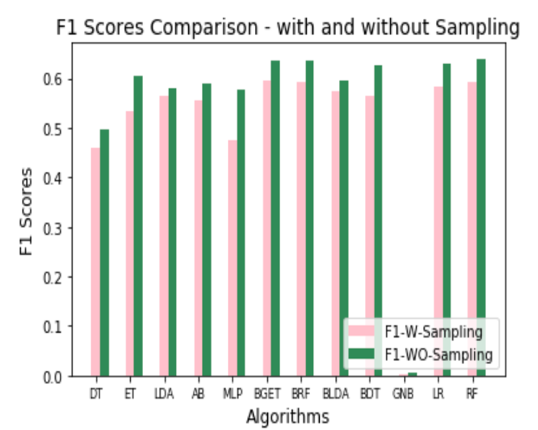
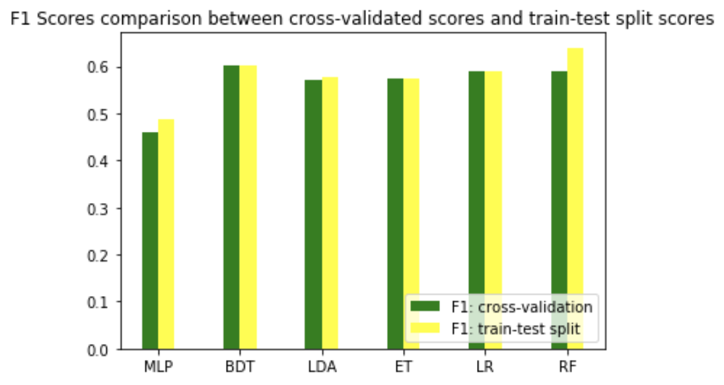
RESULTS
Graphical Analysis
F1 Comparison of with and without sampling procedures
F1 Comparison of cross-validation and train-test split procedures

Slide 11
CHALLENGES ENCOUNTERED
Merging three files into a single file - based on logic preciseness and aiding target prediction
Minimum domain knowledge - understanding features was challenging
Long execution time - KNN and SVM

Slide 12
DEMO

Slide 13
THANK YOU!

