Slide 1


Society / Apartment
Management Portal
A Comprehensive Digital Solution for Residential Community Management
KL University | Project Presentation

Slide 2
Project Presentation By
TEAM NO : 28
BATCH MEMBERS :
NAME : K.P.S PRANAV
ROLL NO: 2520080031
NAME : K.CHAITANYA RAM
ROLL NO : 2520090106
NAME : K. BADARI
ROLL NO : 2520090165

Slide 3



Introduction
What is it?
Who is it for?
Why now?
A centralized web-based platform that digitizes and streamlines all aspects of residential society and apartment complex management.
Society administrators, residents, security staff, and maintenance teams — enabling seamless coordination and transparency.
Growing residential complexes demand efficient digital tools to replace paper-based processes, reduce delays, and improve accountability.

Slide 4
Problem Statement
Manual Record Keeping
Lack of Transparency
Paper-based maintenance logs, visitor entries, and billing lead to errors, loss of data, and inefficiency.
Residents have limited visibility into fund utilization, maintenance schedules, and complaint resolution status.
Delayed Communication
Inefficient Billing & Payments
Important notices, emergency alerts, and meeting updates often fail to reach all residents in time.
Manual collection of maintenance fees, parking charges, and other dues causes delays and disputes.
Security Gaps
Fragmented Operations
Visitor management and access control remain largely manual, creating potential safety risks.
Multiple independent systems (or none) for different functions result in poor coordination among stakeholders.

Slide 5
Objectives
01
02
03
Digitize Core Operations
Enhance Transparency
Streamline Communication
Replace paper-based processes with a unified digital platform for resident records, billing, and maintenance.
Provide real-time visibility into society finances, complaint status, and facility bookings for all stakeholders.
Enable instant notifications, announcements, and two-way communication between management and residents.
04
05
06
Secure Access Control
Simplify Payments
Data-Driven Insights
Implement role-based authentication and digital visitor management to strengthen community security.
Integrate online payment gateways for seamless collection of maintenance dues and other charges.
Generate analytics and reports to support better decision-making by society administrators.

Slide 6
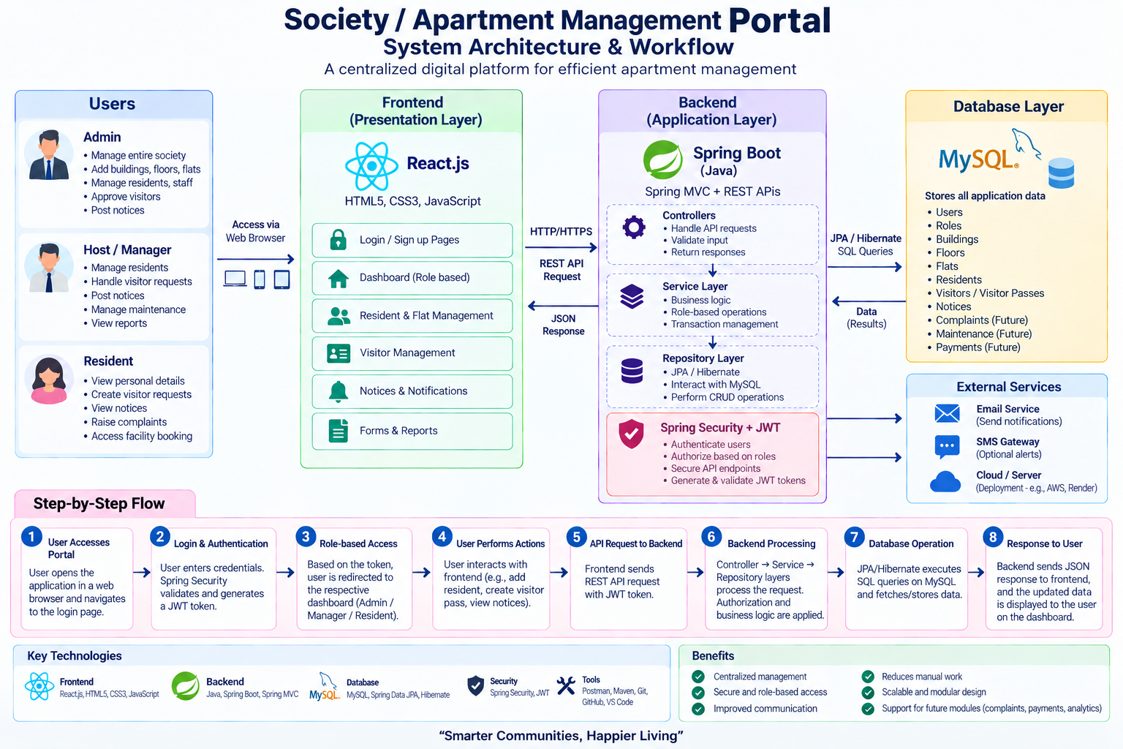
System Architecture
Presentation Layer
React.js Frontend • Responsive Web UI • Admin & Resident Dashboards
▼
Application / Business Logic Layer
Node.js + Express REST APIs • Authentication & Authorization • Business Rules
▼
Data Layer
MongoDB Database • User Profiles • Transactions • Logs & Audit Trails
Payment Gateway
Notification Service
Razorpay / Stripe Integration
Email / SMS / Push Notifications

Slide 7








Key Features
Role-Based Access
Billing & Payments
Complaint Management
Facility Booking
Admin, Resident, Security, and Staff roles with tailored dashboards and permissions.
Automated maintenance invoices, online payments, and payment history tracking.
Raise, track, and resolve complaints with status updates and SLA tracking.
Book clubhouse, gym, party halls with calendar view and conflict prevention.
Visitor Management
Announcements
Reports & Analytics
Resident Portal
Digital visitor logs, pre-approval, and real-time entry/exit tracking.
Push notices, emergency alerts, and event updates to all or selected residents.
Financial summaries, occupancy stats, and complaint resolution metrics.
View dues, raise requests, book facilities, and communicate with management.

Slide 8




Technology Stack
React.js
Node.js
Express.js
MongoDB
Frontend
Runtime
Backend Framework
Database
Component-based UI, React Router, Axios, Context API / Redux for state management.
Server-side JavaScript runtime powering the backend application logic and APIs.
RESTful API endpoints, middleware for auth, validation, and error handling.
NoSQL document store for flexible schemas — users, payments, complaints, logs.
Supporting Technologies
JWT Authentication • bcrypt • Multer (file uploads) • Nodemailer / Twilio • Razorpay SDK • Chart.js • Tailwind CSS / Bootstrap • Git & GitHub

Slide 9
Conclusion & Future Scope
Conclusion
The Society / Apartment Management Portal provides a unified, secure, and user-friendly platform that transforms traditional residential community operations. By digitizing billing, complaints, visitor management, and communication, it significantly improves efficiency, transparency, and resident satisfaction.
Future Scope
Mobile Apps
IoT Integration
AI Chatbot
Multi-Society SaaS
Native Android & iOS applications for residents and security staff.
Smart access control, parking sensors, and energy monitoring.
24/7 virtual assistant for FAQs, complaint triage, and status queries.
Cloud multi-tenant model for managing multiple societies from one platform.

Slide 10
Thank You
Questions & Discussion
KL University | Society / Apartment Management Portal

