Slide 1

ఓం గం గణపతయే నమః
A Digital Home for Every Temple
Multilingual website, seva booking and temple management, proven at Sri Varasidhi Vinayaka Swamy Devasthanam, Thorur
Live demo | Packages | Budget
Vriksha Studio | October 2026

Slide 2
Why temples need more than a website
What devotees and temple offices struggle with today
For devotees
For the temple office
For trustees
Timings and festival dates hard to find
Seva booking by phone or in person
Information only in one language
Poor experience on mobile
Paper receipts and registers
No single record of donors
Accounts scattered in notebooks
No trail of who changed what
Little visibility into income
Trust depends on one person
Hard to show transparency
Data privacy obligations (DPDPA)
One platform answers all three: a public site, an admin office and an audit trail.
Temple Platform | Vriksha Studio

Slide 3
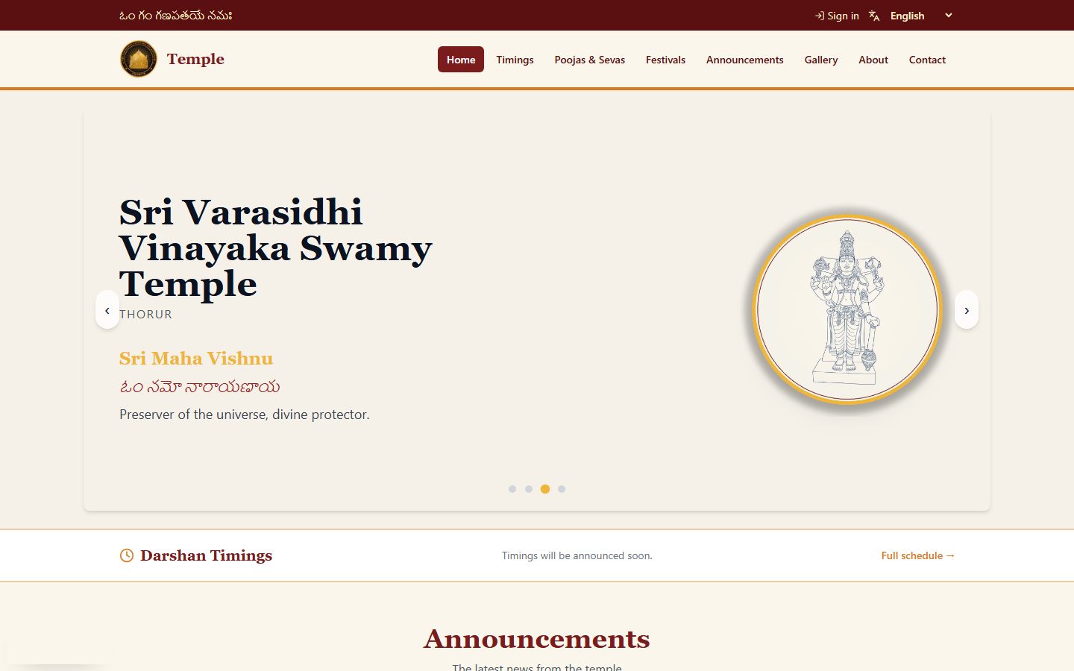
Live demo: the public website
Running on localhost, the same codebase that serves svvdthorur.org
Deity carousel with Sanskrit/Telugu greeting
Darshan timings always on top
Announcements feed
Clear navigation: Timings, Poojas, Festivals, Gallery, About, Contact
Temple branding in one theme
Temple Platform | Vriksha Studio

Slide 4
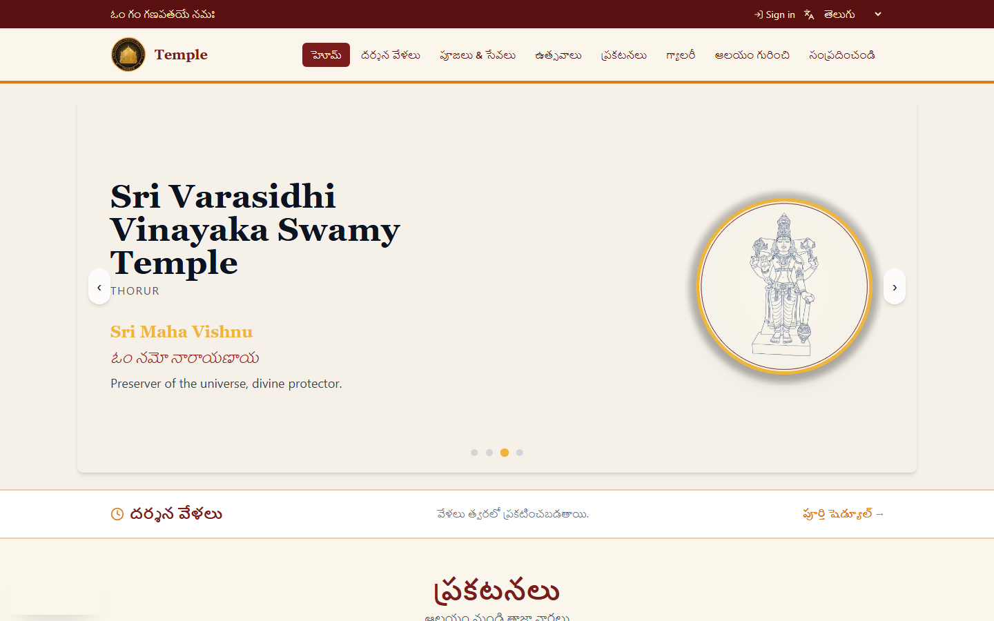
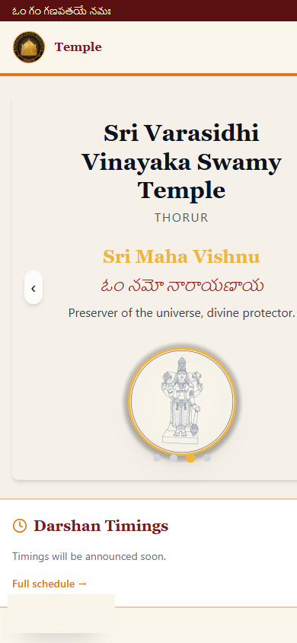
Five languages, built for the phone
English, Telugu, Tamil, Kannada, Hindi: each on its own URL
Per-language SEO
Mobile-first
Add a language with one file
Search engines see every language: canonical and hreflang tags, sitemap, structured data.
Temple Platform | Vriksha Studio

Slide 5
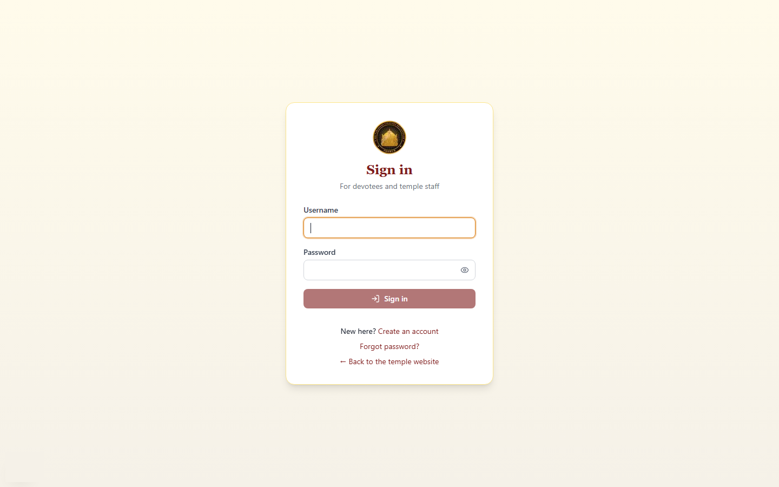
Devotee journey: book a seva in minutes
No account needed; account optional for history
1
Choose a seva
2
Verify email with OTP
3
Booking confirmed + QR ticket by email
4
Pay at the counter (or online with gateway add-on)
5
Staff scans QR at the temple
Optional sign-in shows 'My Bookings'; personal blessing email on birthdays and anniversaries.
Temple Platform | Vriksha Studio

Slide 6
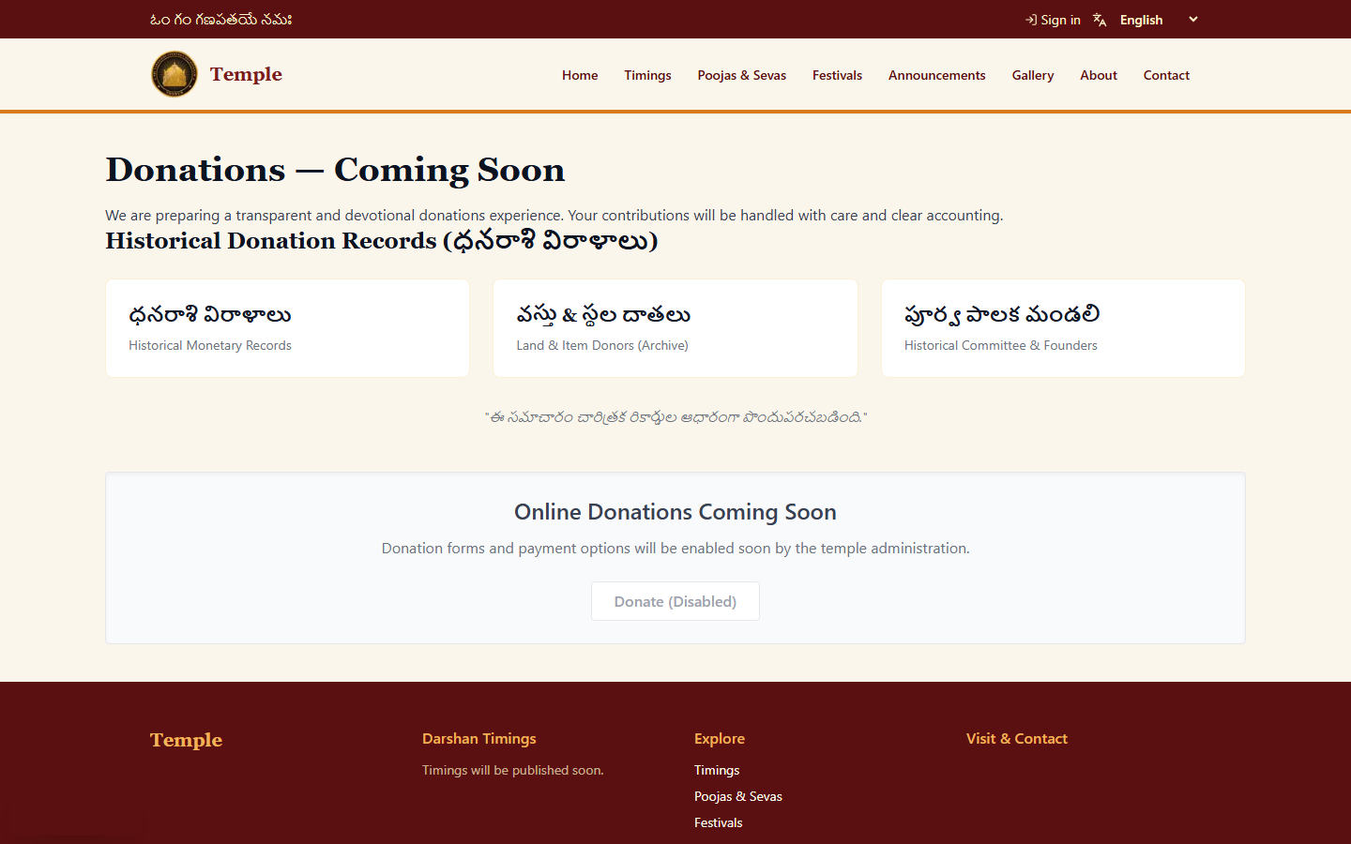
Donations with transparency
Archive of historical donors today, online giving as an add-on
Historic donors, land and item donors, committee archive
Admin records donations and issues PDF receipts
A receipt, once issued, cannot be edited or deleted
Every rupee posts to the finance ledger
Gateway (UPI/cards) available as add-on
Temple Platform | Vriksha Studio

Slide 7
Behind the scenes: the admin panel
Staff manage everything without a developer: 14 modules, 5 roles
Dashboard
Announcements
Festivals
Poojas & Sevas
Gallery
Timings
Seva Tickets + QR scan
Donors & Donations
Finance ledger
Members
Messages
Users
Audit log
Temple profile
Roles
Super Admin
Admin
Trustee
Staff
Devotee
Everything + users + audit
All content, donors, finance
Read-only oversight
Content, tickets, messages
Own bookings only
Temple Platform | Vriksha Studio

Slide 8
How it is built
Modern, tested, containerised: low cost to run, easy to hand over
Devotee / Staff
(browser)
Nginx + TLS
(Let's Encrypt)
Next.js 15 + React 19
public site, admin UI
FastAPI (Python)
52 REST endpoints, RBAC
PostgreSQL
>
>
>
>
One server per temple: ~₹1,000 a month
Docker Compose; GitHub Actions deploys after tests pass
21 versioned DB migrations, ~40 test modules
Each temple isolated: own domain, data and branding
AWS S3
gallery, tickets, receipts
AWS SES
OTP, confirmations, alerts
Temple Platform | Vriksha Studio

Slide 9
Trust: security and privacy built in
Access control
Two-factor login
Audit trail
Five roles; permissions checked on the server for every action
Email OTP; 30-minute idle timeout
Every change recorded; alerts on bulk deletions
Abuse protection
Privacy (DPDPA)
Safe by default
Rate limiting and bot challenge on public forms
Privacy policy on site, emails and tickets
HTTPS, hashed passwords, no AWS keys in app, dependency audits
Temple Platform | Vriksha Studio

Slide 10
Three packages
Same platform; choose what the temple needs today and grow later
Essential
Standard
Complete
₹55,000
₹1,40,000
₹2,60,000
3-4 weeks | one-time, excl. GST
6-8 weeks | one-time, excl. GST
10-12 weeks | one-time, excl. GST
- Public website, 2 languages
- Admin CMS and roles
- Contact form, SEO
- Hosting setup, training
- Everything in Essential
- 5 languages
- Seva booking, OTP, QR ticket
- Devotee accounts
- Donors and PDF receipts
- Everything in Standard
- Finance ledger
- Member directory
- Audit log, 2FA, QR scan
- Occasion blessings
Temple Platform | Vriksha Studio

Slide 11
What it costs to run, and the multi-temple saving
 | Essential | Standard | Complete
Hosting, email, domain, backups / yr | ₹13,600 | ₹15,900 | ₹23,700
Maintenance & support / yr | ₹24,000 | ₹48,000 | ₹84,000
Recurring / yr | ₹37,600 | ₹63,900 | ₹1,07,700
Year 1 total | ₹92,600 | ₹2,03,900 | ₹3,67,700
3-year total | ₹1,67,800 | ₹3,31,700 | ₹5,83,100
5 temples, Standard
One-time platform work: ₹90,000
Temples 2-5: 25% off build
Year 1 total: ₹9,69,500
Without programme: ₹10,19,500
Estimates in INR excl. 18% GST; online payment gateway is an optional ₹35,000 add-on.
Hosting alone is about ₹800-1,200 a month per temple. Full detail in the Budget document.
Temple Platform | Vriksha Studio

Slide 12
Next steps
From this demo to a live temple site in weeks
Week 0
Week 1
Weeks 2-N
Go-live
After
Choose package, sign quotation
Collect content: timings, sevas, photos, committee
Build on staging; review with temple
Domain, HTTPS, training, handover
30-day hypercare, then maintenance
Pilot offer: the next temple's staging site can be set up for review before any commitment.
Chaithanya M | vrikshastudio9@gmail.com
Temple Platform | Vriksha Studio

