Slide 1
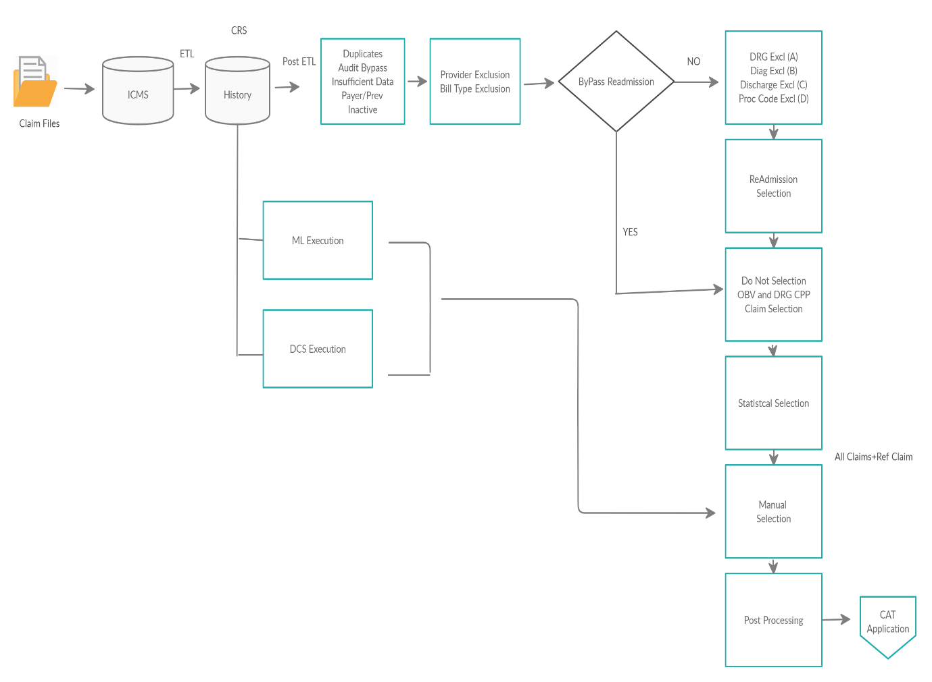

Slide 2
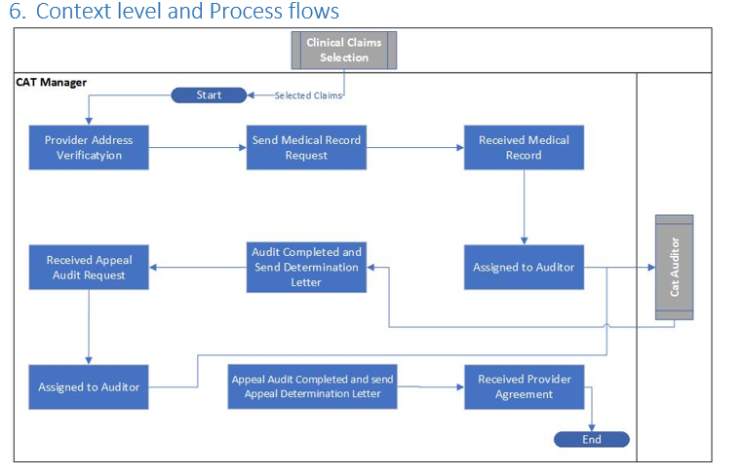
Reference: CCV_COM_CATManager_1.0.doc

