Slide 1


Slide 2
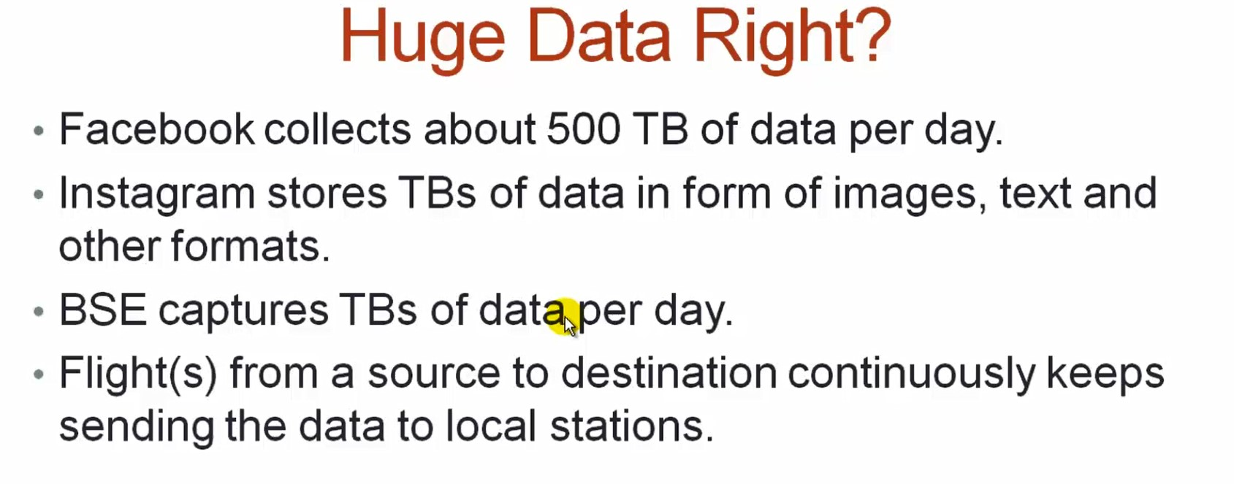

Slide 3
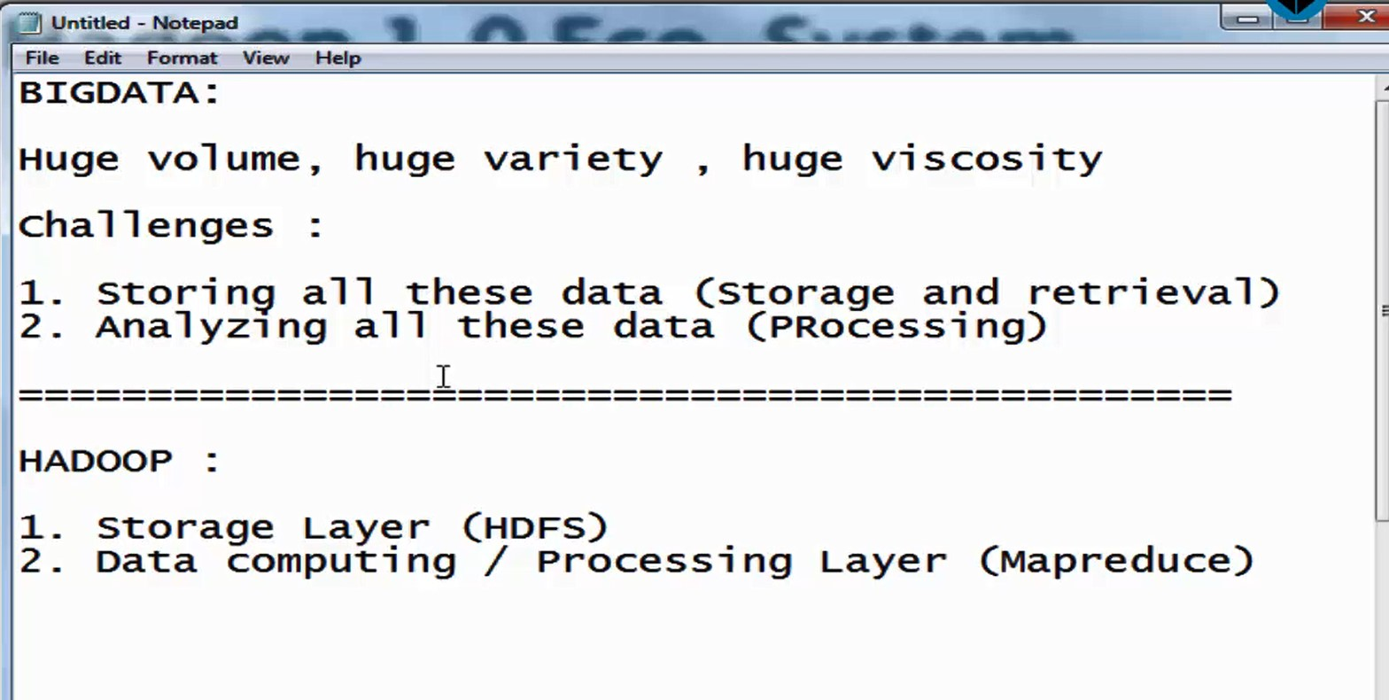

Slide 4
4 V’s of Big Data
Volume - Huge size of Data sets.
Velocity - Speed, Real time Data.
Variety - Structured, Semi-Structured, Unstructured.
Veracity - Quality of the data that is being analyzed. (Accuracy and Trustworthiness)
Challenges?
1.Storing All These Data (Storage and Retrieval)
2.Analyzing All These Data (Processing)
HADOOP ->
1. HDFS (Storage Layer)
2. Map Reduce (Data Computing/Processing Layer)

Slide 5
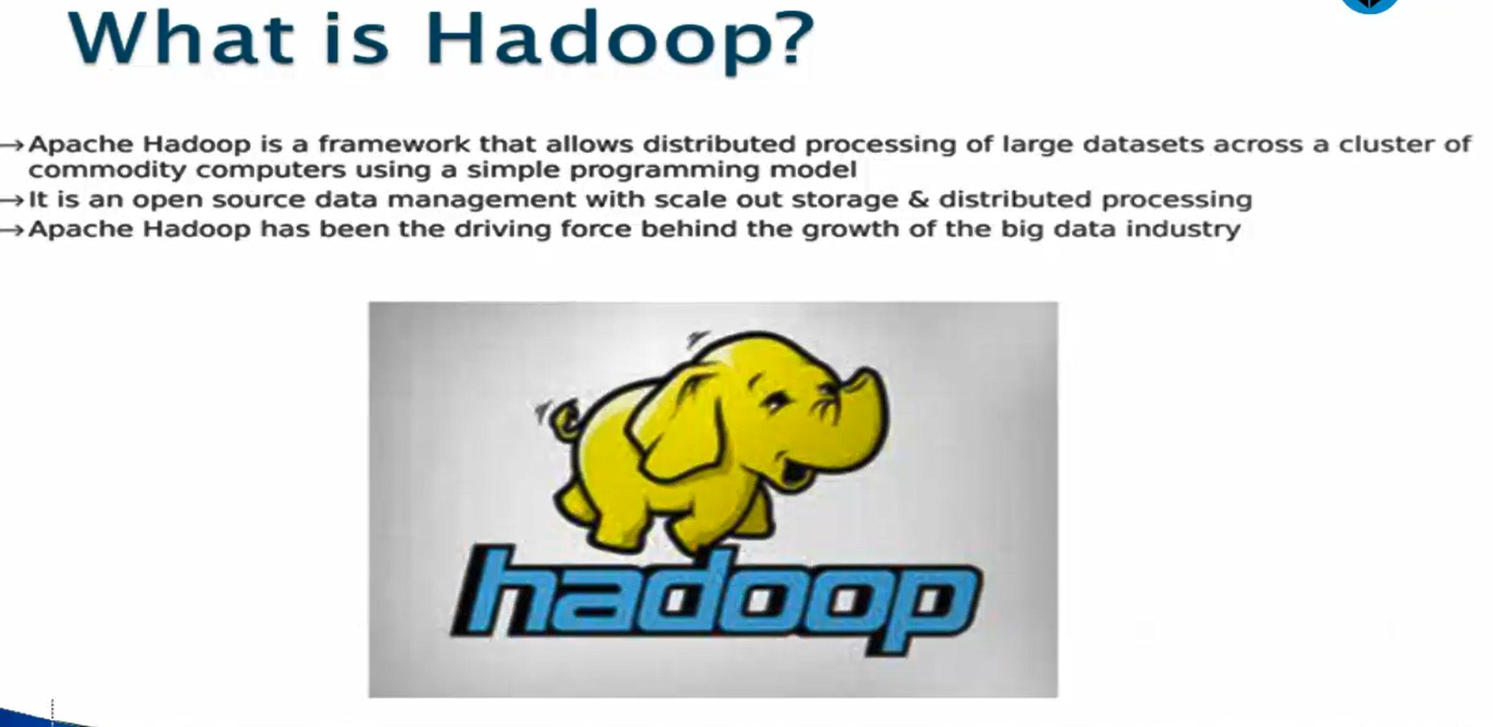

Slide 6
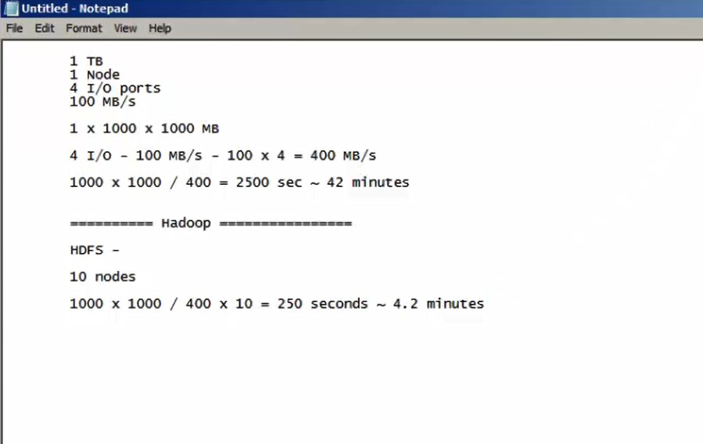

Slide 7
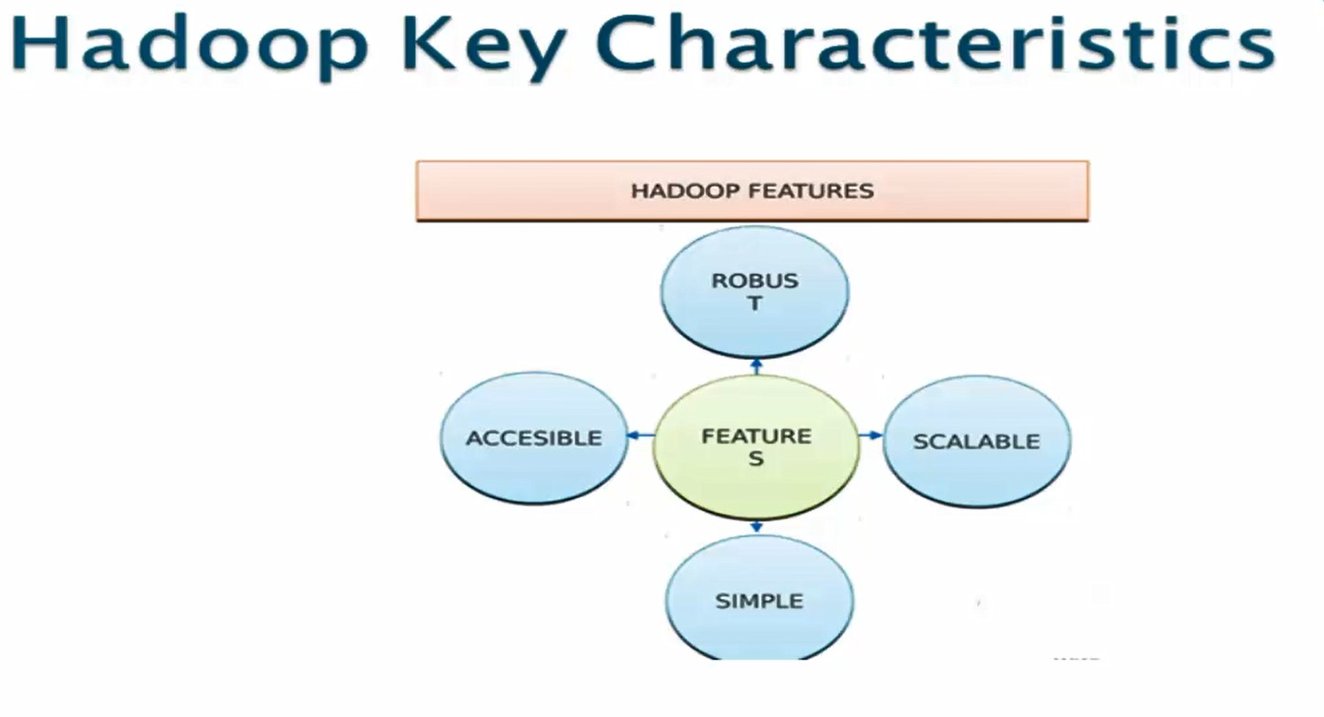

Slide 8
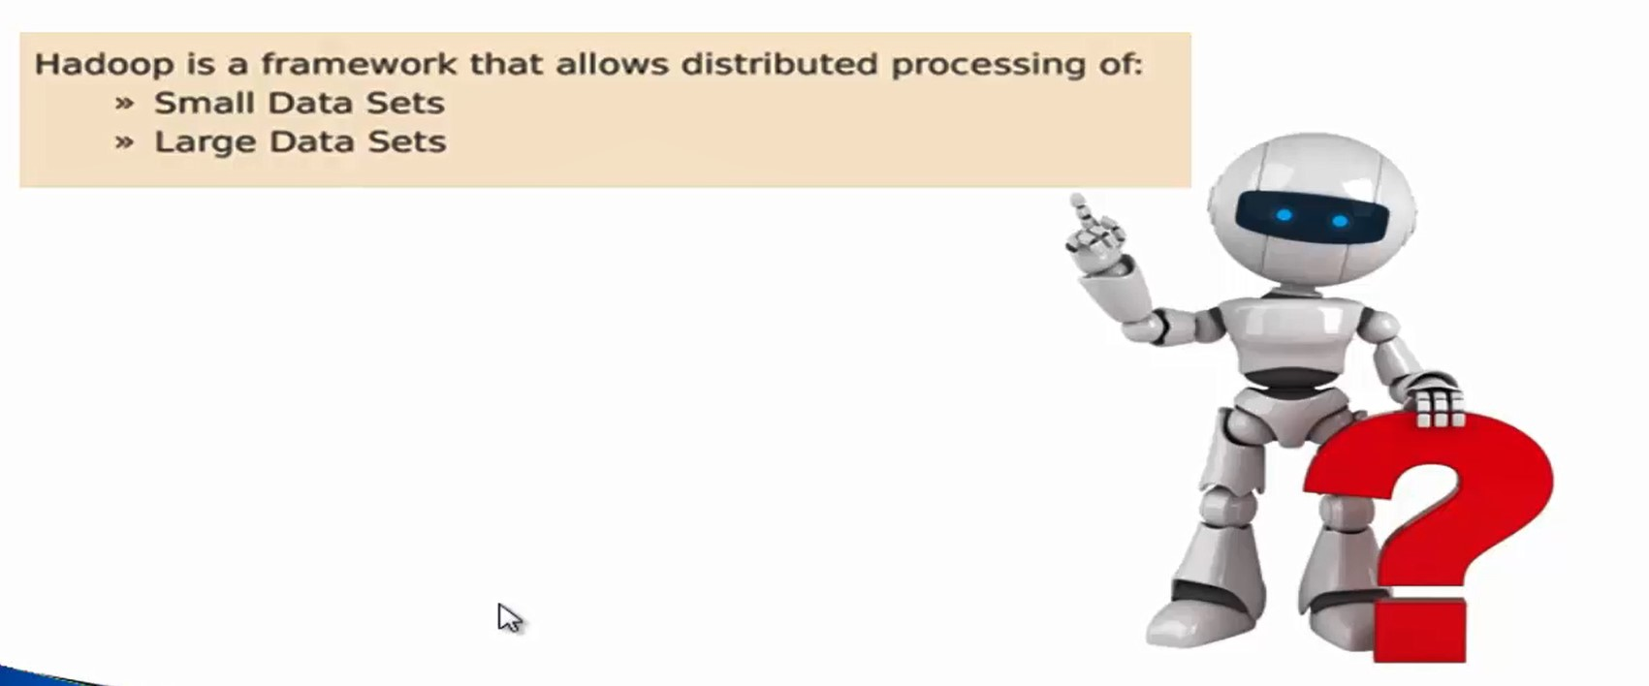

Slide 9
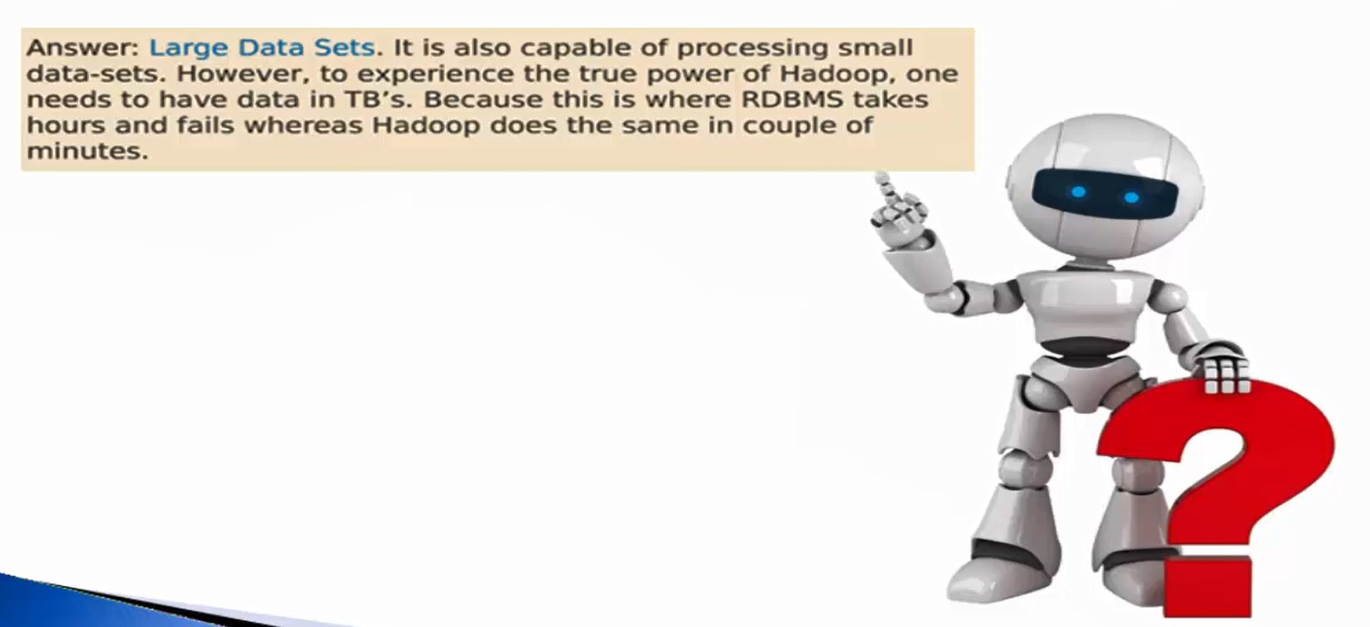

Slide 10
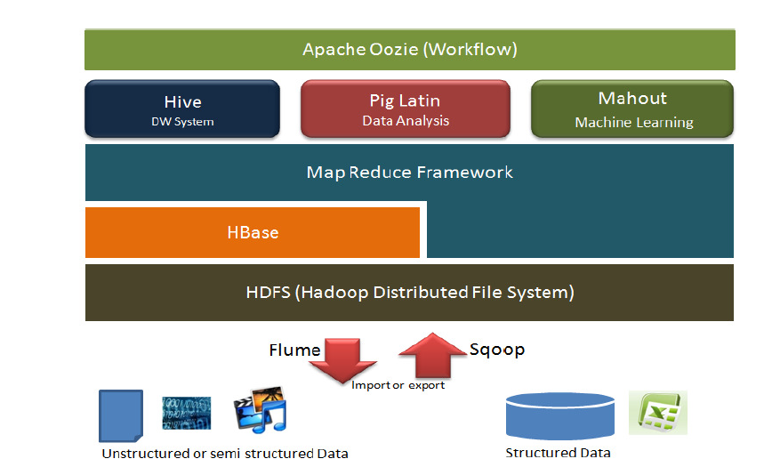
Hadoop Ecosystem Architecture

Slide 11
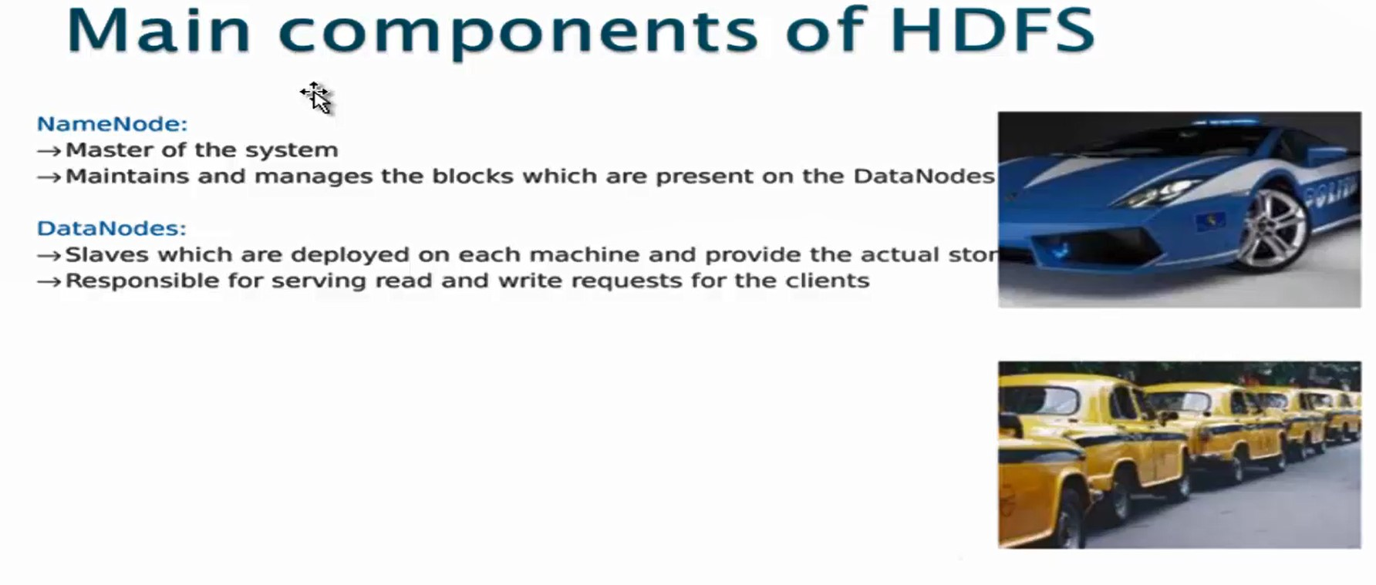

Slide 12
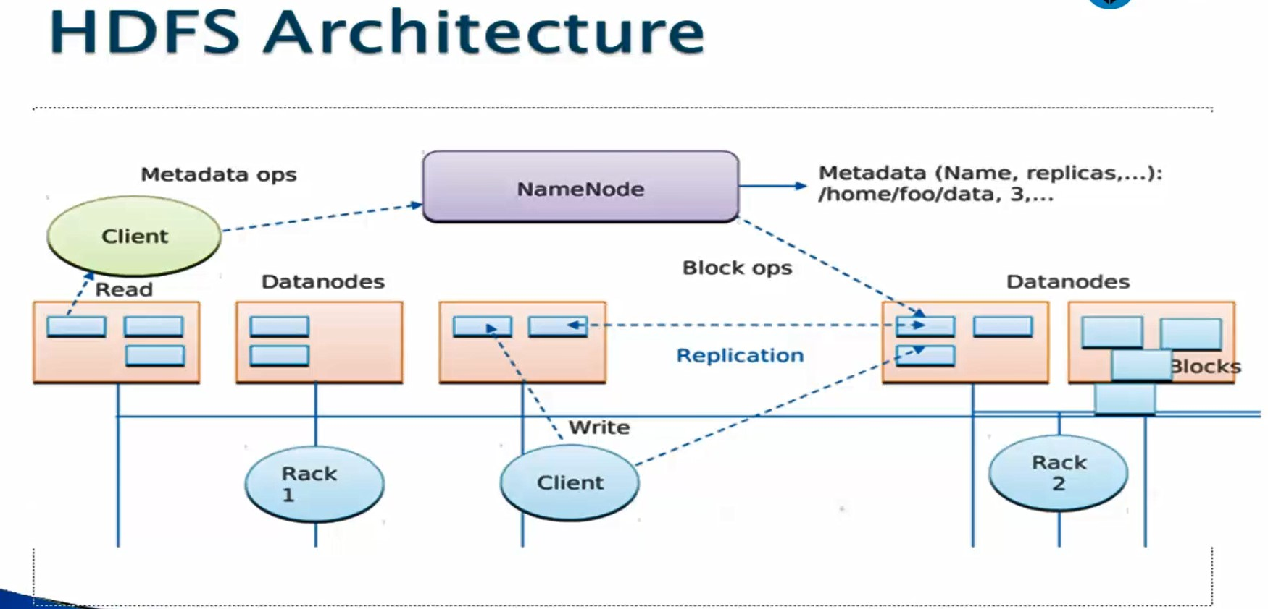

Slide 13
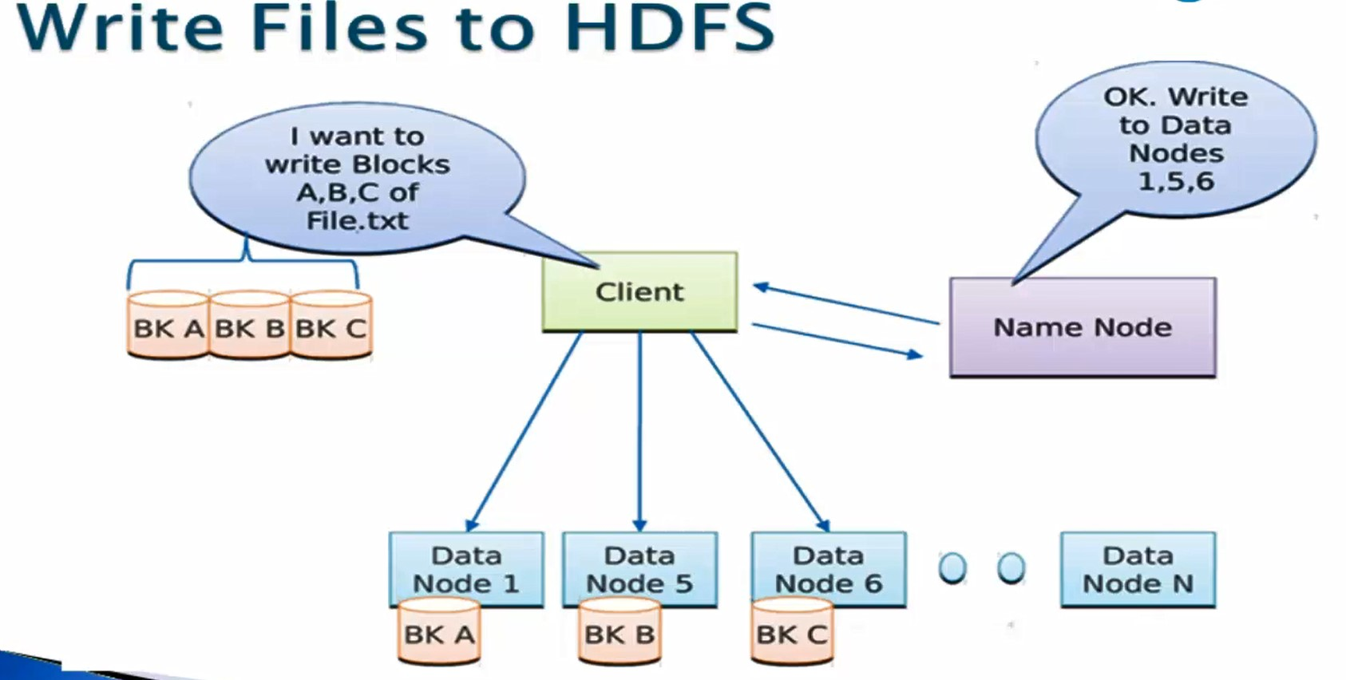

Slide 14
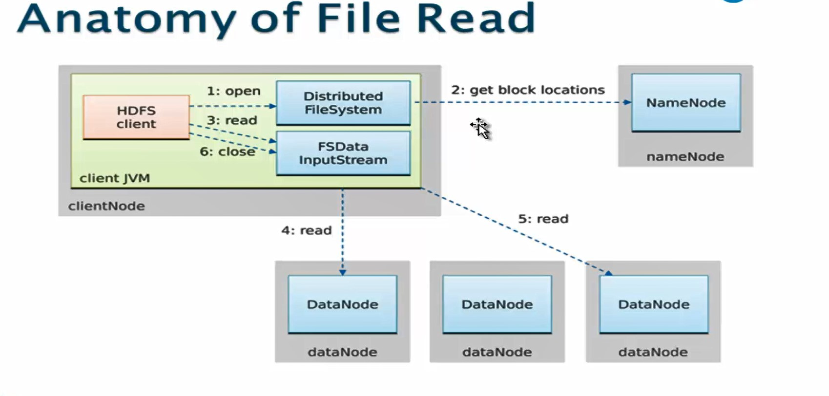

Slide 15
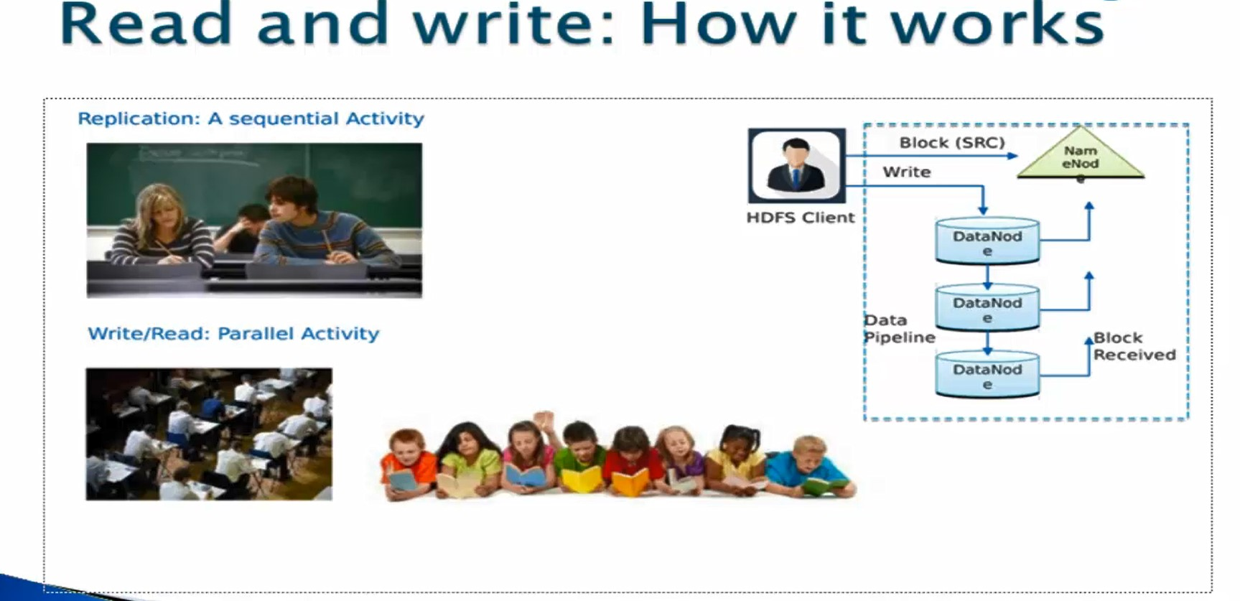

Slide 16
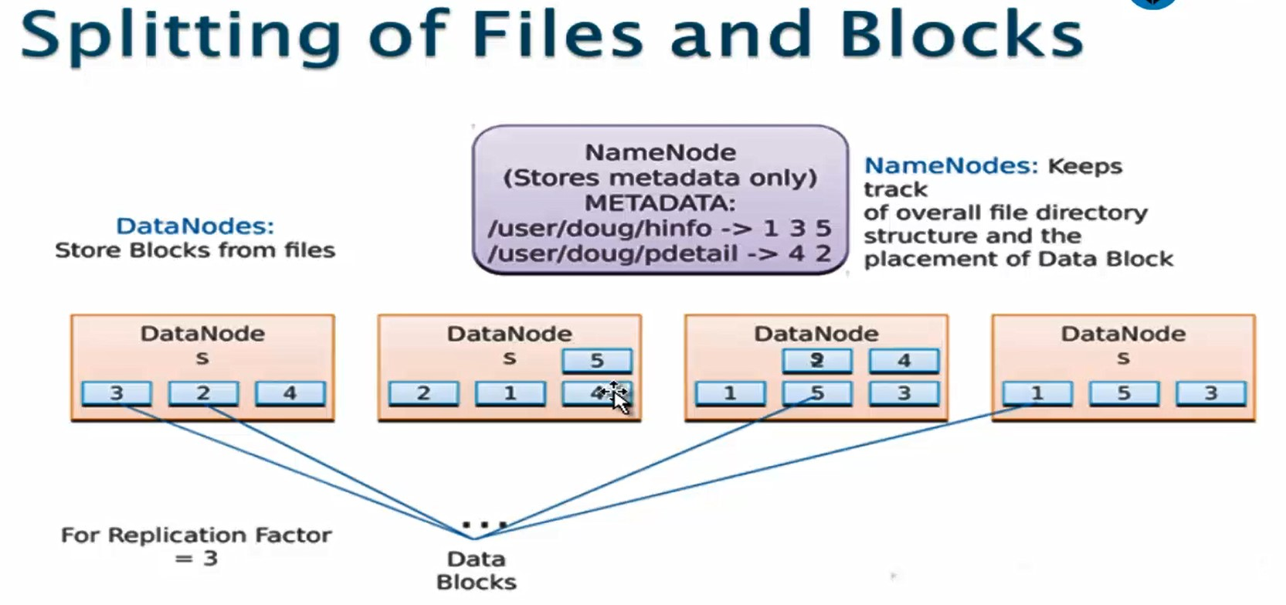

Slide 17
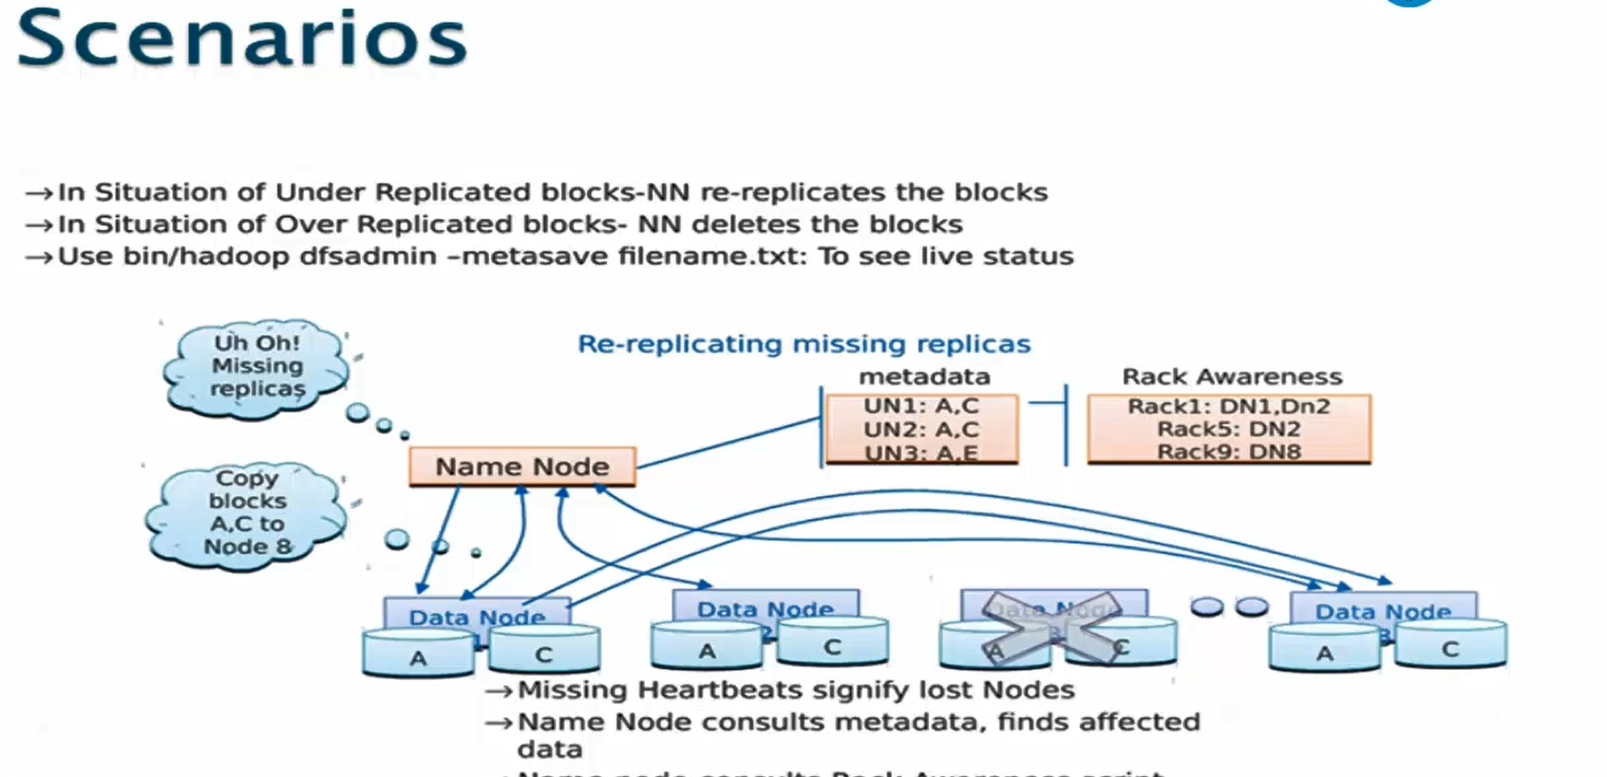

Slide 18
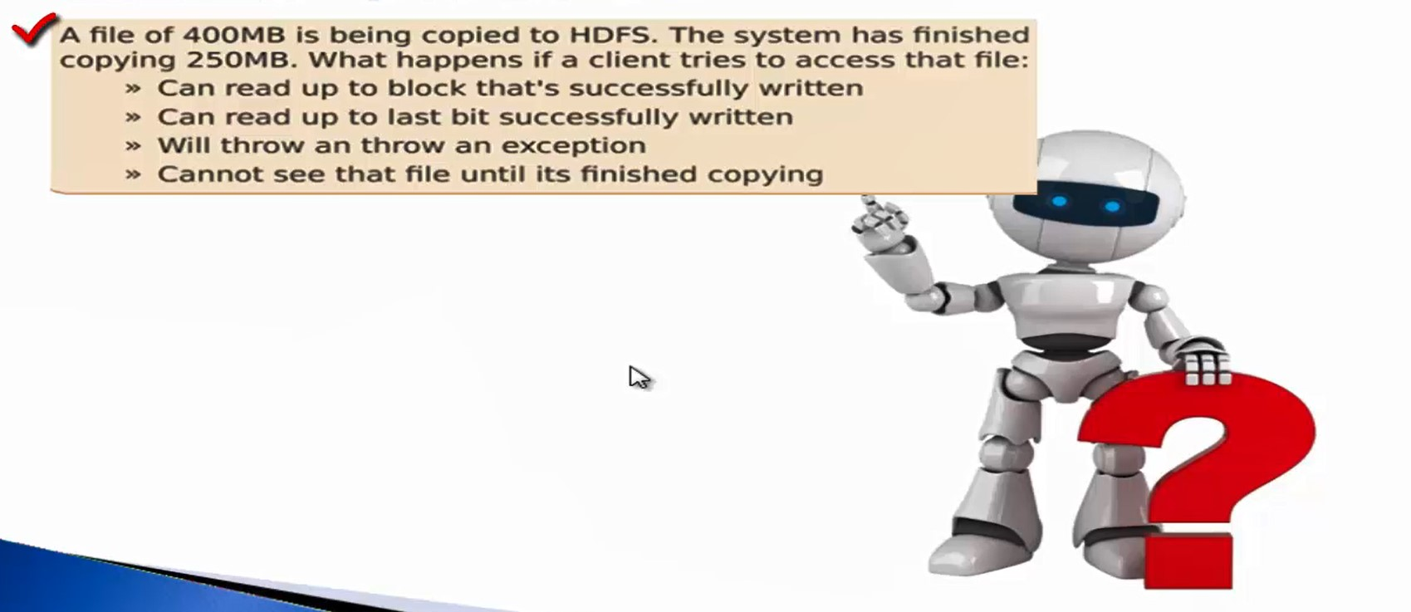

Slide 19
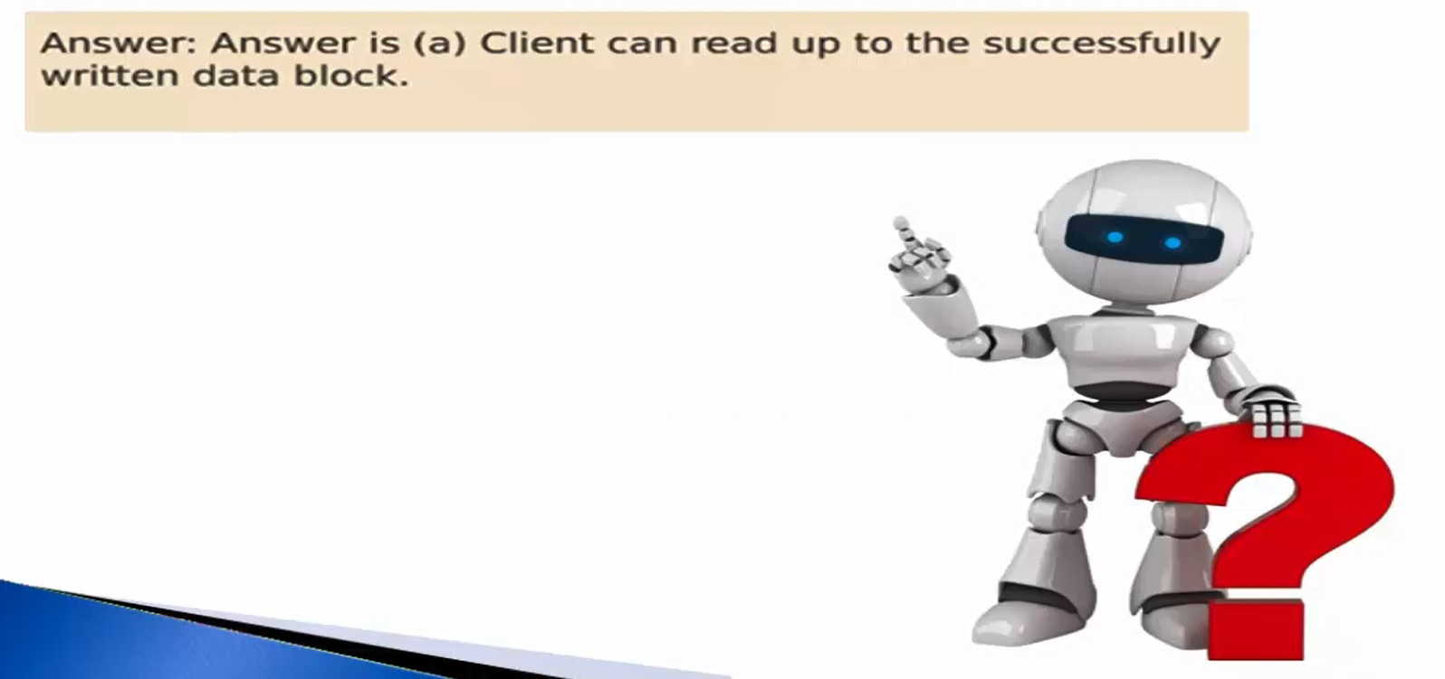

Slide 20
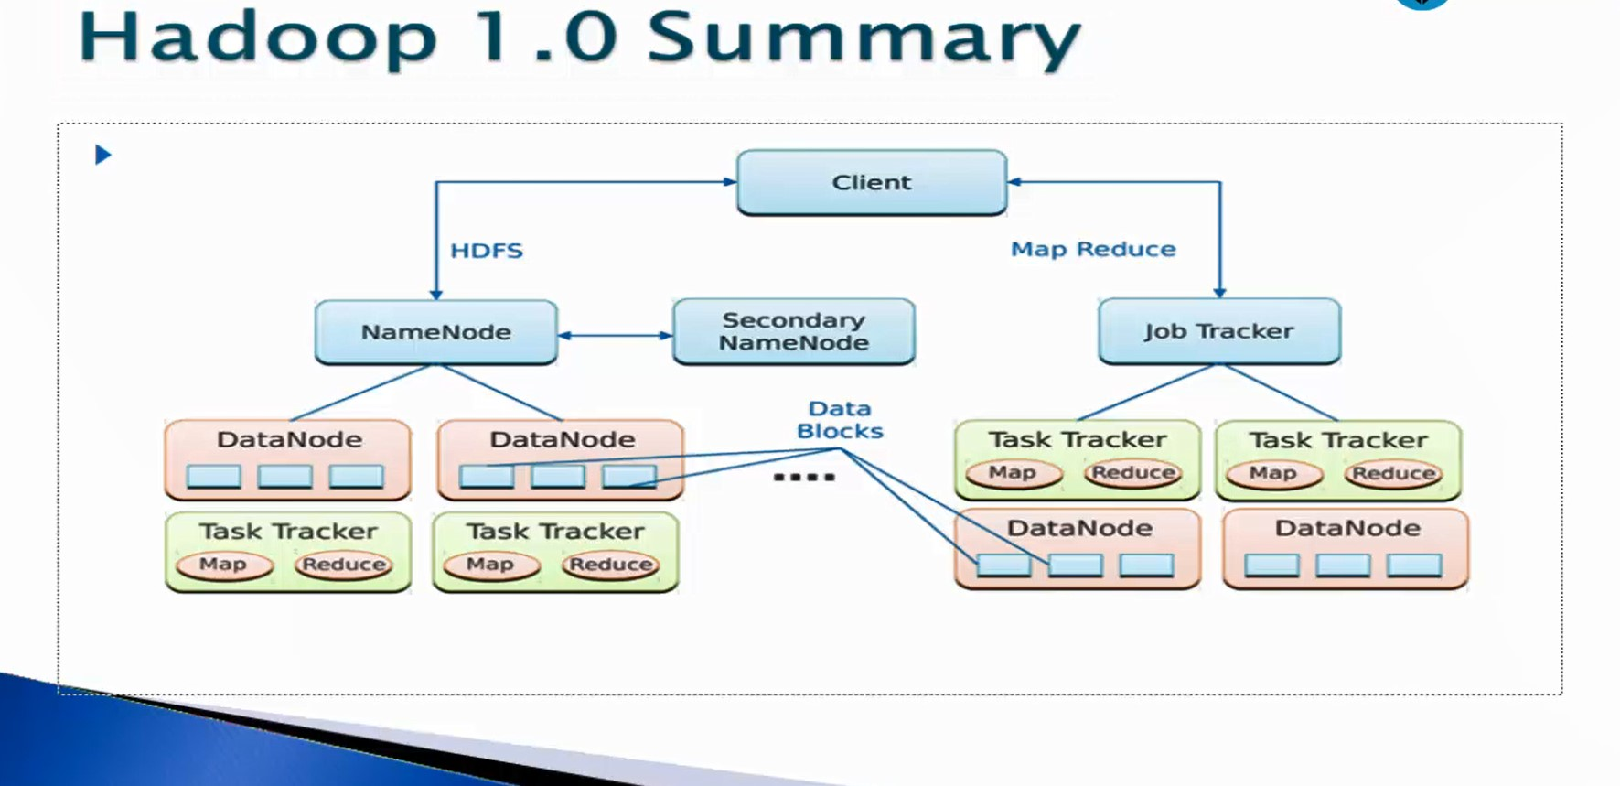

Slide 22
Map Reduce Flow
Input File (file.txt) – Around 300MB
inputsplit1
inputsplit2
inputsplit3
Record Reader
Record Reader
Record Reader
Mapper
Mapper
Mapper
Shuffler
Shuffler
Shuffler
Reducer
Reducer
Reducer
Required Output

Slide 23
(0, Hi How are you yaswant) (23, Welcome to Cotiviti) (43, How the things are going on) (67, How is your on boarding experience in Cotiviti) (113, Thank you yaswant)
Hi How are you yaswant Welcome to cotiviti How the things are going on How is your on boarding experience in Cotiviti Thank you yaswant
INPUT File
Record Reader
(Hi, 1), (How,1), (are, 1), (you,1), (Yaswant, 1), (Welcone,1), (to,1), (Cotiviti,1), (How,1), (the,1), (things,1), (are,1), (going,1), (on,1), (How,1), (is,1), (your,1), (on,1), (boarding,1), (experience,1), (in,1), (Cotiviti,1), (Thank,1), (you,1) (Yaswant,1)
Mapper
(are, [1,1]), (boarding,[1]), (Cotiviti, [1,1]), (experience,[1]), (going,[1]), (Hi, [1]), (How, [1,1,1]), (in,[1]), (is,[1]), (on,[1,1]), (thank,[1]), (to,[1]), (Welcome,[1]), (Yaswant,[1,1]), (you,[1,1]), (your,[1])
Sort and Shuffler
(are, 2), (boarding, 1), (Cotiviti, 2), (experience, 1), (going, 1), (Hi, 1), (How, 3), (in, 1), (is, 1), (on, 2), (thank, 1), (to, 1), (Welcome, 1), (Yaswant, 2), (you, 2), (your, 1)
Reducer

Slide 24
Thank you

