Slide 1

Hive - A Warehousing Solution Over a Map-Reduce Framework

Slide 2
Agenda
Why Hive???
What is Hive?
Hive Data Model
Hive Architecture
HiveQL
Hive SerDe’s
Pros and Cons
Hive v/s Pig
Graphs

Slide 3

Data Analysts with Hadoop

Slide 4
Challenges that Data Analysts faced
Data Explosion
- TBs of data generated everyday
Solution – HDFS to store data and Hadoop Map-Reduce framework to parallelize processing of Data
What is the catch?
Hadoop Map Reduce is Java intensive
Thinking in Map Reduce paradigm can get tricky

Slide 5
… Enter Hive!

Slide 6
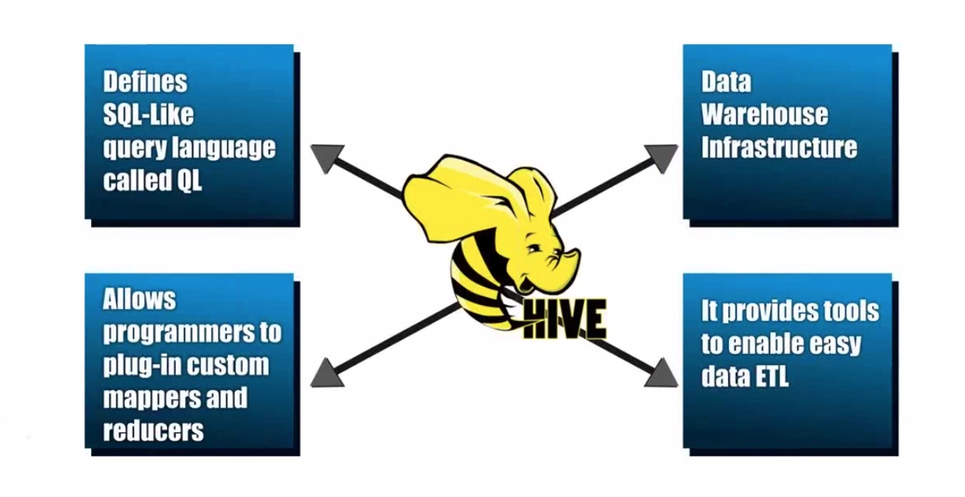
Hive Key Principles
Notes:
Data Warehouse - A system used for reporting and data analysis. DWs are central repositories of integrated data from one or more disparate sources
ETL – process of extracting data from source and bringing it into data warehouse. Extract Transform and Load.

Slide 7

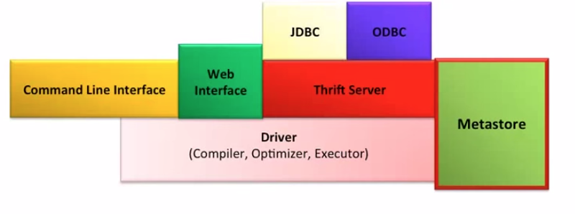
HiveQL to MapReduce
Hive Framework
N
Data Analyst
SELECT COUNT(1) FROM Sales;
rowcount, N
rowcount,1
rowcount,1
Sales: Hive table
MR JOB Instance

Slide 8
Hive Data Model
Data in Hive organized into :
Tables
Partitions
Buckets

Slide 9
Hive Data Model Contd.
Tables
- Analogous to relational tables
Each table has a corresponding directory in HDFS
Data serialized and stored as files within that directory
- Hive has default serialization built in which supports compression and lazy deserialization
- Users can specify custom serialization –deserialization schemes (SerDe’s)

Slide 10
Hive Data Model Contd.
Partitions
Each table can be broken into partitions
Partitions determine distribution of data within subdirectories
Example -
CREATE_TABLE Sales (sale_id INT, amount FLOAT)
PARTITIONED BY (country STRING, year INT, month INT)
So each partition will be split out into different folders like
Sales/country=US/year=2012/month=12

Slide 11
Hierarchy of Hive Partitions
/hivebase/Sales
/country=US
/country=CANADA
/year=2012
/year=2012
/year=2015
/year=2014
/month=12
/month=11
/month=11
File
File
File
Notes:
Partitioned tables can be created using the PARTITIONED BY clause. A table can have one or more partition columns and a separate data directory is created for each distinct value combination in the partition columns. Further, tables or partitions can be bucketed using CLUSTERED BY columns, and data can be sorted within that bucket via SORT BY columns. This can improve performance on certain kinds of queries.

Slide 12
Hive Data Model Contd.
Buckets
Data in each partition divided into buckets
Based on a hash function of the column
H(column) mod NumBuckets = bucket number
Each bucket is stored as a file in partition directory

Slide 13
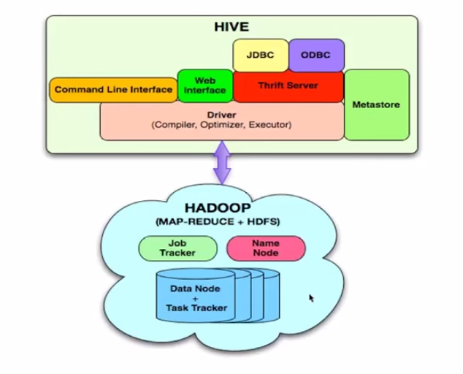
Architecture
Externel Interfaces- CLI, WebUI, JDBC, ODBC programming interfaces
Thrift Server – Cross Language service framework .
Metastore - Meta data about the Hive tables, partitions
Driver - Brain of Hive! Compiler, Optimizer and Execution engine

Slide 14
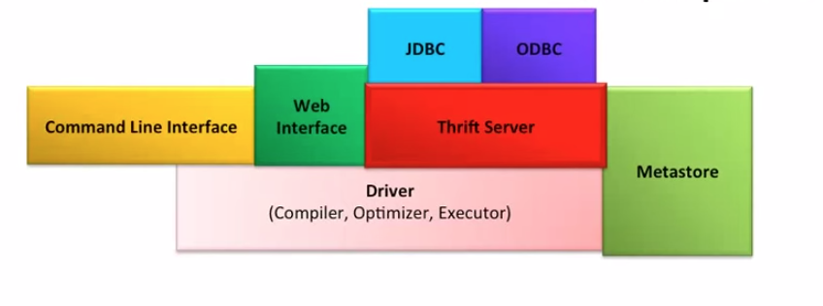
Hive Thrift Server
Framework for cross language services
Server written in Java
Support for clients written in different languages
- JDBC(java), ODBC(c++), php, perl, python scripts

Slide 15
Metastore
System catalog which contains metadata about the Hive tables
Stored in RDBMS/local fs. HDFS too slow(not optimized for random access)
Objects of Metastore
Database - Namespace of tables
Table - list of columns, types, owner, storage, SerDes
Partition – Partition specific column, Serdes and storage
Notes:
Metadata for table contains list of columns and their types, owner, storage and SerDe information. It can also contain any user supplied key and value data; this facility can be used to store table statistics in the future. Storage information includes location of the ta- ble’s data in the underlying file system, data formats and bucketing information. SerDe metadata includes the implementation class of serializer and deserializer methods and any supporting information required by that implementation.
Hive now records the schema version in the metastore database and verifies that the metastore schema version is compatible with Hive binaries that are going to accesss the metastore. Note that the Hive properties to implicitly create or alter the existing schema are disabled by default. Hive will not attempt to change the metastore schema implicitly. When you execute a Hive query against an old schema, it will fail to access the metastore.

Slide 16
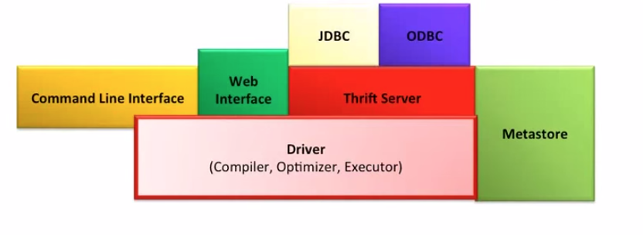
Hive Driver
Driver - Maintains the lifecycle of HiveQL statement
Query Compiler – Compiles HiveQL in a DAG of map reduce tasks
Executor - Executes the tasks plan generated by the compiler in proper
dependency order. Interacts with the underlying Hadoop instance

Slide 17
Compiler
Converts the HiveQL into a plan for execution
Plans can
- Metadata operations for DDL statements e.g. CREATE
- HDFS operations e.g. LOAD
Semantic Analyzer – checks schema information, type checking, implicit type conversion, column verification
Optimizer – Finding the best logical plan e.g. Combines multiple joins in a way to reduce the number of map reduce jobs, Prune columns early to minimize data transfer
Physical plan generator – creates the DAG of map-reduce jobs
Notes:
These repartition operators mark the boundary between the map phase and a reduce phase during physical plan generation.

Slide 18
HiveQL
DDL :
CREATE DATABASE
CREATE TABLE
ALTER TABLE
SHOW TABLE
DESCRIBE
DML:
LOAD TABLE
INSERT
QUERY:
SELECT
GROUP BY
JOIN
MULTI TABLE INSERT
Notes:
The EXTERNAL keyword lets you create a table and provide a LOCATION so that Hive does not use a default location for this table. This comes in handy if you already have data generated. When dropping an EXTERNAL table, data in the table is NOT deleted from the file system.

Slide 19
Hive SerDe
SELECT Query
Hive built in Serde:
Avro, ORC, Regex etc
Can use Custom SerDe’s (e.g. for unstructured data like audio/video data, semistructured XML data)
Record Reader
Deserialize
Hive Table
Hive Row Object
Object Inspector Map Fields
End User

Slide 20
Good Things
Boon for Data Analysts
Easy Learning curve
Completely transparent to underlying Map-Reduce
Partitions(speed!)
Flexibility to load data from localFS/HDFS into Hive Tables

Slide 21
Cons and Possible Improvements
Extending the SQL queries support(Updates, Deletes)
Parallelize firing independent jobs from the work DAG
Table Statistics in Metastore
Explore methods for multi query optimization
Perform N- way generic joins in a single map reduce job
Better debug support in shell

Slide 22

Hive v/s Pig
Similarities:
Both High level Languages which work on top of map reduce framework
Can coexist since both use the under lying HDFS and map reduce
Differences:
Language
Pig is a procedural ; (A = load ‘mydata’; dump A)
Hive is Declarative (select * from A)
Work Type
Pig more suited for adhoc analysis (on demand analysis of click stream
search logs)
Hive a reporting tool (e.g. weekly BI reporting)
Notes:
Declarative programming is where you say what you want without having to say how to do it. e.g SQL, yacc, lex
With procedural programming, you have to specify exact steps to get the result. e.g. C

Slide 23
Hive v/s Pig
Differences:
Users
Pig – Researchers, Programmers (build complex data pipelines,
machine learning)
Hive – Business Analysts
Integration
Pig - Doesn’t have a thrift server(i.e no/limited cross language support)
Hive - Thrift server
User’s need
Pig – Better dev environments, debuggers expected
Hive - Better integration with technologies expected(e.g JDBC, ODBC)
Notes:
Declarative programming is where you say what you want without having to say how to do it. e.g SQL, yacc, lex
With procedural programming, you have to specify exact steps to get the result. e.g. C

Slide 24
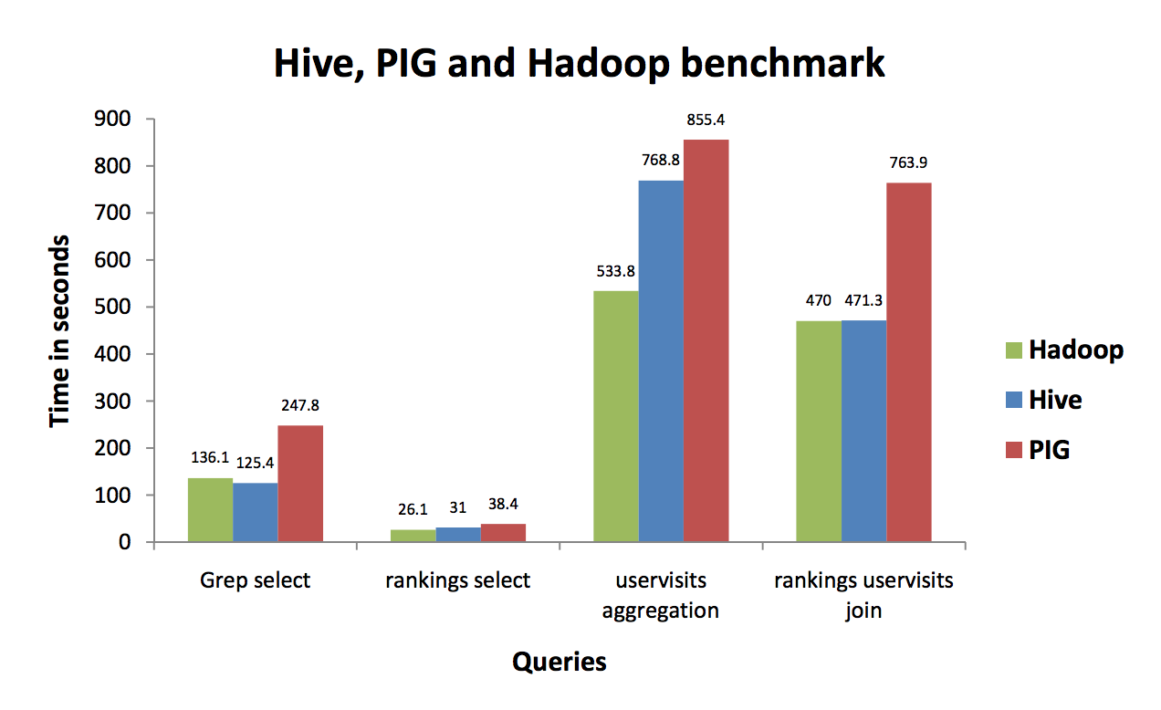
Head-to-Head (the bee, the pig, the elephant)
Version: Hadoop – 0.18x, Pig:786346, Hive:786346
Notes:
SELECT * FROM grep WHERE field like ‘%XYZ%’;
[The table “grep” has two columns: (key STRING, field STRING). It has
500,000,000 rows and takes 50 GB disk space.
~ ]
SELECT pageRank, pageURL FROM rankings WHERE pageRank > 10;
[
The table “rankings” has three columns: (pageRank INT, pageURL STRING,
avgDuration INT). It has 56289700 rows and takes 3.3 GB disk space. ]
SELECT sourceIP, SUM(adRevenue) FROM uservisits GROUP BY sourceIP;
[The table “uservisits” has 9 columns: (sourceIP STRING,destURL
STRING,visitDate STRING,adRevenue DOUBLE,userAgent STRING,countryCode
STRING,languageCode STRING,searchWord STRING,duration INT ). It has
465000000 rows and takes 60GB disk space.
]
SELECT sourceIP, AVG(pageRank), SUM(adRevenue) FROM rankings R JOIN
(SELECT * FROM uservisits UV WHERE UV.visitDate > '1999-01-01' AND
UV.visitDate < '2000-01-01') NUV ON (R.pageURL = NUV.destURL) GROUP BY
sourceIP;
s finished in two jobs on Hive and PIG and three jobs on Hadoop.
The first job, which takes the majority of the time, has 480 mappers and 60
reducers on all Hive, PIG and Hadoop. The second job on PIG has 120 mappers
and 60 reducers. The second job on both Hive and Hadoop has 60 mappers and
60 reducers. The third job on Hadoop has 60 mappers and 1 reducer.

Slide 25
REFERENCES
https://hive.apache.org/
https://cwiki.apache.org/confluence/display/Hive/Presentations
https://developer.yahoo.com/blogs/hadoop/comparing-pig-latin-sql-constructing-data-processing-pipelines-444.html
http://www.qubole.com/blog/big-data/hive-best-practices/
Hortonworks tutorials (youtube)
Graph : https://issues.apache.org/jira/secure/attachment/12411185/hive_benchmark_2009-06-18.pdf
Notes:
Hive has to explicitly maintain consistency between metadata and data – not much details provided in paper
In memory metastore?

