Slide 1


AI Podcast Generator
Pranathi MK
Chaitra BV

Slide 2
What have we done?
Finetune the gpt2 simple model on the podcast data
01
Generate audio output using elevenlabs TTS
02
Streamlit app for prompting to the finetuned model.
03

Slide 3
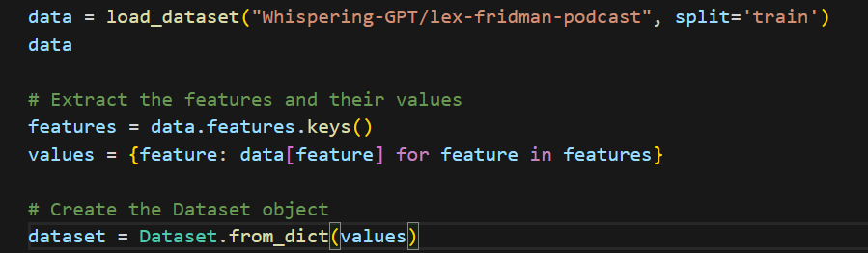
Collecting data to train the model
Step 1: Data Collection
The dataset that we chose to train the model on is Podcast data of Lex Fridman
We have collected and preprocessed this data from huggingface (Whispering-GPT/lex-fridman-podcast)

Slide 4

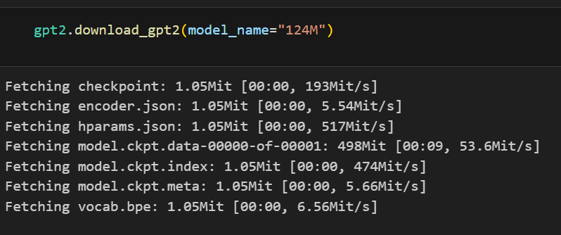
Downloading the model
Step2 : Downloading the gpt2 simple model
We have downloaded the gpt2 simple model files for the models “124M” and “774M”

Slide 5
Experimenting on Harry Potter books
We have experimented the finetuned model on the Harry Potter books to generate podcasts and the model has given good results.
We collected these books and preprocessed the text in these books.
The processed data was given to the model for finetuning
Then we loaded the finetuned model and prompted to generate a conversation from the books. The model performed pretty good on books.

Slide 6
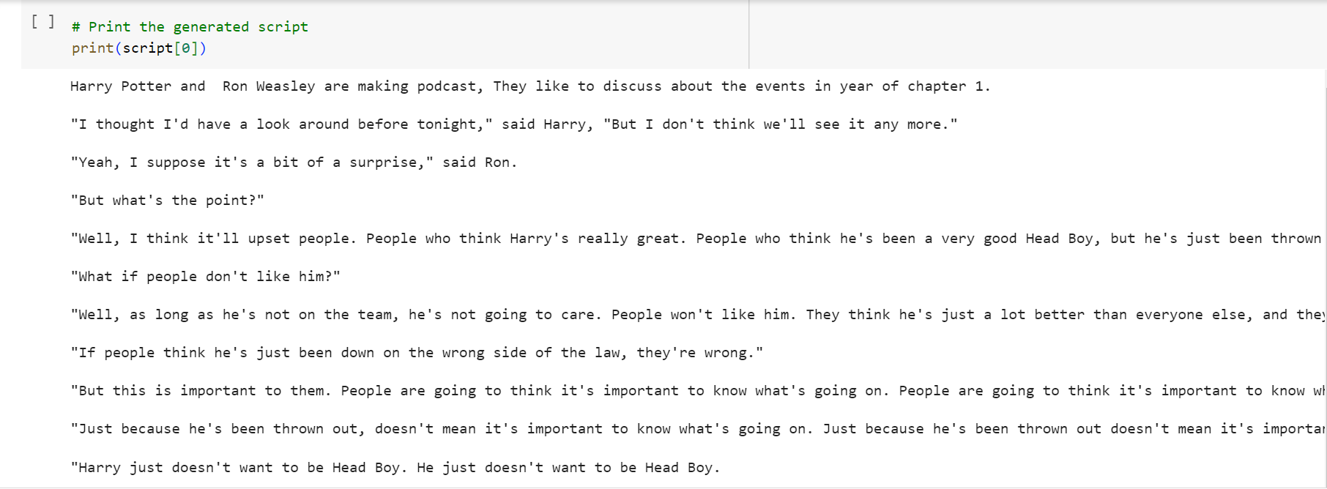
Experiment-1 Results

Slide 7
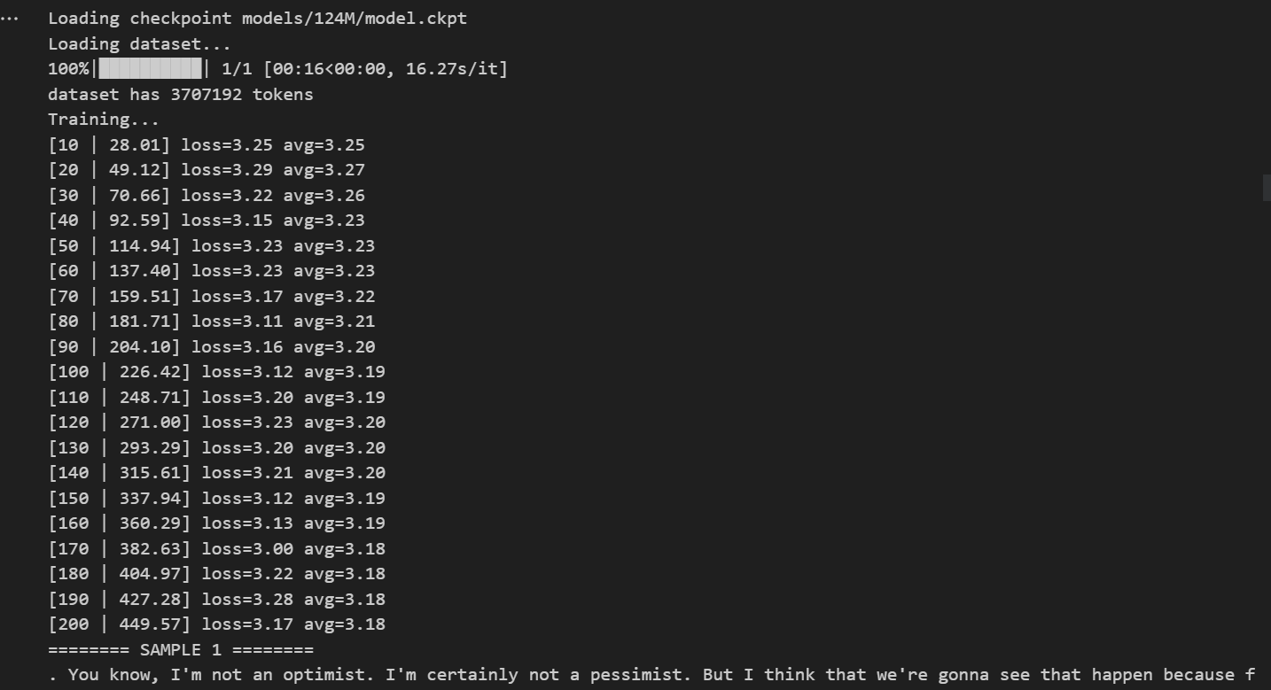
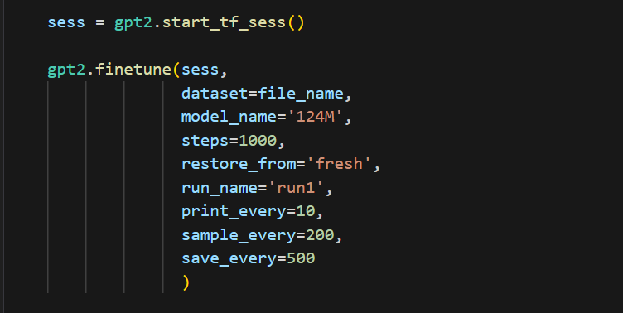
Now finetuning the model..
We have inputted the model with the podcast data that we have obtained and finetuned the model using these AI podcasts of Lex Fridman

Slide 8
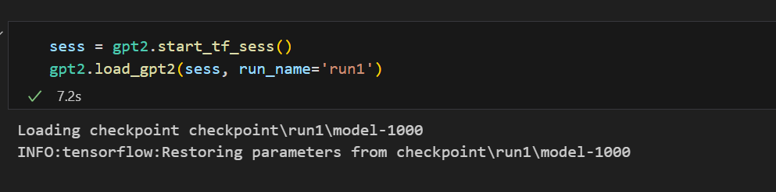
Loading the finetuned model
Saved the checkpoint after finetuning the model on the podcast data and the reading the model to generate podcast by prompting the topic to get podcast transcript

Slide 9
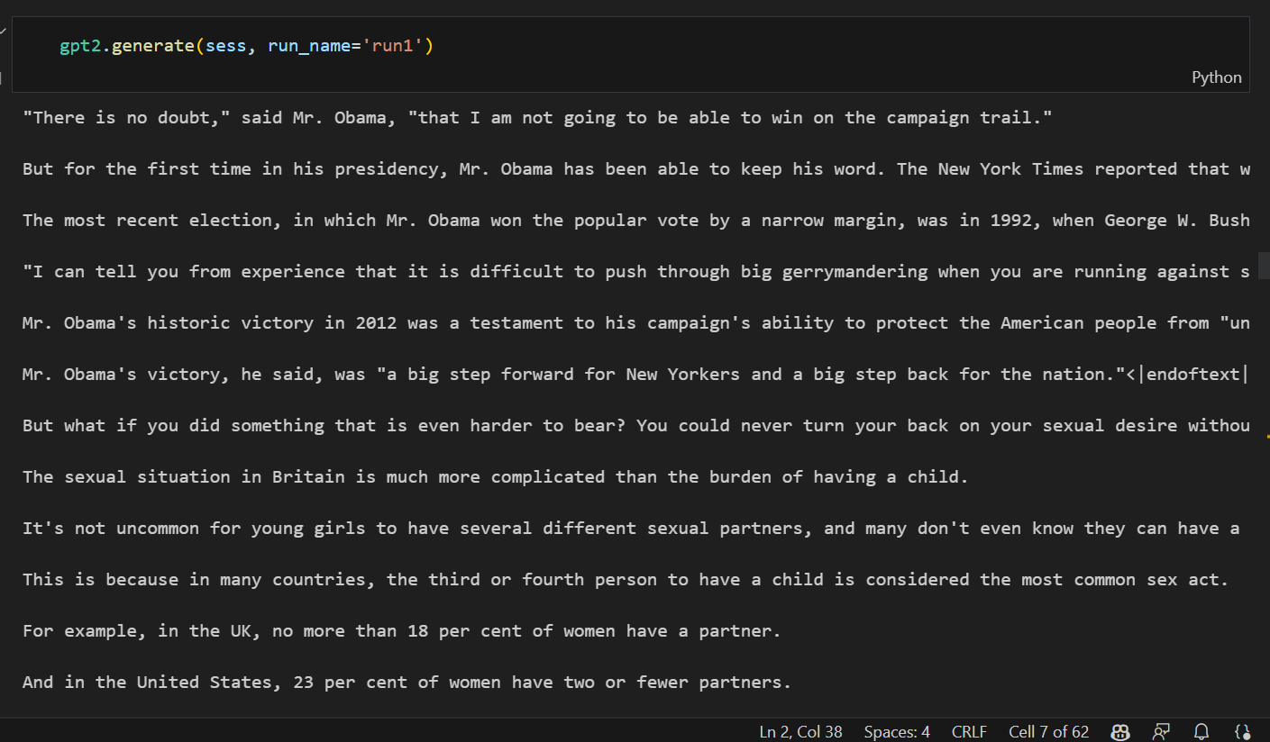
Generating the podcast text from the model

Slide 10
Generating Voice podcasts
We have generated audio podcasts using Elevenlabs TTS model by choosing different voices for different characters
Advantages of using the ElevenLabs TTS for podcast generation:
Natural-sounding voices: The model provides a range of voice options that sound human-like and engaging.
Customization options: Users can adjust parameters such as intonation, pacing, and speed to match the desired tone and style.
Multilingual support: The TTS model supports multiple languages, enabling podcast generation in diverse linguistic contexts.

Slide 11
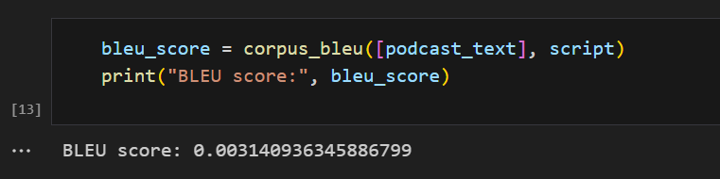
Calculating BLEU scores
Bilingual Evaluation Understudy score is a metric used to evaluate the quality of machine-generated translations or summaries compared to human-generated references. It is widely used in natural language processing and machine translation tasks.
We have good results for the BLEU score indicating that the whole text is completely and fully generated new by the model

Slide 12
Streamlit App for Prompting the Finetuned Model
Introduce Streamlit as an intuitive framework for building interactive web applications.
User input: Allow users to enter prompts or topics for the generated podcast.
Model interaction: Utilize the finetuned GPT-2 model to generate podcast-like text based on the user's input.
Audio conversion: Feed the generated text to the ElevenLabs TTS for audio conversion, producing high-quality podcast-like audio.
Presentation: Display the audio output on the Streamlit app, allowing users to listen to and evaluate the generated podcast.

Slide 13
Thank you!

