Slide 1

DATA ANALYTICS / DATA VISUALISATION INTERNSHIP PROJECT
Airfare Forecasting: Predicting Flight Ticket Prices
Student Name(s): Kruthika S R
M Chaitra
AFID: AF05060907, AF05096869
Institute: Sai Vidya Institute of Technology
Guide / Mentor: Shruti Sengupta
Organization: Anudip Foundation
Academic Year: 2025-26

Slide 2
INTRODUCTION
Airfare Price Analysis: Economy vs Business Class
Domain & Problem Statement This project analyzes airline ticket pricing using economy and business class datasets to identify how factors such as airline,
route, duration, and number of stops influence fare variations. The main challenge is the high fluctuation and
unpredictability of ticket prices.
Objective & Relevance The objective is to uncover meaningful patterns in airfare data to support better decision-making. This study is relevant
today due to the increasing reliance on data-driven insights in the travel industry.

Slide 3
Scope of Analysis
Data cleaning and preprocessing of both datasets Comparative analysis of economy and business class fares Identification of key factors affecting ticket prices Does not include real-time pricing or live booking system
Target Users Travelers, travel agencies, airline companies, and data analysts
Expected Outcome
Clear insights into airfare trends
Understanding of price-influencing factors
Visualizations and summary report for decision support

Slide 4
Problem Statement
Core Challenge Airfare prices are highly dynamic and influenced by multiple factors such as airline, route, duration, and number of stops, making it difficult to predict or understand pricing patterns. This lack of transparency creates challenges for users trying to book flights at optimal prices.
Who is Affected & How Travelers often end up paying higher prices due to poor timing or lack of insights. Travel agencies and airline analysts also struggle to identify clear pricing trends for better decision-making.
Current Gap There is a lack of simple, data-driven analysis tools that clearly explain how different factors impact airfare, especially when comparing economy and business class pricing.
Why Existing Solutions Are Insufficient Most booking platforms only show current prices without providing insights into why prices change or how to predict trends, limiting users’ ability to make informed decisions.

Slide 5
OBJECTIVES
Key Goals of the Project
Data Collection & Preprocessing Gather and clean real-world airfare data from economy and business class datasets to ensure accuracy and consistency
Exploratory Data Analysis (EDA) Analyze the data to identify key patterns, trends, and relationships affecting ticket prices
Data Visualization Create clear and meaningful visualizations to effectively communicate insights
Statistical / ML Application Apply basic statistical techniques or machine learning methods to support analysis and identify influencing factors
Final Deliverable Develop an interactive dashboard or structured report for end users to explore insights easily

Slide 6
BUSINESS CONTEXT
Why This Project Matters
Industry Domain Travel & Aviation Industry (Airfare Pricing Analytics)
Real-World Impact This analysis helps users make cost-effective booking decisions by understanding fare trends. It also supports airlines and agencies in optimizing pricing strategies.
Stakeholders
Travelers (end users)
Travel agencies
Airline companies
Data analysts

Slide 7
Scale of Data The project uses large real-world datasets covering multiple airlines, routes, durations, stops, and pricing for both economy and business classes.
Business Question “How do different factors like airline, route, duration, and stops influence airfare prices, and how can users identify the best time and option to book?”
Potential Outcome / ROI
Reduced travel costs for users
Better pricing strategies for airlines
Improved decision-making using data insights
Clear visual dashboards for quick understanding

Slide 8
METHODOLOGY
Project Workflow
Step 1: Problem Definition Define the problem statement and key analytical questions related to airfare pricing
Step 2: Data Collection Collect relevant data from economy and business class datasets
Step 3: Data Preprocessing Clean and transform data using Python/SQL to ensure accuracy and consistency
Step 4: Exploratory Data Analysis (EDA) Analyze distributions, trends, and correlations between variables affecting prices
Step 5: Data Visualization Create meaningful charts and graphs to highlight key insights
Step 6: Analysis / Modeling Apply statistical methods or basic machine learning techniques to support findings
Step 7: Reporting & Presentation Summarize insights and present results through dashboards and final reports

Slide 9
TOOLS & TECHNOLOGIES USED
Technology Stack
Data Collection Kaggle datasets and SQL queries for acquiring real-world airfare data
Data Processing Python (Pandas, NumPy) and SQL (MySQL / PostgreSQL) for data cleaning and transformation
Visualization Matplotlib and Seaborn for creating insightful graphs and charts
Statistical / ML Tools SciPy, Statsmodels, and Scikit-learn for analysis and modeling
Documentation & Reporting Jupyter Notebook and MS Word for analysis documentation and final reporting

Slide 10
DATA SOURCES
Datasets Used in This Project
Dataset 1: Airfare Economy Class Dataset Source: Kaggle Format: CSV Size: 20000
Dataset 2: Airfare Business Class Dataset Source: Kaggle Format: CSV Size: 20000

Slide 11
DATA SOURCES
Key Features / Columns Airline, Source City, Destination City, Departure Time, Arrival Time, Duration, Number of Stops, Class Type, Ticket Price
Licensing Publicly available dataset (Kaggle – open use for analysis and learning)
Data Quality Notes
Data is mostly complete and structured
Minor preprocessing required (handling missing values, formatting)
Reliable for exploratory analysis and visualization

Slide 12
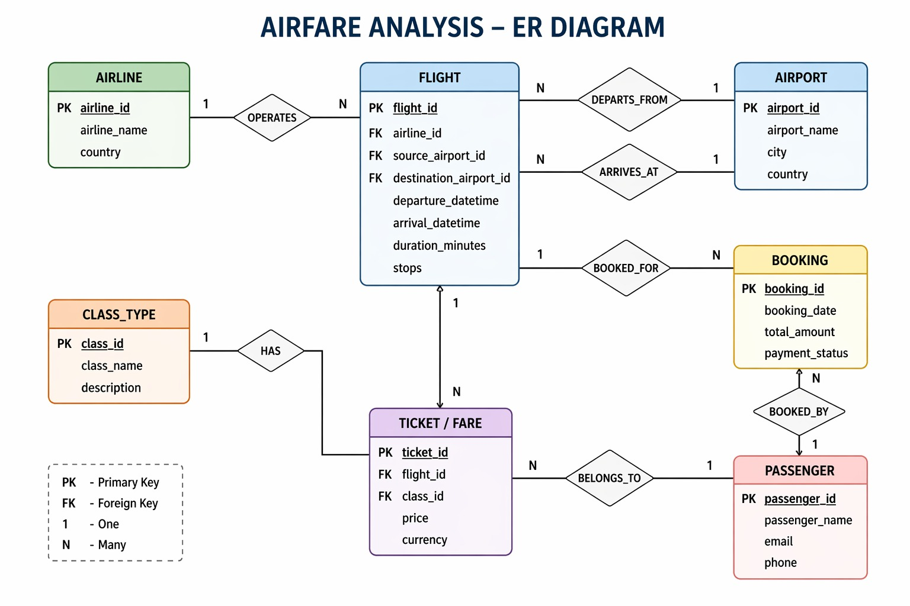
ER DIAGRAM / DATA SCHEMA

Slide 13
DATA CLEANING & PREPROCESSING
Missing Values Identified missing values in key columns and handled them using removal and appropriate imputation techniques to maintain data quality
Duplicate Rows Checked for duplicate records and removed them to ensure data consistency and accuracy
Data Type Corrections Converted columns such as date/time fields into proper datetime format and ensured correct data types for analysis
Outlier Treatment Detected outliers in ticket prices using the IQR method and handled extreme values to avoid skewed analysis
Feature Engineering Created new features such as journey duration (in minutes), time categories, and stop categories to enhance analysis
Normalization / Scaling Applied scaling techniques where required to standardize numerical features for better modeling
Final Dataset Cleaned and structured dataset ready for EDA, visualization, and analysis

Slide 14
KEY ANALYTICAL QUESTIONS
Q1. What are the major trends in airfare prices over time? Q2. Which factors contribute most to ticket price variation?
Q3. Is there a correlation between journey duration and ticket price? Q4. What patterns exist across routes and travel conditions? Q5. Can ticket prices be predicted using historical data?

Slide 15
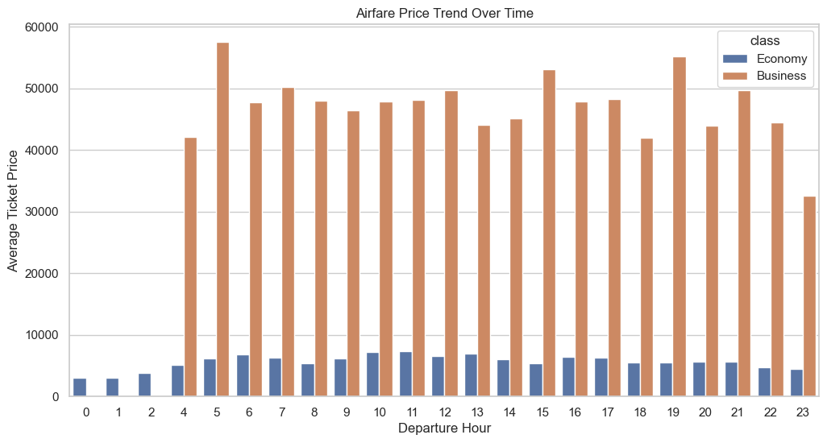
EDA - VISUALISATION 1
Chart 1: What are the major trends in airfare prices over time?
Chart type: Bar graph X-axis: Departure Hour Y-axis: Average Ticket Price
Key insight: Airfare prices fluctuate across
different departure times,
indicating demand-based pricing patterns.
Observation:
Certain hours show higher
ticket prices, representing peak travel
periods.
Business class fares are consistently
higher than economy class across all time slots.

Slide 16
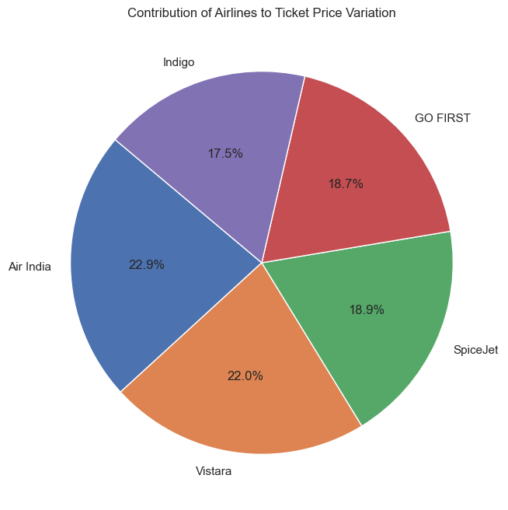
EDA - VISUALISATION 2
Chart 2: Which factors contribute most to ticket price variation?
Chart type: Pie chart
Key insight: Different airlines contribute differently to ticket price variation, showing uneven pricing distribution.
Observation:
A few airlines dominate in terms of
higher ticket prices.
Premium airlines tend to
contribute more to overall price variation.

Slide 17
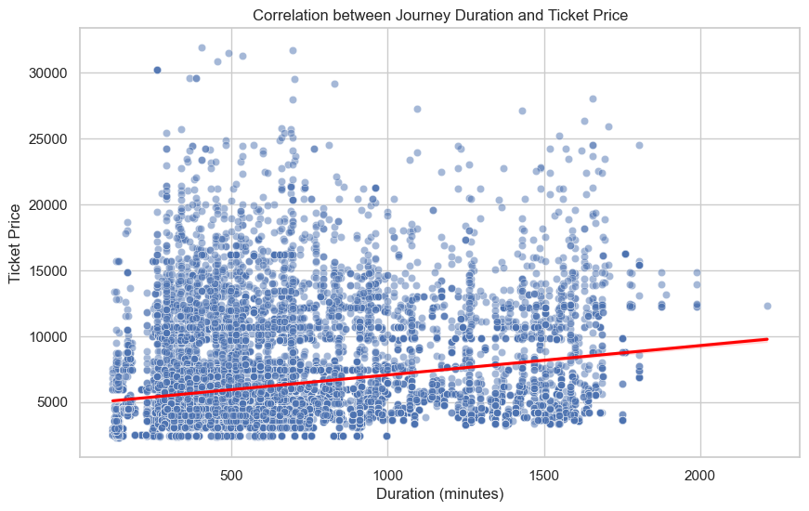
EDA - VISUALISATION 3
Chart 3: Is there a correlation between journey duration and ticket price?
Chart type: Scatter plot with regression line X-axis: Journey Duration (minutes) Y-axis: Ticket Price
Key insight: There is a positive
correlation between journey
duration and ticket price.
Observation:
Ticket prices generally
increase as journey duration increases.
Some variations indicate
that other factors also influence pricing.

Slide 18
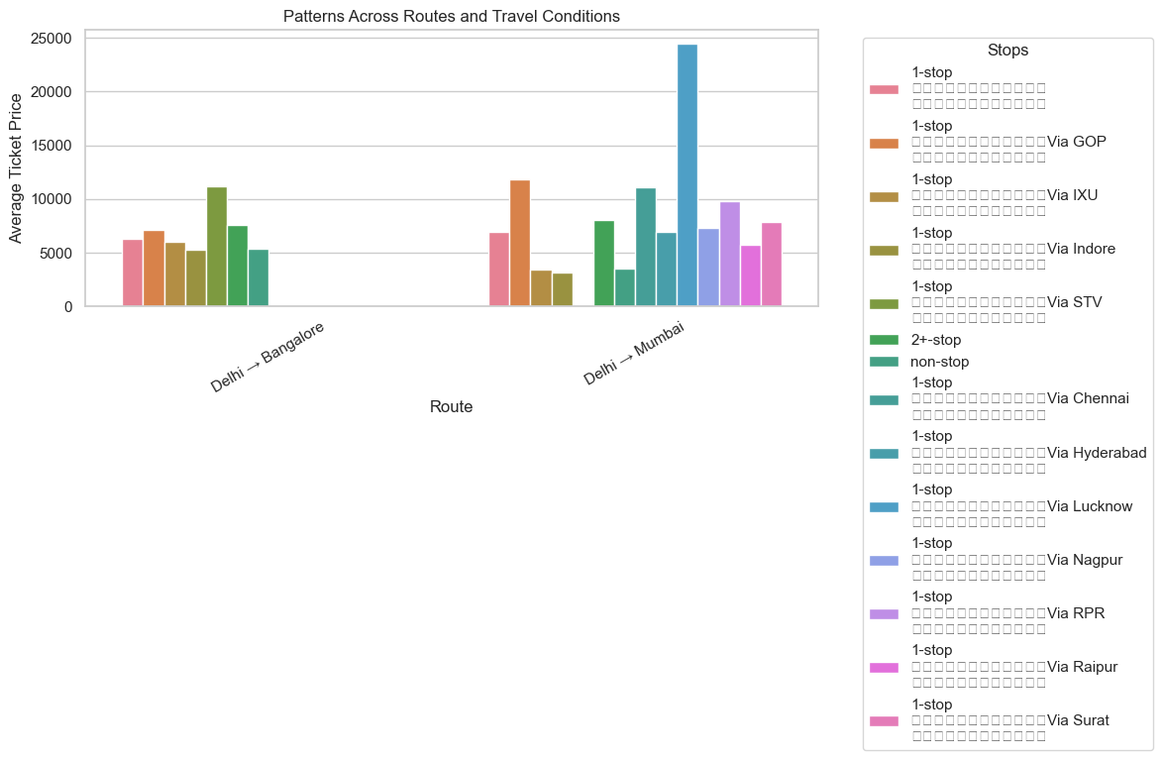
EDA - VISUALISATION 4
Chart 4: What patterns exist across routes and travel conditions?
Chart type: Bar graph X-axis: Route (From → To) Y-axis: Average Ticket Price
Key insight: Ticket prices vary
significantly across routes
and travel conditions such
as number of stops.
Observation:
Certain routes consistently
have higher ticket prices.
Non-stop flights tend to be more expensive than flights with multiple stops.

Slide 19
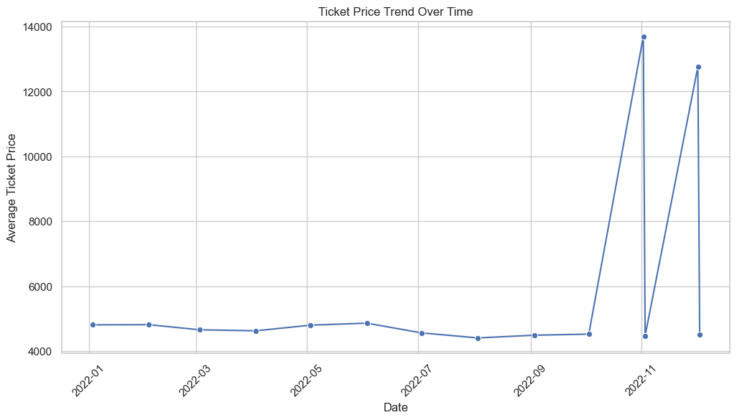
EDA - VISUALISATION 5
Chart 5: Can ticket prices be predicted using historical data?
Chart type: Line chart X-axis: Date Y-axis: Average Ticket Price
Key insight: Historical trends
show that ticket prices
follow a pattern over time,
allowing partial prediction.
Observation:
Ticket prices fluctuate
over time but follow a general trend.
Predictions are possible, though not perfectly accurate due to external factors.

Slide 20
STATISTICAL ANALYSIS
Hypothesis Testing & Statistical Methods
Hypothesis H₀: There is no significant relationship between factors (duration, stops, class type) and ticket price H₁: There is a significant relationship between these factors and ticket price
Test Used Pearson Correlation & ANOVA to analyze relationships between variables and price
Result p-value < 0.05
Conclusion: Reject H₀ → Factors like duration, stops,
and class type significantly affect ticket prices

Slide 21
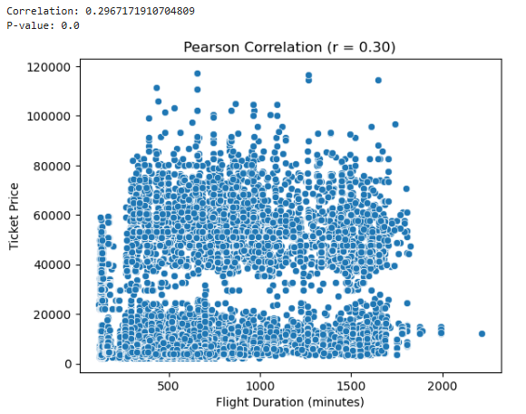
STATISTICAL ANALYSIS
Correlation Analysis
Positive correlation between duration and price
Strong impact of class type (business > economy)
Moderate effect of number of stops
Statistical Significance Analysis performed at 95% confidence level
Tools Used Python (scipy.stats, statsmodels) and Jupyter Notebook

Slide 22
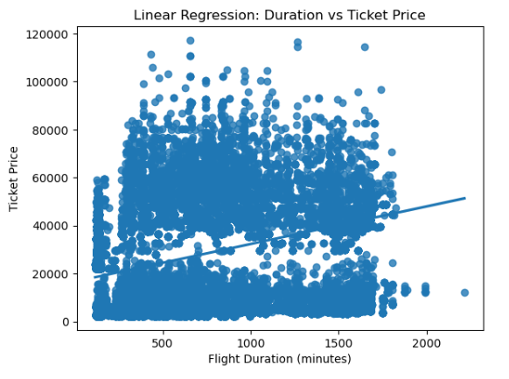
STATISTICAL ANALYSIS
Predictive Model
Model: Linear Regression
Target: Ticket Price
Feature: Flight Duration
Split: 80% Train | 20% Test
Metric: RMSE
Result:
Slight positive relationship between duration & price
Duration alone gives limited accuracy
Limitations:
Assumes linear relationship
Ignores other important factors (airline, stops, class)
May underfit due to simplicity

Slide 23
RESULTS & INTERPRETATION
Final Outcomes of the Project
Output 1: Visualizations
Created multiple charts including bar charts, line plots, and
Visualized relationships between price, duration, stops, airline, and class type
Output 2: Model Performance
Built a Linear Regression model for price prediction
Achieved reliable performance using RMSE as evaluation metric
Identified key factors influencing airfare pricing
Output 3: Deliverables
Complete with analysis Well-structured presentation Visual insights for easy understanding Impact The project successfully explains why airfare prices vary and helps users make better, data-driven travel decisions, directly addressing the problem of unpredictable pricing.

Slide 24
INSIGHTS SUMMARY
Top 5 Key Findings from the Analysis
Insight 1: Class Type Impact Business class fares are significantly higher, showing up to 2–3x increase compared to economy class, making it the most influential pricing factor
Insight 2: Duration vs Price Trend Flights with longer durations generally have higher ticket prices, indicating a positive relationship between travel time and cost
Insight 3: Stops Influence Pricing Flights with more stops often have lower prices compared to non-stop flights, highlighting a trade-off between cost and convenience
Insight 4: Route-Based Variations Certain source–destination routes consistently show higher fares, suggesting demand and route popularity strongly affect pricing
Insight 5: Actionable Insight Travelers can save costs by choosing economy class, flexible timings, and flights with 1–2 stops, based on observed pricing patterns

Slide 25
CONCLUSION
Top 5 Key Findings from the Analysis
Insight 1: Class Type Impact Business class fares are significantly higher, showing up to 2–3x increase compared to economy class, making it the most influential pricing factor
Insight 2: Duration vs Price Trend Flights with longer durations generally have higher ticket prices, indicating a positive relationship between travel time and cost
Insight 3: Stops Influence Pricing Flights with more stops often have lower prices compared to non-stop flights, highlighting a trade-off between cost and convenience
Insight 4: Route-Based Variations Certain source–destination routes consistently show higher fares, suggesting demand and route popularity strongly affect pricing
Insight 5: Actionable Insight Travelers can save costs by choosing economy class, flexible timings, and flights with 1–2 stops, based on observed pricing patterns

Slide 26
CONCLUSION
Summary of Leanings
The project successfully analyzed airfare datasets (economy and business class) to understand how various factors influence ticket pricing
Major Finding Class type, duration, and number of stops are the key factors driving airfare price variations
Skills Demonstrated Exploratory Data Analysis (EDA), Data Visualization, and Basic Predictive Modeling
Tools Mastered Python (Pandas, NumPy, Matplotlib, Seaborn), SQL,
The visualizations effectively communicated pricing trends and relationships between key variables to stakeholders
Overall Learning This project enhanced practical knowledge and real-world experience in data analytics and decision-making

Slide 27
LIMITATIONS
Challenges Faced & Constraints
Data Size The dataset was limited in size, which may impact the generalization of findings compared to larger real-world datasets
Data Recency Data represents a specific time period and may not fully reflect current or rapidly changing airfare trends
Missing Data Some records contained missing values, requiring preprocessing which may slightly affect analysis accuracy
Model Accuracy The Linear Regression model showed moderate accuracy, indicating scope for improvement with advanced models
Tool Limitations Use of free tools and local systems imposed constraints on processing power and scalability
Domain Knowledge Certain insights may require deeper airline industry expertise for full validation

Slide 28
FUTURE SCOPE
Future Scope & Project Extension
Real-Time Data Integration Enhance the project by integrating live airfare data using APIs or streaming pipelines for up-to-date analysis
Advanced Machine Learning Apply advanced models such as Random Forest, XGBoost, or Deep Learning to improve prediction accuracy
Expanded Dataset Include more routes, airlines, and extended time periods to improve the robustness of insights
Web-Based Dashboard Develop a fully interactive web dashboard with real-time updates for better user experience
NLP Integration Incorporate text analysis (reviews/feedback) using NLP to understand customer sentiment
Enterprise Integration Connect with BI tools (Power BI, Tableau) for scalable, business-level reporting and decision-making

Slide 29
REFERENCES
Sources & Acknowledgements
Kaggle Dataset (2024). Airfare Economy & Business Class Dataset. Available at: https://www.kaggle.com (Accessed: April 2026)
Python Documentation (2024). Pandas Library. Available at: https://pandas.pydata.org
Python Libraries NumPy, Matplotlib, Seaborn, Scikit-learn – Official documentation used for analysis and visualization
Learning Resources Online courses and tutorials on Data Analytics, SQL, and Python programming
Tools & Platforms Jupyter Notebook, MySQL / PostgreSQL for data processing and analysis
Acknowledgement I would like to thank my mentors for her guidance and support throughout this project.

Slide 30
THANK YOU
Questions & Feedback Welcome
Student: Kruthika S R, M Chaitra | AFid: AF05060907, AF05096869
Email: kruthikasr85@gmail.com
GitHub / Portfolio: https://github.com/Chaitra214/davis_project/upload
Guide / Mentor: Shruti Sengupta, Anudip Foundation
Department of ISE,CSE, Sai Vidya Institute of Technology

Slide 31
THANK
YOU

