Slide 1
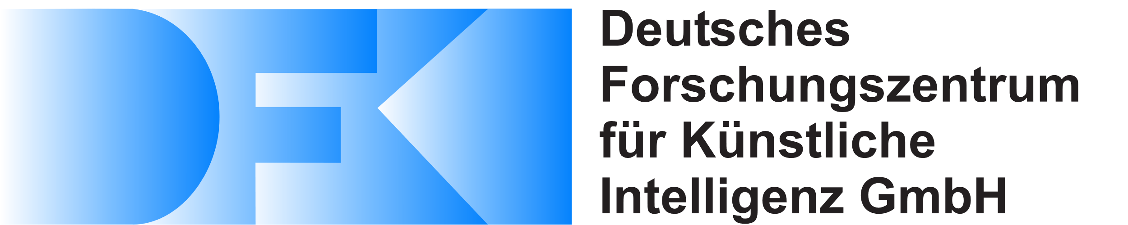
Convolutional Networks with Adaptive Inference Graphs using Reinforcement Learning
By:
Chaitra Nayak
Supervisor: Fatemeh Azimi
Smart Data and Knowledge Services

Slide 2
Table Of Contents
Introduction
Background
Architectural overviews
-Existing Approach
Introduction to adanets with gating units
- Current Approach
Reinforcement learning to implement gating unit with policy gradient
Results
Conclusion

Slide 3
Table Of Contents
Introduction
Background
Architectural overviews
-Existing Approach
Introduction to adanets with gating units
- Current Approach
Reinforcement learning to implement gating unit with policy gradient
Results
Conclusion

Slide 4
Introduction
Neural networks
- Neural Networks in general have a fixed structure. Is this always necessary?
- The more deeper you go into the network, the more sophisticated features it learns
Problem?
- Choosing on enhancing a layer that is relevant to the input image and improve the performance on the model.
- Can a network define its own topology on the go conditioned on input?

Slide 5
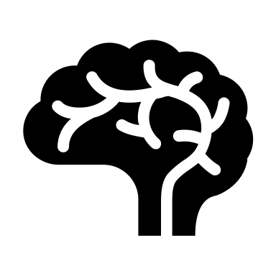
“Do we really need fixed structures for convolutional networks, or could we assemble network graphs on the fly, conditioned on the input?”
Ref:
Veit, A., & Belongie, S. (2018). Convolutional networks with adaptive inference graphs. In Proceedings of the European Conference on Computer Vision (ECCV) (pp. 3-18)

Slide 6
Table Of Contents
Introduction
Background
Architectural overviews
-Existing Approach
Introduction to adanets with gating units
- Current Approach
Reinforcement learning to implement gating unit with policy gradient
Results
Conclusion

Slide 7
Background
Convolutional Network with Adaptive Inference Graphs
- Adanets (Adaptive networks) or ConvNet AIG with gating units that decide on whether a layer should be executed or not for classification
- Gate individual layers during both training and inference, with a data- dependent gating computation.
- Existing approach : Gumbel Softmax
- Adaptive computation for neural networks
- Regularization with dropout techniques

Slide 8
Adanets with Reinforcement Learning
- Reinforcement learning (RL) is an area of machine learning concerned with how software agents ought to take actions in an environment so as to maximize some notion of cumulative reward ^{(1).}
- Integrate the gating choice through policy gradient (Reinforce)
- ResNet110 with Cifar10
- ResNet50 with ImageNet
Ref 1: https://en.wikipedia.org/wiki/Reinforcement_learning

Slide 9
Table Of Contents
Introduction
Background
Architectural overviews
-Existing Approach
Introduction to adanets with gating units
- Current Approach
Reinforcement learning to implement gating unit with policy gradient
Results
Conclusion

Slide 10


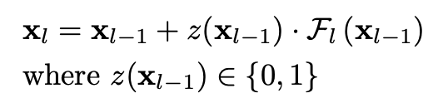
Architectural Overviews
l₁
l₂
l₁
l₂
l₁
l₂
Figures: General architecture for the implementation.
(Top L-R): Structures for feed forward CNN, ResNet and Adanet with gating unit.
Gating unit determines whether the layer needs to be executed for the current input image.
Ref:
Veit, A., & Belongie, S. (2018). Convolutional networks with adaptive inference graphs. In Proceedings of the European Conference on Computer Vision (ECCV) (pp. 3-18)

Slide 11
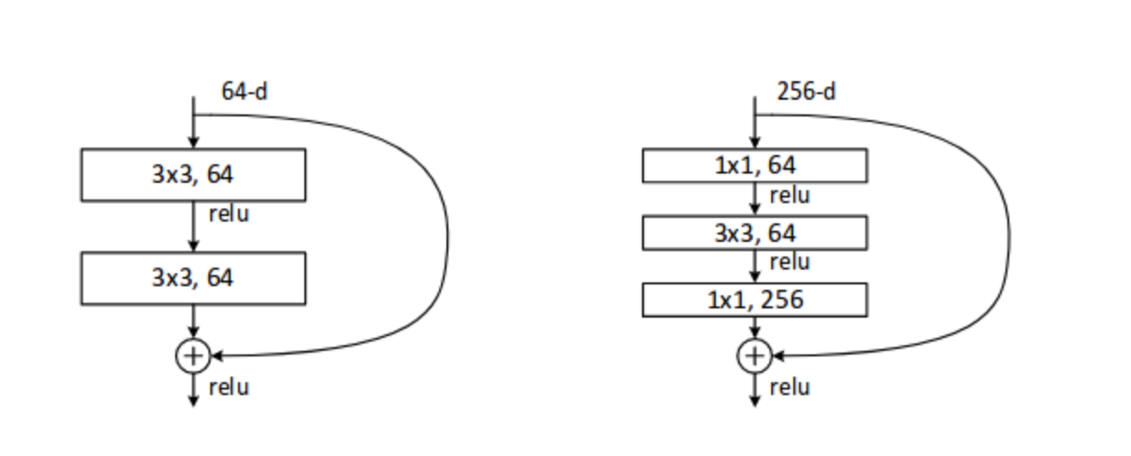
ResNet Architectures:
Layer name | 50-layer | 110-layer
Conv1 | 7x7, 64, stride 2 3x3 max pool, stride 2 | 3x3, 16, stride 1
Conv2_x | 1x1, 64 3x3, 64 x 3 1x1, 256 | 3x3, 16 3x3, 16 x 18
Conv3_x | 1x1, 128 3x3, 128 x 4 1x1, 512 | 3x3, 32 3x3, 32 x 18
Conv4_x | 1x1, 256 3x3, 256 x 6 1x1, 1024 | 3x3, 64 3x3, 64 x 18
Conv5_x | 1x1, 512 3x3, 512 x 3 1x1, 2048
Table: General structure of a ResNet.
Figure1 (R): Each Residual block is either 2 layer deep or 3 layer deep.
Image Ref:
He, K., Zhang, X., Ren, S., & Sun, J. (2016). Deep residual learning for image recognition. In Proceedings of the IEEE conference on computer vision and pattern recognition
(pp. 770-778).

Slide 12
Existing Approach
Softmax
If argmax is 1 execute layer and compute the loss otherwise skip that layer.
Two 3x3 Conv. layers with BN
Conv. Feature Map
Avg. Pooling
2Conv
Gumbel Sampling
Argmax
Repeat
Figure: Gating unit in the basic block of resnet that determines whether or not to execute the layer.
Gating unit makes use of Gumbel-softmax trick that samples from a uniform distribution which provides a
continuos relaxation.
Ref:
Veit, A., & Belongie, S. (2018). Convolutional networks with adaptive inference graphs. In Proceedings of the European Conference on Computer Vision (ECCV) (pp. 3-18)

Slide 13
Table Of Contents
Introduction
Background
Architectural overviews
-Existing Approach
Introduction to adanets with gating units
- Current Approach
Reinforcement learning to implement gating unit with policy gradient
Results
Conclusion

Slide 14
Reinforcement Learning
Current Approach
Agent
State & Reward
Actions
Environment
Figure: General architecture for reinforcement learning.
Approach used: Policy gradient (Reinforce).

Slide 15

Current Approach
1. Only FC layers
2. Only Conv layers
3. Conv layers followed by FC layers.
Produce a new state feature map.
action
Two 3x3 Conv layers with BN
Input state: Conv. Feature Map
Policy (Neural Network)
Environment (inputs,action)
Loss (Maximize our reward)
Output: 2 dim.
(0 or 1)
Output: Gate
activation rates
Repeat
Figure: Current architecture with reinforcement learning.
Implement a policy that will help in making the discrete decision.
Target Rate – 0.7

Slide 16
Table Of Contents
Introduction
Background
Architectural overviews
-Existing Approach
Introduction to adanets with gating units
- Current Approach
Reinforcement learning to implement gating unit with policy gradient
Results
Conclusion

Slide 17
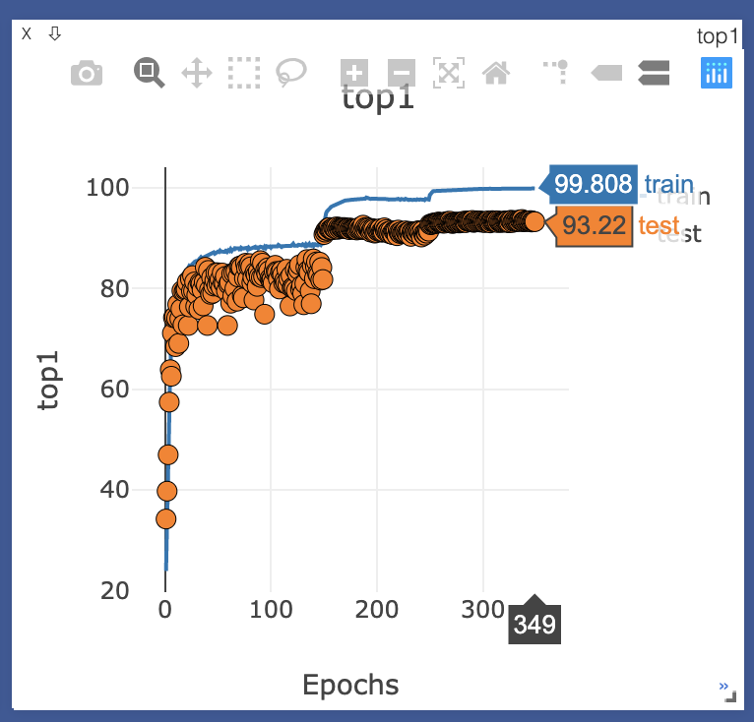
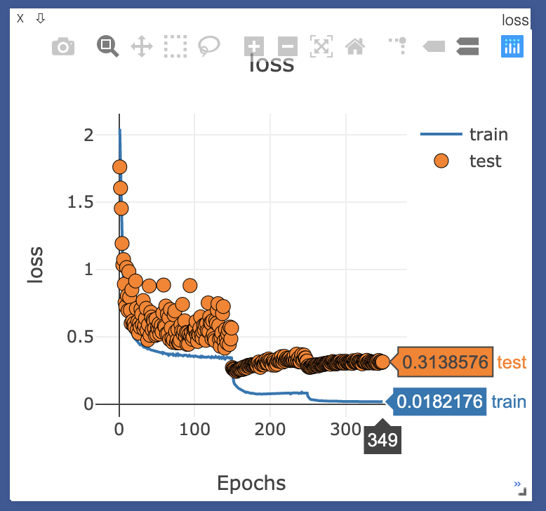
Results
From the Existing approach, Resnet110 for Cifar10:
Without Gates: 93.39
With Gates: Reproduced 93.97 ( Reported in the paper 94.6)
Figures (L-R): Iteractions vs Top1-Iterations vs Loss for Cifar10.

Slide 18
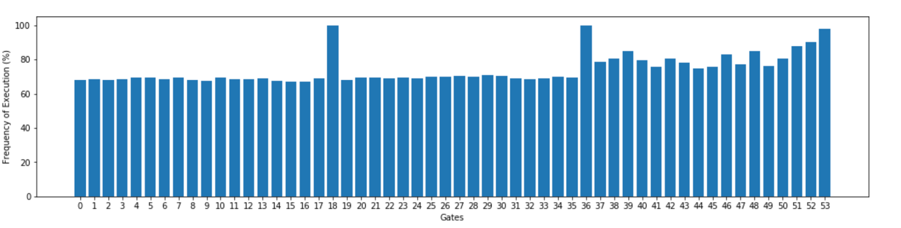
From the Existing approach, Resnet110 for Cifar10:
Reproduced 93.97 ( Reported in the paper 94.6) while saving 33% of computations.
Figure: Average frequency of execution at every gate

Slide 19
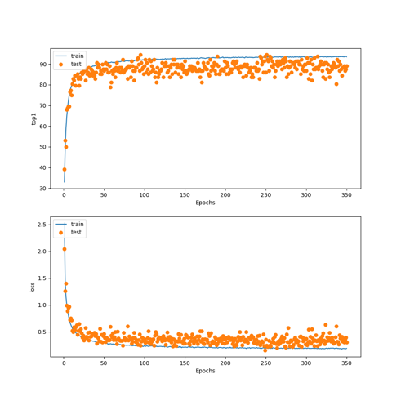
From the Current approach, Resnet110 for Cifar10:
Best Accuracy of 94.53
Figures (Top-Bottom): Iteractions vs Top1-Iterations vs Loss for Cifar10.

Slide 20
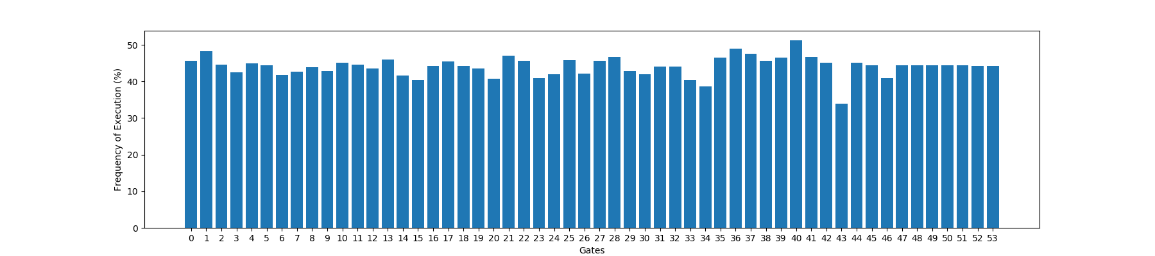
From the Current approach, Resnet110 for Cifar10:
Best Accuracy of 94.53 while saving 45% of computations.
Figure: Average frequency of execution at every gate

Slide 21
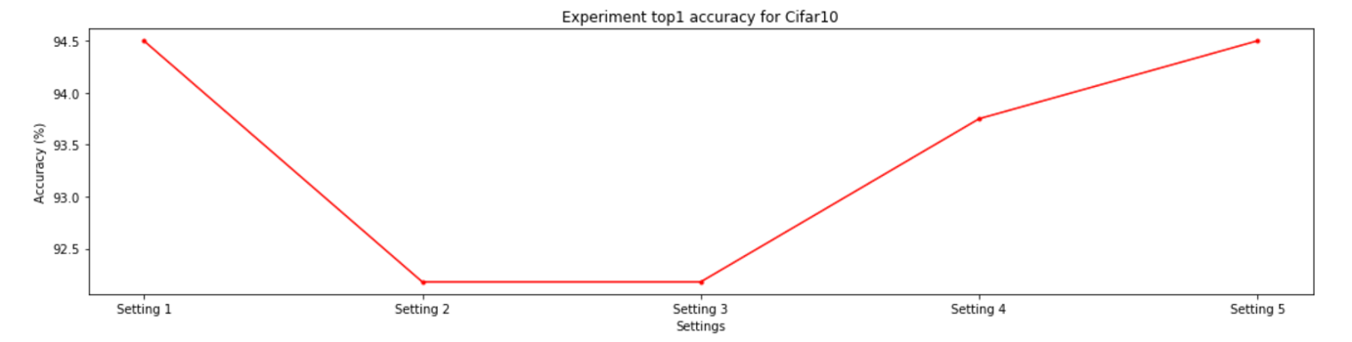
Different Experimental Settings: Based on different settings of batch size, learning rate scheduler, optimizer, and randomness in seed.
Best Setting: ADAM with batch size of 128 and learning rate of 0.001
Figure: Settings vs Top@1 Accuracy for different settings.

Slide 22
Results
From the Existing approach, Resnet50 for Imagenet:
Without Gates: 75.3
With Gates: Reproduced 75.4 ( Reported in the paper 76.18 )
Figures (L-R): Iteractions vs Top1-Iterations vs Loss for Imagenet.

Slide 23
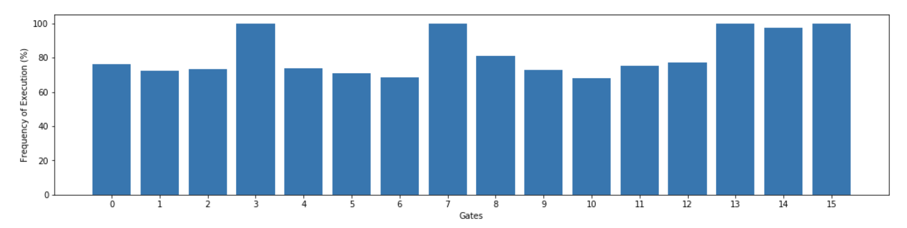
From the Existing approach, Resnet50 for Imagenet:
Reproduced 75.4 ( Reported in the paper 76.18 ) while saving 22% of computations
Figure: Average frequency of execution at every gate

Slide 24
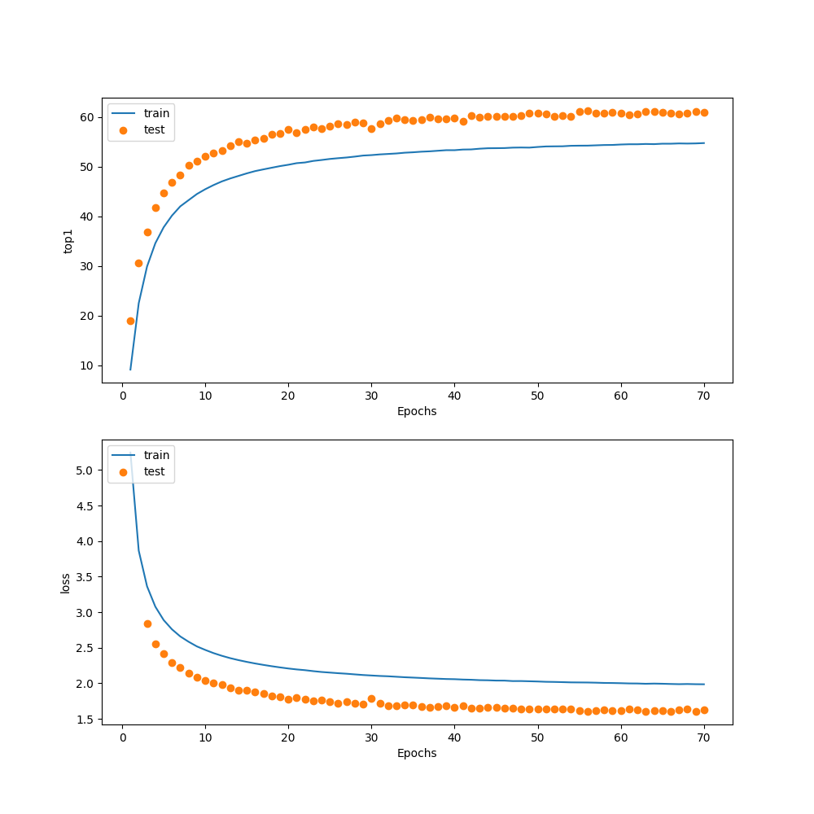
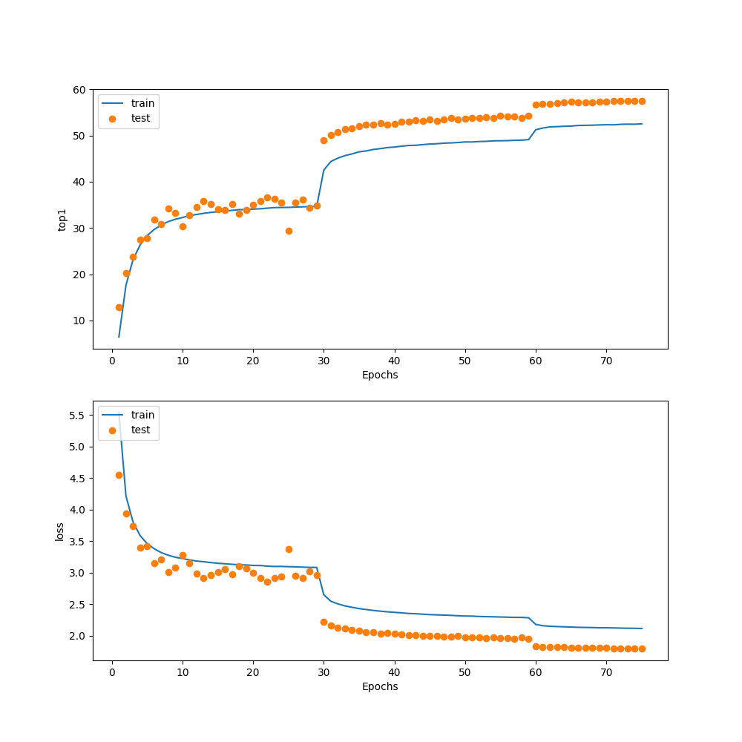
From the Current approach, Resnet50 for Imagenet:
Setting 1: ADAM with batch size of 64
and learning rate of 0.001
Best Accuracy of 61.25
Setting 2: ADAM with batch size of 128
and LR Scheduler ( starting with 0.001 )
Best Accuracy of 57.4
Figures (Top-Bottom): Iteractions vs Top1-Iterations vs Loss for Imagenet.

Slide 25
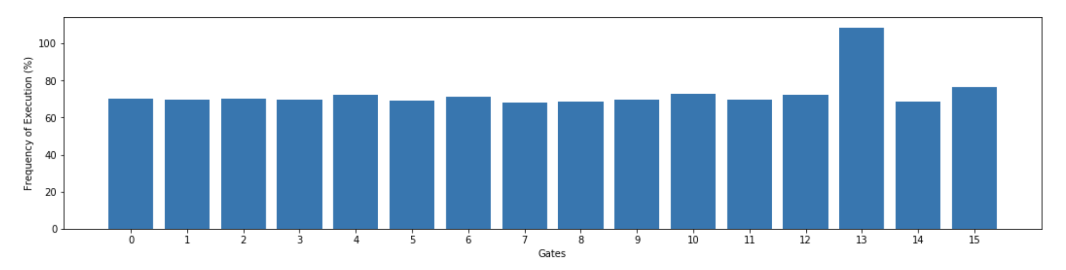
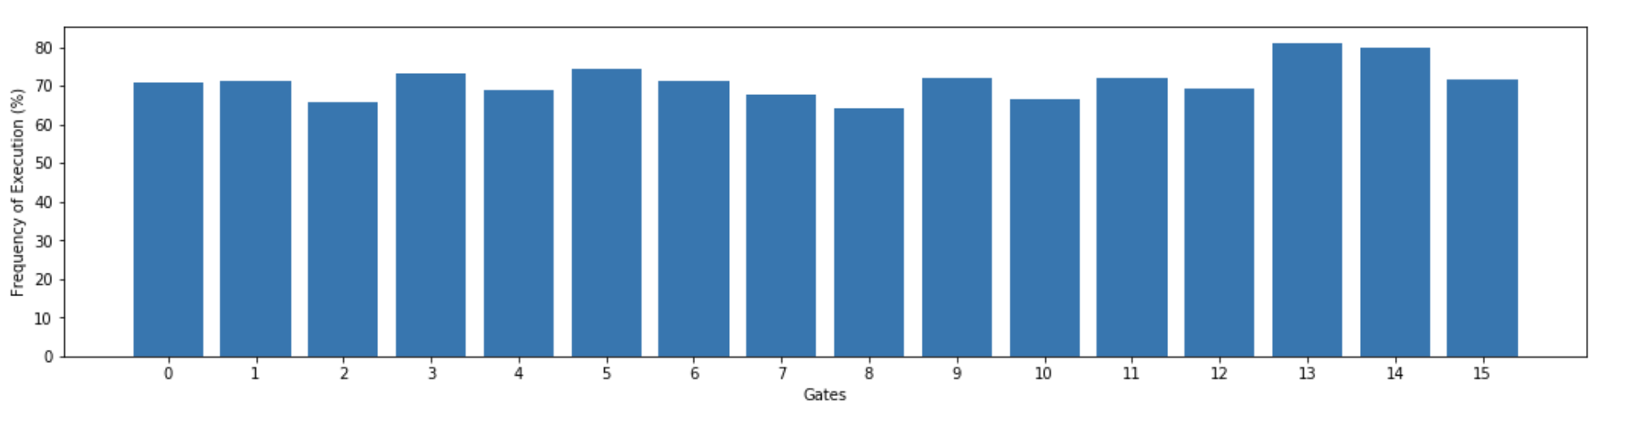
From the Current approach, Resnet50 for Imagenet:
Setting 1: Best Accuracy of 61.25 while saving 27% of computations.
Setting 2: Best Accuracy of 57.4 while saving 28% of computations.
Figure: Average frequency of execution at every gate

Slide 26
Table Of Contents
Introduction
Background
Architectural overviews
-Existing Approach
Introduction to adanets with gating units
- Current Approach
Reinforcement learning to implement gating unit with policy gradient
Results
Conclusion

Slide 27
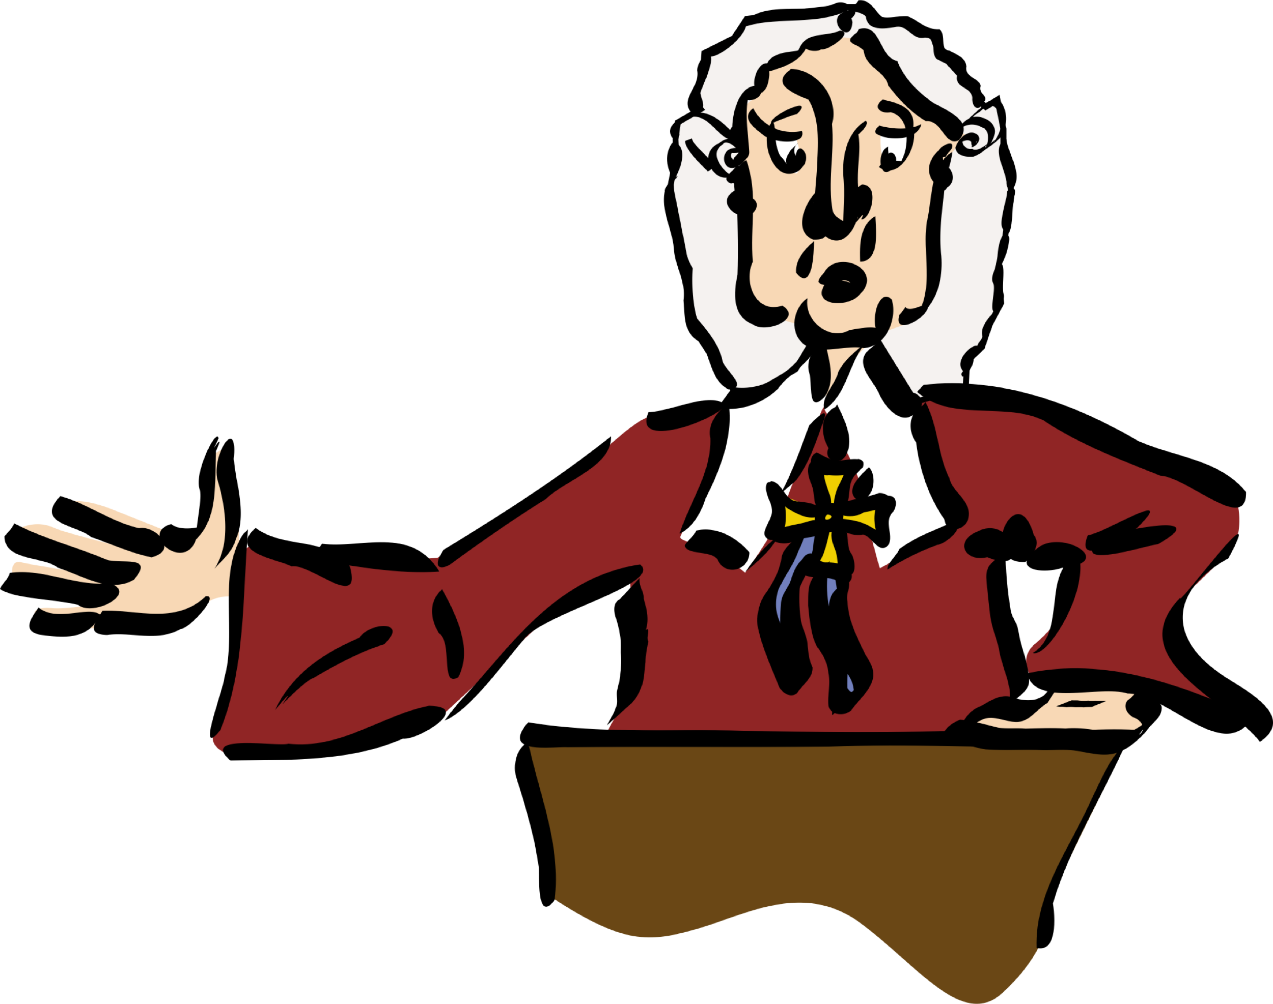
Conclusion

Slide 28
Thank You
Any Questions??

