Slide 1
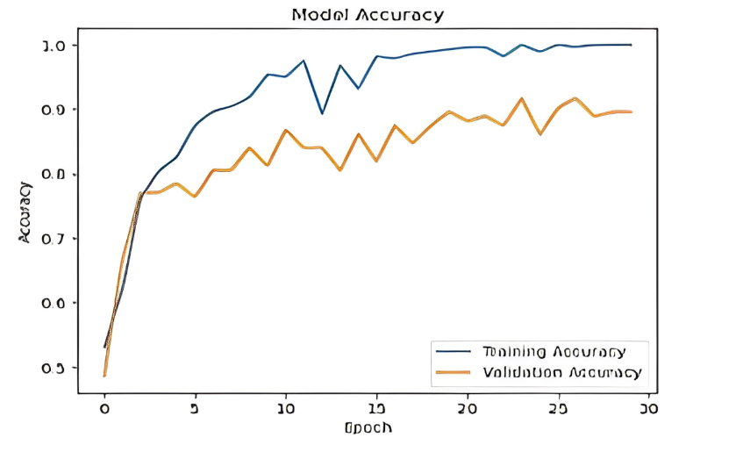
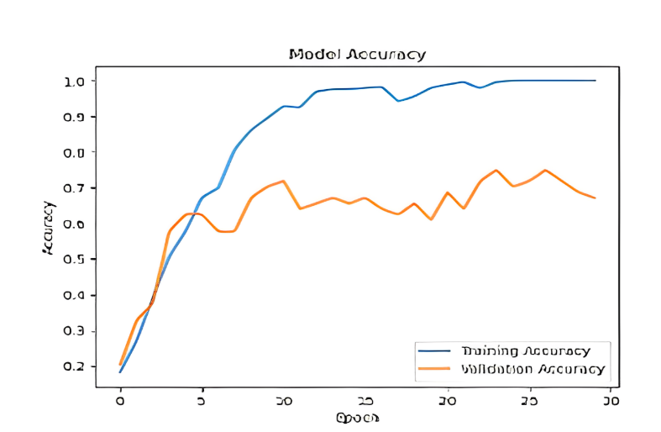
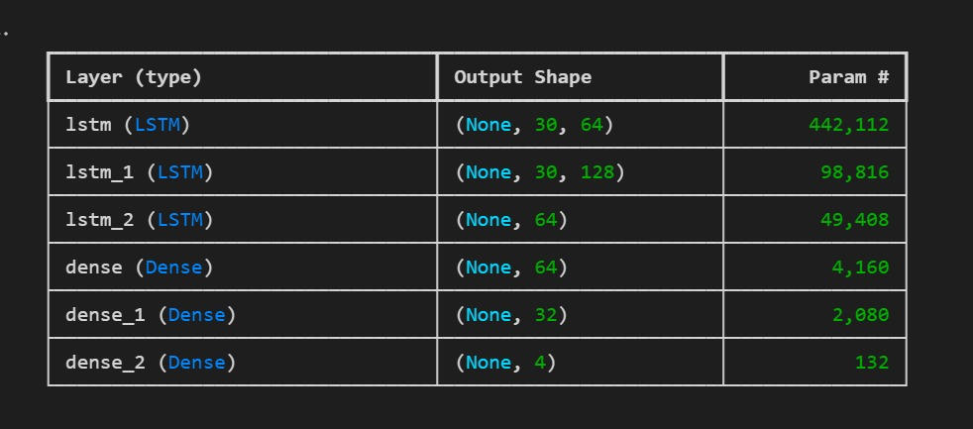
Real-Time Rendering for Cricket Shot Detection using Deep Learning
V. Sree Chaitran, C. Sujith Reddy, K. Ashok Reddy|
Introduction
Results
Previous studies lacked comprehensive systems that integrated various aspects of cricket analysis. This research proposed a novel approach combining techniques for umpire gesture recognition, and batsman shot detection to bridge this gap. It addressed the absence of publicly available datasets for cricket shot detection by creating a custom dataset.
This research successfully developed and implemented a CNN-based model that can automatically classify umpire gestures and batting shots in cricket matches.
The model demonstrated high accuracy in distinguishing umpires and recognizing specific gestures like No Action, Wide, Six, No Ball, Impact Player, Leg Bye and Out displayed by umpires.
Additionally, it performed impressively in detecting and categorizing various cricket shots played by batsmen, such as Pre Stance, Stance, Pull Shot, and Straight Drive.
When evaluated on the newly curated datasets, the model achieved an accuracy of 84.34% for classifying the four types of batting shots, and 81.7% for gesture recognition.
These results validate the proposed approach's effectiveness in accurately categorizing umpire gestures and batsmen actions on the field.
The introduction of new datasets specifically designed for umpire gesture detection and shot classification contributes to advancing research in this field. These datasets enable researchers and practitioners to evaluate and compare different models' performance in a standardized manner, fostering advancements in automated cricket analysis.
Cricket Shot Detection (Accuracy vs Epoch):
The model trains over multiple epochs, the accuracy typically increases as it learns better representations and patterns from the data.
Umpire Pose Detection (Accuracy vs Epoch):
The developed model shows great potential for practical applications in cricket analysis, broadcasting, and coaching. By automating the recognition of umpire gestures and batting shots, it can provide real-time insights and support decision-making during live matches. Identifying specific gestures and shots can enhance match analysis, commentary, and player performance evaluation.
Motivation
The motivation of the project encompasses the development of an advanced system for gesture and shot recognition in cricket, leveraging state-of-the-art deep learning techniques and frameworks to enhance real-time analysis and decision support in cricket matches.
SCOPE of the Project
The proposed approach combines CNN for feature extraction, LSTM for temporal modeling of cricket shots, and MediaPipe for pose estimation and tracking. This integrated solution aims to automate decision-making in cricket matches by classifying umpires/non-umpires, recognizing umpire gestures, and detecting batsman shots, thereby enhancing accuracy, fairness, and overall cricketing experience.
Methodology
Mediapipe Pose Detection: Pose Detection: x, y, z and Visibility = 4, Unpacked across 33 points, 33*4 = 132,
Face Detection (FaceMesh): x, y, z = 3, Unpacked across 468 points, 468*3= 1404,
Left Hand Detection: x, y, z = 3, Unpacked across 21 points, 21*3= 63,
Right Hand Detection: x, y, z = 3, Unpacked across 21 points, 21*3= 63,
Total: 132 + 1404 + 63 + 63 = 1662 points.
Given a Frame we calculate the co-ordinates of 1662 points. For training we split the data into 30 frames and send it to the model for prediction of action (Pre-Stance, Stance, Straight Drive, Pull Shot) based on these 1662 points across 30 frames in a video.
So, input to the model is 30*30*1662 per action (i.e 30 videos per action with 30 frames per video and 1662 points per frame.)
This input is provided to the LSTM model,
Input to the model (30 Frames * 1662 body points)
Umpire Pose Detection:
Dataset of 380 cricket video images across 7 umpire gesture classes like No Ball, Out, Six, split into training (300+) and test (80) sets. Images preprocessed with rescaling using TensorFlow's ImageDataGenerator.
CNN architecture with increasing Conv2D filter sizes (32-256), 3x3 kernels, ReLU activations, MaxPooling for downsampling, and Dense layers (512 units) before final softmax output layer.
Trained for 30 epochs with batch size 16, using Adam optimizer and categorical cross-entropy loss. Monitored validation set performance to detect overfitting/underfitting.
Monitoring the model's learning progress and identifying the optimal number of epochs to train for achieving the best performance without overfitting.
Conclusion
Overall, this research paper presents a valuable contribution to automated cricket analysis by developing a CNN-based model for classifying umpire gestures and batting shots.
The achieved accuracies demonstrate the model's effectiveness and potential for real-world applications. This work paves the way for further research and development, ultimately enhancing the understanding and analysis of the beloved sport of cricket.
References
[1] W Supanich, S Kulkarineetham, P Sukphokha, P Wisarnsart, Machine learning-based exercise posture recognition system using mediapipe pose estimation framework, 2023.
[2] C Akrin, Using Imitation Learning for Human Motion Control in a Virtual Simulation, 2022

