Slide 1


Slide 2


Web API Controllers & CRUD Operations
By : Mr. Shivam Supekar

Slide 3

Agenda
1
Introduction to Web Api Controllers
2
CRUD Operations Overview
3
Routing and HTTP Verbs
4
Model Binding and JSON responses
5
Testing the API
6
7
Use Cases
8
Assignment
9
Debrief

Slide 4
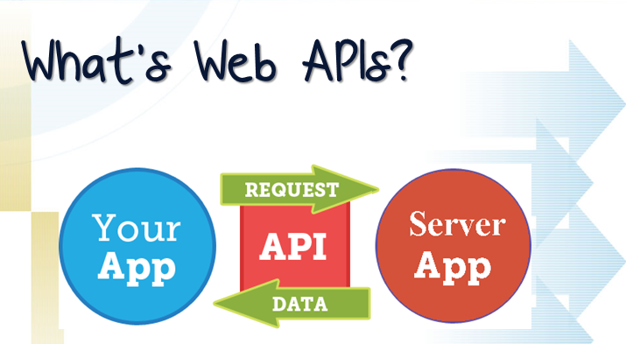

Slide 5


Introduction to Web API Controllers
What is a Web API?
A Web API (Application Programming Interface) enables communication between client applications and backend services over HTTP/HTTPS.
Typically used to expose data and business logic to clients like:
Web browsers
Mobile apps
Other servers or services
Returns data in formats like JSON or XML.
Role of Controllers in Web APIs
Controllers handle incoming HTTP requests and produce responses.
They serve as the entry point for API requests in ASP.NET Core.
Responsible for:
Routing logic to appropriate actions
Processing data and calling services
Returning HTTP responses (e.g., 200 OK, 404 Not Found)

Slide 6
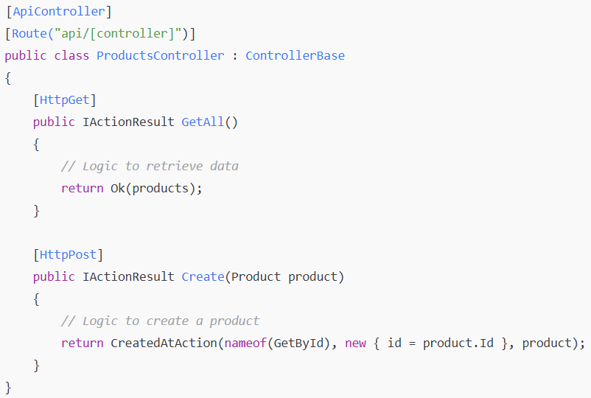
Structure of API Controller in ASP.NET
Key Components:
Components | Behavior
[ApiController] | Enables API-specific behavior like automatic model validation.
[Route("api/[controller]")] | Defines routing based on controller name.
Action Methods | Mapped to HTTP verbs like GET, POST, PUT, DELETE.

Slide 7
Controller Conventions in ASP.NET Core
📝 Naming Conventions
Controller should end with the Controller suffix.
Example : ProductController , UserController
The suffix helps ASP.NET Core identify and register the class as a controller automatically.
Conventionally placed in the Controllers folder

Slide 8

Controller Conventions in ASP.NET Core
🔁 Convention-Based Routing
Prior to attribute routing, ASP.NET Core supported convention-based routing, defined in
Startup.cs or Program.cs
Follows a URL pattern based on controller and action names.
Example URL: /Product/GetAll
Now largely replaced by attribute routing for better control and flexibility.

Slide 9

Controller Conventions in ASP.NET Core
🔁 [ApiController] Attribute
Applied to API controller classes to:
Enable automatic model validation
Provide problem details responses by default
Simplify parameter binding (e.g., [FromBody] is inferred)

Slide 10
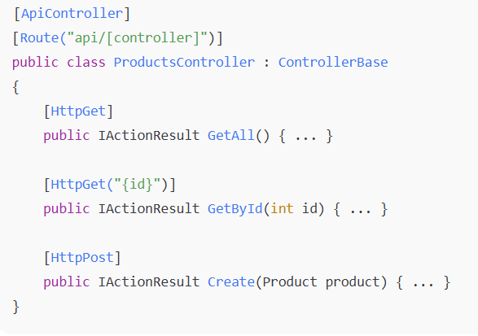
Controller Conventions in ASP.NET Core
🧭 Routing with [Route] and HTTP Verb Attributes
Attribute routing defines explicit routes on controllers and actions:
Common attributes:
[HttpGet], [HttpPost], [HttpPut], [HttpDelete]
[Route("path")]: Customize route at method or class level
Supports route parameters like {id}

Slide 11
CRUD Operations in Web API
📥 Create – POST
Used to add a new resource
Accepts data in the request body (usually JSON)
Returns 201 Created with the new resource or location
📤 Read – GET
Used to retrieve resource(s)
Can return a single item or a list
Returns 200 OK with data or 404 Not Found if missing
🔁 Update – PUT or PATCH
PUT: Replaces the entire resource
PATCH: Partially updates the resource
Returns 204 No Content or 200 OK on success
🗑️ Delete – DELETE
Used to remove a resource
Returns 204 No Content or 404 Not Found

Slide 12
API Routing and HTTP Methods
✅Attribute Routing vs Conventional Routing
🟢 Attribute Routing
Defined directly on controller and action methods using [Route] ,[HttpGet], [HttpPost] etc.
Offers more control and readability
🔵 Conventional Routing
Defined globally in StartUp.cs and Program.cs
✅ Web APIs typically use Attribute Routing for clarity and RESTful structure

Slide 13
Example Rotes(MeterInfo API)
HTTP method | Endpoint | Description
GET | /api/meterinfo | Get all meter records
GET | /api/meterinfo/{id} | Get a specific meter by ID
POST | /api/meterinfo | Create a new meter record
PUT | /api/meterinfo/{id} | Update an existing meter record
Delete | /api/meterinfo/{id} | Delete a meter by ID

Slide 14
Model Binding
🖥️What is Model Binding?
Model Binding automatically maps incoming HTTP request data (e.g., JSON, query strings, route values) to C# objects or parameters.
Simplifies controller logic by handling parsing and conversion.
🎯 Binding Data from Requests
Source | Attribute | Example
Request Body | [FromBody] | JSON to object (e.g., POST/PUT)
Query String | [FromQuery] | /api/products?name=apple
Route Values | [FromRoute] | /api/products/5 ->(id=5)

Slide 15
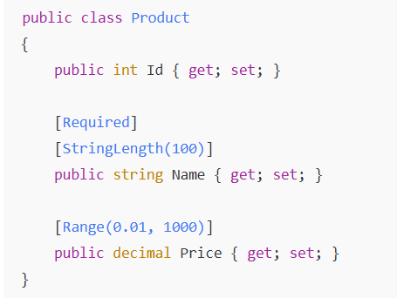
Model Binding
✔️ Validation with Data Annotations
Use attributes in your model class to enforce rules.
Works automatically with [ApiController] for automatic validation
If validation fails, ASP.NET Core returns 400 Bad Request with details

Slide 16
Response Formats
📦 Default Format :JSON
By default, ASP.NET Core Web API returns data in JSON format.
Uses System.Text.Json (or optionally Newtonsoft.Json) for serialization.
Automatically sets Content-Type: application/json in the response headers.
📦 Customizing Responses with ActionResult<T>
ActionResult<T> allows returning:
Strongly-typed data
HTTP status codes
Error messages or problem details
📦 Benefits:
Combines flexibility and type-safety
Makes your API self-documenting

Slide 17
Testing the API
✅ Testing the API
Using Postman: Sending HTTP requests
Using Swagger (Swashbuckle): Auto-generated UI for API testing
Example:
http://localhost:5000/api/ControllerName/MethodName/ParameterName

Slide 18
Use Cases
Web API Controller Conventions 🔹 Used in microservices to organize endpoints cleanly.
API Routes & HTTP Actions (GET/POST/PUT/DELETE) 🔹 Power CRUD operations in apps like e-commerce, HR systems, or inventory tools.
Model Binding 🔹 Binds client data in form submissions (e.g., signup, order forms).
Response Formats (JSON) 🔹 Standard for mobile app backends and third-party API responses.
CRUD Web API Assignment (MeterInfoController) 🔹 Simulates real-world utility or IoT meter data APIs.
Testing with Postman or Swagger 🔹 Common in QA/testing for APIs in software teams and public API docs.

Slide 19

Assignment
🔧 Advanced Assignment 1: Basic CRUD API
Objective: Build a simple CRUD Web API for MeterInfo.
Requirements :
Create a class MeterInfo with basic properties (e.g., Id, Location , Reading ,Timestamp).
Create MeterInfoController with :
Get, Get by Id, POST, PUT and DELETE methods
Use in-memory storage (e.g., a static list) to simulate a database.
Test API endpoints using Postman or Swagger.
Focus:
Understanding controller structure, routing, and basic HTTP verbs.

Slide 20
Assignment
🔧 Advanced Assignment 2: CRUD with EF Core
Objective: Add real data persistence using Entity Framework Core and SQLite or SQL Server DB.
Requirements:
Set up EF Core and create a MeterInfoContext (DbContext).
Register the DbContext using Dependency Injection.
Store and retrieve MeterInfo data using the database.
Add model validation using Data Annotations (e.g., [Required], [Range]).
Focus :
EF Core integration, data persistence, and validation.

Slide 21
Assignment
🔧 Advanced Assignment 3: CRUD with DTOs and AutoMapper
Objective: Refactor the API to use DTOs for input/output and AutoMapper for transformation.
Requirements:
Create MeterInfoCreateDto, MeterInfoReadDto, and MeterInfoUpdateDto.
Use AutoMapper to map between DTOs and the domain model.
Return only necessary fields in the API response (no over-posting).
Return proper status codes (e.g., 201 Created, 404 Not Found, 204 No Content).
Focus:
Clean architecture, separation of concerns, and better response shaping.

Slide 22
Assignment
🔧 Advanced Assignment 4: Advanced API with Pagination, Search & Error Handling
Objective : Enhance the existing CRUD API with production-grade features.
Requirements:
Add pagination support to GET /api/meterinfo (query params: pageNumber, pageSize).
Add search/filter support by Location or Reading.
Implement global exception handling using custom middleware or filters.
Add Swagger documentation for all endpoints and models.
(Optional) Secure the API using basic token-based authentication.
Focus:
API scalability, user experience, maintainability, and robustness.

Slide 23

+
+
+
+
LEVEL
Stretch Goals
+
UP
+
+

Slide 24
Debrief
Web Api Controllers
CRUD Operations
Routing and Http verbs
Testing API
Use cases

Slide 25
📘 Official Resources (High-Quality & Up-to-Date)
https://learn.microsoft.com/en-us/aspnet/core/web-api/?view=aspnetcore-7.0
https://learn.microsoft.com/en-us/aspnet/core/fundamentals/routing?view=aspnetcore-7.0
References

Slide 26
Q&A

