Slide 1


Web API Controllers & CRUD Operations(.NET 8)
By : Mr. Shivam Supekar

Slide 2

Agenda
1
Overview of Web API in .NET 8
2
CRUD Operations Overview
3
Routing and HTTP Verbs
4
Model Binding and JSON responses
5
Testing the API
6
7
Use Cases
8
Assignment
9
Debrief

Slide 3

Introduction to Web API Controllers
What is a Web API?
A Web API is a RESTful Service
Web API stands for Web Application Programming Interface.
It allows client applications to interact with a server over HTTP/HTTPS.
Commonly uses RESTful principles (Representational State Transfer):
Stateless communication
Resource-based URIs
Standard HTTP methods: GET, POST , PUT , DELETE
Default data exchange format: JSON
🛠 Built Using ASP.NET Core Web API (.NET 8)
ASP.NET Core Web API is a lightweight, cross-platform framework for building Web APIs.
.NET 8 brings:
Better performance and minimal APIs
Improved routing and model binding
Built-in OpenAPI/Swagger support

Slide 4
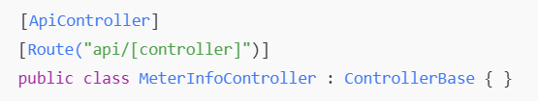
Web API Controller Conventions
Web API Controller Conventions
Decorated with [ApiController] & [Route("api/[controller]")]
Inherits from ControllerBase
Automatically handles model validation in .NET 8

Slide 5
Controller Conventions in ASP.NET Core
📝 Naming Conventions
Controller should end with the Controller suffix.
Example : ProductController , UserController
The suffix helps ASP.NET Core identify and register the class as a controller automatically.
Conventionally placed in the Controllers folder

Slide 6

Controller Conventions in ASP.NET Core
🔁 Convention-Based Routing
Prior to attribute routing, ASP.NET Core supported convention-based routing, defined in
Startup.cs or Program.cs
Follows a URL pattern based on controller and action names.
Example URL: /Product/GetAll
Now largely replaced by attribute routing for better control and flexibility.

Slide 7

Controller Conventions in ASP.NET Core
🔁 [ApiController] Attribute
Applied to API controller classes to:
Enable automatic model validation
Provide problem details responses by default
Simplify parameter binding (e.g., [FromBody] is inferred)

Slide 8
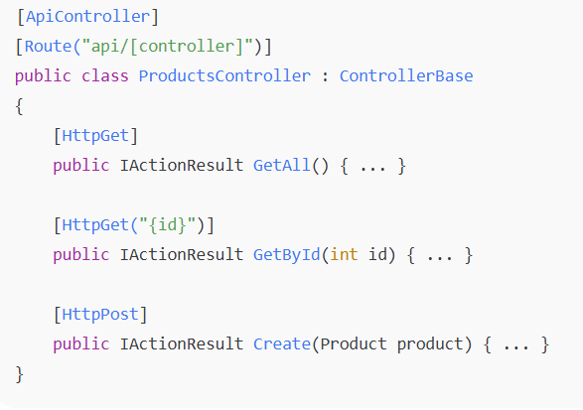
Controller Conventions in ASP.NET Core
🧭 Routing with [Route] and HTTP Verb Attributes
Attribute routing defines explicit routes on controllers and actions:
Common attributes:
[HttpGet], [HttpPost], [HttpPut], [HttpDelete]
[Route("path")]: Customize route at method or class level
Supports route parameters like {id}

Slide 9
CRUD Operations in Web API
📥 Create – POST
Used to add a new resource
Accepts data in the request body (usually JSON)
Returns 201 Created with the new resource or location
📤 Read – GET
Used to retrieve resource(s)
Can return a single item or a list
Returns 200 OK with data or 404 Not Found if missing
🔁 Update – PUT or PATCH
PUT: Replaces the entire resource
PATCH: Partially updates the resource
Returns 204 No Content or 200 OK on success
🗑️ Delete – DELETE
Used to remove a resource
Returns 204 No Content or 404 Not Found

Slide 10
API Routing and HTTP Methods
✅ What Attribute Routing vs Conventional Routing
🟢 Attribute Routing
Defined directly on controller and action methods using [Route] ,[HttpGet], [HttpPost] etc.
Offers more control and readability
🔵 Conventional Routing
Defined globally in StartUp.cs and Program.cs
✅ Web APIs typically use Attribute Routing for clarity and RESTful structure

Slide 11
Example Rotes(MeterInfo API)
HTTP method | Endpoint | Description
GET | /api/meterinfo | Get all meter records
GET | /api/meterinfo/{id} | Get a specific meter by ID
POST | /api/meterinfo | Create a new meter record
PUT | /api/meterinfo/{id} | Update an existing meter record
Delete | /api/meterinfo/{id} | Delete a meter by ID

Slide 12
Model Binding
🖥️What is Model Binding?
Model Binding automatically maps incoming HTTP request data (e.g., JSON, query strings, route values) to C# objects or parameters.
Simplifies controller logic by handling parsing and conversion.
🎯 Binding Data from Requests
Source | Attribute | Example
Request Body | [FromBody] | JSON to object (e.g., POST/PUT)
Query String | [FromQuery] | /api/products?name=apple
Route Values | [FromRoute] | /api/products/5 ->(id=5)

Slide 13
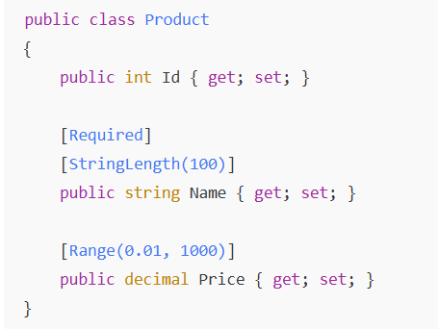
Model Binding
✔️ Validation with Data Annotations
Use attributes in your model class to enforce rules.
Works automatically with [ApiController] for automatic validation
If validation fails, ASP.NET Core returns 400 Bad Request with details

Slide 14
Response Formats
📦 Default Format :JSON
By default, ASP.NET Core Web API returns data in JSON format.
Uses System.Text.Json (or optionally Newtonsoft.Json) for serialization.
Automatically sets Content-Type: application/json in the response headers.
📦 Customizing Responses with ActionResult<T>
ActionResult<T> allows returning:
Strongly-typed data
HTTP status codes
Error messages or problem details
📦 Benefits:
Combines flexibility and type-safety
Makes your API self-documenting

Slide 15
❌ Sample Output (Console):
swift
Testing the API
✅ Testing the API
Using Postman: Sending HTTP requests
Using Swagger (Swashbuckle): Auto-generated UI for API testing
Example:
http://localhost:5000/api/ControllerName/MethodName/ParameterName

Slide 16
Use Cases
Web API Controller Conventions 🔹 Used in microservices to organize endpoints cleanly.
API Routes & HTTP Actions (GET/POST/PUT/DELETE) 🔹 Power CRUD operations in apps like e-commerce, HR systems, or inventory tools.
Model Binding 🔹 Binds client data in form submissions (e.g., signup, order forms).
Response Formats (JSON) 🔹 Standard for mobile app backends and third-party API responses.
CRUD Web API Assignment (MeterInfoController) 🔹 Simulates real-world utility or IoT meter data APIs.
Testing with Postman or Swagger 🔹 Common in QA/testing for APIs in software teams and public API docs.

Slide 17

Assignment
🔧 Advanced Assignment 1: Basic CRUD API
Objective: Build a simple CRUD Web API for MeterInfo.
Requirements :
Create a class MeterInfo with basic properties (e.g., Id, Location , Reading ,Timestamp).
Create MeterInfoController with :
Get, Get by Id, POST, PUT and DELETE methods
Use in-memory storage (e.g., a static list) to simulate a database.
Test API endpoints using Postman or Swagger.
Focus:
Understanding controller structure, routing, and basic HTTP verbs.

Slide 18
Assignment
🔧 Advanced Assignment 2: CRUD with EF Core
Objective: Add real data persistence using Entity Framework Core and SQLite or SQL Server DB.
Requirements:
Set up EF Core and create a MeterInfoContext (DbContext).
Register the DbContext using Dependency Injection.
Store and retrieve MeterInfo data using the database.
Add model validation using Data Annotations (e.g., [Required], [Range]).
Focus :
EF Core integration, data persistence, and validation.

Slide 19
Assignment
🔧 Advanced Assignment 3: CRUD with DTOs and AutoMapper
Objective: Refactor the API to use DTOs for input/output and AutoMapper for transformation.
Requirements:
Create MeterInfoCreateDto, MeterInfoReadDto, and MeterInfoUpdateDto.
Use AutoMapper to map between DTOs and the domain model.
Return only necessary fields in the API response (no over-posting).
Return proper status codes (e.g., 201 Created, 404 Not Found, 204 No Content).
Focus:
Clean architecture, separation of concerns, and better response shaping.

Slide 20
Assignment
🔧 Advanced Assignment 4: Advanced API with Pagination, Search & Error Handling
Objective : Enhance the existing CRUD API with production-grade features.
Requirements:
Add pagination support to GET /api/meterinfo (query params: pageNumber, pageSize).
Add search/filter support by Location or Reading.
Implement global exception handling using custom middleware or filters.
Add Swagger documentation for all endpoints and models.
(Optional) Secure the API using basic token-based authentication.
Focus:
API scalability, user experience, maintainability, and robustness.

Slide 21

+
+
+
+
LEVEL
Stretch Goals
+
UP
+
+

Slide 22
Debrief
Web Api Controllers
CRUD Operations
Routing and Http verbs
Testing API
Use cases

Slide 23
📘 Official Resources (High-Quality & Up-to-Date)
https://learn.microsoft.com/en-us/aspnet/core/web-api/?view=aspnetcore-7.0
https://learn.microsoft.com/en-us/aspnet/core/fundamentals/routing?view=aspnetcore-7.0
References

Slide 24
Q&A

