Slide 1


Razor and API Integration(AJAZ/Fetch)
By : Mr. Shivam Supekar

Slide 2

Agenda
1
JavaScript fetch from Razor Pages
2
Handling API responses
3
AJAX form submission
4
Live DOM updates
5
Use Cases
6
Assignment
7
Debrief

Slide 3

Why Integrate Razor with APIs?
✅ Avoid Full Page Reloads
Use APIs with JavaScript (e.g., fetch) to update parts of the page.
Faster interactions without reloading the entire view
✅ Improve UX & Responsiveness
Real-time updates.
Smoother, more dynamic user experience
✅ Decouple Frontend & Backend
Razor handles layout
APIs handle data and logic
Makes backend reusable across apps and easier to maintain

Slide 4
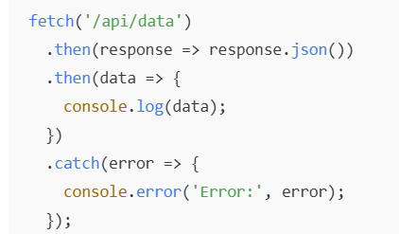
Overview of fetch API
✅ What is fetch() in JavaScript?
A modern, built-in JavaScript API for making HTTP requests
Used to get or send data from/to a server asynchronously
Fully promise-based (no need for external libraries)
✅ Basic Syntax
🔸Returns a Promise
🔸.then() handles the response
🔸.catch() handles errors

Slide 5
Overview of fetch API
🔄 How It Compares to jQuery AJAX
Feature | fetch() | $.ajax() (jQuery)
Built-in | ✅ Yes | ❌ No( requires jQuery)
Promise-based | ✅ Native | ❌Callback –based (unless using Promises manually)
Modern standard | ✅ Yes | 🚫Legacy for modern apps

Slide 6
Calling an API from a Razor Page (Frontend)
✅ Adding JavaScript in Razor Page (.cshtml)
You can include <script> tags directly in your .cshtml file
Use the fetch() API to make calls to backend endpoints (e.g., Web API)
🔍 Where to Place the Script
Place <script> at the bottom of the page or use defer/DOMContentLoaded
You can use @Url.Page() or hardcoded endpoints as needed
⚡ Use Cases
Load product lists
Submit form data without page reload
Build interactive components

Slide 7
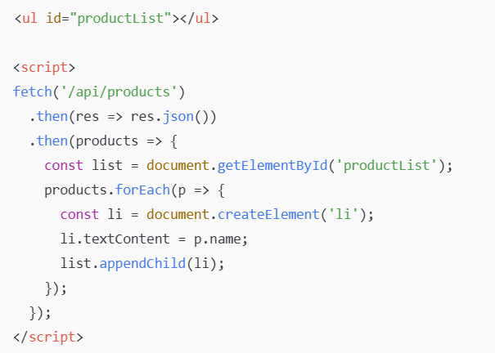
Handling API Response on the UI
✅ 1. Updating the DOM Dynamically
Use JavaScript to insert data directly into the HTML
Allows live updates without reloading the page
Common methods: innerHTML, createElement(), or frameworks (optional)
✅ 2. Looping Through API Data
Example: Rendering a list of products returned from an API

Slide 8
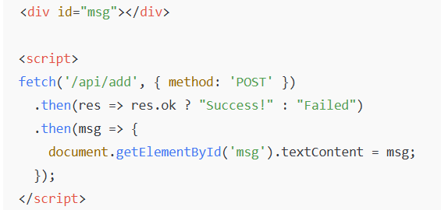
Handling API Response on the UI
✅ 3. Show Success Message (e.g., after POST)
💡 Tips
Always check for errors using .catch()
Sanitize data before injecting into DOM
Use innerHTML with caution to avoid XSS

Slide 9
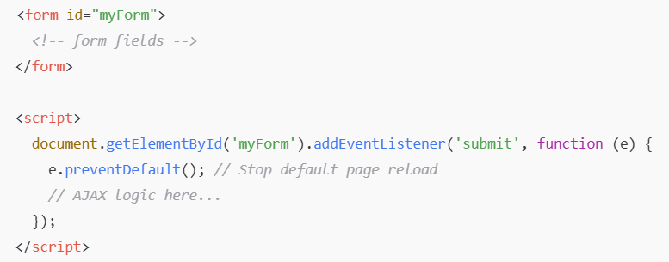
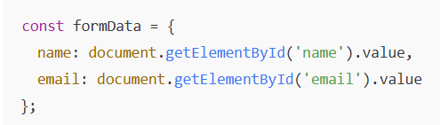
AJAX Form Submission from Razor Page
✅ 1. Prevent Default Form Submit
Use JavaScript to stop the page from reloading
Allows smoother UX and dynamic handling
✅ 2. Serialize Form Data
Convert form fields into a JS object:

Slide 10
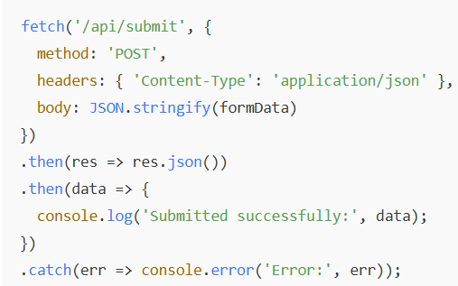
AJAX Form Submission from Razor Page
✅ 3. POST Using fetch()
💡 Benefits
No page reload
Smoother and faster form interactions
Works well with APIs and modern UI

Slide 11
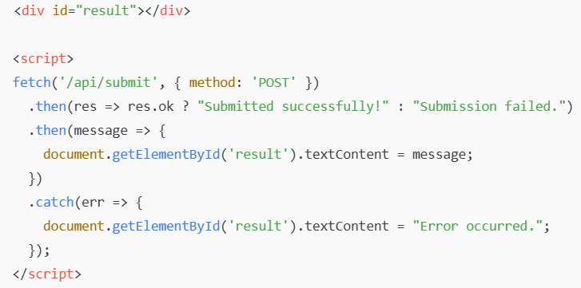
Dynamic DOM Updates
✅ 1. Show Success / Failure Messages
Use JavaScript to display feedback without reloading the page
Commonly used after API calls or form submissions
✅ 2. Update Part of the Page
Use document.getElementById() to target a specific element
Inject content using .textContent or .innerHTML
Example

Slide 12
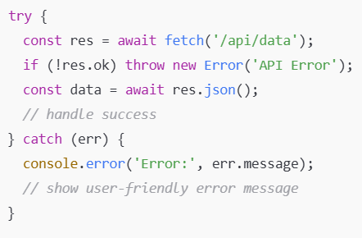
Error Handling in fetch()
✅ 1. Use try/catch with async/await
Catches both network errors and failed responses
res.ok ensures only 2xx responses are treated as success
✅ 2. Gracefully Display API Errors
Avoid showing raw errors to users
Provide clear, non-technical messages

Slide 13
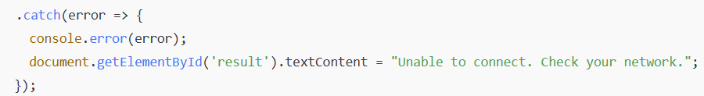
Error Handling in fetch()
✅ 3. Handle Network / Server Failures
Examples:
Internet disconnected
Server not responding
JSON parsing errors
💡 Best Practices
Always check response.ok
Handle all .catch() or wrap in try/catch
Use loading indicators + error fallback UI

Slide 14

Security Considerations with AJAX in Razor Pages
✅ 1. CSRF Protection with AJAX
Razor Pages use [AntiForgeryToken] to prevent CSRF (Cross-Site Request Forgery)
Tokens are automatically added in forms via:

Slide 15
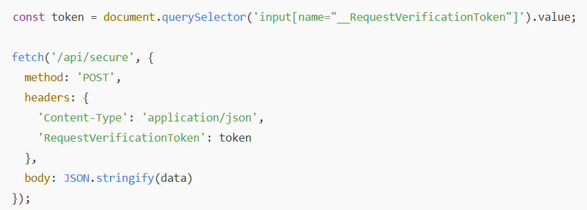
Security Considerations with AJAX in Razor Pages
✅ 2. Using AntiForgeryToken with fetch()
When making AJAX POST requests, you must send the token manually:
✅ Steps:
Add token to page (hidden field or meta tag):
Read it in JS and send with fetch:
<input type="hidden" name="__RequestVerificationToken" value="@Antiforgery.GetTokens(HttpContext).RequestToken" />
OR
<meta name="csrf-token" content="@Antiforgery.GetTokens(HttpContext).RequestToken" />

Slide 16
Security Considerations with AJAX in Razor Pages
🌐 3. CORS (Cross-Origin Resource Sharing)
If you're calling an external API, CORS must be enabled on that server
Server must allow:
Your domain (via Access-Control-Allow-Origin)
HTTP methods (GET, POST, etc.)
Custom headers (like RequestVerificationToken)
✅ Best Practices
Always include AntiForgeryToken in POST requests
Never trust client input — always validate server-side
Be cautious with external APIs — check CORS and HTTPS

Slide 17
Use Cases
🌐 Real-World Use Cases: Razor + API (AJAX/Fetch)
Form Submissions Without Page Reload e.g., Contact forms, feedback, user settings
Dynamic Data Loading e.g., Product listings, dashboards, live search
Live Notifications or Updates e.g., Chat messages, stock updates, alerts
Partial Page Updates e.g., Updating a cart, toggling likes, loading more content
API-Driven UI Components e.g., Dropdowns populated from APIs, filters
Error Feedback Without Redirects e.g., Showing validation errors or API response messages inline

Slide 18

Assignment

Slide 19

+
+
+
+
LEVEL
Stretch Goals
+
UP
+
+

Slide 20
Debrief
JavaScript fetch from Razor Pages
Handling API Responses
AJAX form submissions
Live DOM Updates
Use cases

Slide 21
📘 Official Resources (High-Quality & Up-to-Date)
https://learn.microsoft.com/en-us/aspnet/core/razor-pages/ui-enhancements
https://developer.mozilla.org/en-US/docs/Web/API/Fetch_API
References

Slide 22
Q&A

